Slide 1

Object Oriented Design and Programming
Week 1
Version 2 – 18th December 2015

Slide 2
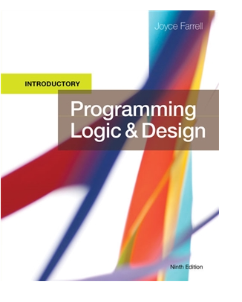
SLIDE TITLE
Farrell, J. (2017) Programming Logic and Design, Comprehensive (9th ed.) Cengage Learning

Slide 3
Chapter 1
An Overview of Computers and
Programming

Slide 4
Objectives
In this chapter, you will learn about:
Computer systems
Simple program logic
The steps involved in the program development cycle
Pseudocode statements and flowchart symbols
Programming and user environments
The evolution of programming models

Slide 5
Understanding Computer Systems
Computer system
Combination of all the components required to process and store data using a computer
Hardware
Equipment associated with a computer
Software
Computer instructions that tells the hardware what to do
Programs
Instructions written by programmers
Programming
Writing software instructions
Notes:
কম্পিউটার সিস্টেম
একটি কম্পিউটার ব্যবহার করে ডেটা প্রক্রিয়া এবং সংরক্ষণ করার জন্য প্রয়োজনীয় সমস্ত উপাদানের সমন্বয়
হার্ডওয়্যার
কম্পিউটারের সাথে যুক্ত যন্ত্রপাতি
সফটওয়্যার
কম্পিউটার নির্দেশাবলী যা হার্ডওয়্যারকে কী করতে হবে তা বলে৷
প্রোগ্রাম
প্রোগ্রামারদের দ্বারা লিখিত নির্দেশাবলী
প্রোগ্রামিং
সফ্টওয়্যার নির্দেশাবলী লেখা

Slide 6
Understanding Computer Systems (continued -1)
Application software such as word processing, spreadsheets, payroll and inventory, even games, app
System software such as operating systems like Windows, Linux, or UNIX, Google Android and Apple IOS
Computer hardware and software accomplish three major operations
Input
Data items such as text, numbers, images, and sound
Processing
Calculations and comparisons performed by the central processing unit (CPU)

Slide 7
Understanding Computer Systems (continued -2)
Output
Resulting information that is sent to a printer, a monitor, or storage devices after processing
A cloud based device is accessed through the Internet
Programming language
Used to write computer instructions called program code
Writing instructions is called coding the program
Examples
Visual Basic, C#, C++, or Java
Syntax
Rules governing word usage and punctuation
Mistakes in a language’s usage are syntax errors

Slide 8
Understanding Computer Systems (continued -3)
Computer memory
Computer’s temporary, internal storage – random access memory (RAM)
Volatile memory – lost when the power is off
Permanent storage devices
Nonvolatile memory
Compiler or interpreter
Translates source code into machine language (binary language) statements called object code
Checks for syntax errors
Program executes or runs
Input will be accepted, some processing will occur, and results will be output

Slide 9
Understanding Simple Program Logic
Programs with syntax errors cannot execute
Logical errors
Errors in program logic produce incorrect output
Logic of the computer program
Sequence of specific instructions in specific order

Slide 10
Understanding the Program Development Cycle
Program development cycle
Understand the problem
Plan the logic
Code the program
Use software (a compiler or interpreter) to translate the program into machine language
Test the program
Put the program into production
Maintain the program

Slide 11
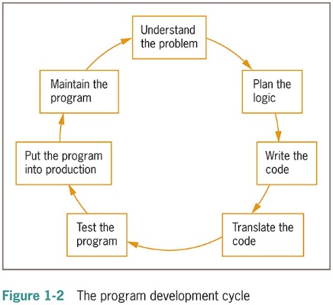

Understanding the Program Development Cycle (continued -1)

Slide 12
Understanding the Problem
One of the most difficult aspects of programming
Users or end users
People for whom a program is written
Documentation
All supporting paperwork for a program

Slide 13
Planning the Logic
Plan the steps of the program and what they include
An algorithm is the sequence of steps or rules you follow to solve a problem
Most common planning tools
Flowcharts
Pseudocode
Desk-checking
Walking through a program’s logic on paper before you actually write the program

Slide 14
Coding the Program
Hundreds of programming languages available
Choose based on features
Similar in their basic capabilities
Coding is easier than the planning step
Experienced programmers can successfully combine logic planning and program coding in one step

Slide 15
Using Software to Translate the Program into Machine Language
Translator program
Compiler or interpreter
Changes the programmer’s English-like high-level programming language into the low-level machine language
Syntax error
Misuse of a language’s grammar rules
Programmer corrects listed syntax errors
Might need to recompile the code several times

Slide 16
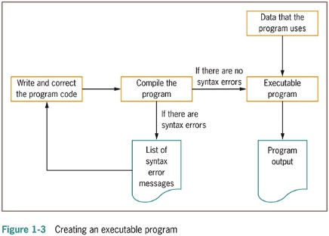
Using Software to Translate the Program into Machine Language (continued -1)

Slide 17
Testing the Program
Logical error
Results when a syntactically correct statement, but the wrong one for the current context, is used
Test
Execute the program with some sample data to see whether the results are logically correct
Debugging is the process of finding and correcting program errors
Programs should be tested with many sets of data

Slide 18
Putting the Program into Production
Process depends on program’s purpose
May take several months
Conversion
The entire set of actions an organization must take to switch over to using a new program or set of programs

Slide 19
Maintaining the Program
Maintenance
Making changes after the program is put into production
Common first programming job
Maintaining previously written programs
Make changes to existing programs
Repeat the development cycle

Slide 20
Using Pseudocode Statements and Flowchart Symbols
Pseudocode
English-like representation of the logical steps it takes to solve a problem
Flowchart
Pictorial representation of the logical steps it takes to solve a problem

Slide 21
Writing Pseudocode
Pseudocode representation of a number-doubling problem
start
input myNumber
set myAnswer = myNumber * 2
output myAnswer
stop

Slide 22
Pseudocode Standards
Programs begin with the word start and end with the word stop; these two words are always aligned
Whenever a module name is used, it is followed by a set of parentheses
Modules begin with the module name and end with return. The module name and return are always aligned
Each program statement performs one action—for example, input, processing, or output

Slide 23
Pseudocode Standards (continued -1)
Program statements are indented a few spaces more than the word start or the module name
Each program statement appears on a single line if possible. When this is not possible, continuation lines are indented
Program statements begin with lowercase letters
No punctuation is used to end statements

Slide 24
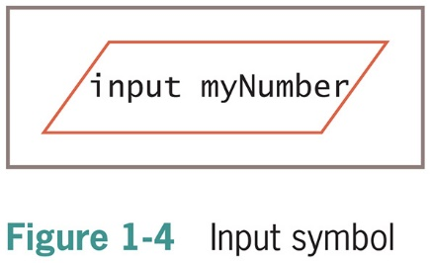
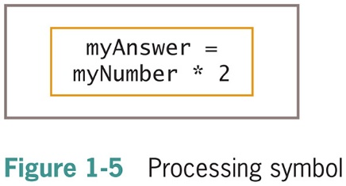
Drawing Flowcharts
Create a flowchart
Draw geometric shapes that contain the individual statements
Connect shapes with arrows
Input symbol
Indicates input operation
Parallelogram
Processing symbol
Contains processing statements such as arithmetic
Rectangle

Slide 25
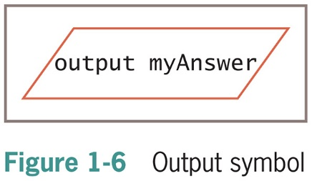


Drawing Flowcharts (continued -1)
Output symbol
Represents output statements
Parallelogram
Flowlines
Arrows that connect steps
Terminal symbols
Start/stop symbols
Shaped like a racetrack
Also called lozenges

Slide 26
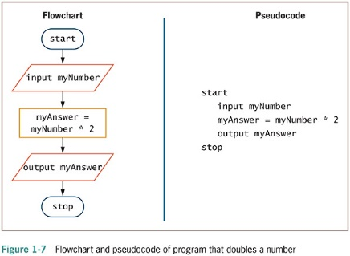
Drawing Flowcharts (continued -2)

Slide 27
Understanding Programming and User Environments
Understanding Programming Environments
Text Editor is used to create simple text files
Integrated development environment (IDE) provides an editor, compiler, and other programming tools
Microsoft Visual Studio IDE
Understanding User Environments
Command line is a location on your computer screen at which you type text entries to communicate with the computer’s operating system
A graphical user interface, or GUI (pronounced gooey), allows users to interact with a program in a graphical environment

Slide 28
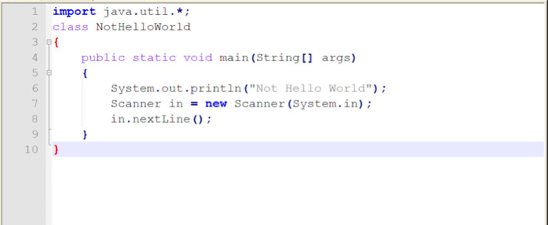
Understanding Programming Environments
Java program in notepad

Slide 29
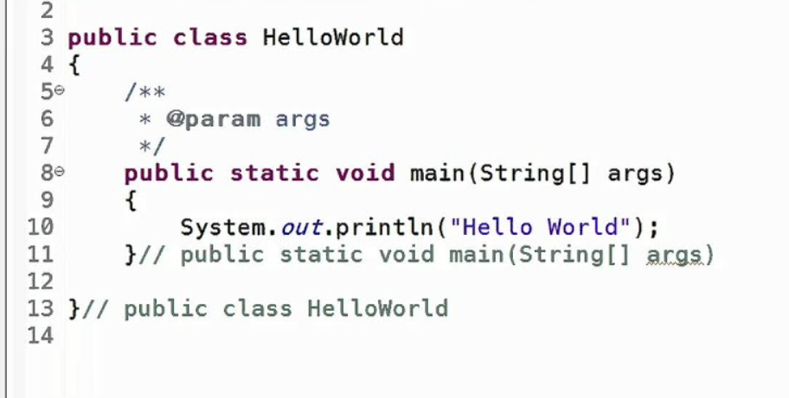
Understanding Programming Environments (continued -1)
Java program in IDE

Slide 30
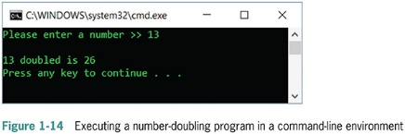
Understanding User Environments

Slide 31
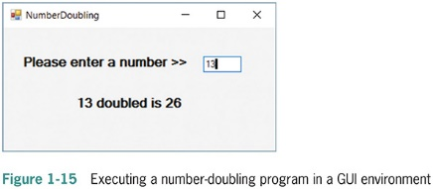
Understanding User Environments (continued -1)

Slide 32
Our Focus:
For a programming problem:
Design flowchart
Write pseudocode
Write programs using Java programming language in Eclipse IDE

Slide 33
Understanding the Evolution of Programming Models
People have been writing modern computer programs since the 1940s
Newer programming languages
Look much more like natural language
Are easier to use
Create self-contained modules or program segments that can be pieced together in a variety of ways

Slide 34
Understanding the Evolution of Programming Models (continued -1)
Major models or paradigms used by programmers
Procedural programming
Focuses on the procedures that programmers create
It follows a step-by-step approach to break down a task into a collection of variables and routines (or subroutines) through a sequence of instructions. Each step is carried out in order in a systematic manner so that a computer can understand what to do.
Object-oriented programming
Focuses on objects, or “things,” and describes their features (or attributes) and their behaviors
It uses classes and objects to create models based on the real world environment. In OOPs it makes it easy to maintain and modify existing code as new objects are created inheriting characteristics from existing ones.
More details in later weeks

Slide 35
Summary
Hardware and software accomplish input, processing, and output
Logic must be developed correctly
Logical errors are much more difficult to locate than syntax errors
Use flowcharts and pseudocode to plan the logic
Avoid infinite loops by testing for a sentinel value
Use a text editor or an IDE to enter your program statements

Slide 36
What to do next:
Quickly revise whatever was discussed in today’s class.
Clear your doubts if any.
Finish tutorial workshops in tutorial timing.
Install java runtime environment and eclipse for java developers on your laptops. (We will use this next week)

Slide 37

kent.edu.au Kent Institute Australia Pty. Ltd. ABN 49 003 577 302 ● CRICOS Code: 00161E ● RTO Code: 90458 ● TEQSA Provider Number: PRV12051

