Slide 1
ASP.NET Core-MVC
MCSE 541:Web Computing and Data Mining
Prof. Dr. Shamim Akhter

Slide 2
MVC (Model-View-Controller) Architecture
A concept in software programming
Divides the program into three parts:
Model, View and Controller.
MVC becomes popular
to design web and mobile application
famous Frameworks uses MVC like Ruby on rails, Js, Django (Python Framework), Symphony (PHP Framework), CakePHP (PHP), Laravel (PHP framework), CherryPy (Python Framework), react, Angular, and etc.
ASP.NET MVC is a Framework whereas MVC is a Design Pattern.

Slide 3
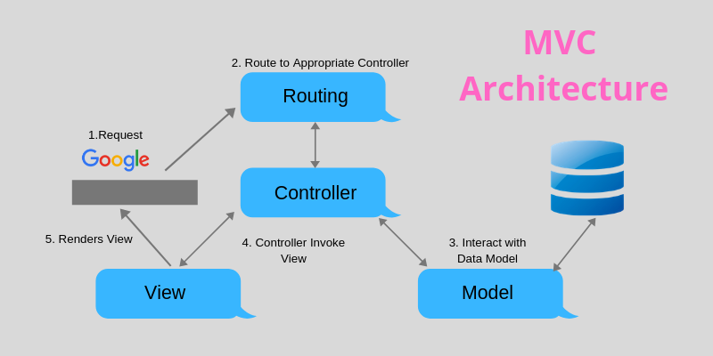
receives the incoming HTTP request and then handle that request.
Response
X
Create HTML (UI) to render the domain data or business data passed by Controller.
Contains a set of classes to represent the domain or business data as well as logic to manage the data.

Slide 4
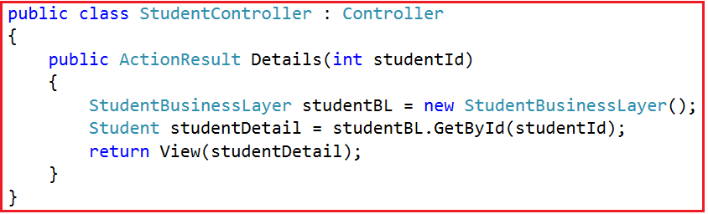
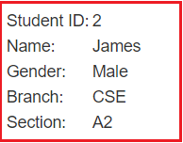
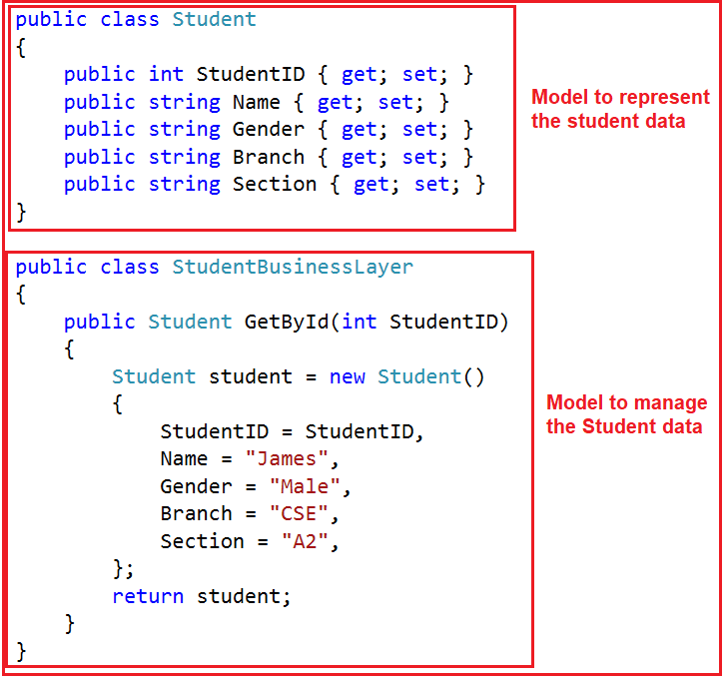
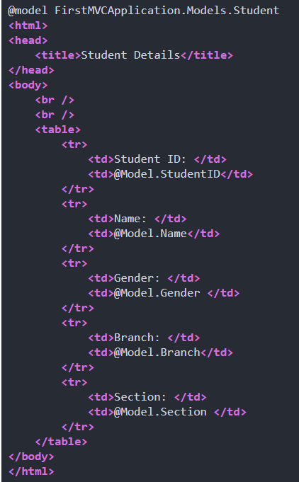
Example: Student Details Web Page
Request url: “http://dotnettutorials.net/student/details/2”
Model
View
Each developer can work on different parts of the application. For example, one developer may work on the view while the second developer can work on the controller logic and the third developer may work on the business logic.

Slide 5
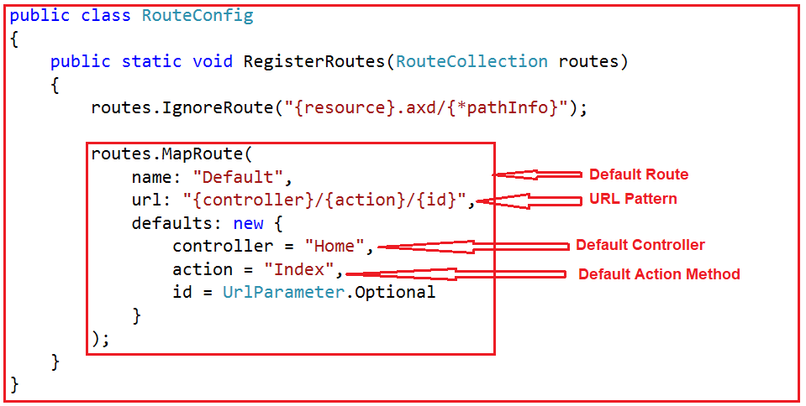
Look Again
“http://dotnettutorials.net/student/details/2”
Something is missing??
Where this mapping is defined?
Routing-a middleware must be able to route incoming HTTP requests to a controller
Mapping is defined within the RegisterRoutes() of the RouteConfig class at RouteConfig.cs class within the App_Start Folder.
ASP.Net 4.5 MVC Template

Slide 6
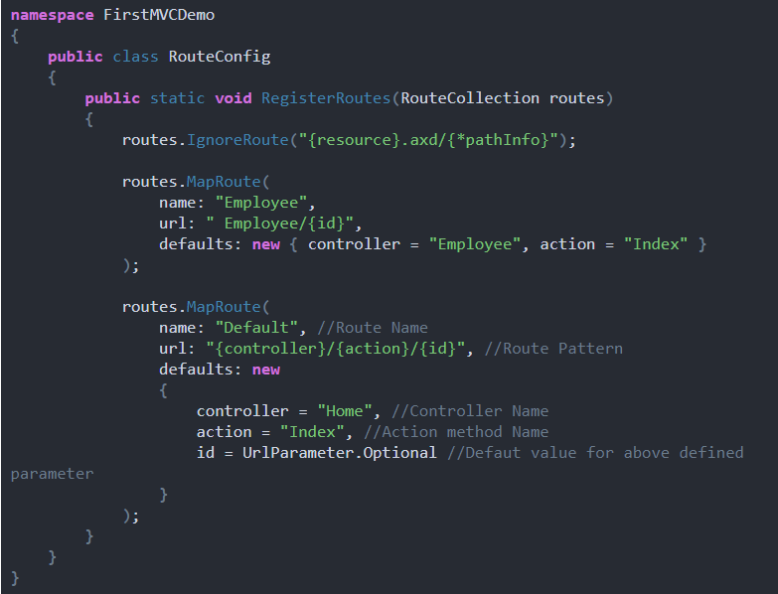
RouteConfig class

Slide 7
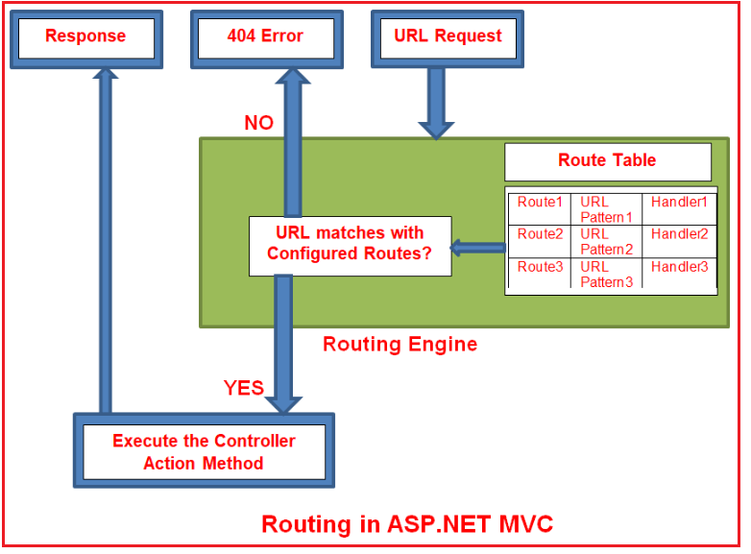
Routing in ASP.NET MVC
Employee example from book.

Slide 8
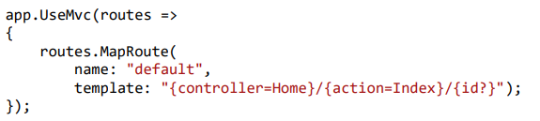

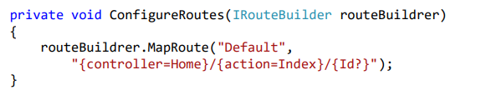
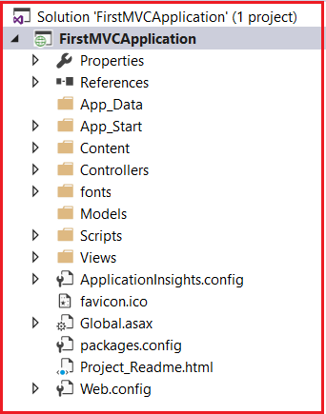
Routing define in Startup class
/Home/Index/123
ASP.Net Core 2.1 MVC
HomeController class, Index method, Id parameter
http://localhost:53605/ =>
controller = Home, action = Index, id = none, since default value
of controller and action are Home and Index respectively.
http://localhost:53605/Home =>
controller = Home, action = Index, id = none, since default
value of action is Index
http://localhost:53605/Home/Index =>
controller = Home, action = Index, id=none
http://localhost:53605/Home/Index/5 =>
controller = Home, action = Index, id = 5

Slide 9
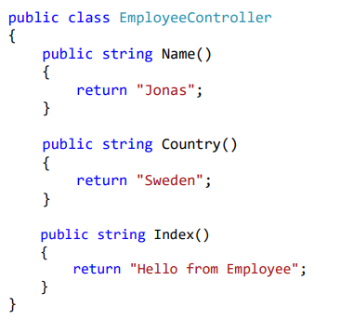
/Employee/Name/
/Employee/Index
/Employee

Slide 10

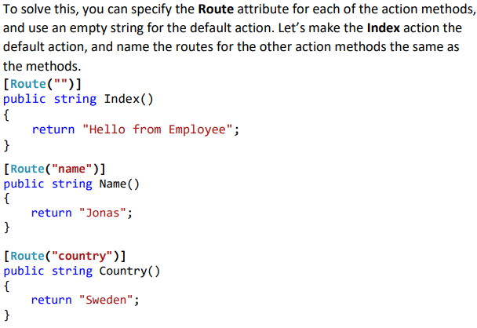
Types of Routing
Convention-Based Routing
Attribute Routing
Assign attributes to the controller class and its action methods. The metadata in those attributes tell ASP.NET when to call a specific controller and action.
Ambiguous Action Exception

Slide 11
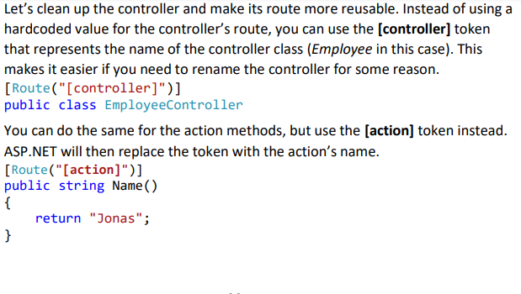


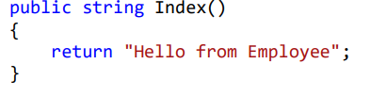
Attribute Routing

Slide 12
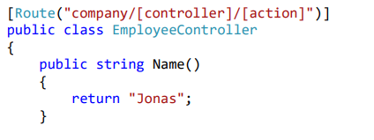
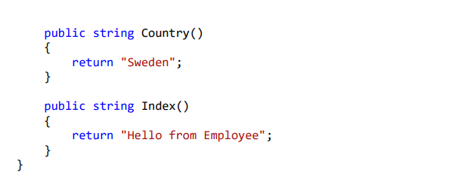
Attribute Routing
No need to place on top of every action

Slide 13
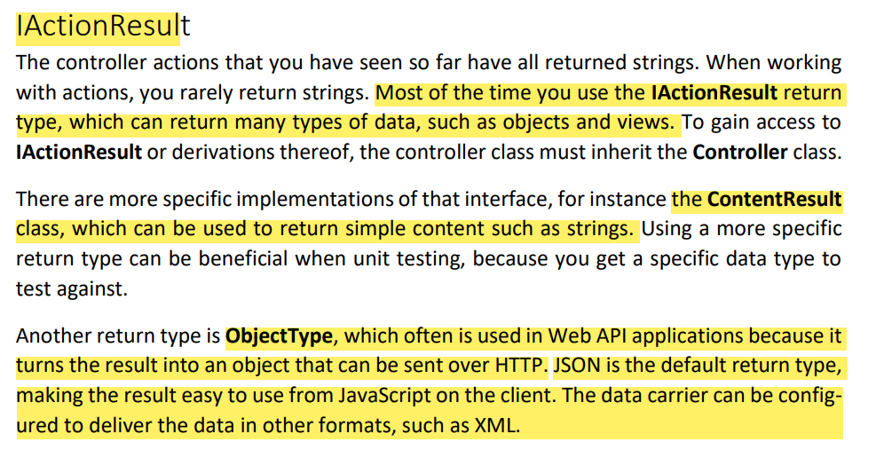

Slide 14
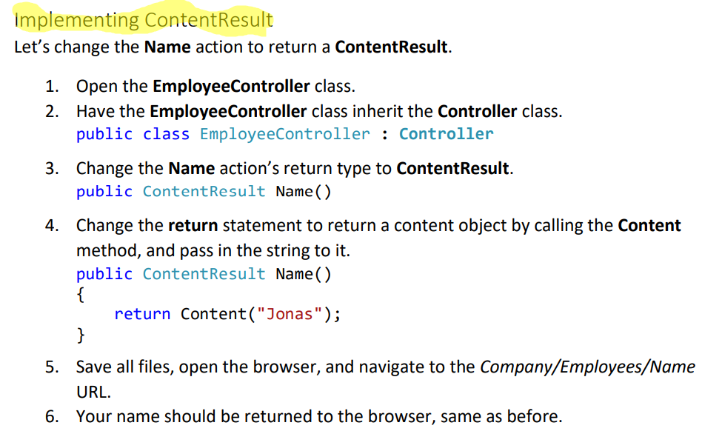

Slide 15
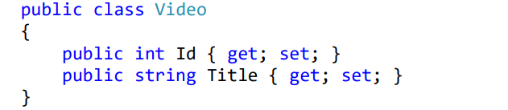
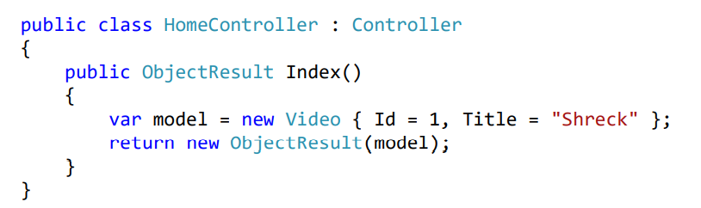
ObjectResult
Video Model Class
Controller Class

Slide 16
