Slide 1
Face Recognition Based Attendance System
TEAM MEMBERS:
Aashka Shah(23IT403)
Veera Agrawal(23IT431)
Shyeni Vasava(23IT435)

Slide 2
01
WHAT IS BIOMETRICS?

Slide 3
LET’S HAVE A LOOK
Mercury is the closest planet to the Sun and the smallest one in the entire Solar System. This planet’s name has nothing to do with the liquid metal, since Mercury was named after the Roman messenger god. Despite being closer to the Sun than Venus, its temperatures aren't as terribly hot as that planet’s. Its surface is quite similar to that of Earth’s Moon, which means there are a lot of craters and plains. Speaking of craters, many of them were named after artists or authors who made significant contributions to their respective fields. Mercury takes a little more than 58 days to complete its rotation, so try to imagine how long days must be there!

Slide 4
TYPES OF BIOMETRICS SYSTEMS
Fonts
Colors
Thanks slide
Icons and infographics
To view this template correctly in PowerPoint, download and install the fonts we used
You can see on the link all the colors used in this presentation
You must keep it so that proper credits for our design are given
These can be used in the template, and their size and color can be edited

Slide 5
PROJECT OVERVIEW
02
Do you know what helps you make your point clear? Lists like this one:
They’re simple
You can organize your ideas clearly
You’ll never forget to buy milk!
You can replace the image. Just right-click on it and select “Replace image”

Slide 6
PROBLEM STATEMENT
03
LET’S LEARN ABOUT MERCURY
Mercury is the closest planet to the Sun and the smallest one in the Solar System. This planet’s name has nothing to do with the liquid metal
LET’S TAKE A LOOK AT VENUS
Venus has a beautiful name and is the second planet from the Sun. It’s hot and is the second-brightest natural object in the night sky

Slide 7
PROJECT SCOPE
01
02
03
04
Mercury is the closest planet to the Sun and the smallest one in the Solar System. This planet’s name has nothing to do with the liquid metal, since Mercury was named after the Roman messenger god
Venus has a beautiful name, it is very hot and is the second planet in our Solar System. Its atmosphere is extremely poisonous. It’s the second-brightest natural object in the night sky after the Moon
Jupiter is a gas giant and the biggest planet in the Solar System. It’s the fourth-brightest object in the night sky and it has around eighty moons. It was named after the Roman god of the skies

Slide 8
MODULES + FEASIBILITY STUDY
01
02
03
05
Mercury is the closest planet to the Sun and the smallest one in the Solar System. This planet’s name has nothing to do with the liquid metal, since Mercury was named after the Roman messenger god
Venus has a beautiful name, it is very hot and is the second planet in our Solar System. Its atmosphere is extremely poisonous. It’s the second-brightest natural object in the night sky after the Moon
Jupiter is a gas giant and the biggest planet in the Solar System. It’s the fourth-brightest object in the night sky and it has around eighty moons. It was named after the Roman god of the skies

Slide 9
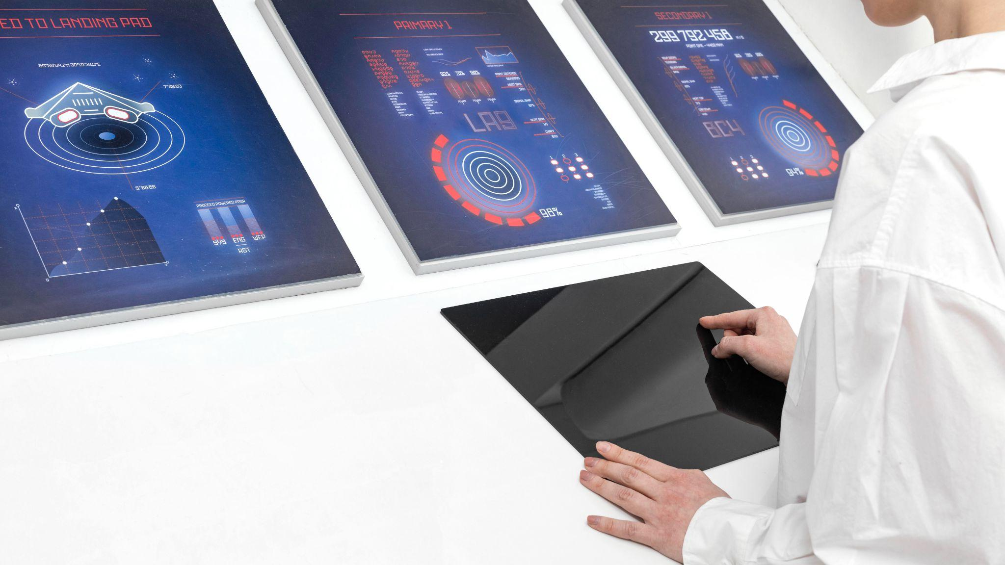
FLOW DIAGRAM
06

Slide 10
COMPARISON STUDY
07

Slide 11
THANK YOU

