Slide 1
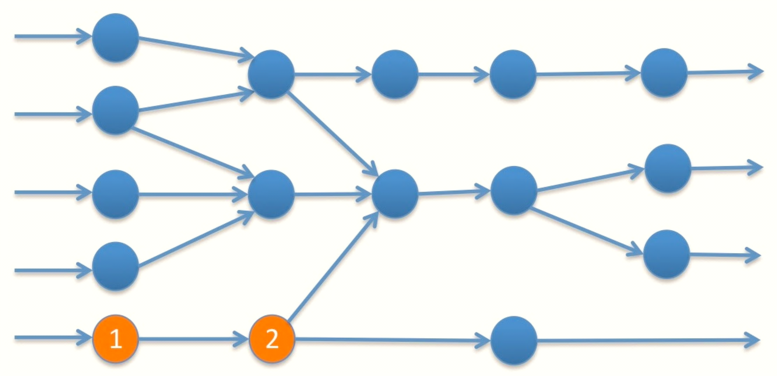
Real Time Streaming Pipeline
A Flexible Scalable Solution
Shylaja Deshpande
Data Engineer
deshpandeshyla@gmail.com

Slide 2
About Me
Data Engineer with 15+ years of experience.
Experience in Database, web application development, Data warehousing, Data pipelines
Worked in WellsFargo, WesternUnion, Alameda County, Zinio, CWCI…
Passionate about Big Data Technologies.

Slide 3


USA.gov?
Who is referring usa.gov?
Where are the users?
What Services Are Mostly Used?
Who is using?
Which is most popular?

Slide 4
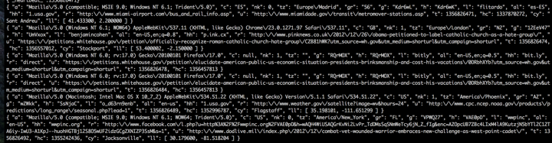
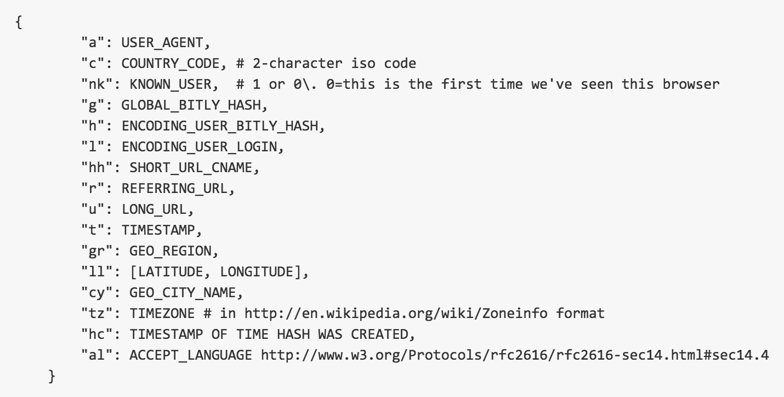
Streaming Data
Usa.gov provides streaming data
JSON Schema

Slide 5
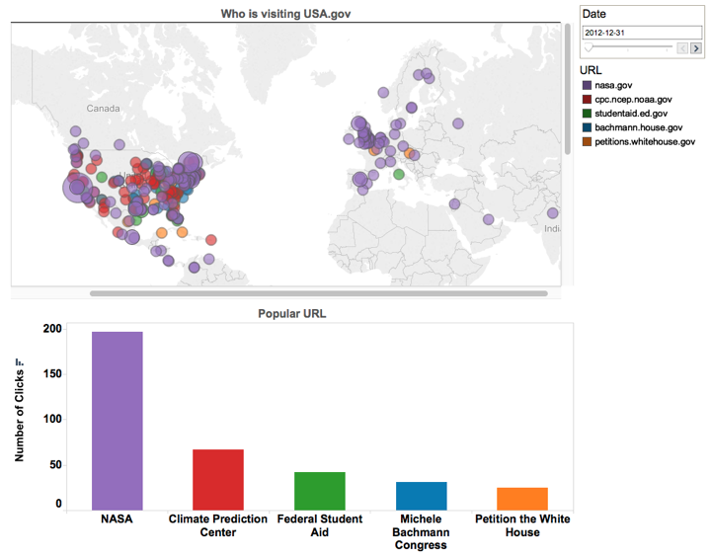
Output

Slide 6






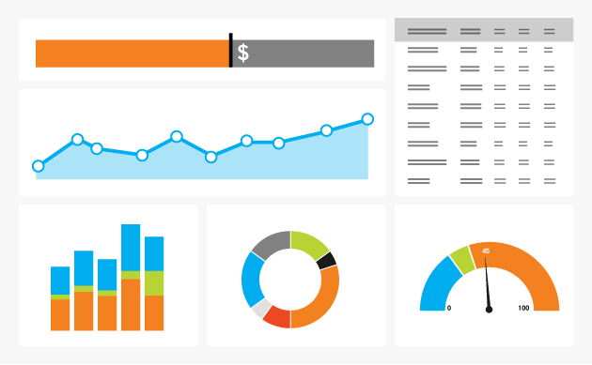

Architecture
Internet
Real Time Stream
Cloud/OnPrem
Spark-C* Connector
Stream
Processing
Thrift Server
Kafka
Real Time
Updates
Spark ODBC
Real Time Dashboard
Tech Stack
Apache Kafka
Apache Spark
Apache Cassandra
Apache Thrift
Simba ODBC
Scala
Tableau

Slide 7
Use Cases
Which part of the world actively using?
When it is most active?
Demographics of the region.
Targeted ads on referring source
Popular referring URL

Slide 8
Sources
Streaming Source
Developer.usa.gov1/1usagov
Tech Stack
Apache Kafka
Apache Spark
Apache Cassandra
Tableau

Slide 9


Shylaja Deshpande
Data Engineer
deshpandeshyla@gmail.com

