Slide 1

Developer Technology Trends 2024
Oshunwusi Oluwaseyi
October 2026

Slide 2



OUTLINE
Executive Summary
Introduction
Methodology
Results
  Visualization – Charts
  Dashboard
Discussion
  Findings & Implications
Conclusion
Appendix

Slide 3

EXECUTIVE SUMMARY
Key findings from ~65,000 developer survey responses
Web stacks (HTML/CSS, JavaScript, TypeScript) dominate today and next year
Database and platform leaders:
  PostgreSQL is the top database and grows next year (994 to 1,265)
  AWS and Microsoft Azure lead cloud platforms
  React, Node.js and Spring Boot lead web frameworks
Python enters next year's top 10 on its own; C# grows (97 to 134)
Most respondents are aged 25-34 (41%) with a Bachelor's degree
Recommendation: prioritise JavaScript/TypeScript, SQL/PostgreSQL and cloud skills

Slide 4

INTRODUCTION
Purpose, audience and value of this analysis
Purpose: identify which technology skills are in demand now and next year
Data: 2024 Stack Overflow Developer Survey (65,437 respondents after cleaning)
Audience: learners, hiring managers and training teams
Value: guides where to invest learning and hiring effort
  Which tools are used today vs wanted next year?
  Who are the respondents (age, country, education)?

Slide 5

METHODOLOGY
Data sources, collection and wrangling steps (Modules 1-5)
M1 Collection: job API (requests), salary table scraping (BeautifulSoup), survey CSV
M2 Wrangling: removed duplicate rows (65,457 to 65,437); filled missing values
  Mode for text (EdLevel, RemoteWork), median for salary (64% missing)
  Normalised salary with Min-Max, Z-score and log transform
M3 EDA: distributions, IQR outliers (978 removed above $220,861), correlations
M4 Visualisation: SQL (SQLite) + matplotlib/seaborn charts
M5 Dashboard: IBM Cognos Analytics, 3 tabs, Top 10 by respondent count

Slide 6

Results
Charts of current vs future technology trends, followed by the dashboard

Slide 7
JOB POSTINGS
Source: job-postings-skills-exact.xlsx (Module 1, Jobs API, exact skill matching). JavaScript leads (2,241), followed by Java (1,209) and Python (1,165).

Slide 8
POPULAR LANGUAGES
Source: popular-languages.csv (Module 1, web scraping). Swift pays the most ($130,801); PHP the least ($84,727).

Slide 9
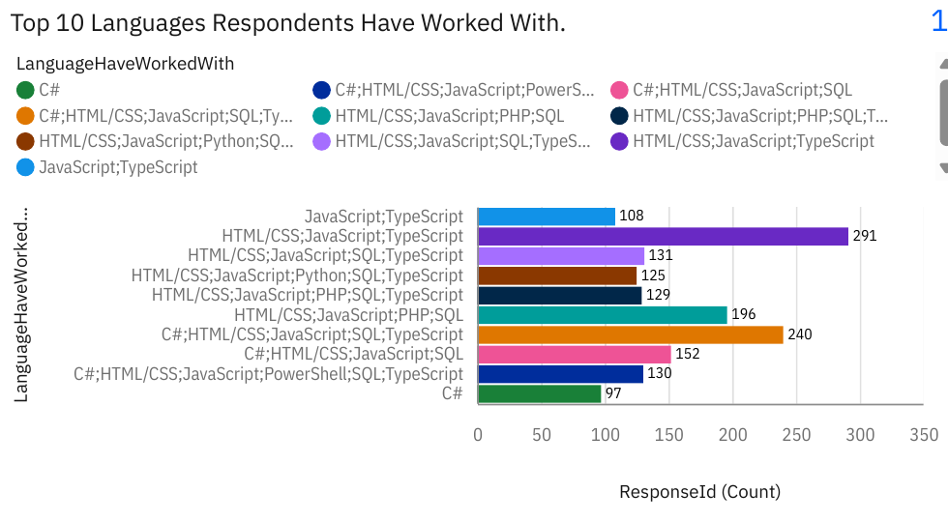
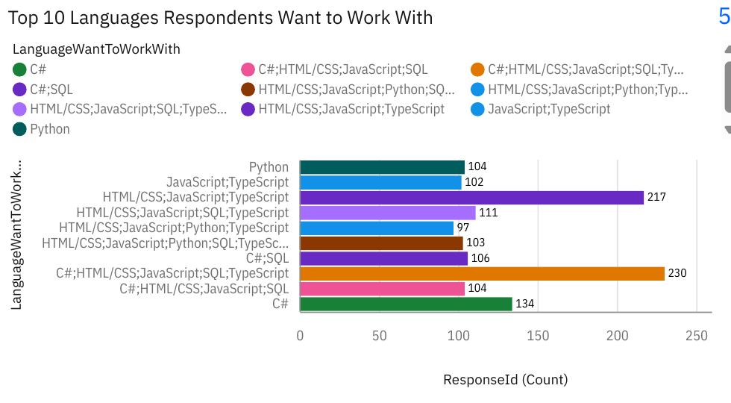
PROGRAMMING LANGUAGE TRENDS
JavaScript/TypeScript web stacks lead both years; Python and C# rise as single languages next year
Current Year
Next Year

Slide 10
PROGRAMMING LANGUAGE TRENDS - FINDINGS & IMPLICATIONS
Findings
HTML/CSS + JavaScript + TypeScript is the most common stack today (291)
Every top 10 stack includes JavaScript or C#; SQL appears in 7 of 10
Next year Python enters the top 10 alone (104); C# alone grows 97 to 134
Implications
JavaScript and TypeScript remain essential for web developers
SQL is a core skill alongside any language stack
Rising Python and C# interest points to data, AI and enterprise growth

Slide 11
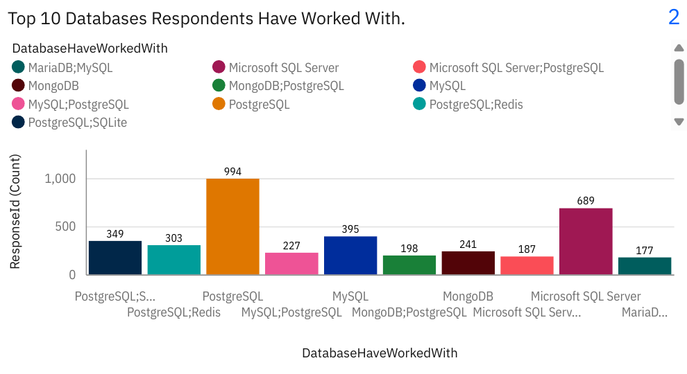
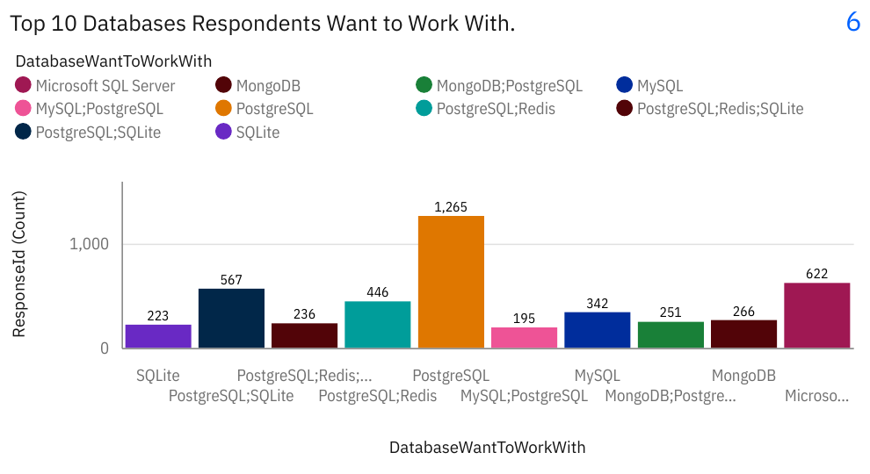
DATABASE TRENDS
PostgreSQL leads today and widens its lead next year; MySQL declines
Current Year
Next Year

Slide 12
DATABASE TRENDS - FINDINGS & IMPLICATIONS
Findings
PostgreSQL leads today (994) and grows next year (1,265, +27%)
Microsoft SQL Server is second in both years (689 to 622)
MySQL declines (395 to 342); PostgreSQL + SQLite/Redis pairings grow
Implications
PostgreSQL is the safest database skill to invest in
Lightweight (SQLite) and caching (Redis) tools are gaining ground
SQL Server stays important in enterprise environments

Slide 13

DASHBOARD
IBM Cognos Analytics dashboard with 3 tabs: Current Technology Usage, Future Technology Trends, Demographics. GitHub link: https://github.com/shykeys-data/ibm-data-analyst-capstone/blob/main/Developer_Survey_Dashboard.pdf

Slide 14
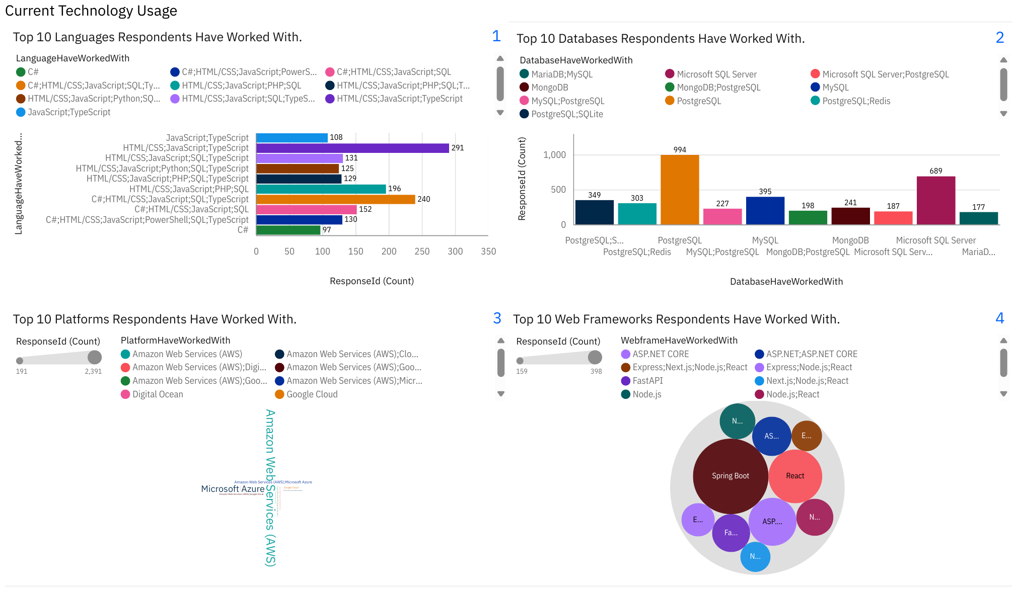
DASHBOARD TAB 1: Current Technology Usage
Dashboard Insight
HTML/CSS + JavaScript + TypeScript is the top language stack (291)
PostgreSQL is the most-used database (994)
AWS is the most-used platform
Spring Boot and React lead web frameworks

Slide 15
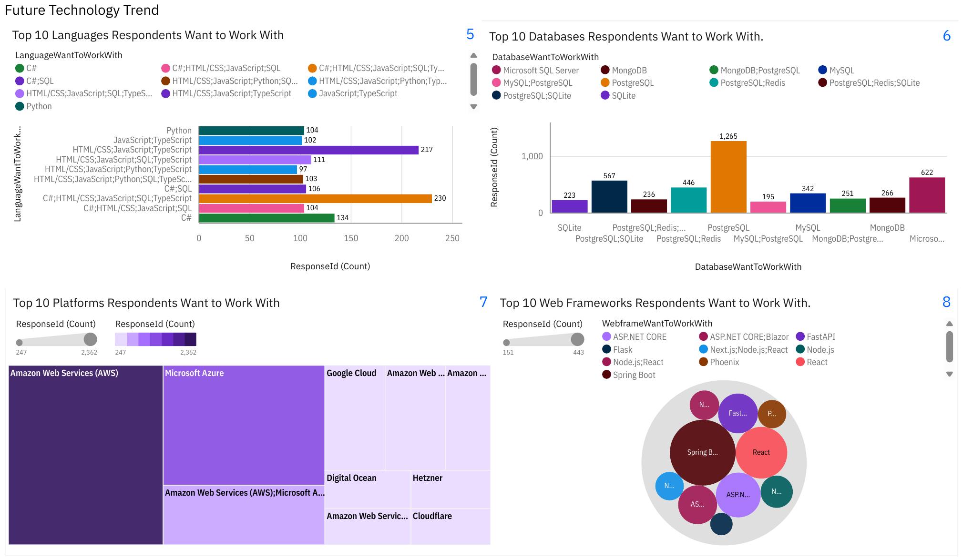
DASHBOARD TAB 2: Future Technology Trends
Dashboard Insight
Web stacks still lead future plans
PostgreSQL demand rises to 1,265
AWS and Microsoft Azure lead wanted platforms
Python appears alone in the top 10

Slide 16
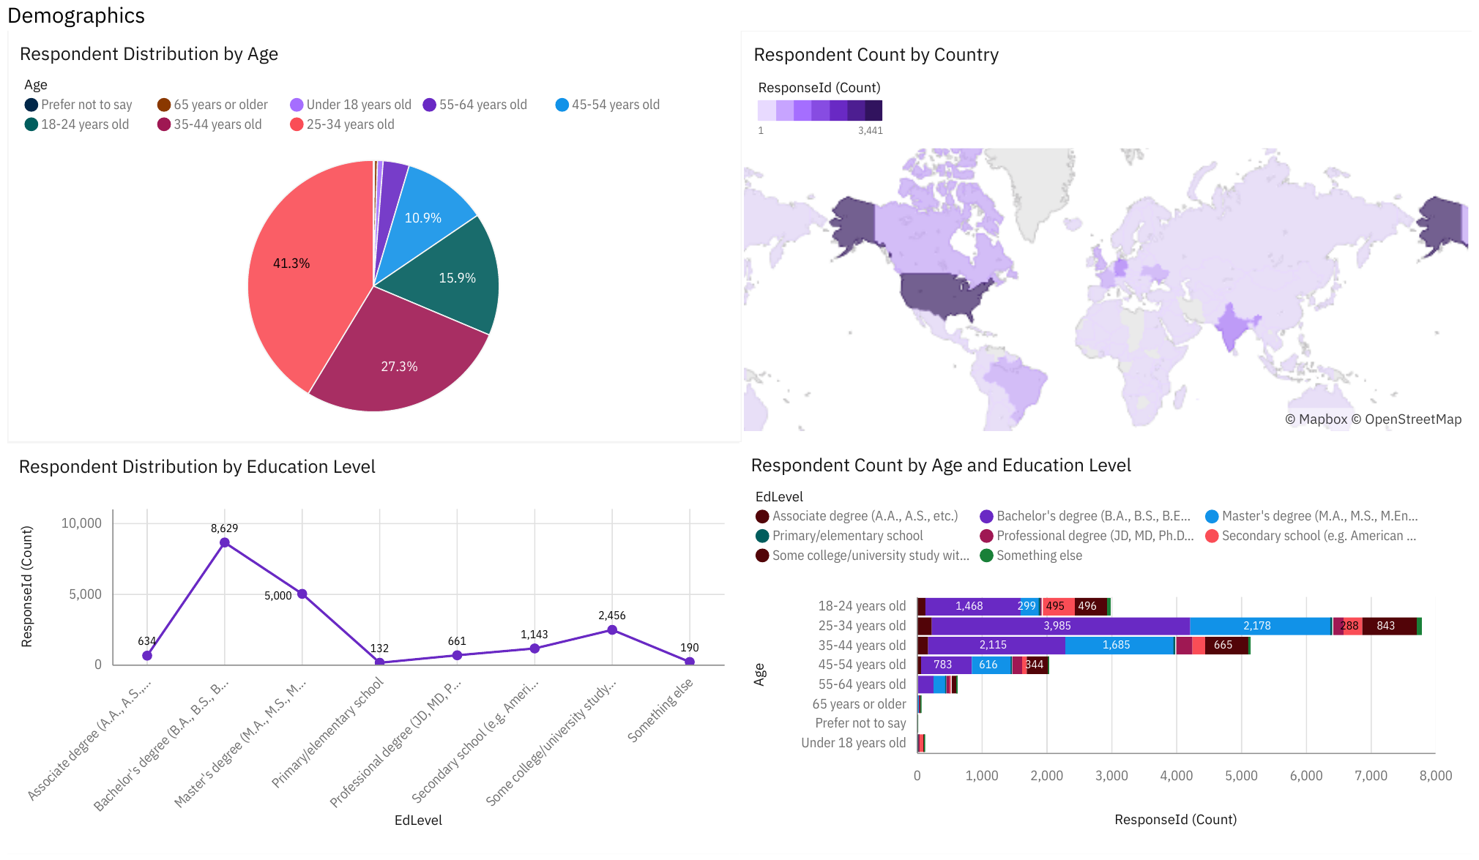
DASHBOARD TAB 3: Demographics
Dashboard Insight
25-34 year olds are the largest group (41.3%)
Bachelor's degree is most common (8,629), then Master's (5,000)
USA and India have the most respondents
25-44 year olds hold most degrees

Slide 17
DISCUSSION
Web technologies dominate both current use and future plans
Databases are consolidating around PostgreSQL
Cloud skills (AWS, Azure) are needed across roles
Limitation: multi-select answers analysed as combinations, so single-tool totals are understated
Limitation: respondents concentrated in the USA, India and Europe

Slide 18
OVERALL FINDINGS & IMPLICATIONS
Findings
JavaScript/TypeScript stacks lead now and next year
PostgreSQL is the top and fastest-growing database
Most respondents are 25-44 with a Bachelor's or Master's degree
Implications
Learners should build JavaScript, SQL and cloud skills first
Employers can expect a large talent pool in these technologies
Training should target early- to mid-career developers

Slide 19

CONCLUSION
Developers centre on web technologies: HTML/CSS, JavaScript, TypeScript
PostgreSQL is the clear and growing database leader
Python and C# show rising interest for next year
These skills offer the strongest career and hiring value

Slide 20

APPENDIX
M2: salary median $65K vs mean $86K; extreme outliers up to $16M, so median was used
M3: IQR removed 978 salary outliers (about 4% of reported salaries)
M3: experience vs job satisfaction is very weak (Pearson 0.10, Spearman 0.12)
M4: pay rises with age and experience; remote workers earn the highest median in most age groups
M4: aged 25-34, developers spend ~45 min/day searching for answers vs ~22 min answering
Note: multi-select answers were counted as combinations in the dashboard

