Slide 1

Resume builder
MALLA REDDY COLLEGE OF ENGINEERING AND TECHNOLOGY
PRESENTED BY-
Jella shylaja-21N31A6664
Bana bhavagna-21N31A6617
Chevuri Sailaja-21N31A6637

Slide 2
Contents:
ABSTRACT
INTRODUCTION
EXISTING SYSTEM
PROPOSED SYSTEM
PROPOSED SYSTEM ARCHITECTURE
SOFTWARE AND HARDWARE REQUIREMENTS
CONCLUSION

Slide 3
ABSTRACT
The resume or CV is typically the first item that a potential employer encounters regarding the job seeker and is typically used to screen applicants, often followed by an interview, when seeking employment.
In the job search process, a well-written and well-designed resume is essential. Our program does the thinking and writing for you.
Resume Builder simplifies the work of finding the job by providing intelligent and user-friendly software.
Resume Builder can display the resume structure in a user-friendly format, so that you can choose which sections of the resume to publish.

Slide 4
INTRODUCTION
It is an application that simplifies the task of creating a resume for individuals.
The system is flexible to be used and reduces the need of thinking and designing an appropriate resume according to qualifications.
The system is developed to provide an easy means for creating a professional looking resume. Individuals just have to fill up a form that specifies questions from all required fields such as personal questions, educational, qualities, interest, skills and so on.
The answers provided by the users are stored and the system automatically generates a well structured resume. Users have option to create resume in any format and file.

Slide 5
EXISTING SYSTEM
In existing system is we have to create resumes manually either by using word or Google doc. The
whole system was suffering from drawbacks, the system was to be maintained by keeping , maintaining and retrieving the information but it was very lengthy process.

Slide 6
PROPOSED SYSTEM
The proposed system is an online platform that provides an easy-to-use interface for
Creating and designing resumes. The system will provide pre-built templates for various industries and job roles, allowing users to select the template that best suits their needs.
Additionally , the system will provide a text editor that enables users to enter their resume details, Which they can format using a variety of options, such as font type, size, and color.
The system will also include features such as the ability to upload a profile picture and add links to social media profiles, email, and phone number. The website will be designed using HTML, CSS, and JavaScript, making it responsive and accessible across different devices and Browsers.

Slide 7
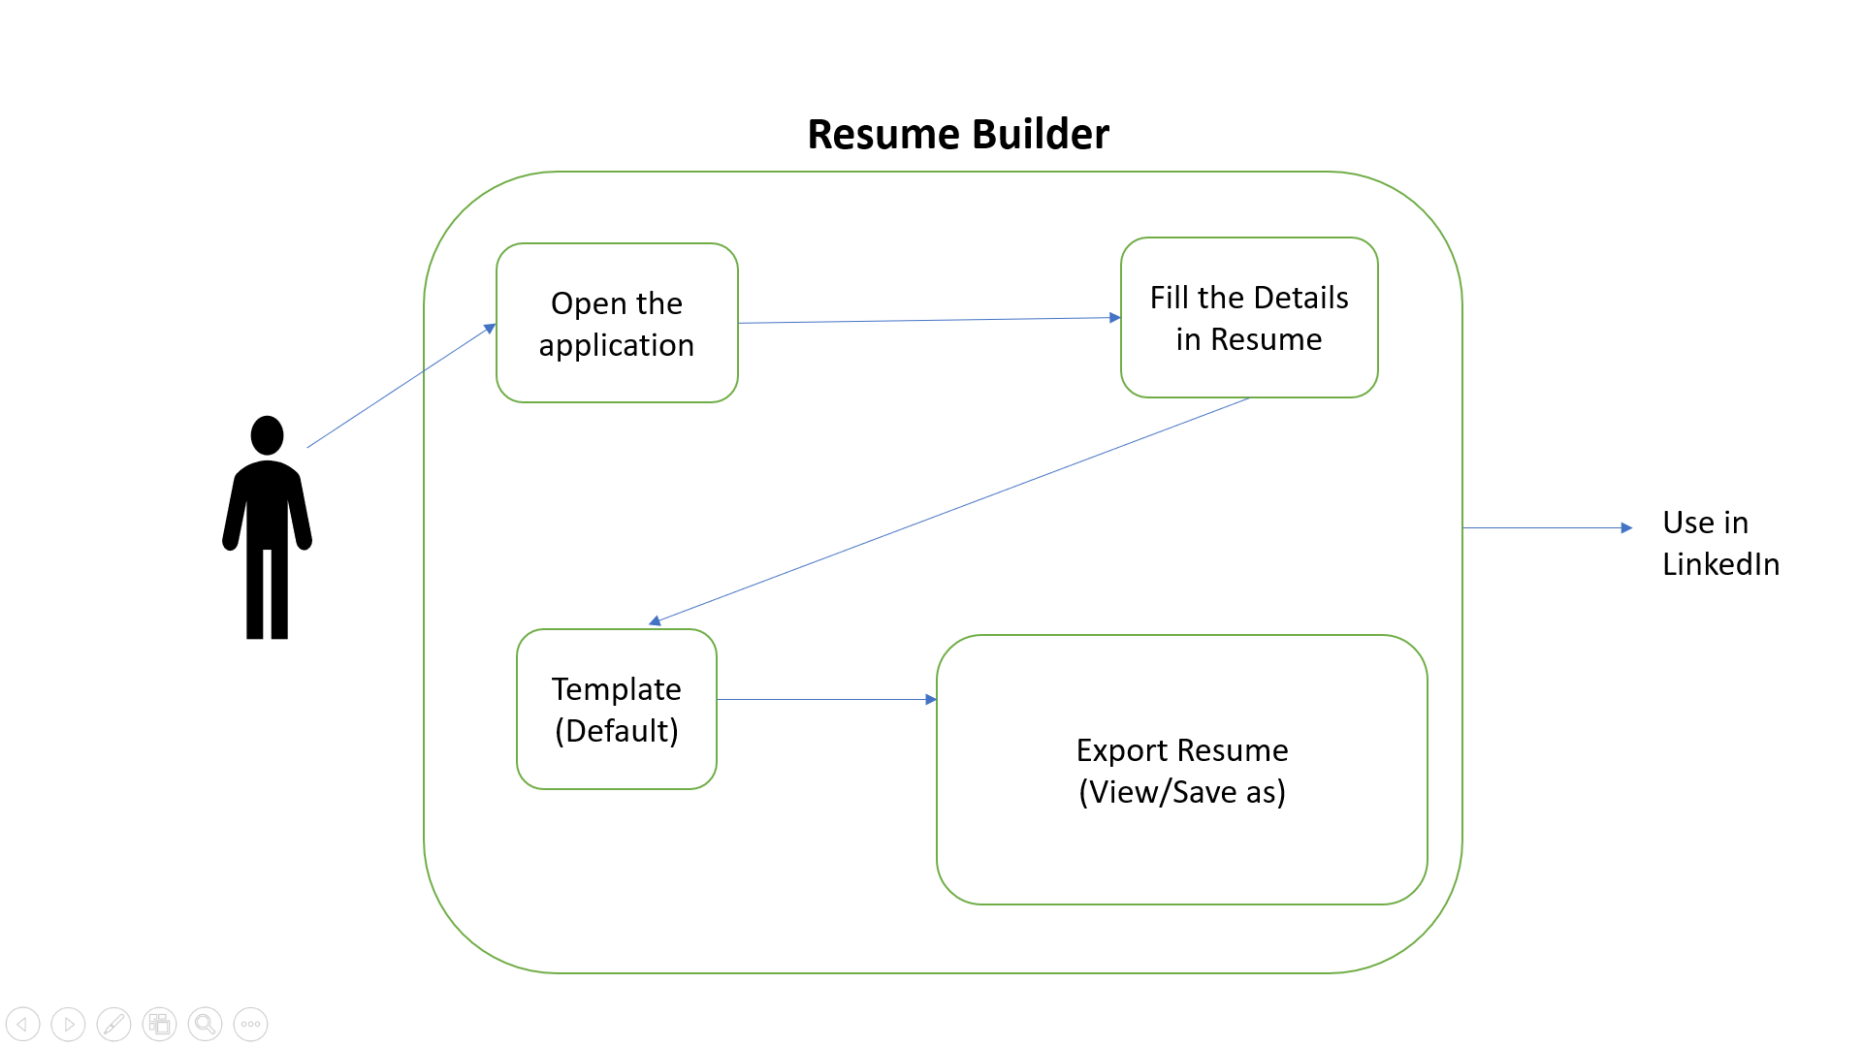
PROPOSED SYSTEM ARCHITECTURE

Slide 8
SYSTEM REQUIREMENTS
HARDWARE SPECIFICATIONS:
PROCESSOR: i3 or above.
RAM: 2GB or above
SOFTWARE SPECIFICATIONS:
OS: Windows 7 or above.
CODING LANGUAGE: Python, Html,Javascript,Css.
.

Slide 9
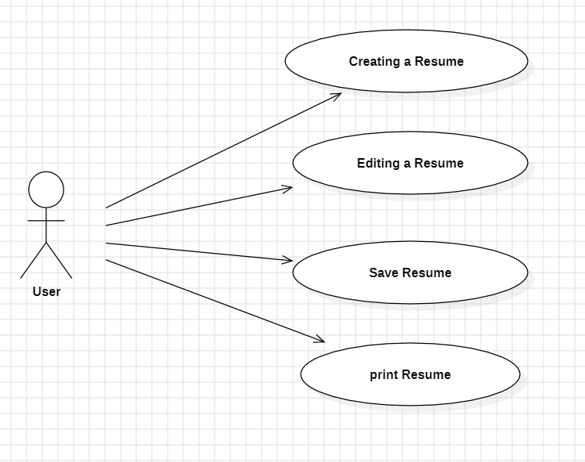
UML Diagrams
1.Use Case Diagram
A use case is a specific sequence of interactions between an external actor and a system that results in a measurable outcome. These interactions are depicted in the Use Case Diagram, outlining the essential functionalities and behaviors of the system as experienced by the user.

Slide 10
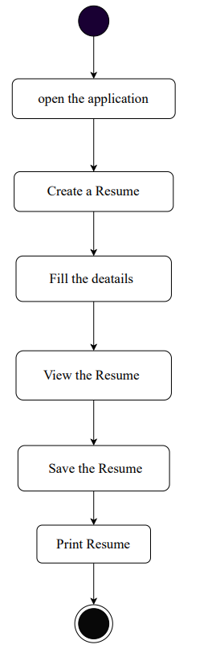
Activity Diagram
Activity diagram is another important behavioral diagram in UML diagram to describe dynamic aspects of the system. Activity diagram is essentially an advanced version of flow chart that modeling the flow from one activity to another activity.

Slide 11
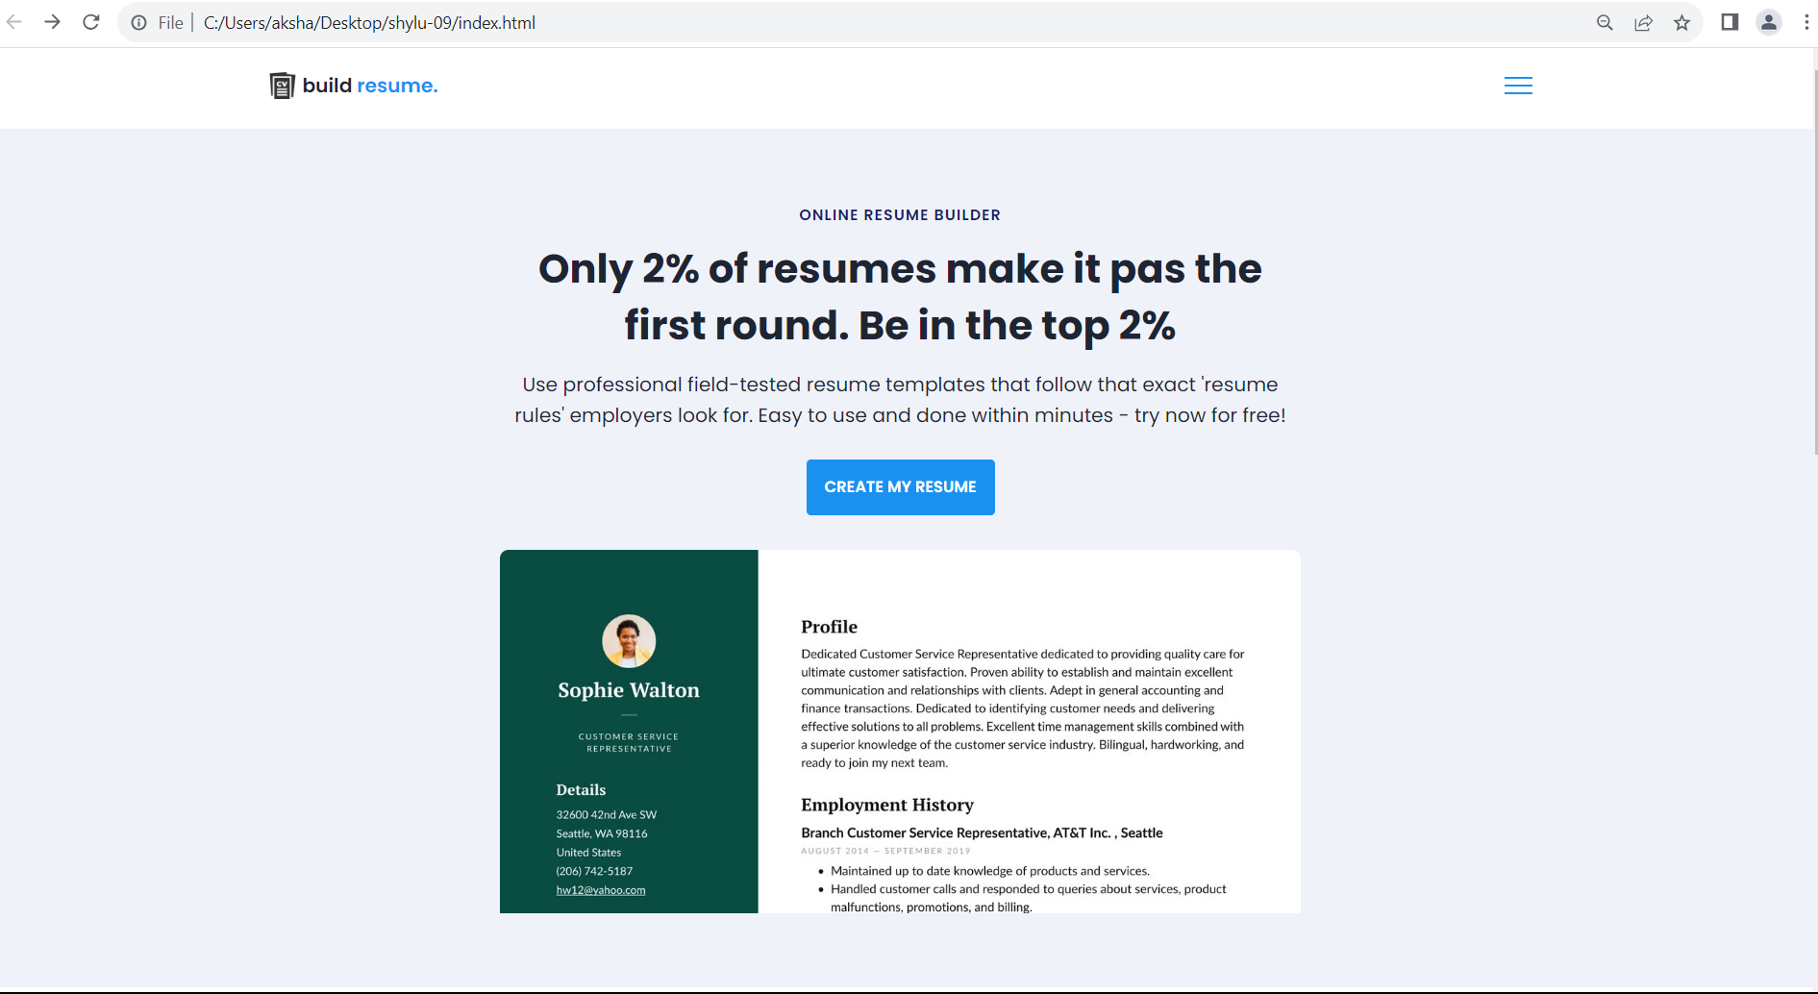
OUTPUT SCREENS

Slide 12
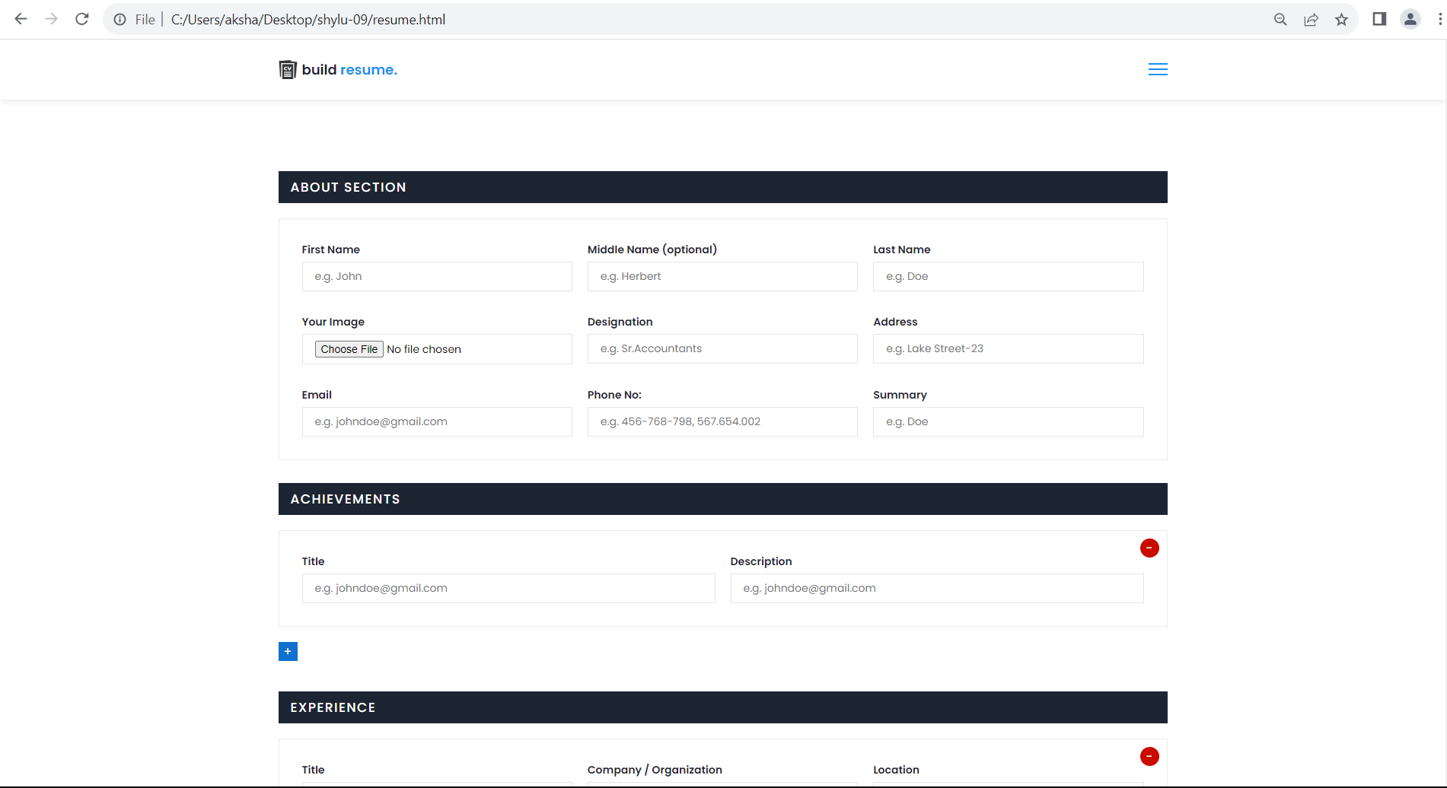

Slide 13
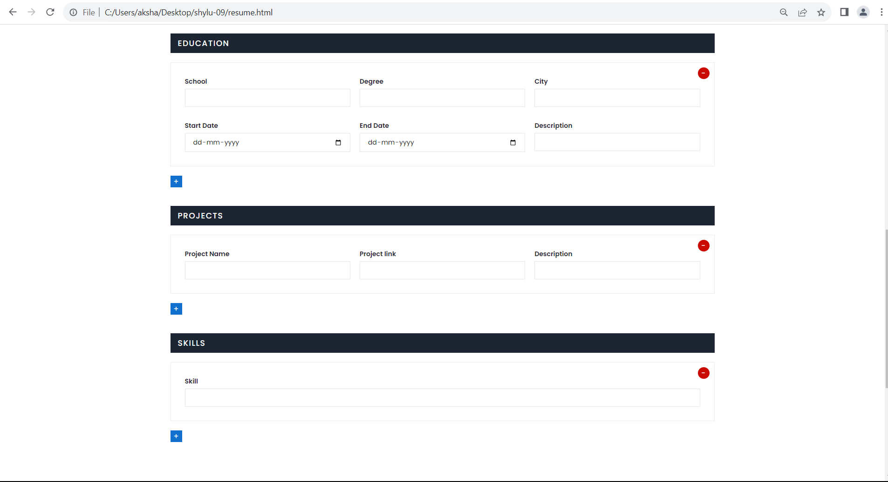

Slide 14
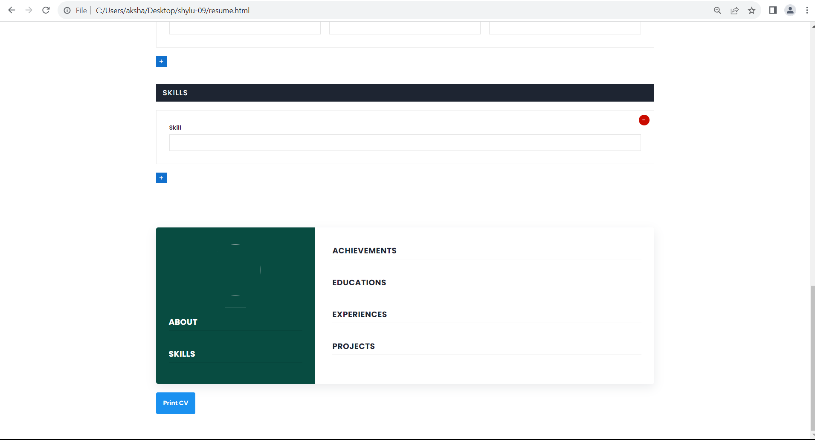

Slide 15
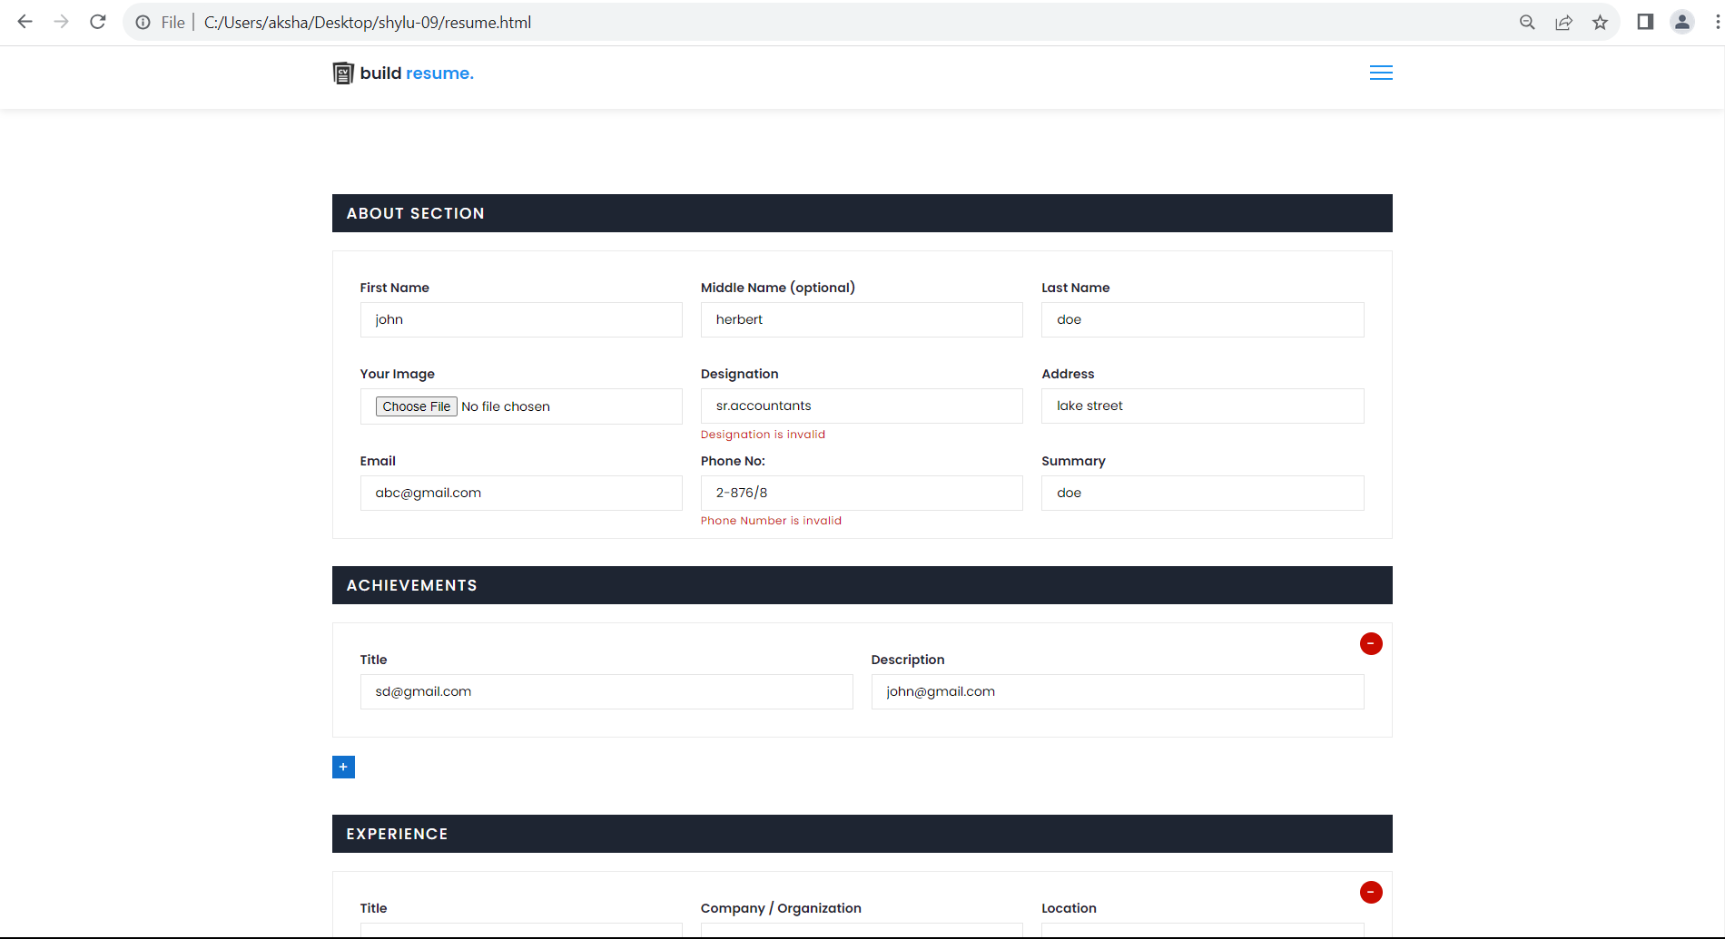

Slide 16
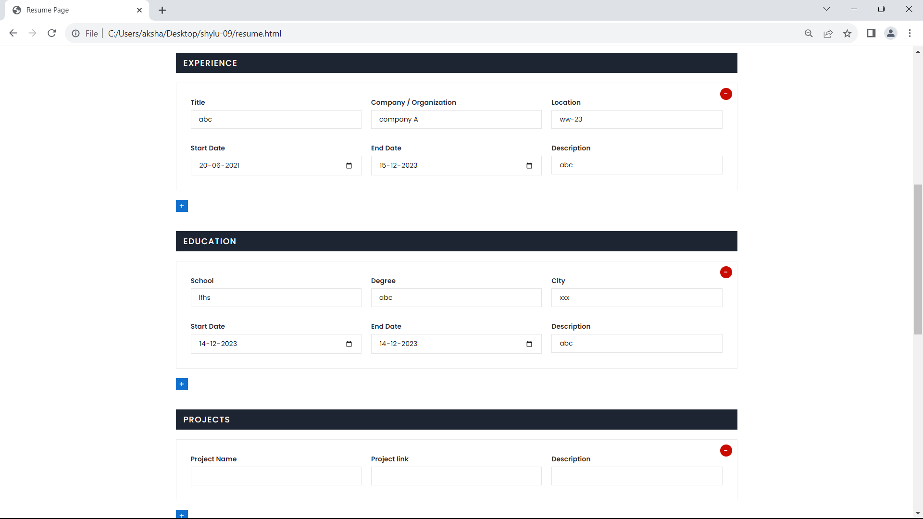

Slide 17
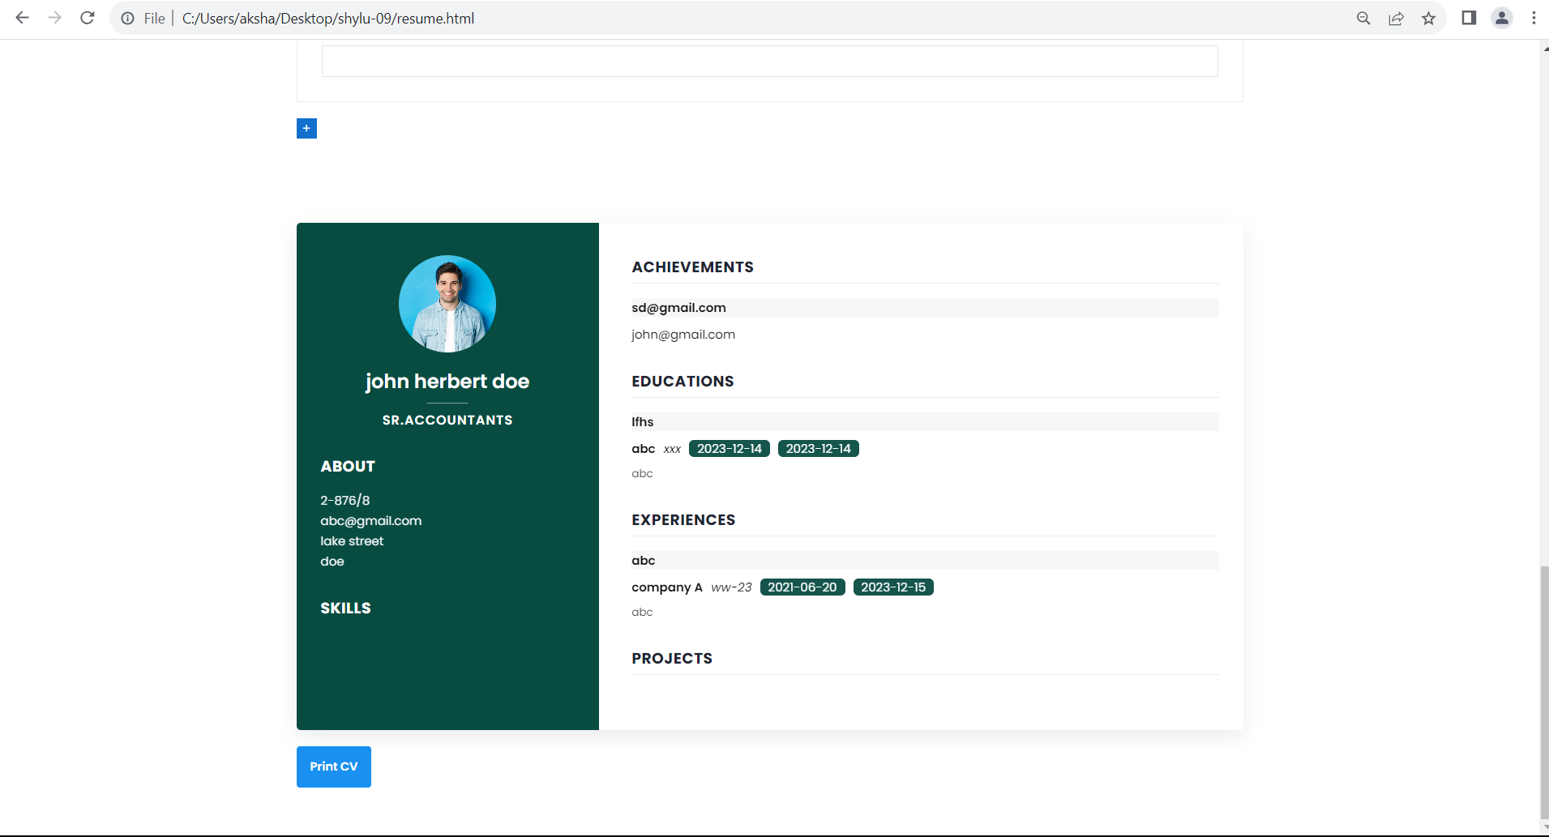

Slide 18
CONCLUSION
To save time and energy making their resumes, many job seekers choose to use an online resume builder.
It stands as a dynamic solution, empowering individuals to craft polished and professional resumes with ease. The user-friendly interface, coupled with structured input fields and diverse templates, simplifies the complex task of resume creation, catering to users across various industries and career stages.

Slide 19
THANK YOU

