Slide 1
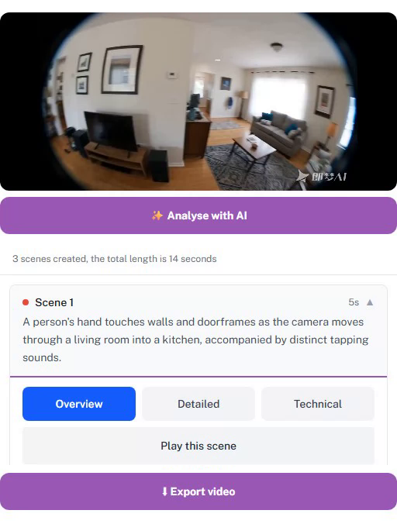
VIDEO COLLAB · UCL × SENSES HUB
Editing video, together.
A collaborative video editor where blind and low-vision creators direct the edit — with a sighted helper on a second device and AI assistance that always asks first.
React 19 · Vite · Supabase · Express 5 · FFmpeg · Gemini 2.5 Flash
Notes:
Video Collab is a working web product, productized from the video-collab-probe research platform built with 10 blind or low-vision creator + sighted helper pairs (UCL × Senses Hub). The screenshot on the right is the creator's phone view of a real project.

Slide 2
WHY IT EXISTS
The creator directs; everyone else assists
Blind and low-vision (BLV) creators usually have to hand their footage to someone sighted — and lose authorship of their own story.
Video Collab keeps the BLV creator in the director's seat. The project lives on their phone; a sighted helper joins from a second device; AI describes footage and makes edits on request.
It grew out of a Wizard-of-Oz research probe used by 10 creator–helper pairs in Nairobi, then was productized: real backend, real AI, no researcher in the loop.
Every edit on every scene offers three routes:
Edit by Myself
Big labelled self-edit tools: trim, split, move, delete, captions — fully usable by ear and keyboard.
Ask AI to Edit
Natural-language requests mapped to one validated operation, confirmed by voice before anything changes.
“Independence is coming… this is the beginning of it.”
— study participant (BLV creator)
Ask Helper to Edit
Send a task to the sighted helper's device; its status is spoken back when they respond.
Notes:
Core message: agency within collaboration. The app does not replace the helper — it restores the creator's control over what happens to their footage. The three routing options are the heart of the interaction model and come straight from the study findings.

Slide 3
SYSTEM ARCHITECTURE
Three parts, one realtime backbone
Web app
React 19 + Vite SPA, mobile-first, Tailwind 4.
Deployed on Vercel; talks to Supabase directly with the anon key + RLS.
Supabase
Auth (allowlist + password) · Postgres with row-level security · private Storage bucket · Realtime: postgres_changes, presence, broadcast.
API server
Express 5 on Railway. Bundled FFmpeg + Gemini 2.5 Flash.
Holds the only copies of the service-role and Gemini keys.
The browser never holds a secret: Gemini and service-role keys exist only in server env vars; every server route re-verifies the caller's JWT and project membership because service-role bypasses RLS.
Phone videos upload straight to Supabase Storage over the TUS resumable protocol (6 MiB chunks) — interrupted mobile uploads resume instead of restarting.
Heavy work (FFmpeg segmentation, AI description, MP4 render) runs as fire-and-forget jobs on the server with atomic claims, single-flight guards, and a boot-time crash-recovery sweep.
Notes:
Deliberately boring, replaceable infrastructure: an SPA + a managed Postgres platform + one Node service. The interesting engineering is in the accessibility layer and the media/AI pipeline, not in exotic infra. Direct browser-to-Supabase traffic keeps latency low; the Express server exists exactly where secrets or heavy compute are involved.

Slide 4
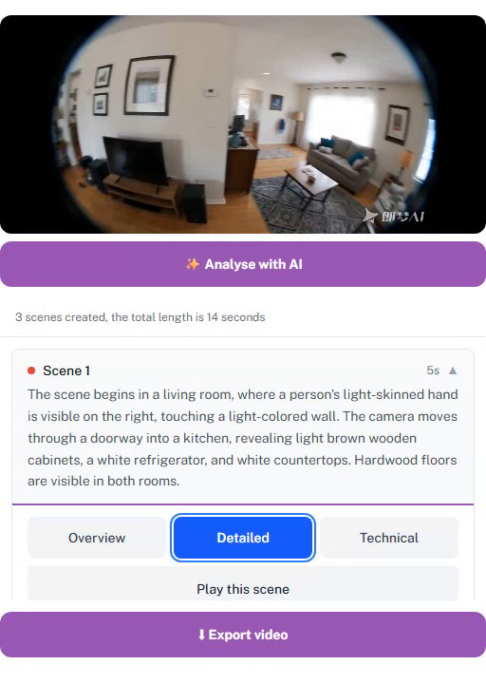
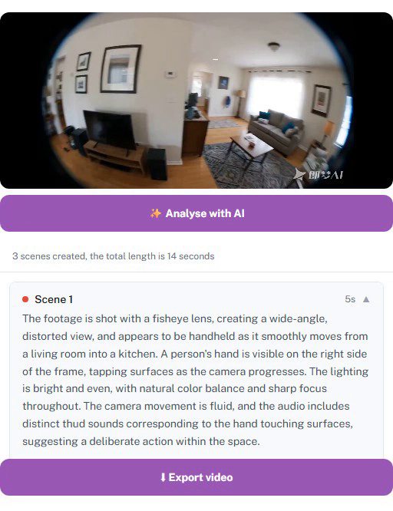
KNOW YOUR OWN FOOTAGE
Every scene described — at the depth you choose
Gemini 2.5 Flash describes the actual 480p scene clip with audio — motion and speech, not a frozen frame — and the app reads it aloud at the user's chosen speech rate.
Overview — what's happening (15–30 words)
Detailed — what's visible (40–70 words)
Technical — how it looks (60–100 words)
Notes:
Three progressive detail levels per scene, generated during processing and stored per level with model provenance. Originally descriptions came from a single midpoint keyframe; that missed motion, speech and the most informative moment, so the pipeline now sends the downscaled scene clip with audio to Gemini, with an automatic keyframe fallback and an env kill-switch. The prompt style guide is written for screen-reader directness: no 'the video shows', hedging only under real uncertainty, on-screen text quoted verbatim only when legible.

Slide 5
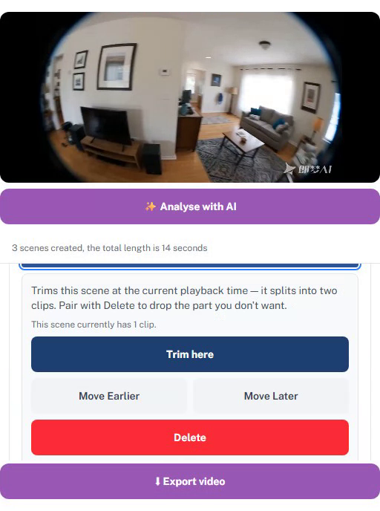
AGENCY BY DESIGN
Any edit, three ways: yourself, AI, or your helper
Edit by Myself — trim, split, move, delete, caption, mute — with undo/redo. Large labelled controls (44–48 px targets), each action announced as it lands in the shared timeline.
Ask Helper to Edit — a spoken or typed request becomes a durable task on the helper's device: Done / Needs discussion / Can't do, with the outcome spoken back to the creator.
Ask AI to Edit — natural language in, one confirmed operation out (next slide).
Ask about this scene — free-text visual Q&A answered by Gemini from the scene's keyframe, in concrete spatial language (left/right, foreground/background).
Analyse with AI — one tap requests up to three curated suggestions (issue → structural → creative, max one per scene); each suggestion must itself be routed through the same three channels, and its resolution syncs to both devices.
Self-edit tools on a scene
Notes:
The routing model applies uniformly: manual edits, delegated tasks, AI edits, and even AI suggestions all flow through the same three-way choice, so the creator always decides who acts. Suggestions are deliberately capped at three 12–30-word sentences to keep audio-first consumption manageable.

Slide 6
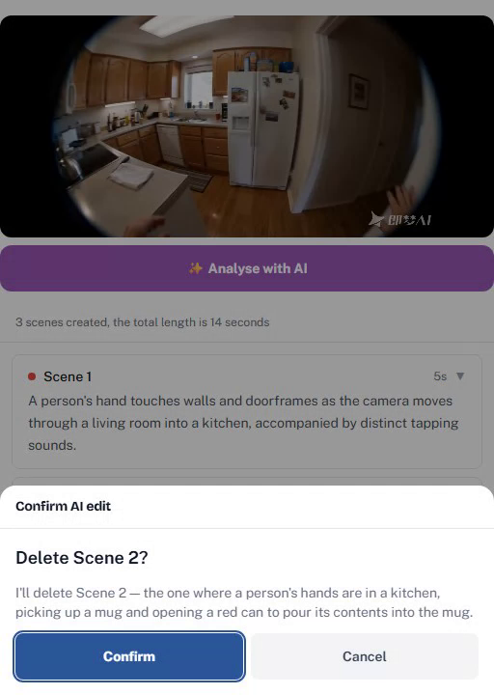
AI THAT ASKS FIRST
Natural-language edits, confirmed before they apply
1
Speak or type
“Delete scene 2 from the timeline.”
2
One validated operation
Gemini 2.5 Flash must return exactly one whitelisted op — delete, trim, split, move, caption, brightness/contrast/saturation, zoom, rotate, mute — and the server range-clamps every numeric value.
3
Deterministic spoken summary
The confirmation sentence is composed by the app from the validated operation — never the model's free text — “because for a blind user a summary/op mismatch is unrecoverable.”
4
Nothing applies until Confirm
The proposal appears as an alert dialog; ambiguous requests get one clarifying question instead of a guess.
Confirm-first dialog for an AI edit
Notes:
Trust is engineered, not assumed: the model's output is treated as a proposal. Whitelisting + range-clamping happens server-side; the spoken summary is deterministic so the screen-reader user hears exactly what will happen; and the timeline is untouched until an explicit Confirm. A single shared module (fixActions.js) defines the AI-fixable operations and their numeric ranges for BOTH Ask-AI-to-Edit and the suggestions fix templates, so the two features can never validate differently. The dialog itself is a focus-trapped role=alertdialog; Escape cancels.

Slide 7
TWO DEVICES, ONE TIMELINE
Live collaboration over Supabase Realtime
One URL, one shared edit state, two role-adapted surfaces: the creator gets an audio-first scene list, the helper a visual timeline editor.
one Realtime channel per project
Creator (phone)
Scene blocks, TTS + earcons, voice input; the video element itself is hidden from assistive tech.
Helper (laptop)
Synced preview + activity feed, trim/split/move, captions, text overlays, colour sliders.
postgres_changes — durable: timeline state, tasks, suggestions, render status
broadcast — ephemeral: playhead (2 s throttle), play/pause, activity feed
presence — awareness: “Helper joined the editor”, announced aloud
Edit state is append-only, versioned JSONB: save version N+1; if the peer saved first, the unique index rejects it and the client rebases its operation onto the latest state and retries — two-person convergence without a CRDT.
The helper's colour grading reaches the creator's playing video live as a CSS filter, and export reproduces it with mathematically matched FFmpeg filters.
Every remote change is narrated on the other device — “Your helper trimmed scene 2” — and a reconnect refetches everything, so state survives refreshes and dropped connections.
Notes:
Realtime architecture: durable data flows through Postgres and fans out via postgres_changes (RLS applies to the change stream too); transient signals use broadcast; presence powers join/leave announcements. The versioned-state design accepts last-writer-wins at two-person scale but the version check prevents silent clobbering. The same route mounts CreatorDevice or HelperDevice based on the member's role.

Slide 8
BUILT AUDIO-FIRST
Accessibility is the product, not a checklist
One voice, never two
A queued app-wide announcer: polite + assertive live regions, messages drained one at a time with 150 ms gaps, visual echoes aria-hidden — nothing is ever spoken twice.
Sound as interface
Earcons from one shared AudioContext: rising 880 Hz “speak now”, 587 Hz “got it”, low 330 Hz error, analysis-done chime. TTS reads descriptions at the user's rate (0.5–2×).
The video is invisible
On the creator device the player is aria-hidden and inert on purpose — the scene-block list is the interface, and each block's name carries the full description.
Focus follows the work
Analysis done → first suggestion; render done → the Download link; suggestion routed → its resolution badge. Auto-follow during playback moves no focus at all — participants asked for silence.
Fixes from the field
TalkBack anti-jitter scroll locks, interception of synthetic double-taps, scene counts rendered as one text node so they aren't read as fragments — field fixes kept as documented contracts.
And the baseline
44–48 px targets, visible focus outlines, skip links, prefers-reduced-motion honoured, keyboard everywhere (timeline as listbox, trim handles as sliders), hardware Back collapses the scene.
The end-to-end tests drive the app through its accessible names — the accessibility tree is the test contract.
Notes:
These patterns were carried verbatim from the research probe — the porting spec literally states 'Accessibility is the product: preserve the probe's screen-reader contracts verbatim.' Adversarial design reviews treated stranded focus as a critical bug. More depth if asked: expanding a scene pushes a history entry so the hardware Back gesture collapses it instead of leaving the editor; a 'Paused on scene N' read-out is assertive because TalkBack drops polite writes while re-reading a just-activated button; the announcer clears itself after 2 s so re-focusing never re-reads stale messages; the mic flow announces only when the mic is actually hot.

Slide 9
UNDER THE HOOD
From phone camera to finished MP4
1
Upload — TUS resumable upload from the phone into a private Storage bucket (path is pinned to the project by a DB constraint).
Hardened in production
x264 thread pool clamped — Railway's many-core hosts spawned ~60 encoder threads and OOM-killed HD encodes.
600 s SIGKILL timeout; error text distinguishes our kill vs container OOM vs platform redeploy.
Boot-time sweep marks jobs interrupted by a redeploy as failed, so retries are never wedged.
Model clips sized for Gemini's inline cap, with automatic keyframe fallback — description quality can degrade, never disappear.
2
Segment — FFmpeg cuts fixed-interval ~5 s scenes (configurable, frame-accurate re-encode), extracts a midpoint keyframe, and builds a 480p model clip per scene.
3
Describe — Gemini 2.5 Flash writes all three description levels per scene; results are stored with model provenance. Status transitions are announced to the creator.
4
Edit — The shared timeline (EDL) lives as versioned JSONB; all edits — manual, AI, helper — mutate it through the same store.
5
Export — Each clip is normalised to 1280×720@30 H.264/AAC with its colour grade baked in, then stream-copy concatenated and served by signed URL.
Notes:
Segmentation re-encodes because phone-video keyframes can be 5–10 seconds apart — stream-copying at cut points would produce broken scenes. Mute is implemented as volume=0 rather than stripping the audio stream, so the final concat stays uniform.

Slide 10
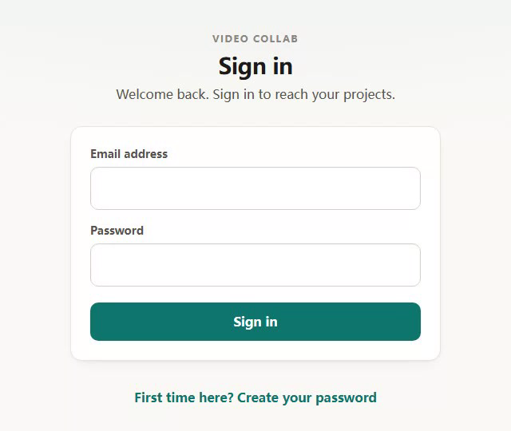
TRUST BOUNDARIES
Locked down by default
Row-level security everywhere — every table policy and even storage-object access resolve through one membership check; file paths embed the project id, so files ride the same gate as rows.
Allowlist at the database — a trigger on auth.users blocks account creation for unlisted emails, regardless of what any client does.
4-digit join codes — helpers join by speaking a code across the room: single-use, 15-minute expiry, rate-limited (5 failures → lockout).
Server-only writes for AI output — suggestions have no client INSERT policy; members can update only the resolution columns.
Render input treated as hostile — member-writable timeline JSON is coerced and range-clamped at two independent layers before reaching FFmpeg — closing a filtergraph-injection hole caught in adversarial review.
Allowlist + password sign-in — magic links were dropped after real-world email delivery proved unreliable
Notes:
The threat model assumes a compromised or malicious client: the database enforces the allowlist and membership, the server re-verifies identity and membership on every route, and anything a member can write is sanitized before it parameterizes FFmpeg. Join codes replaced invite links because a code can be spoken aloud between two people in the same room — an accessibility-driven security design.

Slide 11
HOW IT'S BUILT
Tested against the real stack
Unit level — server modules are dependency-injected and tested with Vitest + Supertest (FFmpeg and Gemini swap out as fakes); the web app carries 35+ colocated component tests with Testing Library.
End-to-end — a two-browser Playwright suite drives creator and helper simultaneously against live Supabase and live Gemini: AI analysis, routed suggestions, task round-trips, colour-grade sync, and a real FFmpeg export with a downloadable MP4.
Exact assertions, tolerant waits — counts and texts are asserted exactly; only timing allows up to 30 s for Realtime over the public internet.
Quality gates before UI — AI features shipped only after diagnostic runs on real participant footage were judged by the researcher (“unit mocks hide what only real data reveals”), plus live smoke scripts for auth, RLS policies, join codes and the upload → describe pipeline.
Even the demo video is code — Playwright-captured UI b-roll, voiceover synced by FFT audio cross-correlation, and an OpenCV face-blur step that fails closed rather than shipping an unblurred face.
Notes:
The screenshots in this deck are frames from that scripted Playwright b-roll — the same pipeline that builds the 60-second demo film. Reproducibility applies to outreach artifacts, not just code.

Slide 12
STATUS
Deployed, and heading into pilot
Live today on Vercel + Railway + Supabase: creators upload from their phones, helpers join with a spoken 4-digit code, finished MP4s download from the cloud.
Next step: an unsupervised pilot with blind and low-vision creators and the helpers they already trust — friends, family, community.
Built at UCL × Senses Hub, productized from the video-collab-probe research platform (10 creator–helper pairs; the probe stays frozen as the study artifact).
React 19 · Vite · Tailwind 4 · Supabase (Auth · Postgres/RLS · Storage · Realtime)
Express 5 · FFmpeg · Gemini 2.5 Flash · Playwright · Vitest
Notes:
Close on the arc: research probe → product → pilot. The technical stack is deliberately mainstream so the novel parts — the audio-first editing model, confirm-first AI, and two-device realtime collaboration — carry the story.

