Slide 1
Quantum Campaign Optimizer
A transparent three-stage quantum–classical marketing pipeline
Quantum campaign
optimization
Four-qubit learning → ten-qubit selection → six-qubit simulation
Shylan Kamesh S
Sai Santhosh T
Derin Godson
Atomiq 2026
ATOMIQ / QFF 2026 ORGANIZER DATA QISKIT SIMULATORS
01

Slide 2
Bank term-deposit campaign
What the shared Atomiq problem asks us to compute
01 Who will convert?
02 Who should we target?
03 Will we hit the target?
Predict probabilities for all 100 unseen customers; report quality and rank the top ten.
Select exactly six from ten under official budget and capacity limits.
Estimate the probability that at least three of those six convert.
300 labeled training customers, 100 hidden-label test customers. Duration excluded.
ATOMIQ / QFF 2026 ORGANIZER DATA QISKIT SIMULATORS
02

Slide 3
End-to-end architecture
Unbroken customer-ID and continuous-probability traceability
INPUT
STAGE 1
STAGE 2
STAGE 3
OUTPUT
300 training + 100 test customers
4Q QML kernel + classical benchmarks
10Q XY-QAOA + 210 exact checks
6Q RY encoding, shots and noise
Six IDs and campaign-success probability
›
›
›
›
Guardrails: training-only preprocessing • measured QAOA gap • exact analytical Stage 3 check
ATOMIQ / QFF 2026 ORGANIZER DATA QISKIT SIMULATORS
03

Slide 4
Stage 1 / Four-qubit quantum learning
Executed FidelityQuantumKernel + QSVC, three-fold training-only validation
Quantum feature map
0.163
0.100
100%
RY(πx) + RZ(πx) on each qubit
Neighbor RZZ entanglers
Quantum kernel: |⟨φ(x)|φ(y)⟩|²
SVC probability model
OOF average precision
OOF Brier score
Quantum blend share
Training-only model selection
Fit transforms and feature selection only on training fold
Freeze OOF selection, then refit. Quantum subset: 64 rows.
ATOMIQ / QFF 2026 ORGANIZER DATA QISKIT SIMULATORS
04

Slide 5
Stage 2 / Ten-qubit constrained optimization
QAOA candidate sampling + an exact classical feasibility certificate
210
0.000
6 / 10
Exact six-person combinations
Observed QAOA objective gap
Selected from candidates
Maximize Σ xᵢ(pᵢVᵢ − cᵢ), Σ xᵢ = 6
Final customer IDs
Budget 9/25, capacity 19/22, net value 6.1375
C0005
C0007
C0009
C0020
C0022
C0036
XY mixer preserves exactly six (not budget). Exact solver certifies final IDs; no speedup claim.
ATOMIQ / QFF 2026 ORGANIZER DATA QISKIT SIMULATORS
05

Slide 6
Stage 3 / Six-qubit conversion simulation
An interpretable, independently benchmarked probability
0.022797
θᵢ = 2 asin(√pᵢ)
Ideal sampled tail probability
RY(θ₀) • RY(θ₁) • … RY(θ₅)
0.024049
Measure six qubits
Success ⇢ at least three “1” outcomes
Exact Poisson–binomial reference
32,768 Aer shots. Depth 2. Rightmost bit = q0.
95% shot interval: 0.021236–0.024469.
ATOMIQ / QFF 2026 ORGANIZER DATA QISKIT SIMULATORS
06

Slide 7
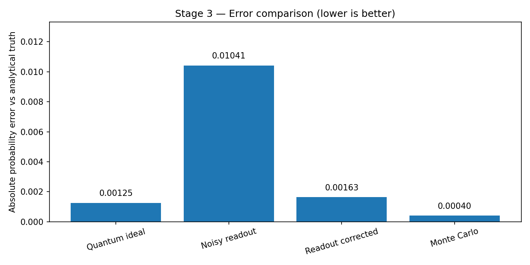
Noise and error measurements
Independent 2.5% readout flips; exact known-matrix correction
Observed results
Ideal: 0.022797; exact: 0.024049
Noisy: 0.034454
Mitigated: 0.022420
Synthetic independent readout model ≠ device-calibrated noise.
ATOMIQ / QFF 2026 ORGANIZER DATA QISKIT SIMULATORS
07

Slide 8
Quantum and classical computation
A precise, reproducible research boundary
Quantum components
Classical components
4Q FidelityQuantumKernel + QSVC
10Q XY-QAOA, 8,192 Aer shots
6Q RY simulation, 32,768 Aer shots
Qiskit 2.6.2, Aer 0.17.2, QML 0.9.1
Data preprocessing and model fitting
Optimizer parameter search
Exact enumeration of 210 subsets
Exact Poisson-binomial + Monte Carlo
QAOA depth: 44 Aer-native; 6,144 in u/cx basis. No hardware or speedup claim.
ATOMIQ / QFF 2026 ORGANIZER DATA QISKIT SIMULATORS
08

Slide 9
Prediction uncertainty and limitations
Training OOF metrics guide selection; hidden test accuracy is unknown
01
QSVC has OOF average precision 0.163 and ROC-AUC 0.549
02
Four selected categorical indicators give 86 tied top probabilities
03
Official alphanumeric tie rule determines the top-ten candidate pool
04
200 probability perturbations: mean overlap 0.67 of six selected IDs
05
Sensitivity is illustrative, not a confidence interval or evidence of advantage
ATOMIQ / QFF 2026 ORGANIZER DATA QISKIT SIMULATORS
09

Slide 10
Why the XY mixer matters
Cardinality is guaranteed by the ansatz; budget/capacity still need checks
XY-QAOA / 10 qubits
X-mixer / original baseline
Uniform weight-six initial state
XY ring preserves cardinality
Measured feasible fraction: 100%
All six XY trials measured the optimum
Plus state over all 1,024 states
RX can change the selection count
Depth 1 mean feasibility: 31.6%
Depth 2 mean feasibility: 26.0%
Seeds 11, 22, 33; depths 1, 2; 2,048 shots. All 210 six-person subsets are feasible here.
ATOMIQ / QFF 2026 ORGANIZER DATA QISKIT SIMULATORS
10

Slide 11
Campaign result and reproducibility
Expected net value 6.1375; quantum probability of at least three conversions 2.28%
4 qubits → 10 qubits → 6 qubits
44 tests passed, zero skipped. Independent output audit passed.
Exact dependencies, seeds, source hashes and measurement counts included.
github.com/shylankamesh/atomiq-quantum-campaign-2026
ATOMIQ / QFF 2026 ORGANIZER DATA QISKIT SIMULATORS
11

Slide 12
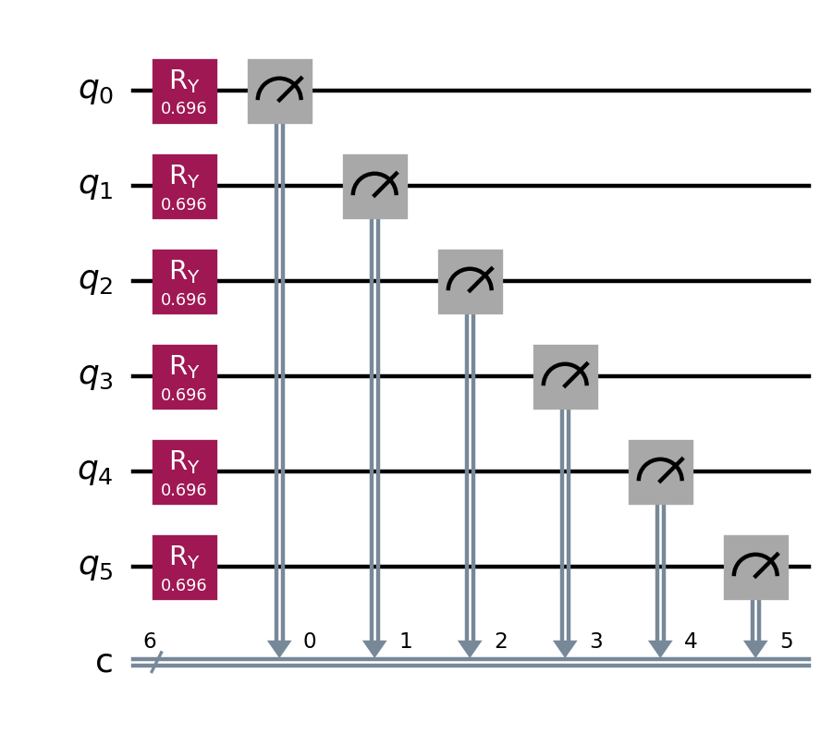
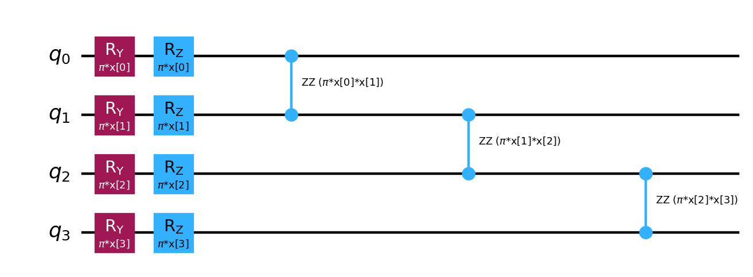
Executed quantum circuit designs
4-qubit feature map and 6-qubit campaign circuit
Feature map: logical depth 5, u/cx depth 11. Campaign: depth 2, six RY gates, no entanglers.
Qiskit-rendered diagrams. Simulator execution only. q0 is the rightmost measured bit.

