Slide 1
Quantum Campaign Optimizer
A transparent three-stage quantum–classical marketing pipeline
PREDICT. OPTIMIZE. VERIFY.
Four-qubit learning → ten-qubit selection → six-qubit simulation
Real constraints. Exact classical certificates. Explicit quantum evidence.
Chi(r)ps & Qreativity
ATOMIQ / QFF 2026 • SYNTHETIC DEMO — NOT OFFICIAL RESULTS
01

Slide 2
One campaign. Three scientific questions.
What the shared Atomiq problem asks us to compute
01 Who will convert?
02 Who should we target?
03 Will we hit the target?
Predict probabilities for all 100 unseen customers; report quality and rank the top ten.
Select exactly six from ten under official budget and capacity limits.
Estimate the probability that at least three of those six convert.
Quantum complexity is not the goal; correctness, feasibility, traceability and honest benchmarks are.
ATOMIQ / QFF 2026 • SYNTHETIC DEMO — NOT OFFICIAL RESULTS
02

Slide 3
End-to-end architecture
Unbroken customer-ID and continuous-probability traceability
INPUT
STAGE 1
STAGE 2
STAGE 3
OUTPUT
Labeled history + 100 test customers
4Q QML kernel + classical benchmarks
10Q XY-QAOA + 210 exact checks
6Q RY encoding, shots and noise
Six IDs and campaign-success probability
›
›
›
›
Guardrails: training-only preprocessing • measured QAOA gap • exact analytical Stage 3 check
ATOMIQ / QFF 2026 • SYNTHETIC DEMO — NOT OFFICIAL RESULTS
03

Slide 4
Stage 1 / Four-qubit quantum learning
Qiskit ML-compatible entangled fidelity kernel + calibration-aware blend
Quantum feature map
0.871
0.172
25%
RY(πx) + RZ(πx) on each qubit
Neighbor RZZ entanglers
Quantum kernel: |⟨φ(x)|φ(y)⟩|²
SVC probability model
Validation PR-AUC
Validation Brier
Quantum blend share
How we preserve evaluation integrity
Fit transforms and feature selection only on training fold
Choose blend weight on held-out validation, never test labels
ATOMIQ / QFF 2026 • SYNTHETIC DEMO — NOT OFFICIAL RESULTS
04

Slide 5
Stage 2 / Ten-qubit constrained optimization
QAOA candidate sampling + an exact classical feasibility certificate
210
0.000
6 / 10
Exact six-person combinations
Observed QAOA objective gap
Selected from candidates
Maximize Σ pᵢ xᵢ with Σ xᵢ = 6
Synthetic selected IDs
Subject to budget + capacity constraints
DEMO_0379
DEMO_0407
DEMO_0343
DEMO_0333
DEMO_0377
DEMO_0373
XY mixer preserves exactly six (not budget). Exact solver certifies final IDs; no speedup claim.
ATOMIQ / QFF 2026 • SYNTHETIC DEMO — NOT OFFICIAL RESULTS
05

Slide 6
Stage 3 / Six-qubit conversion simulation
An interpretable, independently benchmarked probability
0.99927
θᵢ = 2 asin(√pᵢ)
Ideal sampled tail probability
RY(θ₀) • RY(θ₁) • … RY(θ₅)
0.99910
Measure six qubits
Success ⇢ at least three “1” outcomes
Exact Poisson–binomial reference
Also tested: Monte Carlo, readout bit-flip noise, mitigation and sensitivity.
ATOMIQ / QFF 2026 • SYNTHETIC DEMO — NOT OFFICIAL RESULTS
06

Slide 7
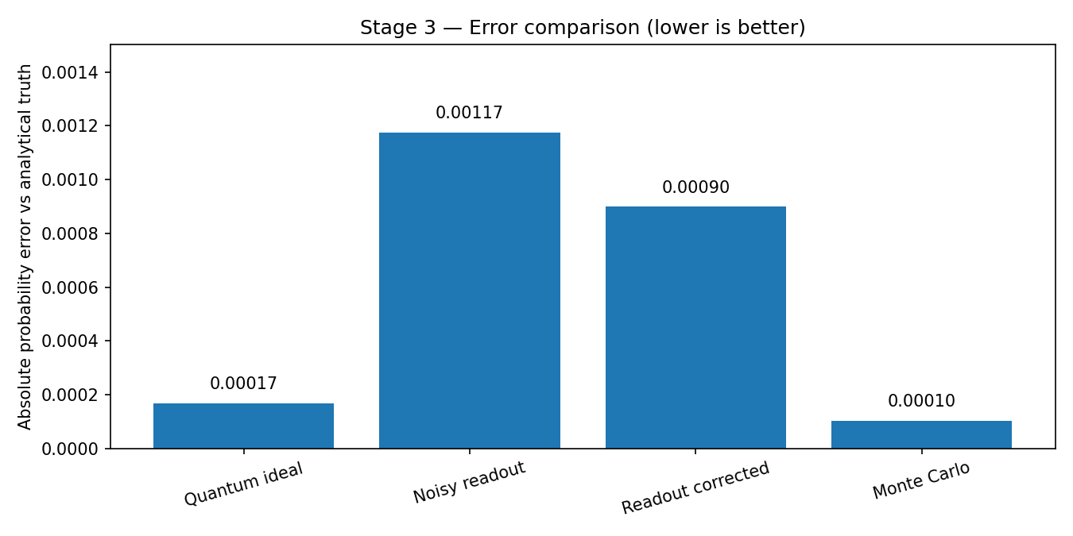
Evidence over hype
We report limitations and failure cases, not just favorable scores
What the demo shows
Ideal shots track exact DP
Readout noise shifts estimates
Mitigation can worsen error
Synthetic independent readout model ≠ device-calibrated noise.
ATOMIQ / QFF 2026 • SYNTHETIC DEMO — NOT OFFICIAL RESULTS
07

Slide 8
What is quantum — and what is classical?
A precise, reproducible research boundary
Quantum components
Classical components
4Q entangling feature-map fidelity
10Q QAOA diagonal phase oracle
6Q rotation-encoded shot circuit
Aer execution after Qiskit installation
Data preprocessing and model fitting
Optimizer parameter search
Exact enumeration of 210 subsets
Exact Poisson-binomial + Monte Carlo
No hardware speedup • no organizer results • simulated X vs XY comparison only
ATOMIQ / QFF 2026 • SYNTHETIC DEMO — NOT OFFICIAL RESULTS
08

Slide 9
From reproducible prototype to valid submission
Complete these organizer-specific actions before the 10 PM IST deadline
01
Load the actual CSV/XLSX datasets and verify the objective/limits
02
Execute --engine qiskit and rerun all tests on installed Qiskit/Aer
03
Replace synthetic IDs/plots/numbers with actual validated outputs
04
Publish root-level outputs + lockfile + report in public GitHub
05
Upload view-only deck and record the mandatory 1–2 minute video
ATOMIQ / QFF 2026 • SYNTHETIC DEMO — NOT OFFICIAL RESULTS
09

Slide 10
Why the XY mixer matters
Cardinality is guaranteed by the ansatz; budget/capacity still need checks
XY-QAOA / 10 qubits
X-mixer / original baseline
Uniform weight-six initial state
XY ring mixer conserves Hamming weight
Feasible probability: 25.4%
Exactly-six mass: 100.0%
Uniform plus state (all 1024 states)
RX mixer may flip selection count
Feasible probability: 3.3%
Exactly-six mass: 14.6%
Same synthetic inputs + equal optimizer budget • 22/210 feasible subsets • not a hardware test
ATOMIQ / QFF 2026 • SYNTHETIC DEMO — NOT OFFICIAL RESULTS
10

Slide 11
A campaign decision you can audit.
Our goal: scientific rigor over unsupported quantum-advantage claims
4 qubits → 10 qubits → 6 qubits
Prediction quality • Feasibility • Probability accuracy
Classical certificates • Full customer-ID traceability
Atomiq Quantum Campaign Optimizer / Source and reproducibility in README
ATOMIQ / QFF 2026 • SYNTHETIC DEMO — NOT OFFICIAL RESULTS
11

