Slide 1

MSBA 265 / PROJECT 2
Classification:
from pixels
to decisions
What is it? Which model?
What preparation? Which mistakes?
PASS / REVIEW / REJECT
FOUNDATION LECTURE | Original simulated inspection imagery | October 2026
Notes:
SLIDE 1: Classification: from pixels to decisions

Slide 2
MSBA 265 / PROJECT 2 / CLASSIFICATION
The route: understand, prepare, compare, decide
A better classifier starts with a better question—not a bigger model.
QUESTION
INPUT
MODEL
EVIDENCE
What label and action?
>
What will be available?
>
Which useful baseline?
>
Which errors and costs?
Keep the business question connected to every technical step.
MSBA 265 | Original teaching visuals | Sources: course synthesis
02
Notes:
SLIDE 2: The route: understand, prepare, compare, decide

Slide 3
MSBA 265 / PROJECT 2 / CLASSIFICATION
Same business, different prediction task
The target determines whether the problem is regression or classification.
REGRESSION
CLASSIFICATION
DECISION
Predict repair cost
Output: $245
Evaluate: MAE / RMSE
Predict defect status
Output: pass / defect
Evaluate: precision / recall
Route the item
Output: approve / review / reject
Evaluate: operational cost
MSBA 265 | Original teaching visuals | Sources: S13 S15
03
Notes:
SLIDE 3: Same business, different prediction task

Slide 4
MSBA 265 / PROJECT 2 / CLASSIFICATION
Binary, multiclass, or multilabel?
One label per image is not the same as several labels per image.
BINARY
MULTICLASS
MULTILABEL
Exactly one of two
normal OR defective
Exactly one of many
scratch OR dent OR stain
Several may coexist
scratch AND stain
MSBA 265 | Original teaching visuals | Sources: S15
04
Notes:
SLIDE 4: Binary, multiclass, or multilabel?

Slide 5

MSBA 265 / PROJECT 2 / CLASSIFICATION
What label? What location? Which pixels?
Classification, detection, and segmentation answer different questions.
CLASSIFICATION
DETECTION
SEGMENTATION
Defective: image label
Defect: bounding box
Defect: pixel mask
SIMULATED teaching illustrations—not dataset samples or model predictions.
MSBA 265 | Original teaching visuals | Sources: S7 S16
05
Notes:
SLIDE 5: What label? What location? Which pixels?

Slide 6
MSBA 265 / PROJECT 2 / CLASSIFICATION
Models consume representations, not file names
Your input contract is as important as your algorithm.
TABLES
TEXT
IMAGES
Rows x features
numeric matrix + schema
or supported categorical columns
TF-IDF sparse vectors
OR token IDs + attention mask
Engineered feature vectors
OR pixel tensors
OR pretrained embeddings
MSBA 265 | Original teaching visuals | Sources: S6 S7 S9 S14
06
Notes:
SLIDE 6: Models consume representations, not file names

Slide 7
MSBA 265 / PROJECT 2 / CLASSIFICATION
The honest model-development loop
Fit on training data. Choose on validation. Report on untouched test data.
AUDIT + SPLIT
FIT
CHOOSE
REPORT
Labels, groups, time
>
Train preprocessing + model
>
Validation: model + threshold
>
Test once; inspect failures
Keep the business question connected to every technical step.
MSBA 265 | Original teaching visuals | Sources: S1 S10
07
Notes:
SLIDE 7: The honest model-development loop

Slide 8
MSBA 265 / PROJECT 2 / CLASSIFICATION
Choose a shortlist, not a universal winner
Start with data type; then consider labels, cost, and constraints.
What is the input type?
TABLE
TEXT
IMAGE
Logistic + tree ensemble
TF-IDF linear + transformer
Features + pretrained encoder
Then compare: label volume | error cost | interpretability | latency | compute
MSBA 265 | Original teaching visuals | Sources: S2 S6 S9 S12
08
Notes:
SLIDE 8: Choose a shortlist, not a universal winner

Slide 9
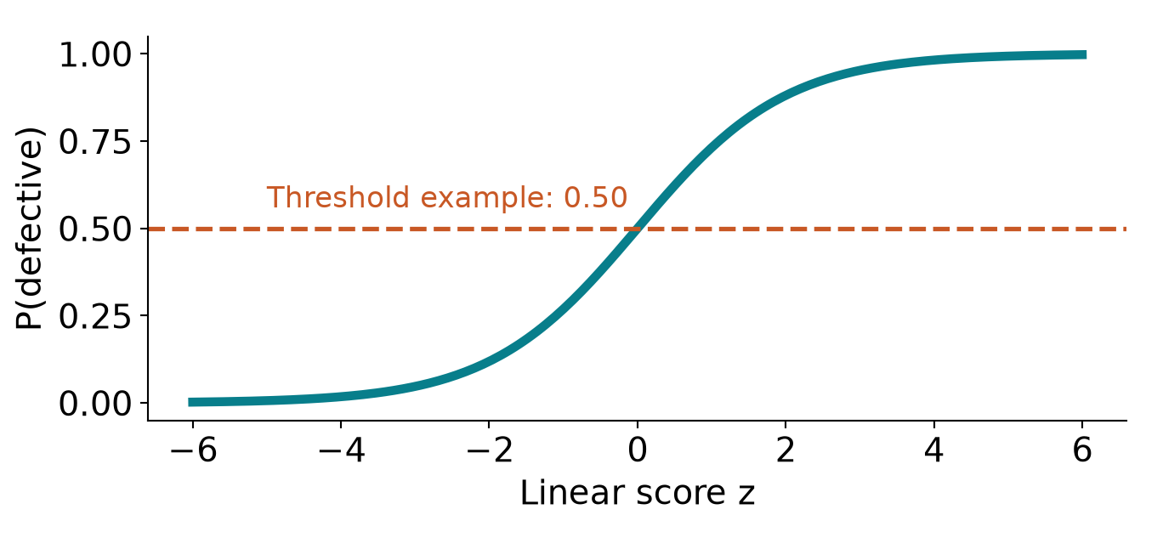
MSBA 265 / PROJECT 2 / CLASSIFICATION
Logistic regression: a transparent first challenger
A linear score becomes a class probability—not an ordinary regression line.
z = b + w dot x
p = 1 / (1 + exp(-z))
Train with log loss
Choose a threshold
Scale / encode / impute
Prediction: probability. Action: thresholded label. Neither implies causation.
MSBA 265 | Original teaching visuals | Sources: S13 S10
09
Notes:
SLIDE 9: Logistic regression: a transparent first challenger

Slide 10
MSBA 265 / PROJECT 2 / CLASSIFICATION
Decision trees: learn a sequence of questions
Nonlinear rules can emerge without scaling the feature axes.
Texture score > 0.6?
NO
YES
Edge density > 0.4?
Likely defect
Likely normal
Inspect further
Illustrative rules only. Limit tree depth and verify held-out performance.
MSBA 265 | Original teaching visuals | Sources: S2
10
Notes:
SLIDE 10: Decision trees: learn a sequence of questions

Slide 11
MSBA 265 / PROJECT 2 / CLASSIFICATION
Random forest versus gradient boosting
Many independent trees reduce variance; sequential trees improve a loss.
RANDOM FOREST
GRADIENT BOOSTING
Different samples + feature subsets
Aggregate many trees
A robust nonlinear benchmark
Add trees sequentially
Follow the remaining loss gradient
A strong tabular candidate
MSBA 265 | Original teaching visuals | Sources: S2
11
Notes:
SLIDE 11: Random forest versus gradient boosting

Slide 12
MSBA 265 / PROJECT 2 / CLASSIFICATION
Today's practical tabular toolkit
These are strong candidates—not a global ranking.
Tool | Why consider it? | What you still configure
XGBoost (trees) | Boosting; learned missing-value routes | Categorical mode, tuning, memory
LightGBM | Histogram boosting; efficient large-table candidate | Category declarations; leaf complexity
CatBoost | Native categorical-feature processing | Declare categories; missing-category policy
HistGradientBoosting | scikit-learn boosting; missing values | Supported category dtype/settings; tuning
Random forest | Accessible nonlinear comparison | Depth, leaf size, estimator input support
Exact library support varies. Validate the pinned estimator and its input schema.
MSBA 265 | Original teaching visuals | Sources: S2 S3 S4 S5
12
Notes:
SLIDE 12: Today's practical tabular toolkit

Slide 13
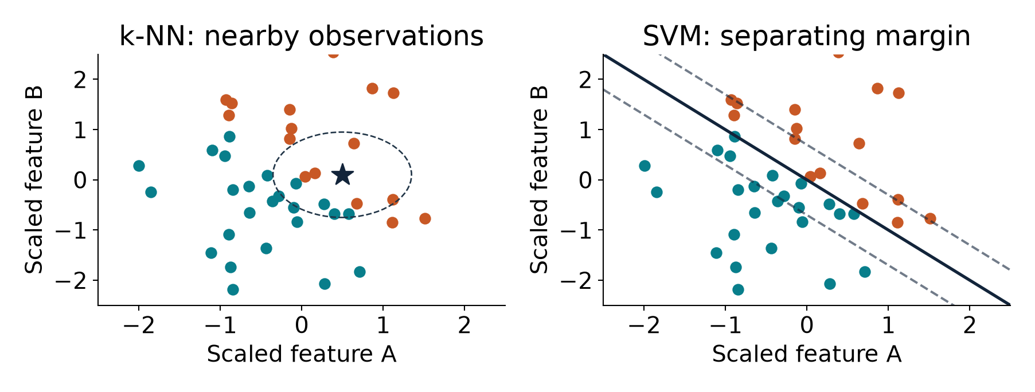
MSBA 265 / PROJECT 2 / CLASSIFICATION
k-NN and SVM: geometry matters
If distances or margins drive the model, scale and representation matter.
k-NN: meaningful distances | Linear SVM: sparse features | Kernel SVM: modest data size
MSBA 265 | Original teaching visuals | Sources: S12
13
Notes:
SLIDE 13: k-NN and SVM: geometry matters

Slide 14
MSBA 265 / PROJECT 2 / CLASSIFICATION
Text baselines are not obsolete
TF-IDF + a linear classifier can be fast, useful, and auditable.
TEXT
FEATURES
MODEL
LABEL
A support message
>
Words / n-grams -> TF-IDF
>
Logistic / linear SVM / NB
>
Billing / delivery / refund
Keep the business question connected to every technical step.
MSBA 265 | Original teaching visuals | Sources: S9 S14
14
Notes:
SLIDE 14: Text baselines are not obsolete

Slide 15
MSBA 265 / PROJECT 2 / CLASSIFICATION
Images: engineered features, CNNs, or transformers?
Representation choice can matter more than the classifier at the end.
ENGINEERED FEATURES
CNN
VISION TRANSFORMER
Color / texture / edges
Small feature matrix
Fast classical baselines
ResNet / EfficientNet families
Local filters + learned features
Image tensors
Patches + attention
Image tensors through processor
Pretrained checkpoint recommended
MSBA 265 | Original teaching visuals | Sources: S6 S7 S17
15
Notes:
SLIDE 15: Images: engineered features, CNNs, or transformers?

Slide 16
MSBA 265 / PROJECT 2 / CLASSIFICATION
Transfer learning: borrow features, learn the task
Start with a frozen encoder; fine-tune only if validation justifies it.
IMAGE
ENCODER
HEAD
OUTPUT
Checkpoint preprocessing
>
Pretrained features
>
Task-specific classifier
>
Our labels, not old labels
Keep the business question connected to every technical step.
MSBA 265 | Original teaching visuals | Sources: S6 S7
16
Notes:
SLIDE 16: Transfer learning: borrow features, learn the task

Slide 17
MSBA 265 / PROJECT 2 / CLASSIFICATION
Modern foundation models: useful, not magic
Zero-shot is a hypothesis to test—not a substitute for labeled evaluation.
PRETRAINED EMBEDDINGS
CLIP-STYLE ZERO-SHOT
TASK FINE-TUNING
Train a small classifier
Reuse a representation
Validate domain fit
Compare image/text embeddings
Candidate label prompts
Test prompt sensitivity
Adapt to labeled examples
Image or text transformers
Budget compute + monitor overfit
MSBA 265 | Original teaching visuals | Sources: S8 S9 S11
17
Notes:
SLIDE 17: Modern foundation models: useful, not magic

Slide 18
MSBA 265 / PROJECT 2 / CLASSIFICATION
What can an algorithm handle for us?
Built-in capabilities reduce work; they do not remove responsibility.
Capability | Helpful candidate | Still our responsibility
Nonlinear interactions | Trees / ensembles / neural models | Enough examples; regularization; valid labels
Numeric missing values | Supported boosting estimators | Meaning of missingness; sentinels; drift
Categorical representation | CatBoost / configured categorical boosting | Schema, missing categories, unseen values
Small labeled image set | Pretrained encoder / transfer learning | Domain evaluation; split; image resolution
Imbalanced classes | Weights / sampling / threshold tools | Rare-class metrics; costs; probability checks
Exact library support varies. Validate the pinned estimator and its input schema.
MSBA 265 | Original teaching visuals | Sources: S1 S2 S3 S4 S5 S6
18
Notes:
SLIDE 18: What can an algorithm handle for us?

Slide 19
MSBA 265 / PROJECT 2 / CLASSIFICATION
Preprocessing depends on the model
Required input preparation is not the same as optional optimization.
Candidate | Expected input | Usually prepare first
Logistic / SVM / k-NN | Numeric dense or supported sparse features | Encode; impute; scale numeric features
Tree / random forest | Numeric or supported encoded features | Encode as needed; validate NaN support; no usual scaling
Categorical boosting | Declared categories + numerical features | Library-specific types; missing/unseen policy; no usual scaling
Multinomial Naive Bayes | Nonnegative counts / common TF-IDF vectors | Train vocabulary; retain sparse format; no centering
Pretrained CNN / ViT | Pixel tensors matching checkpoint | Decode; channels; size; dtype/range; checkpoint normalization
Exact library support varies. Validate the pinned estimator and its input schema.
MSBA 265 | Original teaching visuals | Sources: S1 S3 S6 S12 S13
19
Notes:
SLIDE 19: Preprocessing depends on the model
.html

Slide 20
MSBA 265 / PROJECT 2 / CLASSIFICATION
A reusable tabular preprocessing pipeline
Learn the preparation once—from training rows—and reuse it.
NUMERIC
Train-fitted imputer -> scaler
JOIN
features
FIT
classifier
CATEGORICAL
Missing policy -> encoder
Common logistic workflow: ColumnTransformer -> Pipeline -> cross-validation.
MSBA 265 | Original teaching visuals | Sources: S1 S3
20
Notes:
SLIDE 20: A reusable tabular preprocessing pipeline

Slide 21
MSBA 265 / PROJECT 2 / CLASSIFICATION
Text preprocessing: keep the meaning
Choose either a vocabulary pipeline or the checkpoint's tokenizer.
TF-IDF ROUTE
TRANSFORMER ROUTE
BOTH ROUTES
Learn vocabulary on train
Consider n-grams + negation
Choose stop words deliberately
Use matching tokenizer
Padding + attention mask
Explicit truncation / chunking
Audit language + duplicates
Protect sensitive content
Keep document groups together
MSBA 265 | Original teaching visuals | Sources: S1 S9 S14
21
Notes:
SLIDE 21: Text preprocessing: keep the meaning

Slide 22


MSBA 265 / PROJECT 2 / CLASSIFICATION
Messy images: audit before you transform
Separate the real defect from the way the camera captured it.
SCRATCH?
GLARE?
BLUR?
Target signal
Acquisition variation
Detail may be missing
SIMULATED teaching illustrations—not dataset samples or model predictions.
MSBA 265 | Original teaching visuals | Sources: course synthesis
22
Notes:
SLIDE 22: Messy images: audit before you transform

Slide 23


MSBA 265 / PROJECT 2 / CLASSIFICATION
Resizing can erase the evidence
Choose resolution and geometry using the smallest important feature.
ORIGINAL
DOWNSAMPLED
CENTER CROP
Small defect near the edge
Fine detail becomes ambiguous
The defect is outside this crop
SIMULATED teaching illustrations—not dataset samples or model predictions.
MSBA 265 | Original teaching visuals | Sources: S6 S7 S16
23
Notes:
SLIDE 23: Resizing can erase the evidence

Slide 24
MSBA 265 / PROJECT 2 / CLASSIFICATION
Pixels need a contract
Shape, color order, dtype, range, and normalization must match.
DECODE + SHAPE
VALUES
CHECKPOINT
RGB vs grayscale / alpha
Orientation + dimensions
Batch: N x C x H x W*
uint8: often 0..255
float: often scaled to 0..1
Check before normalizing
Use documented size + mean/std
Avoid double rescaling
Same contract at inference
MSBA 265 | Original teaching visuals | Sources: S6 S7 S16 S17
24
Notes:
SLIDE 24: Pixels need a contract

Slide 25

MSBA 265 / PROJECT 2 / CLASSIFICATION
Augmentation: vary the view, preserve the label
Simulate plausible acquisition changes—not impossible biology or physics.
ORIGINAL
FLIP
LIGHT VARIATION
Keep the defect visible
Valid only if orientation allows
Check physical plausibility
SIMULATED teaching illustrations—not dataset samples or model predictions.
MSBA 265 | Original teaching visuals | Sources: S6 S16
25
Notes:
SLIDE 25: Augmentation: vary the view, preserve the label

Slide 26

MSBA 265 / PROJECT 2 / CLASSIFICATION
Segmentation: move the image and mask together
A one-pixel annotation error can become a misleading training target.
IMAGE
MASK
OVERLAY
Pixel intensities
Integer class IDs
Verify spatial alignment
SIMULATED teaching illustrations—not dataset samples or model predictions.
MSBA 265 | Original teaching visuals | Sources: S16
26
Notes:
SLIDE 26: Segmentation: move the image and mask together

Slide 27
MSBA 265 / PROJECT 2 / CLASSIFICATION
The most dangerous shortcut: leakage
Split by the unit that must be new at deployment.
SAME ITEM
FUTURE DATA
LEARNED PREPARATION
Adjacent frames / near duplicates
Group by item or capture sequence
Changing process or season
Use a chronological holdout
Scaler / vocabulary / sampler
Fit only in the training partition
MSBA 265 | Original teaching visuals | Sources: S1
27
Notes:
SLIDE 27: The most dangerous shortcut: leakage

Slide 28
MSBA 265 / PROJECT 2 / CLASSIFICATION
Rare defects make accuracy deceptive
A 99% accurate model can detect none of the failures.
99% accuracy
Always predict NORMAL
990 correct / 1,000
0 of 10 defects detected
100 icons represent 1,000 items; orange = 10 defects
Majority baseline: high accuracy, zero defect recall. Illustration, not measured results.
MSBA 265 | Original teaching visuals | Sources: S10 S11 S15
28
Notes:
SLIDE 28: Rare defects make accuracy deceptive

Slide 29
MSBA 265 / PROJECT 2 / CLASSIFICATION
Confusion matrix: name each kind of mistake
Positive class = defective. Rows are actual; columns are predicted.
PREDICTED: NORMAL DEFECT
ACTUAL
NORMAL
TN 900
Good item passes
FP 50
Good item flagged
1,000 items total
50 actual defects
80 predicted alerts
Positive class: DEFECT
ACTUAL
DEFECT
FN 20
Defect missed
TP 30
Defect caught
Illustrative counts. Always state the positive class and label both axes.
MSBA 265 | Original teaching visuals | Sources: S15
29
Notes:
SLIDE 29: Confusion matrix: name each kind of mistake

Slide 30
MSBA 265 / PROJECT 2 / CLASSIFICATION
Precision, recall, F1: different questions
Report the metric that matches the action—and show the counts.
PRECISION
RECALL
F1
TP / (TP + FP)
30 / 80 = 37.5%
Of alerts, how many are real?
TP / (TP + FN)
30 / 50 = 60.0%
Of defects, how many are caught?
2PR / (P + R)
60 / 130 = 46.2%
Harmonic balance, not business cost
MSBA 265 | Original teaching visuals | Sources: S15
30
Notes:
SLIDE 30: Precision, recall, F1: different questions

Slide 31
MSBA 265 / PROJECT 2 / CLASSIFICATION
Choose thresholds with business costs
The same probability model can produce different operating decisions.
THRESHOLD 0.50
THRESHOLD 0.20
FP = 50; FN = 20
$5 x 50 + $100 x 20
TOTAL: $2,250
FP = 150; FN = 5
$5 x 150 + $100 x 5
TOTAL: $1,250
Assumed costs: false positive $5; false negative $100. Illustrative validation results.
MSBA 265 | Original teaching visuals | Sources: S10
31
Notes:
SLIDE 31: Choose thresholds with business costs

Slide 32
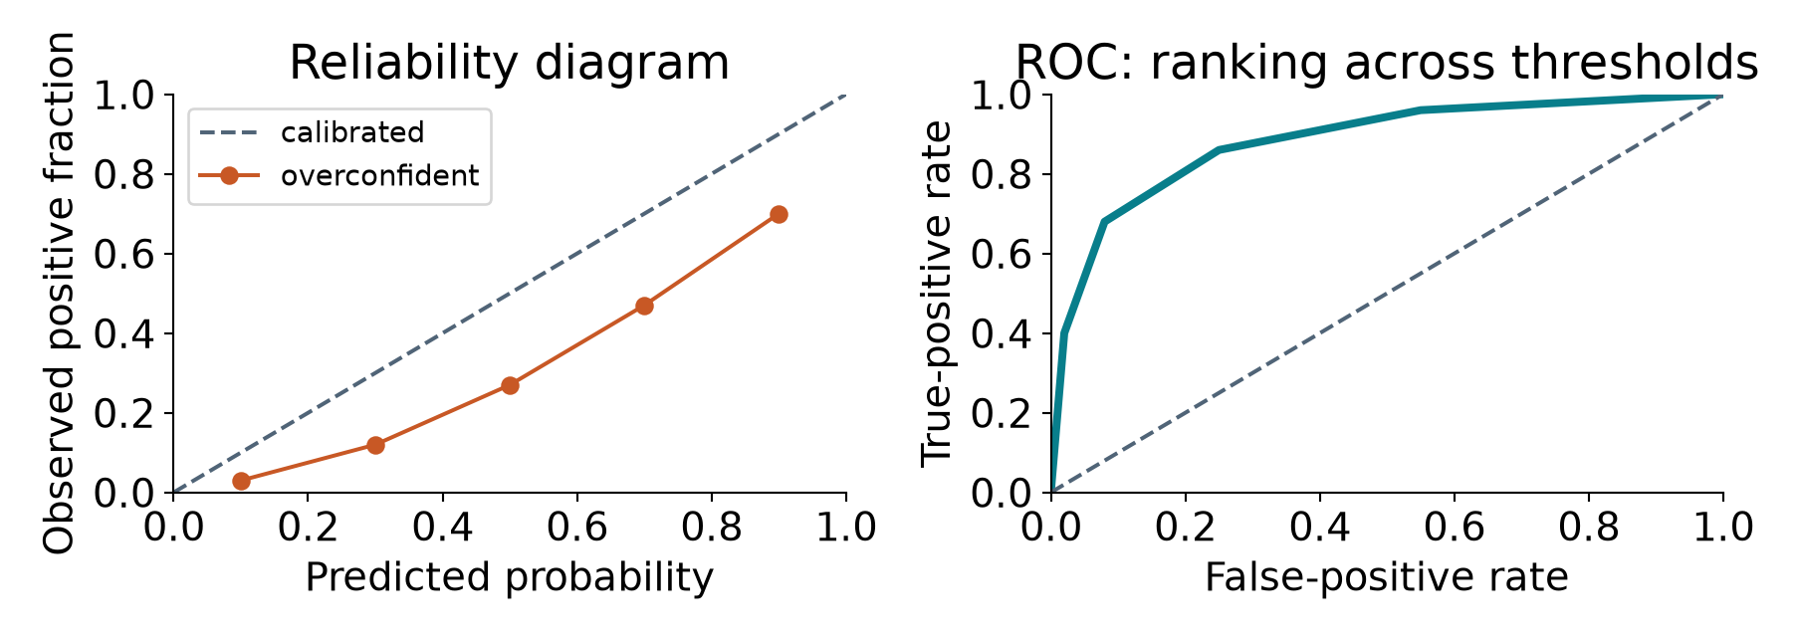
MSBA 265 / PROJECT 2 / CLASSIFICATION
Ranking is not calibration
A strong ROC curve does not prove that '80%' means 80%.
Conceptual curves: ranking, operating threshold, and calibration are different questions.
MSBA 265 | Original teaching visuals | Sources: S11 S15
32
Notes:
SLIDE 32: Ranking is not calibration

Slide 33
MSBA 265 / PROJECT 2 / CLASSIFICATION
The error gallery is a diagnostic tool
Look at mistakes by class, camera, lighting, and defect size.
FALSE POSITIVES
FALSE NEGATIVES
AFTER DEPLOYMENT
Glare mistaken for damage?
Background shortcut?
Incorrect annotation?
Tiny defect lost in resize?
Blur / unusual material?
Label or representation gap?
New camera / supplier?
Changing prevalence?
Review queue + drift monitoring
MSBA 265 | Original teaching visuals | Sources: S1 S11
33
Notes:
SLIDE 33: The error gallery is a diagnostic tool

Slide 34
MSBA 265 / PROJECT 2 / CLASSIFICATION
Three use cases, three defensible starting points
Explain your shortlist before you train it.
CHURN TABLE
SUPPORT MESSAGES
PRODUCT INSPECTION
Explainable first benchmark
Logistic + boosted trees
Encoding + missingness + costs
Fast text routing
TF-IDF linear model; transformer comparison
Vocabulary / tokenizer + document split
Small labeled image set
Features + logistic; pretrained encoder
Resolution + item groups + defect recall
MSBA 265 | Original teaching visuals | Sources: S2 S6 S9 S13 S14
34
Notes:
SLIDE 34: Three use cases, three defensible starting points

Slide 35
MSBA 265 / PROJECT 2 / CLASSIFICATION
Our Project 2 bridge: classification first
Lecture -> guided image lab -> independent assignment.
AUDIT
BASELINE
COMPARE
EXTEND
Real images + labels
>
Features + classifier
>
Pretrained representation
>
Masks -> segmentation?
Keep the business question connected to every technical step.
MSBA 265 | Original teaching visuals | Sources: course synthesis
35
Notes:
SLIDE 35: Our Project 2 bridge: classification first

Slide 36
MSBA 265 / PROJECT 2 / CLASSIFICATION
Before leaving: defend the whole workflow
Algorithm choice is only one part of the answer.
CHECK 1
CHECK 2
CHECK 3
Model accepts NaN.
Does that make the data trustworthy?
99% accuracy, rare defects.
What must we ask next?
Crop then classify.
Can the label change?
MSBA 265 | Original teaching visuals | Sources: S1 S10 S15
36
Notes:
SLIDE 36: Before leaving: defend the whole workflow

Slide 37
MSBA 265 / PROJECT 2 / CLASSIFICATION
Sources: algorithms and representations
Official documentation consulted October 4, 2026; not a benchmark ranking.
S2 scikit-learn: ensemble methods and HistGradientBoosting
S3 CatBoost: categorical features
S4 XGBoost: missing values and categorical support
S5 LightGBM: missing and categorical features
S6 PyTorch: transfer learning for computer vision
S7 Hugging Face: ViT image classification and preprocessing
S8 Hugging Face: CLIP and zero-shot image classification
S9 Hugging Face: transformer text classification
S17 Torchvision: pretrained model families and input contracts
MSBA 265 | Original teaching visuals | Sources: course synthesis
37
Notes:
SLIDE 37: Sources: algorithms and representations

Slide 38
MSBA 265 / PROJECT 2 / CLASSIFICATION
Sources: preparation and trustworthy evaluation
Original diagrams and simulated image illustrations; no third-party photos.
S1 scikit-learn: leakage and consistent preprocessing
S10 scikit-learn: choosing a decision threshold
S11 scikit-learn: probability calibration
S12 scikit-learn: SVMs, margins, and computational tradeoffs
S13 scikit-learn: logistic regression
S14 scikit-learn: text feature extraction
S15 scikit-learn: classification evaluation metrics
S16 Torchvision: transforms and joint image/mask transformations
MSBA 265 | Original teaching visuals | Sources: course synthesis
38
Notes:
SLIDE 38: Sources: preparation and trustworthy evaluation

