Slide 1
Explore IDE’s & File Handling

Slide 2
Integrated Development Environments (IDE)
PyCharm (feature-rich, free community version, paid professional)
Spyder (designed for data science, advanced features for scientific computing)
Thonny (beginner friendly, simplified interface)
IDLE (default free comes with Python)
Visual Studio Code (customizable and powerful IDE with excellent Python support through extensions)
Jupyter Notebook (NOT and IDE, popular interactive environment for Python, especially in data science and machine learning)
etc

Slide 3
Agenda
Intro to IDLE
How to use the interactive shell
Use shell with source code
Compilation from the editor window
Syntax and runtime errors

Slide 4

Intro to IDLE

Slide 5
IDLE
Included in the Python distributions for Windows and macOS and can easily be installed on Linux
Last name of Eric Idle, one of the founding members of the Monty Python comedy club

Slide 6

How to use the interactive shell
Get comfy, use the language, practice and exercise

Slide 7
How to use the interactive shell
Easy to enter and test Python statements without writing full programs.
Start the shell (search in your computer for IDLE and open)
Notice it displays some version and copywrite info followed by it’s prompt >>>
At this prompt you can type any Python code that you want
Then, when you press the enter key, Python runs the code, displays the results if there are any, and displays another prompt.

Slide 8
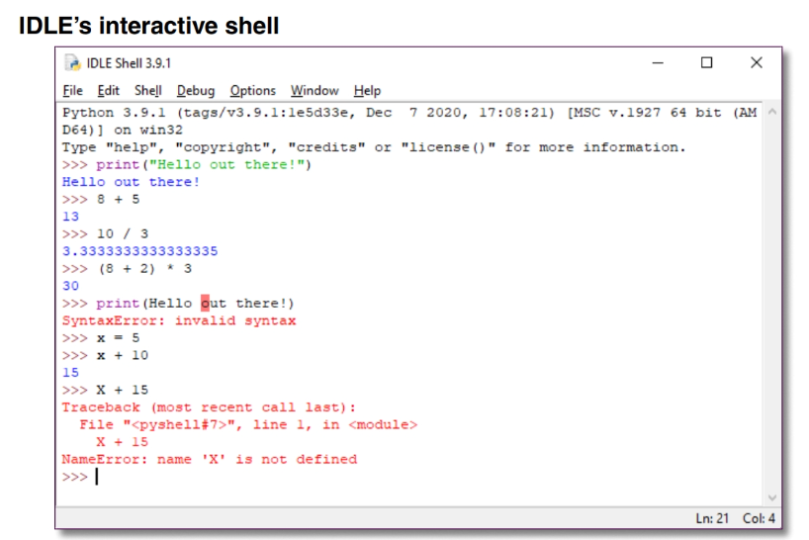
1.
The first prompt executes a print function that prints “Hello out there!” to the console.
2.
This displays the characters coded within the quotation marks immediately after the prompt.

Slide 9
3.
The second ..... ……… evaluates arithmetic expressions and
4.
This displays the result of the expression ……….. After the ……

Slide 10
5.
The ….. ..... ……… evaluates another ……….. expression
6.
This …….. the …… of the expression ……….. After the ……

Slide 11
7.
8.

Slide 12
9.
The fifth prompt executes another print() function. However, this print() function does not include quotation marks around the characters, and those quotation marks are required.
10.
As a result, the shell displays an error message for a SyntaxError that says “invalid syntax”

Slide 13
11.
The next two prompts show what happens when you set a variable named x equal to 5 and then add 10 to that variable.
12.
The result is 15.

Slide 14
11.
The last statement attempts to 15 to X. This displays a NameError message that says “name ‘X’ is not defined”. That’s because variables names are case sensitive, so x and X refer to two different variables. The variable named x has been defined earlier in the session, but the variable named X has not been defined yet in this session.

Slide 15
Use the interactive shell to work with source files

Slide 16

Train your motors kills
Close your IDLE and start over
Reopen the IDLE

Slide 17

Working with the IDLE and a source file/ source code
Download the file “future_value.py” from canvas week 1
Use the IDLE shell to open this downloaded file.
Source code defined: In programming, a source file is a plain text file that contains the instructions, logic, and algorithms that make up a program. It's essentially the code written by a programmer, in a human-readable format, that is then translated into a machine-executable format (like binary or object code) by a compiler or interpreter.

Slide 18
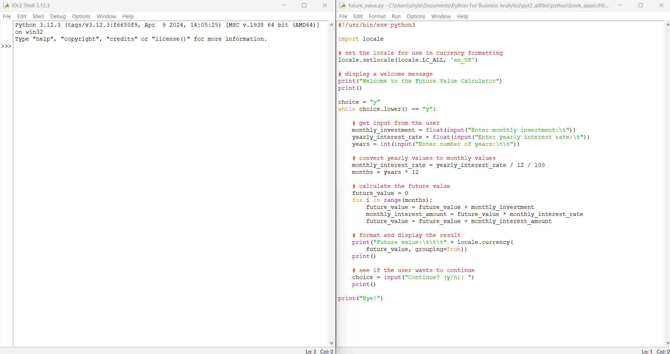
IDLE’s editor window

Slide 19
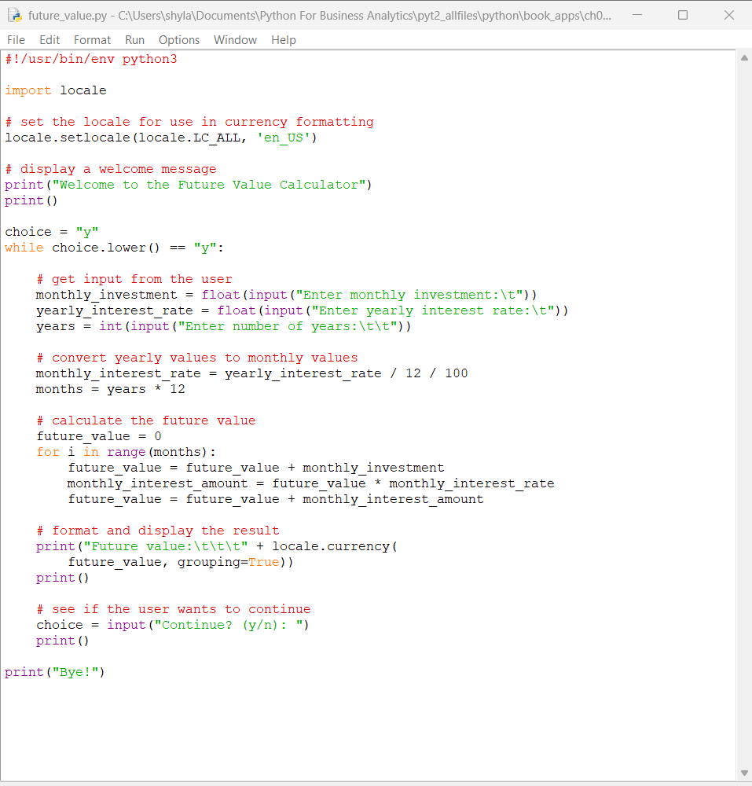
The Editor
The editor works as a simple word processor (Microsoft Word, Text, Notepad, etc)
You may edit the source code for a program using same techniques.
  Examples: Ctrl+X, Ctrl+C, Ctrl+V, Ctrl+Z, etc.
  Commands in File menu
  Check out edit and format
  Save as

Slide 20
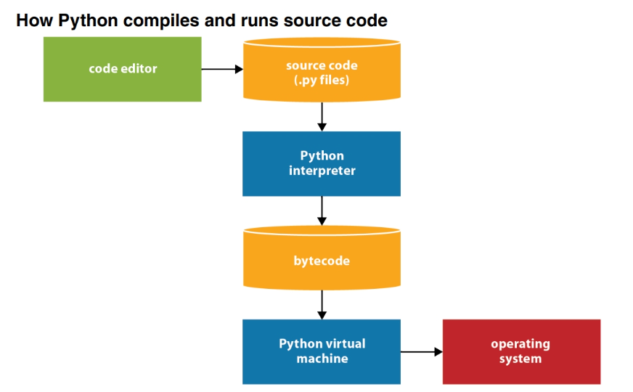
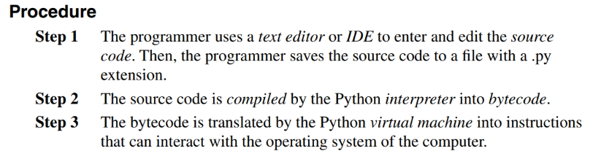
Compile and run a program
Simply press F5 key
  Python compiles the source code into bytecode and runs it (it’s ran the computers operating system).
The compilation process is done automatically with the push of a key when you are using an IDE to develop your Python programs

Slide 21
Fix syntax & runtime errors
Write the code for a program, then test the program.
Goal of testing a program:
  Find all of the errors (or bugs) in the program.
  Whenever you find a bug, you need to debug it or fix it.
The process looks like: Test>>Fix>>Test>>Fix (until you finish debugging the entire program)

Slide 22
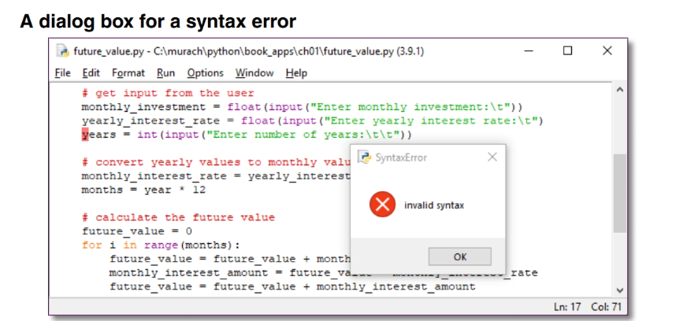
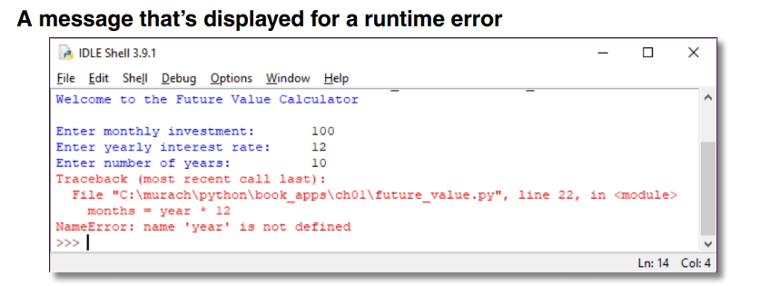
Fix syntax & runtime errors
Two types of errors:
  Syntax error: Errors that occur because Python coding rules have been violated. As a result, the program can not be compiled.
  Runtime error: occurs after all the code has compiled cleanly and the program is being executed. Then an error message is displayed that helps you identify the cause of the error. This type of error is also known as an exception.
Notes:
The first example shows the dialog box that’s displayed when a syntax error is detected. In addition, the point at which the error was detected is highlighted in the source code. Keep in mind, though, that the error may not be exactly at that point. In fact, it is likely to be in the previous statement. In this example, the error occurs because the statement before the highlighted statement should end with another right parenthesis.
When an exception occurs, the program ends, or “crashes,” unless the
exceptions are handled by the program. You’ll learn how to handle the exceptions that occur so your programs won’t crash if we have time. However, you can often prevent exceptions from occurring in the first place by fixing the code that caused the exception. (Chapter 8)

Slide 23
Final tips & takeaways
Coming to the end of the intro
IDLE is the default integrated development environment for Python.
The shell is a great place to run quick Python statements whereas the editor window is more for writing and developing Python programs.
When developing programs you may run into different types of errors/bugs, these all need fixing before coming to a successful completion.

Slide 24
Begin in class exercises!

Slide 25
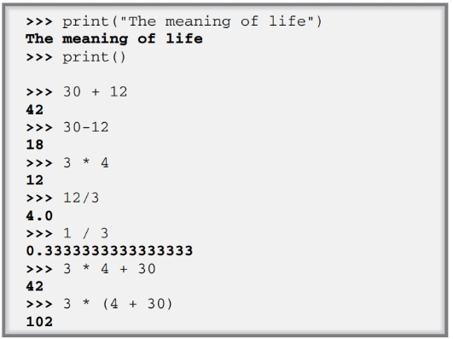
Experiment with IDLE’s interactive shell
Start IDLE. That should display a window for the interactive shell
Enter the following print functions and arithmetic expressions into the interactive console.
Notes:
Note that
the print() function prints a blank line if you don’t code anything between the parentheses,
the * is used for multiplication in an arithmetic expression,
the spaces before and after arithmetic operators aren’t required, and
parentheses are used just as they are in algebraic expressions. If you make entry errors, the shell should display appropriate error message

Slide 26
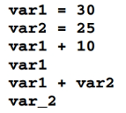
Experiment with IDLE’s interactive shell
Try entering these statements to see how they work
Notes:
Note that
The last one is deliberately incorrect, so it should display an error message.

Slide 27
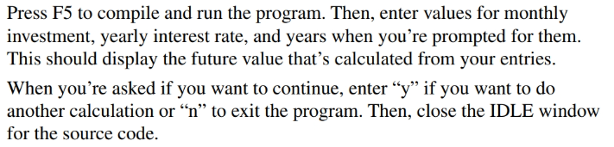
Experiment with IDLE’s interactive shell
Run the Console version of the future value program (download from canvas)
1a.
1b.

Slide 28
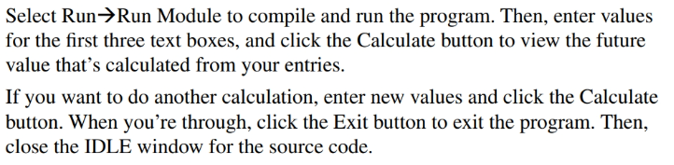
Experiment with IDLE’s interactive shell
Run the GUI version of the future value program (download from Canvas)
1a.
1b.

Slide 29
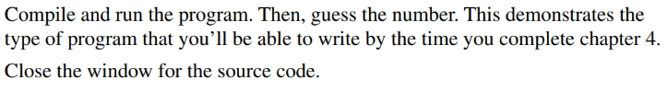
Experiment with IDLE’s interactive shell
Run the guess the number program (download from Canvas)
1a.
1b.

Slide 30
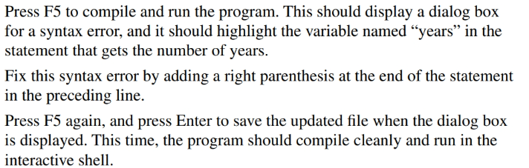
Experiment with IDLE’s interactive shell
Use the IDLE to test and debug a program using “future_value_errors.py” (download from Canvas)
1a.
1b.
1c.

Slide 31
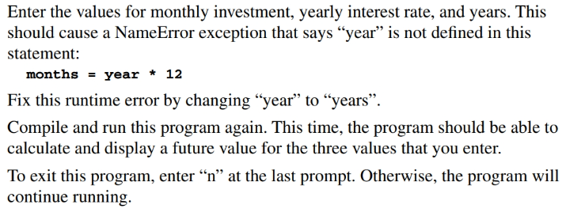
Experiment with IDLE’s interactive shell
Use the IDLE to test and debug a program using “future_value_errors.py” (download from Canvas)
1a.
1b.
1c.
1d.

Slide 32
Challenge
Get assigned one of the Python IDE’s
Create a 2 minute showcase of how to open a source code file
  Show users where the editor window is versus where the console/shell is located within the IDE
  Run/compile the program with a purposeful error included
  Show where users can view the error
  Show how to fix it, rerun the program
  Save the successful program
Turn in source code and link for users to download and install
List of IDE’s:
Spyder
PyCharm
Visual Studio Code
Thonny
Next session, first 5 minutes will be used to pair students. Each student will show the other student their assigned IDE and walk through each step with them. (“Show your partner around”)
We will rotate until each member has had a chance to each IDE.

Slide 33
What to expect for upcoming session
Learn how to write your first programs
  Statements, comments, functions
  Assign values to variables
  Name variables
  Code arithmetic expressions
  Assignment in statements
  String data, assign strings, join strings, include special characters in strings
  Print() function, input() function, int(), float(), round(), chain functions
  Introduction to illustrative programs

Slide 34
Thank you
Shyla Solis
209-9862918
ssolis1@pacific.edu

