Slide 1
Basic Coding Skills To Write Your First Program

Slide 2
Agenda
Basic coding skills (statements, comments, functions)
Work with data types and variables (assignment, naming)
Work with numeric data (arithmetic expressions (ae), ae in assignment statements, console for testing numeric operations)
Work string data (assign, join strings, include special characters in strings, use console for testing operations)
Python Functions (print(), input(), int(), float(), etc and chain functions)
Two illustrative programs

Slide 3

Basics

Slide 4
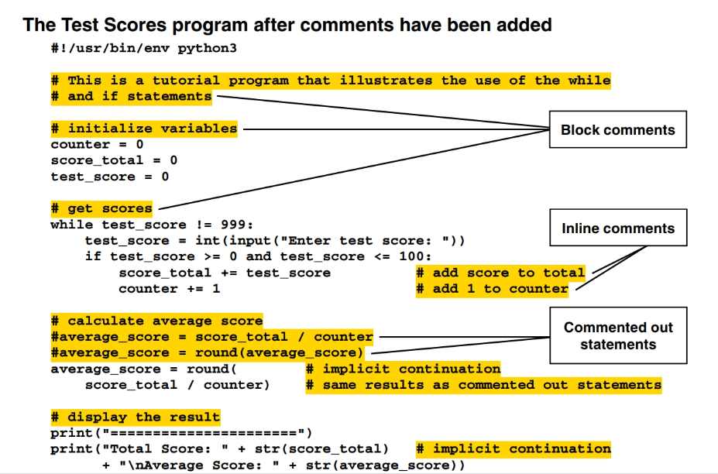
Comments
Inline comments
Block comments
Guidelines for using comments
• describe portions of code that are hard to understand, but don’t overdo them.
• comment out (or disable) statements that you don’t want to test.
• If you change the code that’s described by comments, change the comments too.

Slide 5
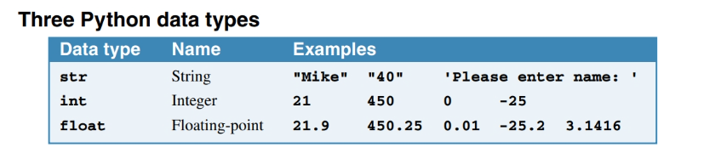



Three basic python data types
Code that initializes variables
Code that assigns new values to the variables above
Code that assigns values to two variables
Code that causes an error because of incorrect case
Notes:
To code a literal value for a string, enclose the characters of the string in single or double quotation marks. This is called a string literal.
To code a literal value for a number, code the number without quotation marks. This is called a numeric literal.
A variable can change, or vary, as code executes. • A data type defines the type of data for a value. • An assignment statement uses the equals sign (=) to assign a value to a variable. The value can be a literal value, another variable, or an expression like the arithmetic expressions in the next figure.
• To initialize a variable, you assign an initial value to it. Then, you can assign different values later in the program.
• You can assign a value of any data type to a variable, even if that variable has previously been assigned a value of a different data type.
• Because variable names are case-sensitive, you must be sure to use the correct case when coding the names of variables.

Slide 6
Initializing variables
To code a literal value for a string, enclose the characters of the string in single or double quotation marks. This is called a string literal.
To code a literal value for a number, code the number without quotation marks. This is called a numeric literal.
To initialize a variable, you assign an initial value to it. Then, you can assign different values later in the program.

Slide 7
A variable
A variable can change, or vary, as code executes.
An assignment statement uses the equals sign (=) to assign a value to a variable. The value can be:
a literal value
another variable, or
an expression like the arithmetic expressions.

Slide 8
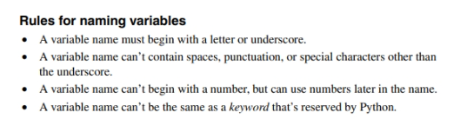

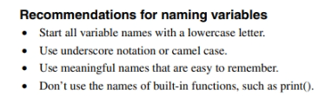
Naming conventions

Slide 9
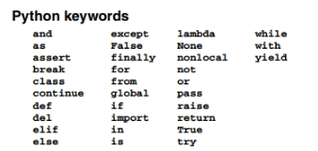
Reserved are the Python Keywords

Slide 10
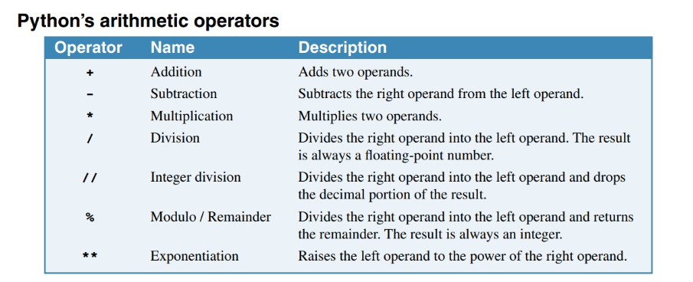
Work with Numeric Data

Slide 11
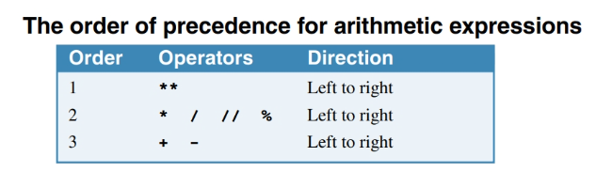
Yes, order matters

Slide 12
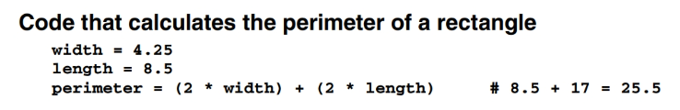
Use arithmetic expressions in assignment statements

Slide 13
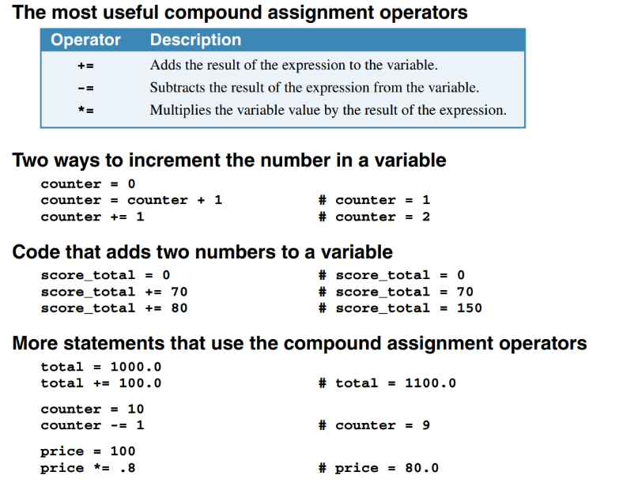
Use arithmetic expressions in assignment statements

Slide 14

Functions
• A function is a reusable unit of code that performs a specific task.
• Python provides many built-in functions that do common tasks like getting input data from the user and printing output data to the console.
• When you call a function, you code the name of the function followed by a pair of parentheses. Within the parentheses, you code any arguments that the function requires, and you separate multiple arguments with commas.
• In a syntax summary like the one at the top of this page, brackets [ ] mark the portions of code that are optional. And the italicized portions of the summary are the ones that you have to supply.

Slide 15
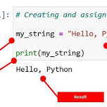
Let’s work with strings

Slide 16
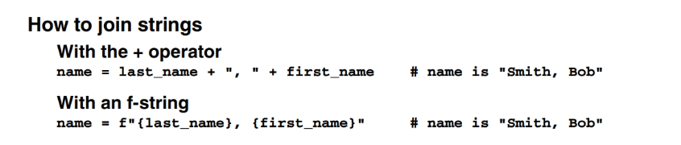
Join Strings

Slide 17
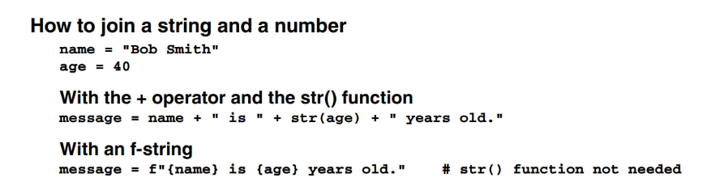
Join Strings Cont’d

Slide 18
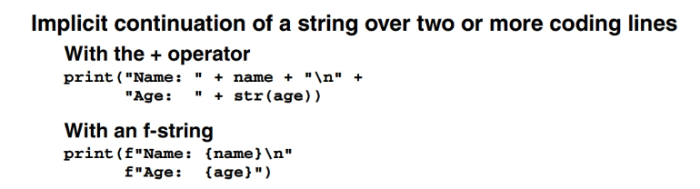
Join Strings Cont’d

Slide 19
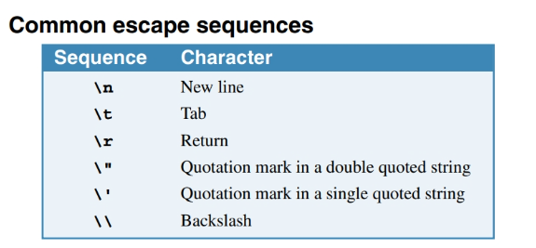
Use escape sequences to include special characters in a string

Slide 20
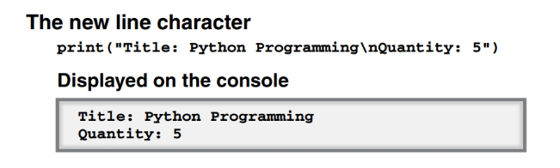
Example:

Slide 21
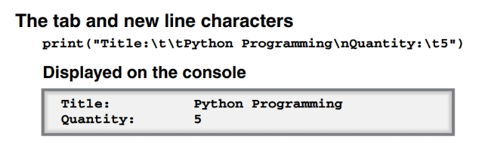
Example:

Slide 22
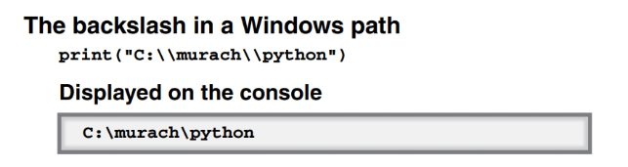
Example:

Slide 23
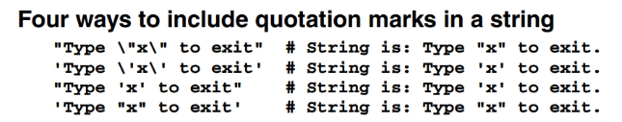
Example:

Slide 24
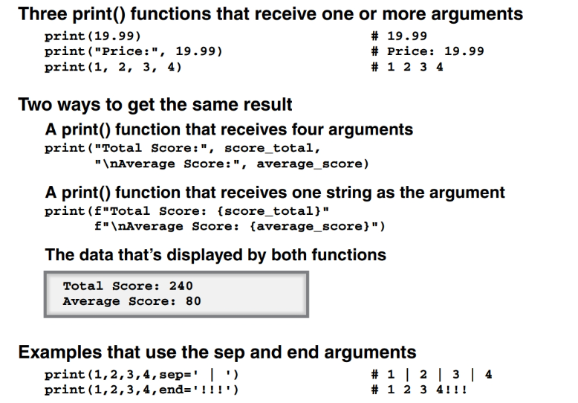
Function called print()

Slide 25
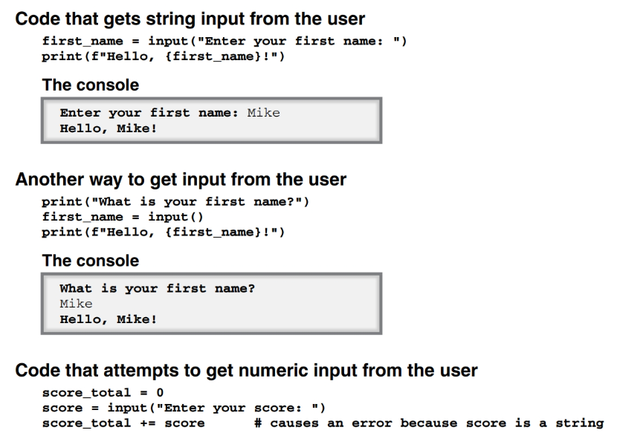
Different ways the input() function can be used
The input() function always returns string data, even if the user enters a number.

Slide 26
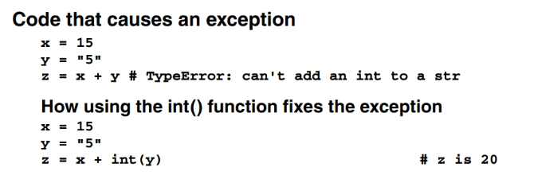
Three functions for working with numbers

Slide 27
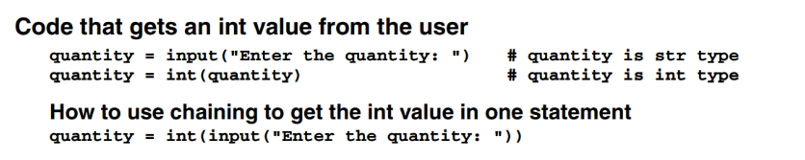
Three functions for working with numbers

Slide 28
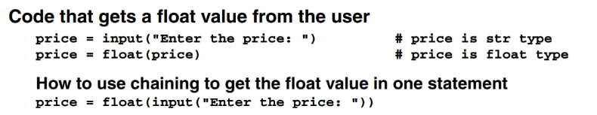
Three functions for working with numbers

Slide 29
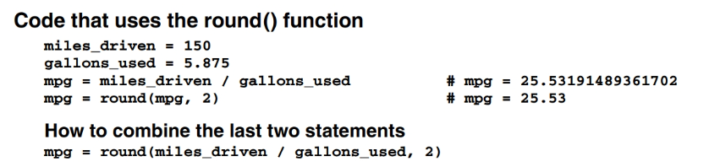
Three functions for working with numbers

Slide 30
Your turn!

Slide 31
Build a program: “Miles Per Gallon Program”
Allow the user to enter two values: the number of miles that were driven and the gallons of gas that were used
The program should calculate and display the miles per gallon.
Force characters displayed to user to be boldfaced.
Display the title of the program to the user
When using the input function to allow the user to respond, include escape sequences for tab characters
Chain the input function with a float() function
Calculate the miles per gallon by dividing miles driven by gallons used.
Round the miles per gallon to two decimal places.
Be creative to display the result to the user (must use a total of 4 print() functions)
Don’t forget to test and debug!

Slide 32
Thank you
Shyla Solis
209-9862918
ssolis1@pacific.edu

