Slide 1
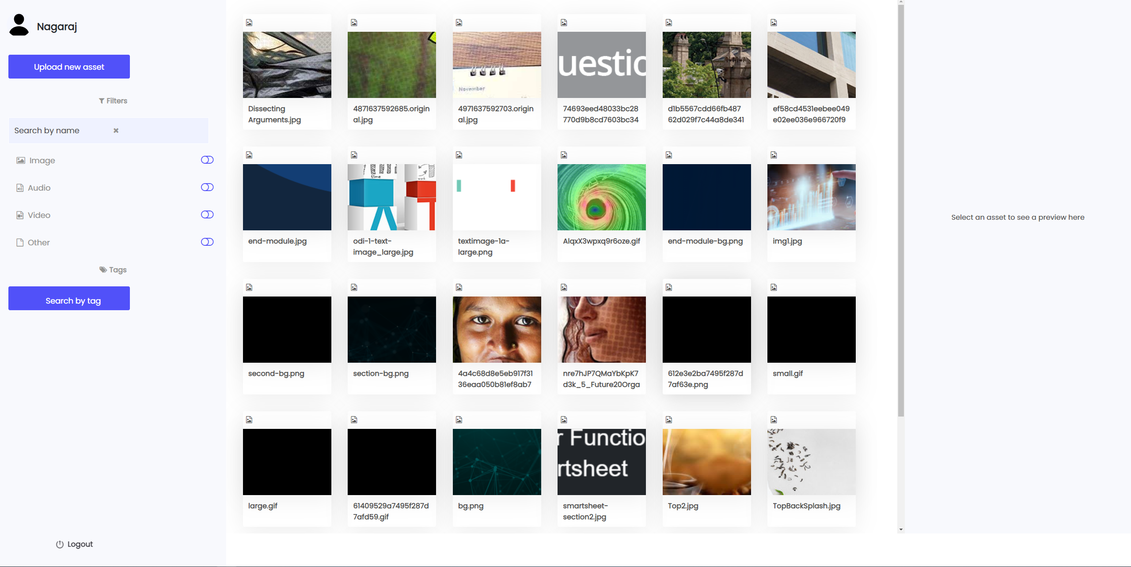
Choose the image here.

Slide 2
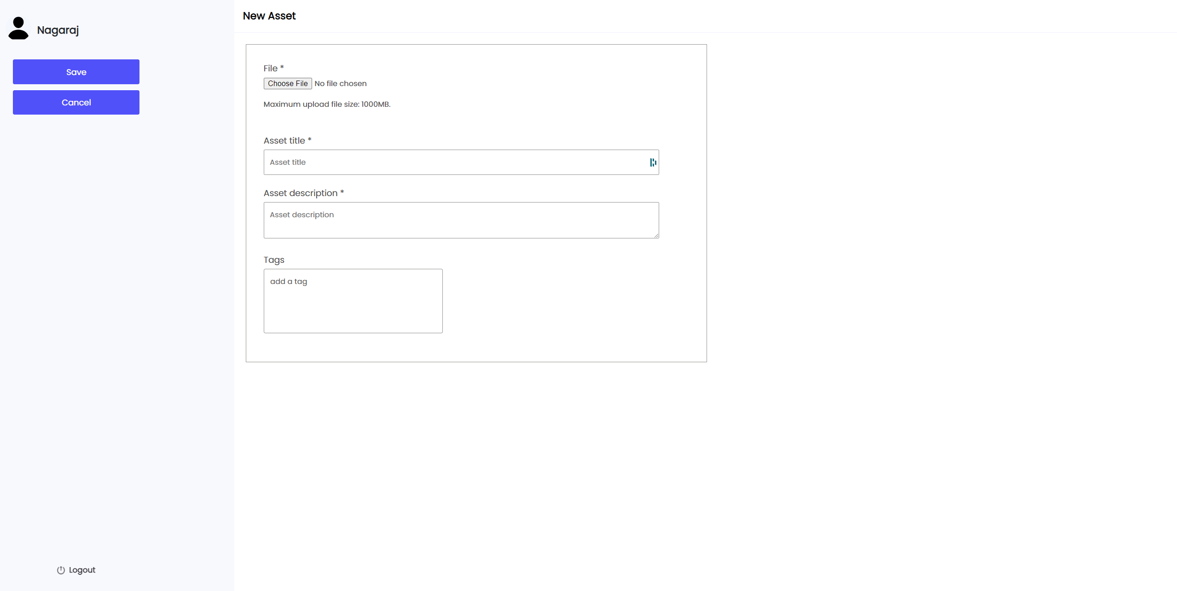
Click here to open up a pop to choose the file type

Slide 3


Choose file type
Video
Image
others
Click here to upload images

Slide 4

X
Image Preview
Click here or drag your image to upload
Type alt-text here
Give me suggestions
Upload image
Cancel
Save & Upload

Slide 5
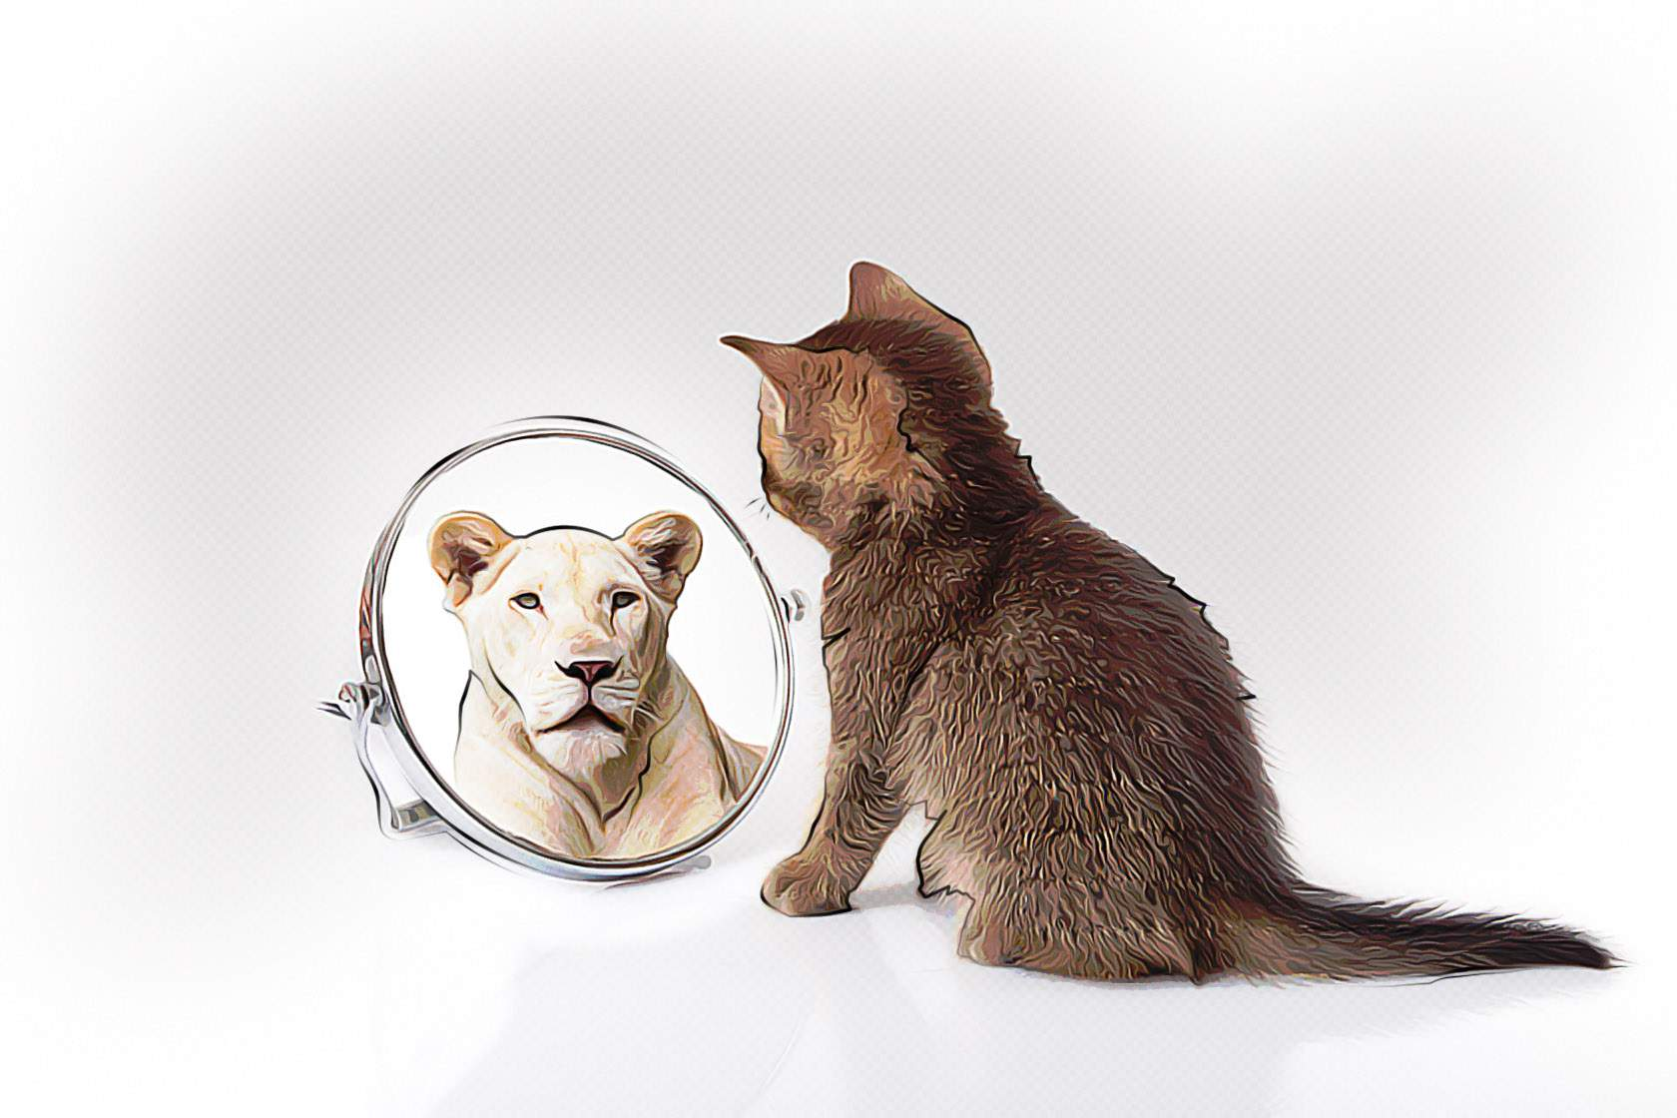


X
Image Preview
Type alt-text here
Give me suggestions
Click here to generate alt-text suggestions.
An illustration of a small to medium-sized cat sitting, with whiskers, snout, and tail.
A carnivore of the Felidae family, looking at its reflection in a mirror.
A depiction of a cat with its whiskers, snout, and tail, gazing at its reflection.
An image of an animal of the Felidae family, observing its reflection in a mirror.
A picture of a cat, with its whiskers, snout, and tail, studying its reflection in a mirror.
Suggestions shown below with scroll bar. Select a suggestion to edit and use the alt-text.
Cancel
Save & Upload

Slide 7
Alt text suggestions box
An illustration of a small to medium-sized cat sitting, with whiskers, snout, and tail.
A carnivore of the Felidae family, looking at its reflection in a mirror.
A depiction of a cat with its whiskers, snout, and tail, gazing at its reflection.
An image of an animal of the Felidae family, observing its reflection in a mirror.
A picture of a cat, with its whiskers, snout, and tail, studying its reflection in a mirror.
Edit and choose suitable all text

Slide 8
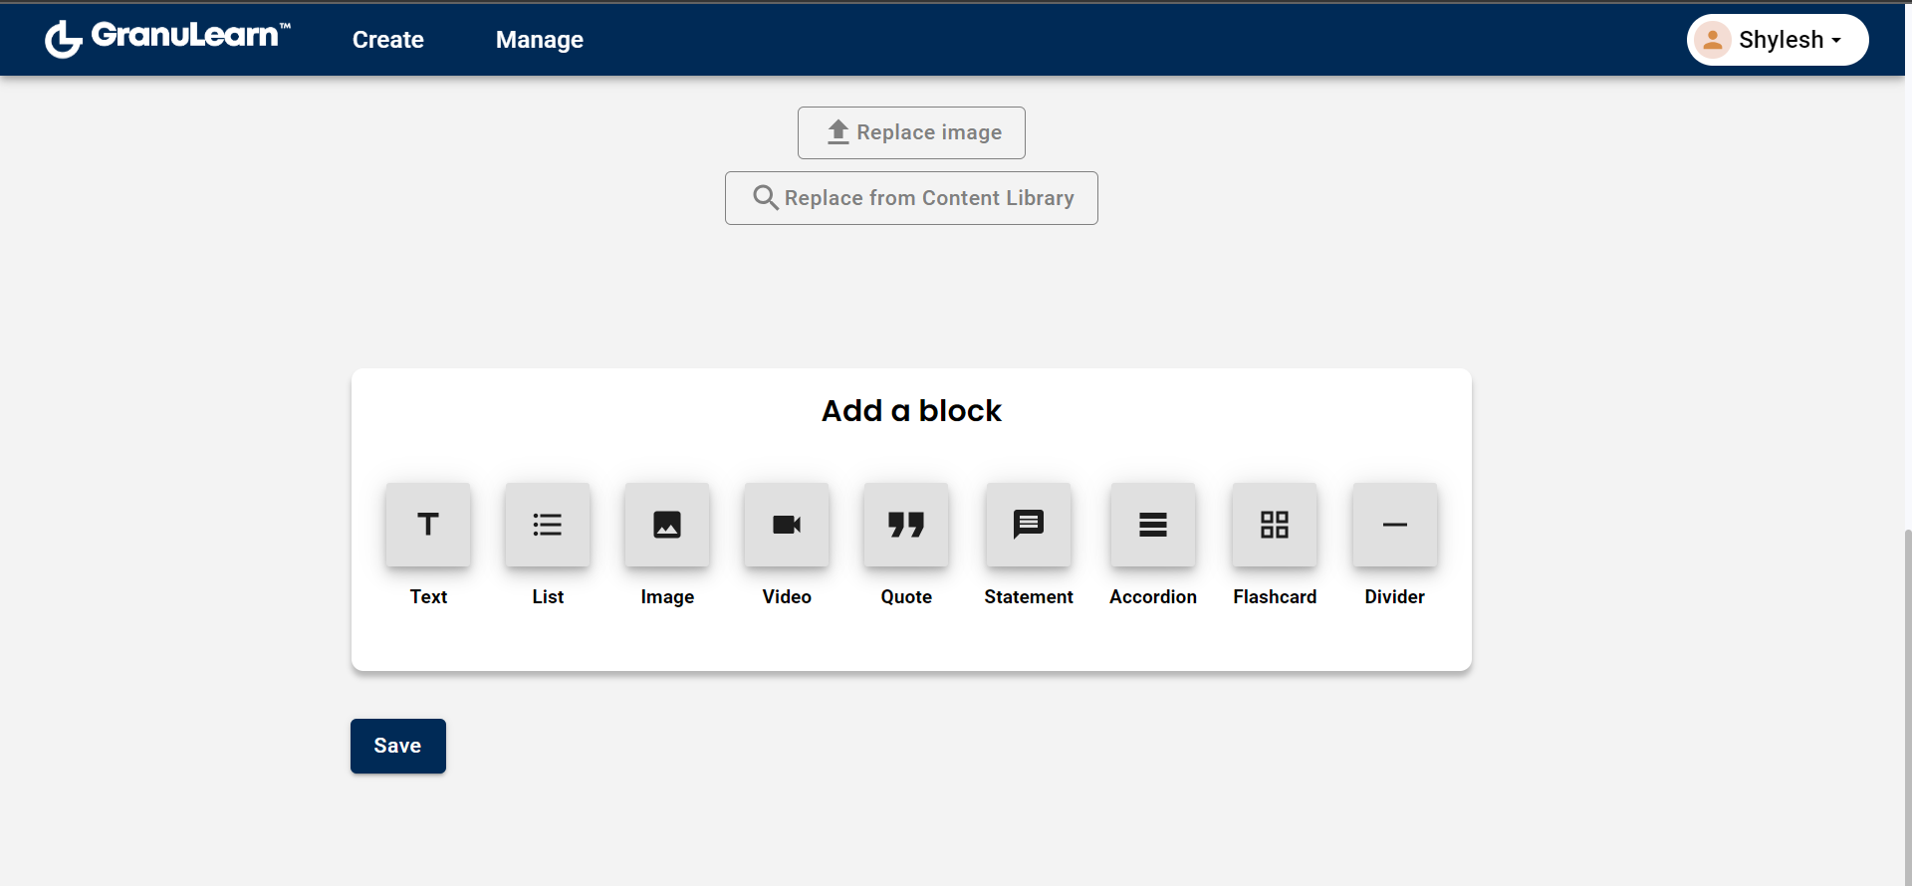
Click here to choose image for alt text generation.

Slide 9
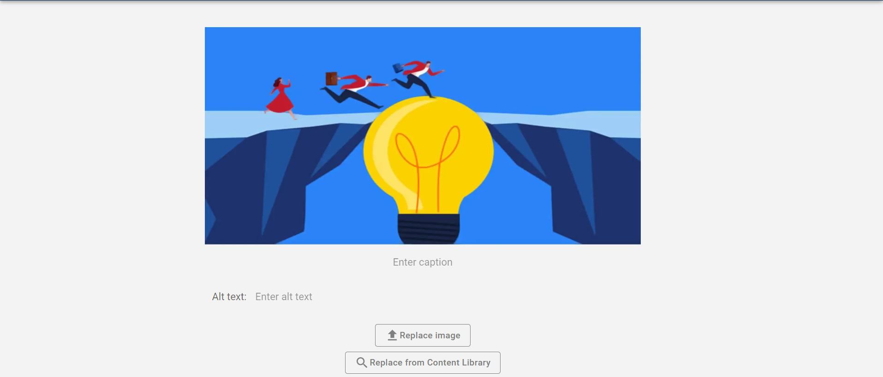
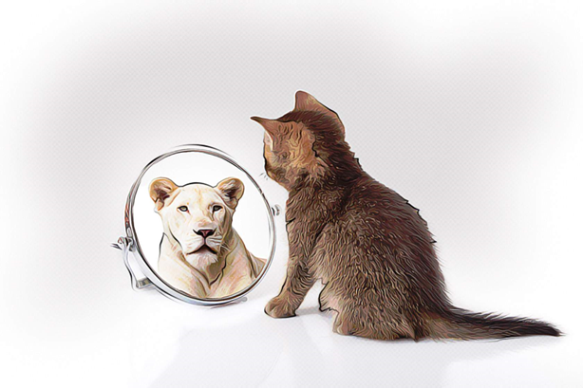
Click here the generate alt text button for suggestions
Generate alt text

Slide 10
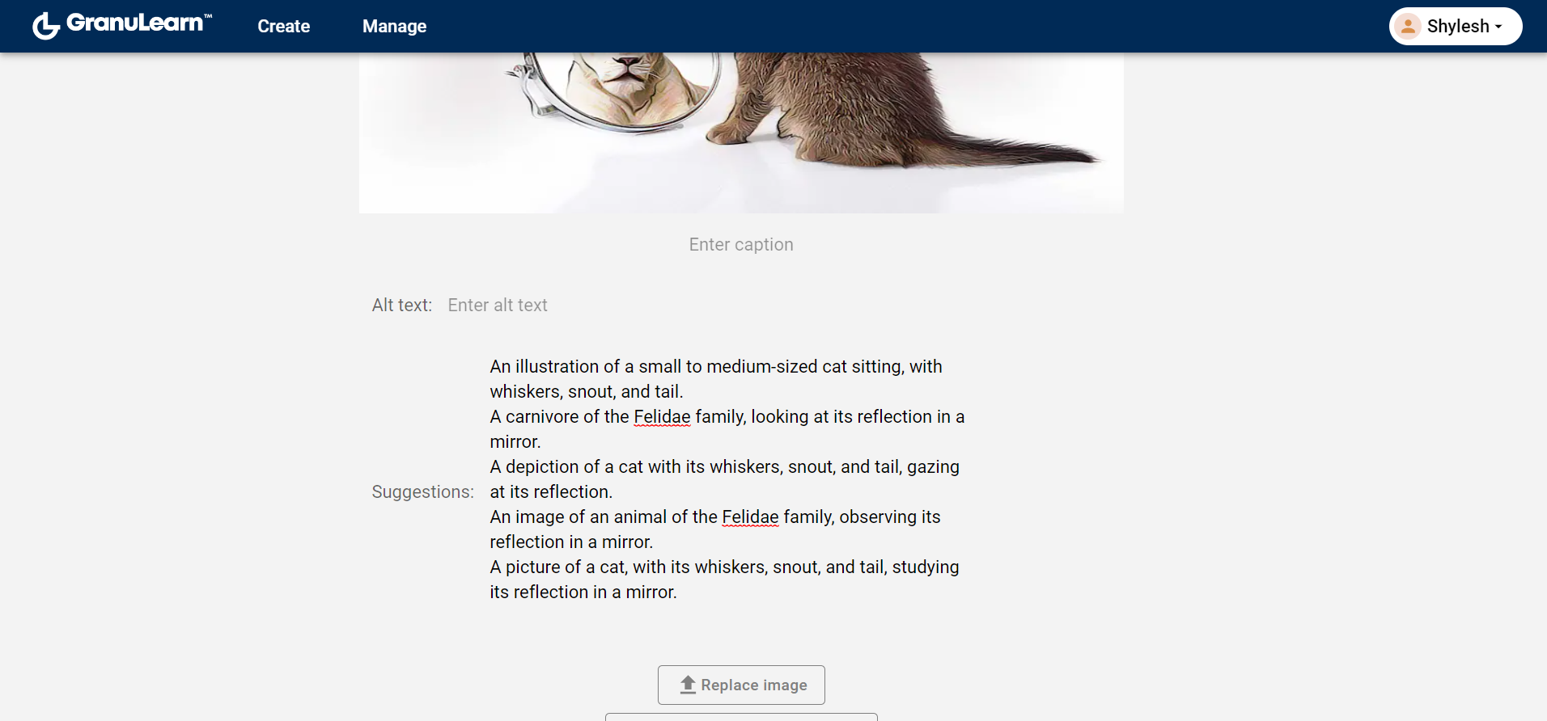


Suggestions
Feedback
Re-generate.

