Slide 1
Token Gate - An Org-Wide LLM Compression Gateway
A LiteLLM gateway with Headroom compression: benchmark results and the enterprise savings case | October 2026
Notes:
Introduce Token Gate: an org-level LiteLLM gateway that compresses agent traffic with Headroom before it reaches the model provider, and measures savings with compression on versus off. Everything in this deck comes from one benchmark run.

Slide 2
Token Gate roughly halves the tokens agents send
49.4%
45%
~$478
fewer tokens
lower LLM cost
saved per month
129,785 to 65,629 across 6 agent tasks
$0.144 to $0.079 for the same tasks
at 50 developers x 40 requests a day
Savings come from input tokens only. Output-heavy models save less, so validate on your own traffic (slide 8).
Source: Token Gate benchmark 2026-10-21, claude-haiku-4-5, proxy mode, 6 tasks x 1 run
Notes:
Three numbers to remember: about half the tokens, about 45 percent of the cost, and a few hundred dollars a month for a 50-developer team on this one workload. Flag early that the cost saving is smaller than the token saving because output tokens are not compressed.

Slide 3
Agents pay for the same tool output again and again
97%
of all tokens are input: tool results (logs, issues, search hits) are re-sent on every agent step.
88%
of the bill is input tokens on Claude Haiku 4.5 ($1 per million in, $5 per million out).
JSON
tool payloads are verbose and repetitive, which is exactly what the gateway compresses well.
Source: Token Gate benchmark 2026-10-21, claude-haiku-4-5, proxy mode, 6 tasks x 1 run
Notes:
The cost problem in agent systems is mostly input. Each step re-sends everything the agent has seen so far, including big tool outputs. In this benchmark about 97 percent of tokens and 88 percent of cost were input.

Slide 4
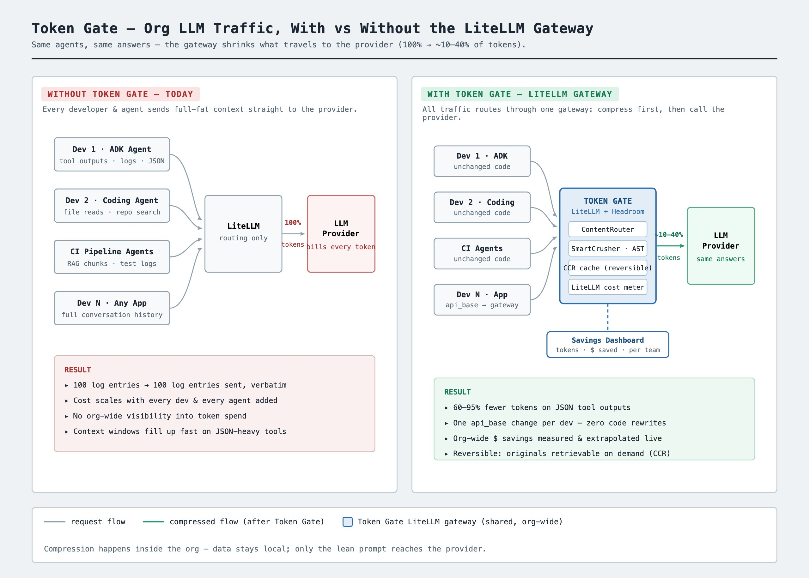
One LiteLLM gateway compresses traffic for every agent
1
Agents stay unchanged
Teams point their LiteLLM api_base at the gateway; no code rewrites.
2
The gateway compresses
Headroom, inside the gateway, shrinks verbose tool output before the model sees it.
3
Savings are measured
LiteLLM reports tokens and cost, so savings are visible per task and per team.
Notes:
Walk through the diagram: left is today, every agent calls the provider with full-size context. Right is Token Gate: a single shared LiteLLM gateway with Headroom compression built in. Teams only change their api_base.

Slide 5
Every task used fewer tokens: 32% to 63% fewer
Source: Token Gate benchmark 2026-10-21, claude-haiku-4-5, proxy mode, 6 tasks x 1 run
Notes:
Tasks that pull the large log and runbook payloads compress most, around 60 percent. Tasks dominated by a smaller issues list compress least, around a third. Total tokens include input and output.

Slide 6
The same work cost $0.065 less, a 45% saving
Task | Tokens before | Tokens after | Saved | Cost before | Cost after
checkout failures | 26,958 | 15,249 | 43.4% | $0.0295 | $0.0182
error summary | 11,221 | 7,634 | 32% | $0.0132 | $0.0094
open p1 issues | 8,825 | 5,678 | 35.7% | $0.0103 | $0.0071
slow queries | 28,780 | 11,846 | 58.8% | $0.0316 | $0.0138
rollback guidance | 27,125 | 10,076 | 62.9% | $0.0304 | $0.0126
on call brief | 26,876 | 15,146 | 43.6% | $0.0291 | $0.0177
Total | 129,785 | 65,629 | 49.4% | $0.1440 | $0.0788
Source: Token Gate benchmark 2026-10-21, claude-haiku-4-5, proxy mode, 6 tasks x 1 run
Notes:
Cost savings are a few points lower than token savings because output tokens, which the gateway does not compress, cost five times as much as input on Haiku 4.5.

Slide 7
At enterprise scale the savings add up quickly
How the estimate works
$0.0109 saved per request
x developers
x 40 requests per day
x 22 working days
$5,736 a year for 50 developers, $114,724 for 1,000.
Source: Token Gate benchmark 2026-10-21, claude-haiku-4-5, proxy mode, 6 tasks x 1 run
Notes:
This is a linear extrapolation of the per-request saving measured in the benchmark, using the org defaults in config.yaml. A request here is one agent task. Real numbers depend on the real mix of tools, payload sizes and models.

Slide 8
Caveat: output tokens cost more and are not compressed
Input only. The gateway compresses what you send, not what the model writes back.
Output costs more. About 5x input on Haiku 4.5 and around 8x on some Gemini models.
Verbose models dilute savings. Long answers or reasoning tokens make output a larger share of the bill.
Source: Token Gate benchmark 2026-10-21, claude-haiku-4-5, proxy mode, 6 tasks x 1 run
Notes:
Be explicit with finance and engineering leaders: the saving percentage depends on model pricing and response length. The chart is an illustration using this benchmark's measured input and output token counts, re-priced at different output-to-input ratios, and again with output volume multiplied by four. The 8x figure reflects some Gemini models, where output is priced around eight times input.

Slide 9
What to validate before an org-wide rollout
What the benchmark is
What to check next
Mock data: 88 KB of synthetic logs, issues and runbooks, not production traffic.
Small sample: 6 tasks, 1 run each; results will vary run to run.
Savings vary by payload: 32% to 63% across tasks.
Answer quality: conclusions looked consistent, but some counts differed (error-summary reported 5 errors for search-gateway instead of 6). Check accuracy on your own tasks.
Prompt caching: cached input is already cheaper, which would shrink the saving.
Latency and gateway operations were not measured.
Notes:
Be honest about the limits. The error-summary task is worth pointing out: with compression the agent reported slightly lower error counts for two services. That may be run-to-run variation or a small loss from compression, and it is exactly what a pilot on real tasks should check.

Slide 10
Recommended path: pilot, measure, then roll out
1
2
3
Pilot
Measure
Roll out
Route one real agent workflow through the Token Gate gateway for two weeks.
Compare tokens, cost and answer quality using your model's real input and output prices.
Expand org-wide behind the gateway, with a savings dashboard per team.
Notes:
Close with the ask: agree a pilot workflow and success criteria (token reduction, cost, and answer-quality checks) before committing to an org-wide rollout.

