Slide 1
HOMEWORK 4
Reinforcement Learning
From Tabular MDPs to Deep Continuous Control
Shyngys Aitkainov
ETH Zurich · Robot Learning 2026
01 · 02 · 03 · 04
Notes:
Hi, I'm Shyngys. In this five-minute video I'll walk through my Homework 4 submission — four reinforcement learning exercises, starting from tabular dynamic programming and ending with deep continuous control on a 6-DOF robot arm.

Slide 2
EXERCISE 1 · MDP
Dynamic Programming on Cliff Walking
Policy Iteration
Discount γ — Bias vs Horizon
Full evaluation (inner loop) then greedy improvement.
V(s) = Σₐ π(s,a) · Σ P(s'|s,a)·[r + γV(s')]
Fewer outer iterations, each is expensive.
γ → 0
Myopic agent: only cares about immediate reward. Won't plan to the goal.
γ → 1
Value Iteration
Far-sighted: plans long horizons optimally. Convergence slows; undiscounted episodic tasks still converge.
Single Bellman optimality backup per sweep.
V(s) = maxₐ Σ P(s'|s,a)·[r + γV(s')]
More iterations, each is cheap. Policy at the end.
Environment: 4×12 grid, reward −1/step, cliff = −100 terminal, stochastic slip.
HW4 · Exercise 1 · Policy Iteration & Value Iteration
Notes:
Exercise 1 is Cliff Walking — a 4 by 12 grid MDP. I implemented both policy iteration and value iteration. Policy iteration alternates two phases: fully evaluate the current policy until V-pi converges, then take one greedy improvement step. Fewer outer iterations but each is expensive. Value iteration collapses both into a single Bellman optimality backup per sweep — more iterations, but each is cheap. On gamma: near zero the agent is myopic and won't plan to the goal; near one it's far-sighted but convergence slows since value differences shrink.

Slide 3
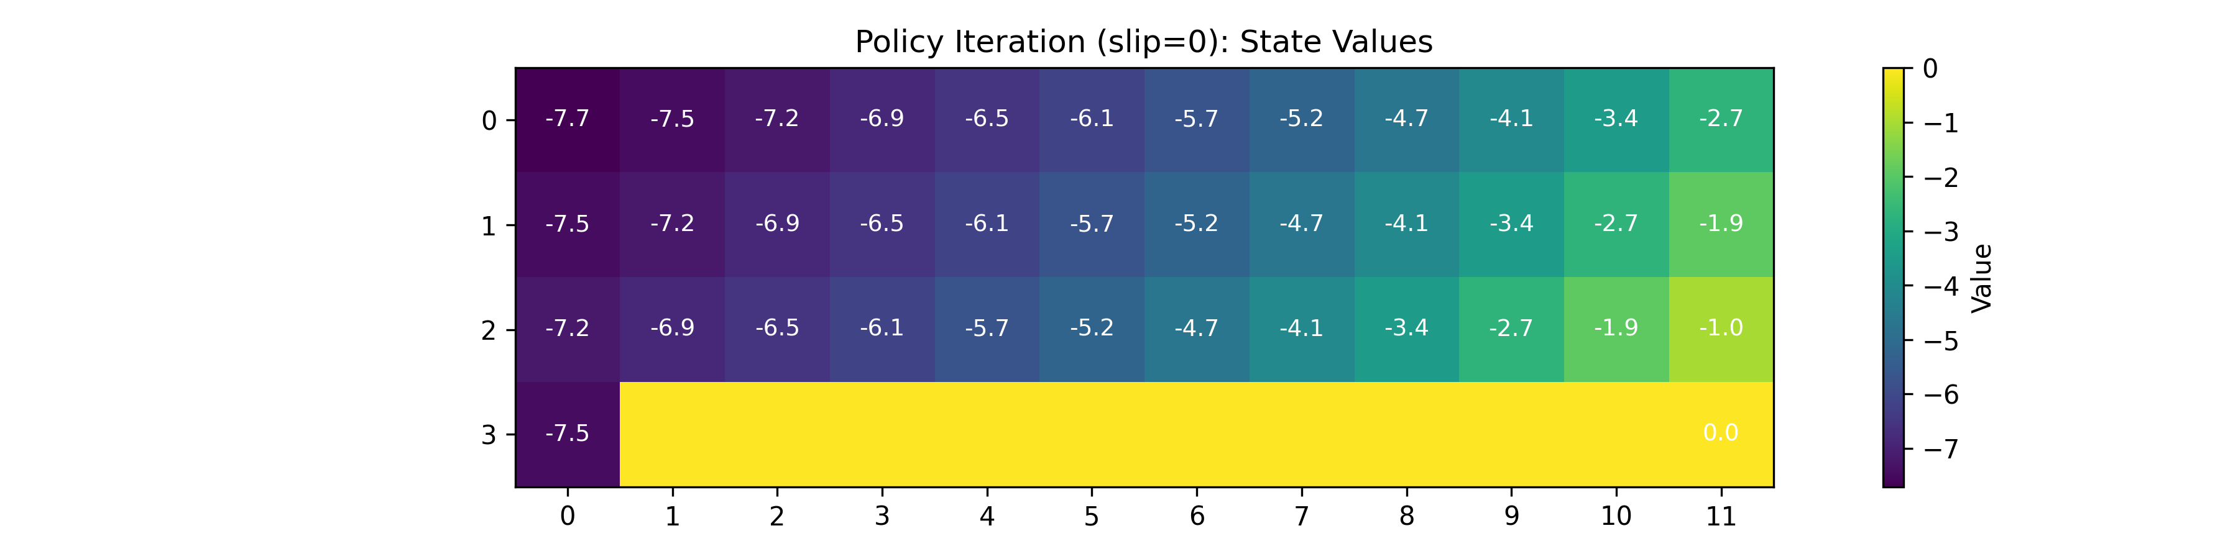
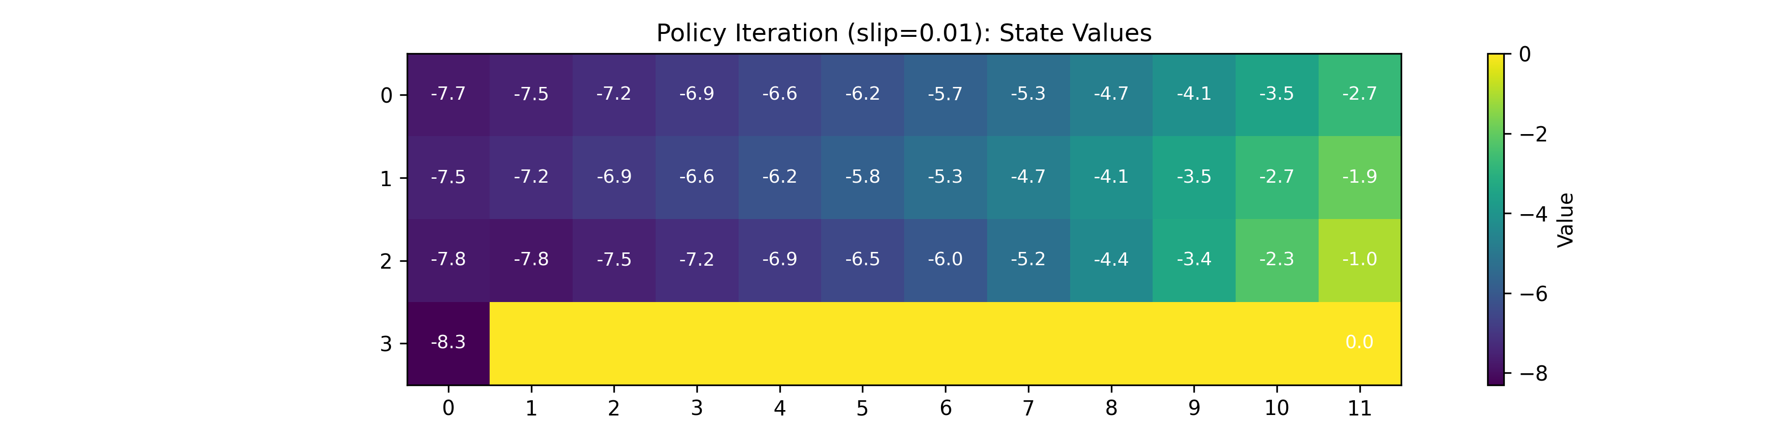
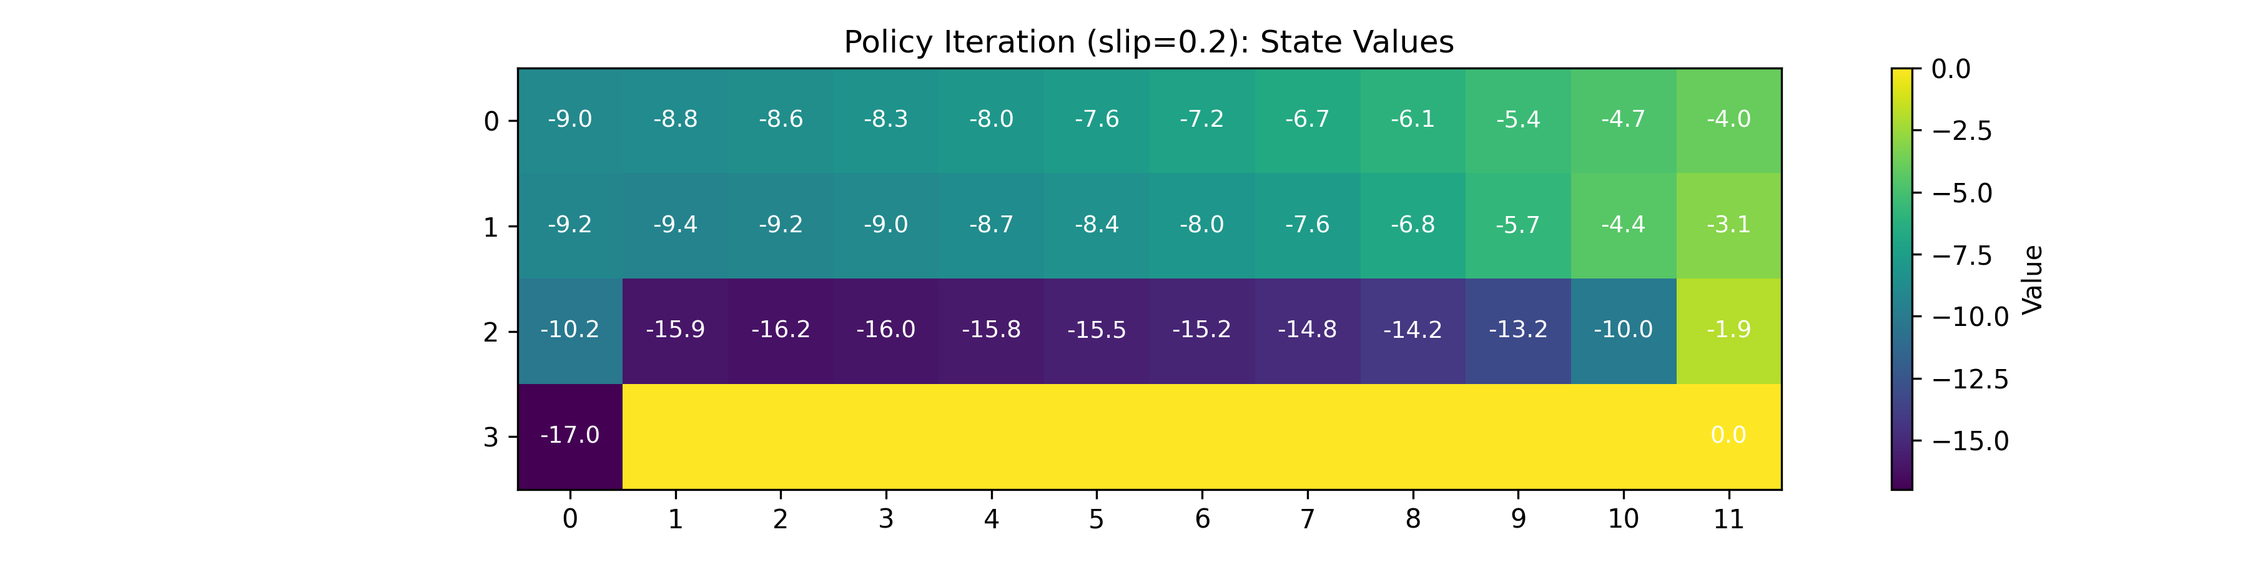
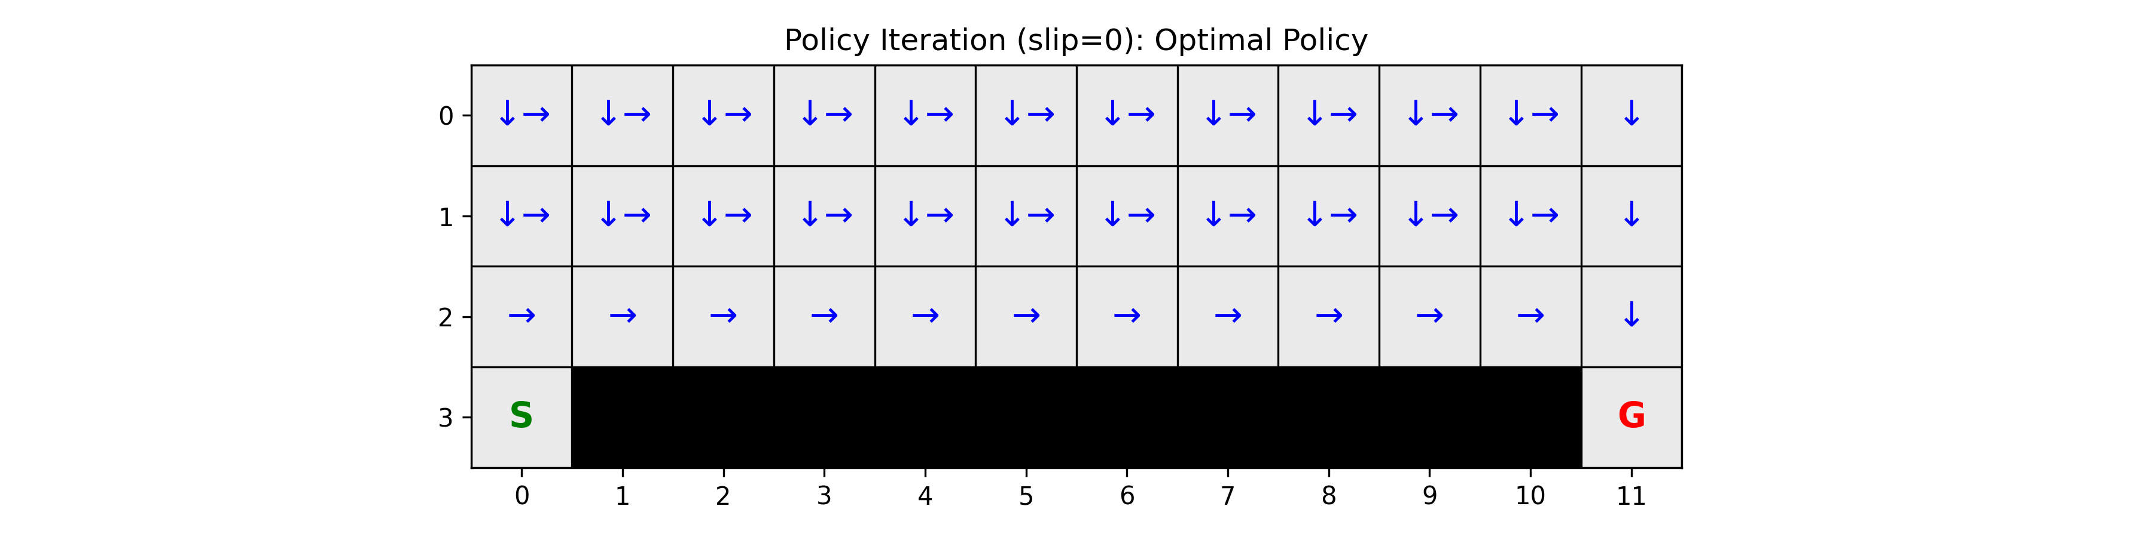
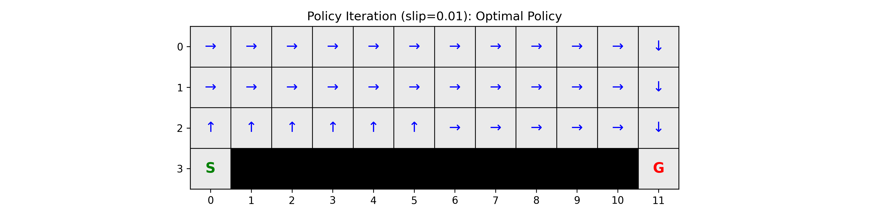
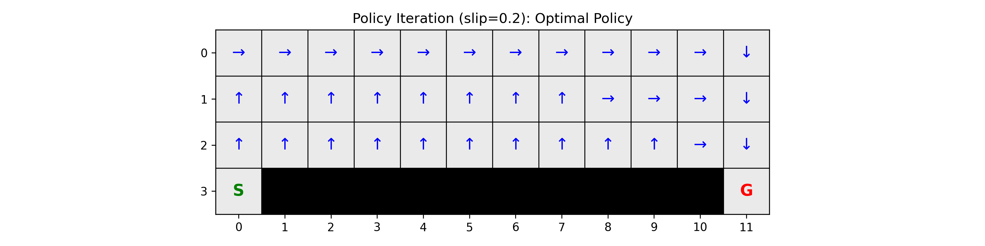
EXERCISE 1 · SLIP CHANCE
Effect of Stochasticity — Conservative Under Noise
slip = 0.0
slip = 0.01
slip = 0.2
Shortest path along cliff edge.
Tiny risk — policy barely shifts.
Detours via the top row — safer.
Expected cliff penalty ≈ slip · ¼ · (−100) per adjacent step. At 0.2 → ~−5/step → long safe path wins.
Notes:
Here's how the optimal value and policy shift with the slip probability. Top row is the state-value function — darker blue means lower value. Notice that at slip zero, the cliff boundary is sharply defined. As slip grows, the danger spreads upward into previously safe cells. Bottom row is the policy. At slip zero the agent walks directly along the cliff edge — no risk, shortest path wins. At 0.01 the risk is tiny, so it barely changes. At 0.2 the agent detours all the way up to the top row. Each cliff-adjacent step carries an expected penalty of slip times one-quarter times minus 100. At 20 percent that's roughly minus five per step, which far exceeds the minus one per extra step of the longer safe path. So higher stochasticity makes the optimal policy risk-averse.

Slide 4
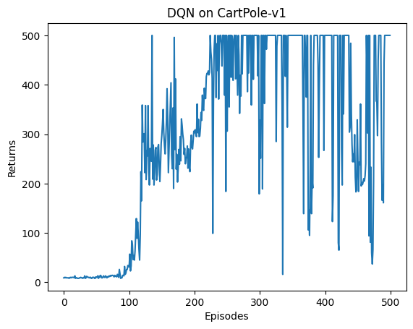
EXERCISE 2 · DEEP Q-NETWORK
DQN on CartPole — 100% Success Rate
Training Curve
Evaluation (50 eps)
500.00
mean return · std = 0 · 100% success
Hyperparameters
lr = 1e−3
ε = 0.03
target_update = 10
hidden_dim = 128
γ = 0.99 · batch = 64
HW4 · Exercise 2 · DQN on CartPole-v1
Notes:
Exercise 2 — DQN on CartPole. The agent sees four continuous state variables and picks left or right. The training curve shows the classic DQN pattern: it's flat until around episode one hundred, then rapidly climbs. After training, evaluation over fifty episodes gives a mean return of exactly five hundred — a perfect one-hundred-percent success rate with zero variance. My final hyperparameters: learning rate one-e-minus-three, epsilon 0.03, target network update every ten steps, hidden dimension 128.

Slide 5
EXERCISE 2 · THEORY
Why Replay, Target Networks, and Double DQN?
01
Experience Replay
02
Target Network
03
Double DQN
Consecutive transitions are correlated → violates i.i.d. Random mini-batches from the buffer break correlation, recycle data, and smooth the training distribution.
Shared θ makes y = r + γ·maxₐ'Q(s',a';θ) a moving target. A frozen θ⁻ (updated every N steps) gives the online net a stable objective to learn toward.
Standard max overestimates due to noise. Double DQN selects with online net, evaluates with target net → decorrelates selection & evaluation noise.
All three fixes attack the same failure: function-approximation instability in bootstrapped TD learning.
Notes:
Three questions for DQN. First, experience replay. Consecutive transitions are highly correlated — same policy, similar states. This breaks i-i-d assumptions of SGD. Random mini-batches from the buffer decorrelate updates and let us reuse each transition many times. Second, the target network. Without it, both the prediction and the target share theta, so every gradient step moves both sides — a moving target that causes divergence. A frozen copy of theta, synced every N steps, gives us a stable objective. Third, Double DQN. The max operator over noisy Q-estimates is biased upward. Double DQN decouples selection from evaluation — pick the action with the online net, evaluate it with the target net — which decorrelates the noise and removes the bias.

Slide 6
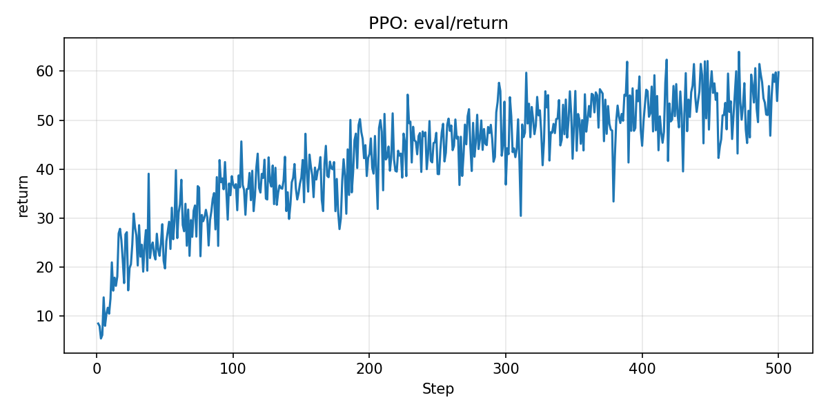
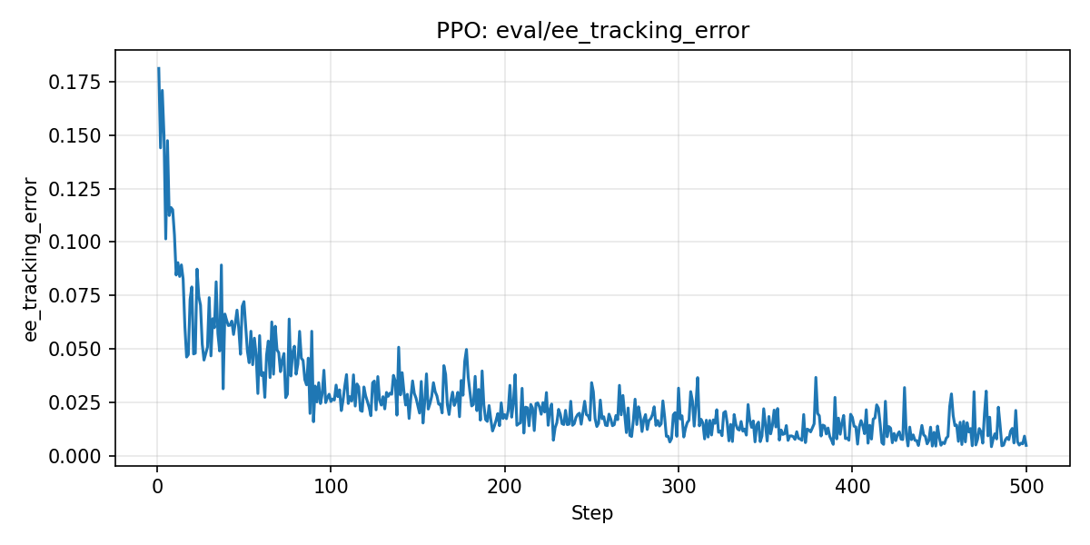
EXERCISE 3 · PPO
PPO on SO100 — On-Policy Continuous Control
Eval Return (500 iterations)
Mean Return (20 eps)
54.7
tracking error = 0.018 m
Tracking Error
HW4 · Exercise 3 · PPO (clipping, GAE, KL-adaptive LR)
Notes:
Exercise 3 moves to continuous control — PPO on the SO100 arm, a six-DOF end-effector tracking task. Over 500 iterations the eval return climbs steadily from around 5 to about 55, and the tracking error drops from 0.18 meters to under 2 centimeters. The final mean over 20 evaluation episodes is 54.7 return, with 1.8 centimeter mean tracking error. The policy has clearly learned the task.

Slide 7
EXERCISE 3 · THEORY
Clipping, On-Policy Data, and GAE λ
Why clip instead of KL constraint?
Why discard data after each update?
TRPO's hard KL constraint needs second-order (Fisher, CG, line-search). PPO's min-clip gives a soft trust region using only first-order Adam. Without clipping, a single huge ratio can destroy the policy.
Advantages and log-probs are only valid under the collecting policy. After several steps, the policy drifts — importance weights explode, advantages go stale, and clipping silently zeros gradients.
GAE λ — Bias–Variance Dial
λ = 0
λ = 0.95
λ = 1
Pure 1-step TD. Low variance, biased by V errors.
Practical sweet spot. ~10-step effective horizon.
Monte Carlo returns. Unbiased but very noisy.
HW4 · Exercise 3 · Theoretical Questions
Notes:
Three PPO questions. Why clip instead of enforcing a KL constraint like TRPO? TRPO needs second-order methods — Fisher matrix, conjugate gradient, line search. PPO gets a similar soft trust region using only first-order Adam. Without clipping, one large importance ratio can blow up the policy in a single step. Why not reuse rollouts? PPO is on-policy — advantages and log-probs are only valid under the collecting policy. After a few epochs, the policy drifts, importance weights explode, advantages go stale, and clipping just silently zeroes the gradients. Third, GAE lambda. It's the bias-variance dial. Lambda zero is one-step TD — low variance, high bias. Lambda one is pure Monte Carlo — unbiased but noisy. 0.95 is the practical sweet spot with a roughly ten-step effective horizon.

Slide 8
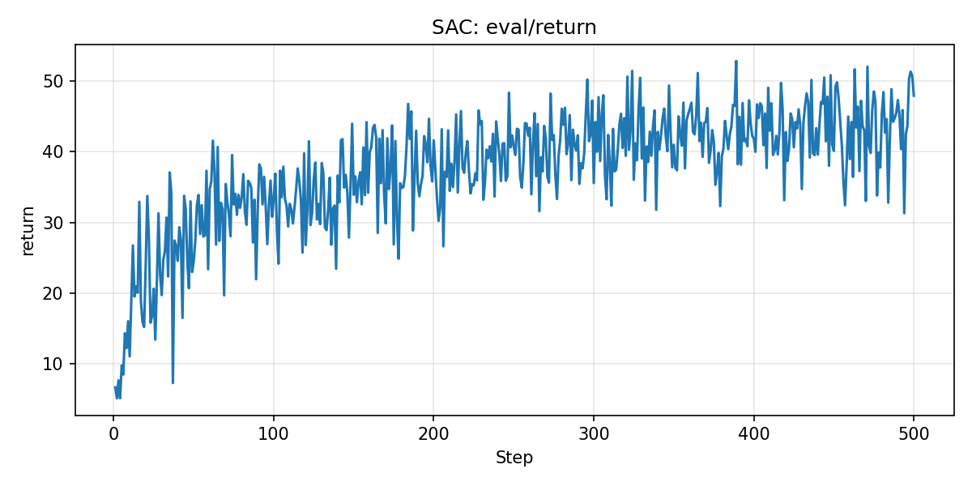
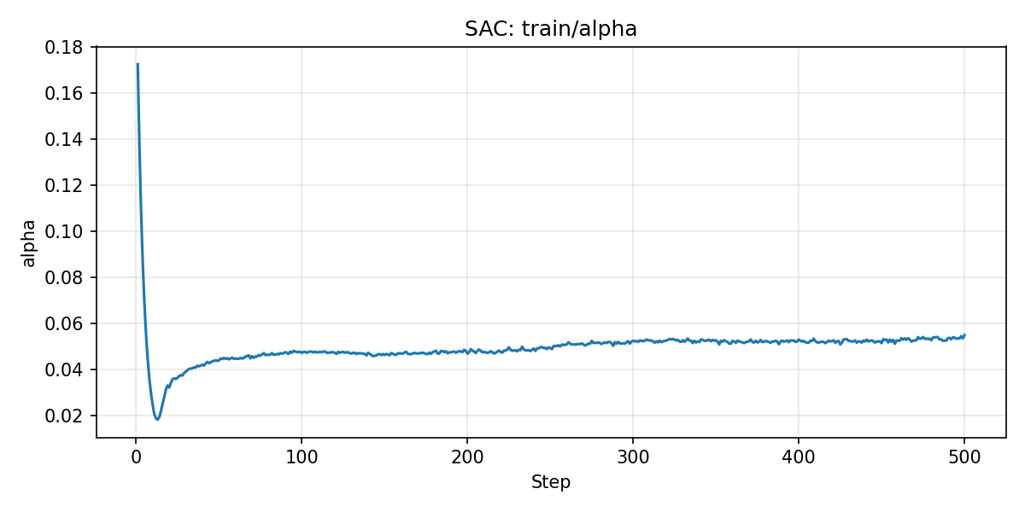
EXERCISE 4 · SAC
SAC on SO100 — Off-Policy with Max Entropy
Eval Return
Mean Return (20 eps)
42.1
tracking error = 0.031 m
Auto-Tuned α
HW4 · Exercise 4 · SAC (double-Q, entropy target, replay)
Notes:
Exercise 4 — SAC on the same SO100 task. SAC is off-policy with a maximum entropy objective. The return climbs to around 42 with a 3.1-centimeter tracking error. The alpha plot on the bottom right shows the auto-tuned temperature spiking early — the policy was too random — then settling around 0.05 once the target entropy is reached. The whole thing is self-regulating.

Slide 9
EXERCISE 4 · THEORY (1/2)
Max-Entropy Objective & Tanh Correction
Why an entropy bonus?
Why correct log π for tanh?
J(π) = E[Σγᵗ(rₜ + α·H(π))]
u ~ N(μ,σ) → a = tanh(u)
Systematic exploration — prevents premature collapse to a deterministic suboptimal policy.
Robustness — stochastic policies survive perturbations and dynamics shift.
Multi-modal: keeps mass on multiple good actions.
Smoother optimization landscape, better gradients.
log π(a|s) = log π(u|s) − Σ log(1 − tanh²(u))
Tanh compresses the density near ±1 — change-of-variables demands a Jacobian correction.
Without it: entropy is over-estimated, α tunes wrong, actor gradients are biased.
Critic target, actor loss, and α-loss all read log π — all three would break.
HW4 · Exercise 4 · Entropy & Tanh Correction
Notes:
Two SAC design choices. First, the entropy bonus. SAC maximizes reward plus alpha times the policy's entropy. This encourages systematic exploration, prevents premature collapse to a deterministic suboptimal policy, and makes the policy more robust to perturbations. It also keeps mass on multiple good actions — useful when the task is multi-modal. Second, the tanh squashing. The actor samples u from a Gaussian, then squashes with tanh to keep actions in minus-one to one. But tanh is nonlinear, so the change-of-variables formula requires a log-Jacobian correction: log of one minus tanh-squared. Without it, the log-probability is wrong, entropy is overestimated, alpha tunes to the wrong level, and the actor gets biased gradients.

Slide 10
EXERCISE 4 · THEORY (2/2)
Auto α and Update-to-Data Ratio
How auto-α works
UTD: Update-to-Data Ratio
L_α = E[ −log α · (log π + H_target) ]
PPO
≈ 0.01
Entropy ABOVE target
(log π + H_target) < 0 → α decreases → less regularization, policy can sharpen.
10 epochs × 2 mini-batches ÷ 2048 env steps
SAC
≈ 1.0
Entropy BELOW target
One gradient step per new transition (replay buffer).
(log π + H_target) > 0 → α increases → stronger entropy push, policy explores more.
SAC ≈ 10× more sample-efficient. PPO ≈ 10× cheaper per env step.
Self-regulating loop holds the policy at target entropy ≈ −act_dim.
HW4 · Exercise 4 · α-tuning & UTD Ratio
Notes:
Auto alpha works via gradient descent on an objective that's positive when entropy drops below target and negative when it's above. So if the policy becomes too random, alpha decreases and lets it sharpen. If it becomes too certain, alpha increases and pushes it to explore. The equilibrium holds entropy at roughly minus the action dimension. The UTD ratio — gradient updates per environment step — highlights the core difference between PPO and SAC. PPO runs ten epochs over two thousand transitions, giving a UTD of about one percent. SAC does roughly one gradient step per new transition, so UTD is about one. That's why SAC is roughly ten times more sample-efficient, but costs ten times more compute per environment step.

Slide 11
EXERCISE 4 · SYNTHESIS
On-Policy vs Off-Policy — The Core Tradeoff
 | On-Policy (PPO) | Off-Policy (SAC)
Sample efficiency | Low — data discarded | High — replay reuses data
Stability | Smooth (data matches policy) | Can oscillate (stale data)
Exploration | Policy stochasticity | Entropy bonus + replay diversity
Hyperparameter tuning | More forgiving | Sensitive (τ, α, critic lr)
Wall-clock time | Fast update, slow to converge | Slow update, fewer env steps
Complexity | Simple (no replay/target nets) | Replay + target nets + 3 opts
Pick PPO for cheap simulation and stability. Pick SAC for real robots where every sample costs.
Both trained 500 iters on SO100 — PPO 54.7 return, SAC 42.1. Same budget, different tradeoffs.
Notes:
On-policy versus off-policy — the big-picture tradeoff. On-policy PPO is simple, stable, and easy to parallelize, but sample-inefficient — each transition is used once and discarded. Off-policy SAC reuses data via a replay buffer, so it's roughly ten times more sample-efficient, but more complex and sensitive to hyperparameters. The practical rule: PPO when simulation is cheap, SAC when every environment sample costs money — like real robots.

Slide 12
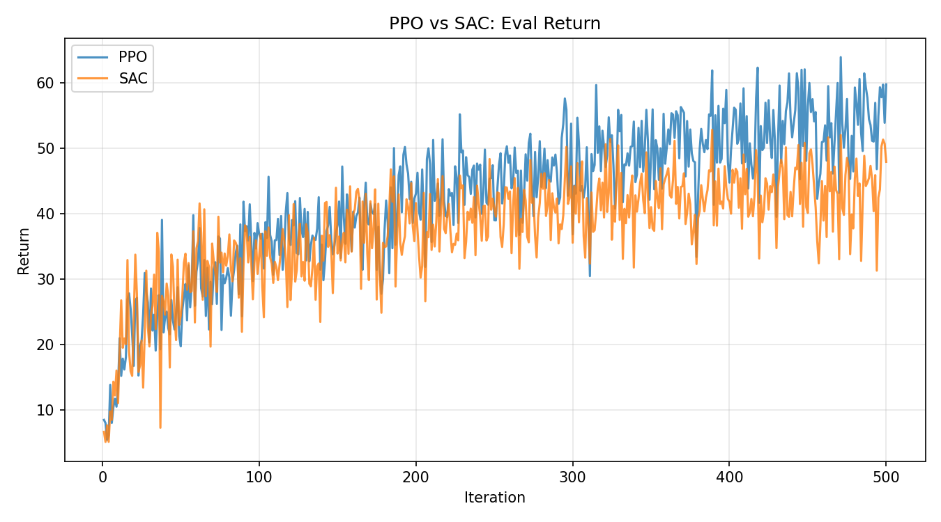
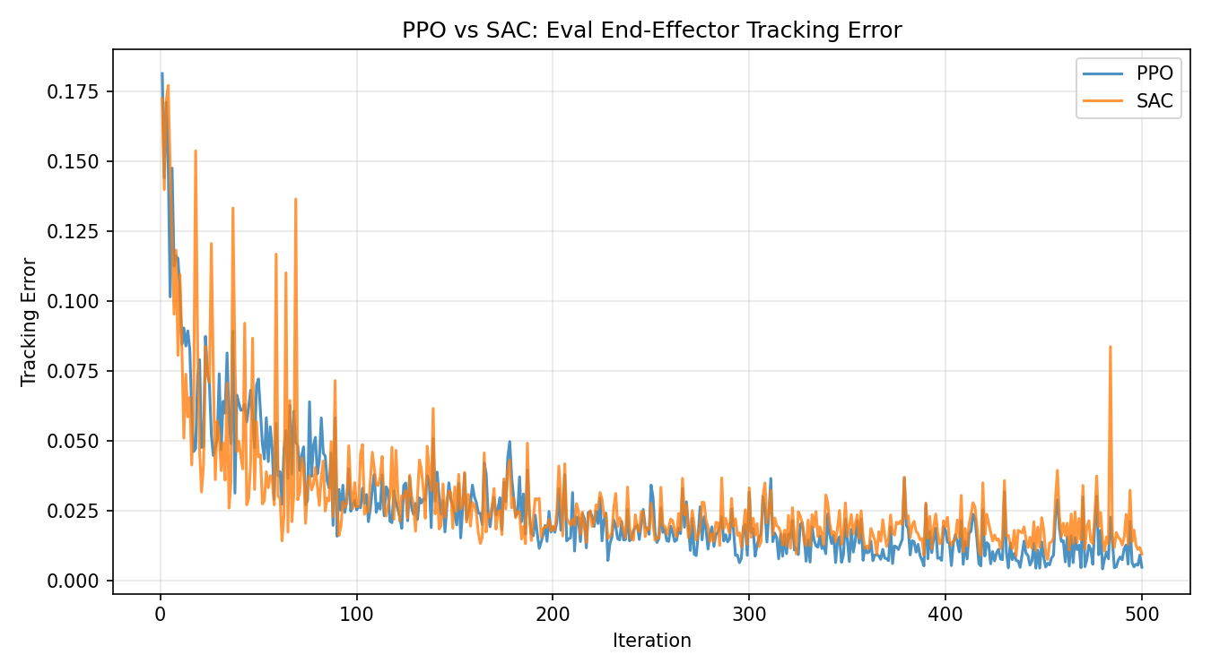
PPO vs SAC — Side by Side
Same SO100 task, same 500 iterations, same reward structure.
Eval Return
End-Effector Tracking Error
Thank You
Shyngys Aitkainov · ETH Zurich Robot Learning 2026 · HW4: Reinforcement Learning
Notes:
Head to head on the exact same task: PPO reaches 54.7 return versus SAC's 42.1, with slightly lower tracking error. Same 500 iterations, same reward structure — the gap is mostly about how each algorithm uses data. That wraps up the four exercises. Thank you.

