Slide 1

Automated KPI Categorisation & Simulation for NHS Ward-Level Performance
A Practical Data Solution Inspired by Real NHS Challenges
Shyni shanmughan
06/06/2025

Slide 2


Understanding the Problem :A Real-world Analogy
The restaurant Analogy
The NHS Reality
35 Unique Dishes
Each has different ingredients
No Standard Recipes
Manual Labels, “Hot”, “Warm” ,”Cold”
Reviews only twice a year
35 NHS Wards
Each uses separate Excel Templates
KPI names, Layouts and thresholds vary
Colour-coded Performance (Gold/silver/bronze/white) often “Manual”
Partial formula, Manul review needed
Full reports were done only Bi-annually
Chaos in services
No consistency or Auditability
Manual Efforts, High Risk
Owner Can’t track overall Quality
No Standardisation
Hard to monitor performance accurately

Slide 3


Why I needed a solution :The Manual Pain Points Behind the scenes
Manual Work-flow before the Automation
Problems This caused:
Excel Templates
Manually paste KPI values every Bi-month
CF-rule Coloured Cells
Interpret formatting (Gold/Silver/Bronze/White)
Count + Calculate
Manually count colours to get % scores
Summary + Accreditation
Division builds summaries twice a year with risk of human error.
No data traceability – Colour-coded values had no underlying data or stored logic.
Manual effort overload – Every report involved copy-paste, colour counting, and manual validation
Impossible to scale – 35 templates x multiple KPIs = too large to manage bi-monthly.
No reliable audit trail – Performance bands (Gold/Silver/Bronze) couldn’t be verified or traced.
No automation or reuse – Logic was locked inside each spreadsheet.
Dashboarding was blocked – Visualisation tools (Power BI) couldn’t use raw Excel due to lack of structure.
Simulation or analysis not possible – No logic meant you couldn’t model “what if” scenarios.
Performance improvement was slowed – Without consistent data, ward managers couldn’t act fast.

Slide 4
Decision-Making Process: From problem to prototype
Identifying the Bottle Neck:
Manual reporting was time-consuming, error-prone, and unscalable.
Colour-based KPI ratings were not machine-readable or traceable.
Limited ability to test or adjust performance thresholds dynamically.
Choosing a Practical Approach
Prioritised rule-based logic over machine learning due to limited labelled data.
Chose a simulation-driven approach to enable “what-if” analysis of thresholds and value changes.
Engaged clinical colleagues repeatedly to clarify the meaning and intent of 100+ diverse KPIs, ensuring the logic matched real-world interpretation.
Built a reusable threshold lookup table to manage inconsistencies across 35 ward templates.
Structuring the Build
Python selected for automation and control over Excel-driven data
Developed a threshold engine to assign Gold/Silver/Bronze categories based on logic
Created a modular script to extract, transform, and simulate KPIs.
Design kept explainable and auditable for clinical and operational users.
Why This Made Sense
Fit within the real resource limits of the division.
Allowed continuous iteration without disrupting current workflows.
Provided a clear bridge between manual systems and dashboard-ready data.
This approach gave us a foundation that was not only automated but also trusted, auditable, and ready for NHS scaling.

Slide 5




Code Structure & Project Repository
GitHub Repository:
github.com/shyniarjun/NHS_Data_categorisation_and_simulation
Technologies used:
Datascience_project.ipynb
→Main Jupyter notebook with full logic, automation, and simulations
Python – Data transformation, automation, simulation
Jupyter Notebook – Workflow development, logic transparency
Markdown – Documentation for clinical & technical teams
CSV – Datasets
Power BI - data validation and potential dashboard integration
(not core to current prototype)
Docs/
Background.md → Real NHS problem framing
Methodology.md → Categorisation logic breakdown
Insights.md →Simulation findings and learnings
Lessons_learned&Next_steps→ Reflection and future steps.
KPI_Data_2024.csv → Sample dataset used in simulation
KPI_Threshold_Lookup_Table.csv → Threshold master file for category logic
README.md → Overview, setup instructions, and execution guidance

Slide 6






The Automation Solution: From Chaos To Clarity
What I Built
What it solved
Clinical System (Amat, NerveCentre,etc)
Data Extraction(python Scripts)
Mapped KPI Look Up Table
Creating a logic to assign categories (Gold/Silver/Bronze/White/Manual)
Threshold Comparison Engine
Final Dataset→ Power BI Dashboard + Simulation Models.
Reusable logic across 35 wards
70% reduction in manual effort
Made dashboards and solutions possible
KPI bands now traceable and Explainable
Enabled performance planning , not just reporting
Immediate View of risk /excellence zones across Wards.

Slide 7
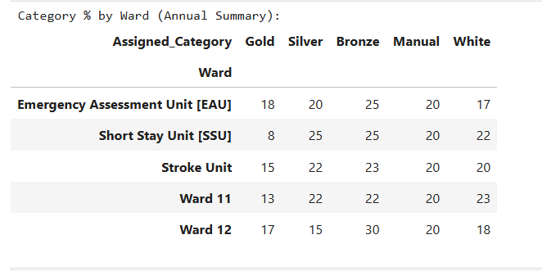

Final Categorisation Output: Ready for Dashboarding or Analysis
Gold | Excellent
Silver | Improving
Bronze | Needs improvement
White | Needs Attention
Manual | Manual Review
This categorised output is the final product of my automation logic:
Consistent calculation of KPI categories across 35 wards
Ready-to-export summary for Excel or Power BI dashboarding
Supports accreditation scoring and month-on-month performance review
Easily updated for future months or wards with no code rewrite
Replaces manual colour-counting and reduces human error.
Note: “The goal wasn’t just categorisation – it was building clarity and scalability.”

Slide 8
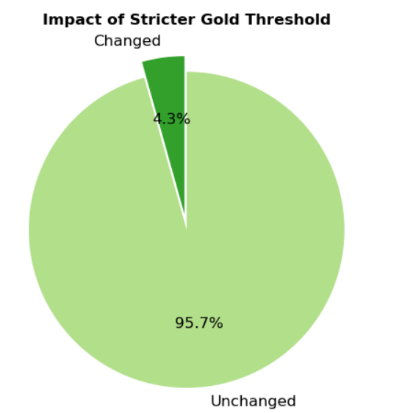
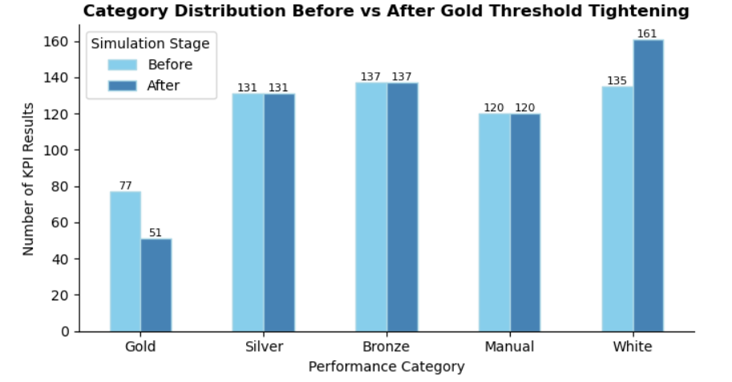
Simulation 1: Threshold Tightening Impact
Scenario : Gold threshold tightening from 95% to 97%.
Purpose: Assess how stricter targets affect current performance
Key Insights:
Minimal Disruption: Only 4.3% of KPI results were impacted, showing that most metrics already perform well under current standards.
Drop in Gold Ratings: A notable number of KPIs previously rated as Gold shifted to Silver or White, highlighting borderline performers.
White Category Grew: A subtle increase in the White (unclassified) category suggests that stricter thresholds may unintentionally push some results out of all defined categories
Actionable Insight: This simulation provides a low-risk way to stress-test rating systems before real implementation, enabling data-driven policy refinement
Strategic Value: Offers NHS leaders a proactive tool to evaluate the impact of threshold changes without disrupting real-time operations.

Slide 9
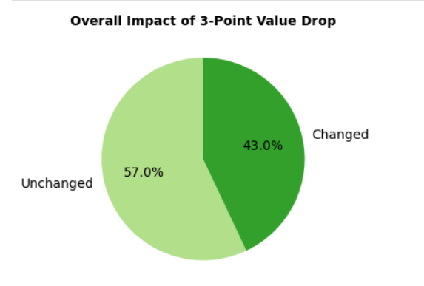
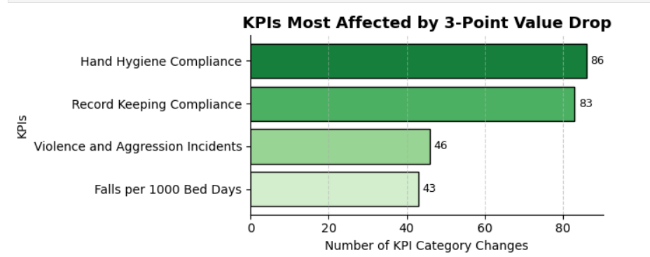
Simulation 2: Impact of a 3-Point Value Drop
Scenario :A uniform 3-point drop in KPI values to mimic performance pressure
Purpose: To identify KPIs most sensitive to performance drops and evaluate potential risk if standards slip slightly.
Key insights:
43% of KPI categories changed — indicating high sensitivity to even small performance drops.
Vulnerable KPIs Identified: Hand Hygiene and Record Keeping Compliance were the most affected.
Early Warning System: Highlights KPIs at risk of slipping under strain—useful for prioritising support and resilience planning.

Slide 10

Lessons Learned & Next Steps
Next Steps:
Strengthen Automation Logic
Continue refining scripts to handle edge cases, data inconsistencies, and logic exceptions.
2. Explore Smart Logic (NLP/ML)
Develop early models for interpreting text-based KPIs and flagging anomalies for manual review.
3. Documenting the system better, so it can be reused or scaled if others want to adopt it
Modelling “what-if” scenarios helped leadership anticipate risks and refine thresholds
5. Simulations Add Strategic Depth
4. Outcomes Need Collaboration, Not Just Code
NHS data work isn’t just technical — I actively involved clinical colleagues to ensure logic supported real patient care priorities.
3. Simplicity Over Complexity
Technology is only useful if it fits the context. I focused on clarity, not complexity
2. Real-World Problems Need Workarounds
There was no plug-and-play solution .I learned to create logic through structured workaround thinking.
1. Solving with What I Had
Learned to build impactful solutions using basic tools.

Slide 11
Merits & Limitations of the Prototype
Merits
Limitations
Real-World Relevance: Tackles a real NHS problem with immediate operational value.
Automated Logic Engine: Removes manual effort, adds consistency and auditability.
Simulation for Strategic Planning: Offers NHS leaders data-driven “what-if” scenarios without disrupting services.
Transparency & Trust: Logic is fully traceable and explainable — important for clinical stakeholder or managerial adoption.
Reusable & Scalable Design: Structure can be applied across wards and months with no code rewrite.
Manually reviewed KPIs Not Fully Automated: Some thresholds still require human interpretation (“more than comparator”).
No Live Data Integration Yet: Currently works on static exports — not yet live-linked to systems.
Sole Analyst Constraints: Built independently without tech team or full testing infrastructure.
Lacks Groundwork for NHS-Wide Architecture: No formal data architecture layer or high-level integration strategy ,future scaling needs wider approval and design input.
Despite limitations, this prototype demonstrates what’s possible with initiative, structure, and NHS context understanding.

Slide 12

Why I’m Proud of This Project
This wasn’t just a data task - it was a transformation.
As the only analyst in a manual-heavy division, I built something from scratch that made performance data traceable, structured, and insightful across multiple wards and trust level.
I’m proud that this work turned invisible, error-prone reporting into a system that empowers better decisions - and I did it without waiting for perfect tools or resources.
Thank you…….
If given historical data or labelled outcomes, I would evolve this into a predictive tool ,using logistic regression or decision trees to forecast KPI downgrades before they happen.

