Slide 1
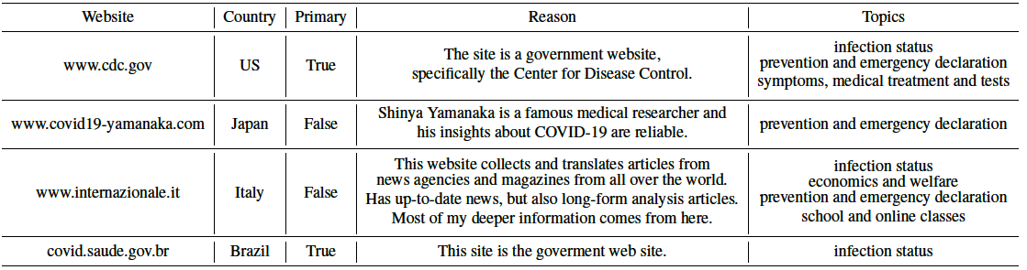
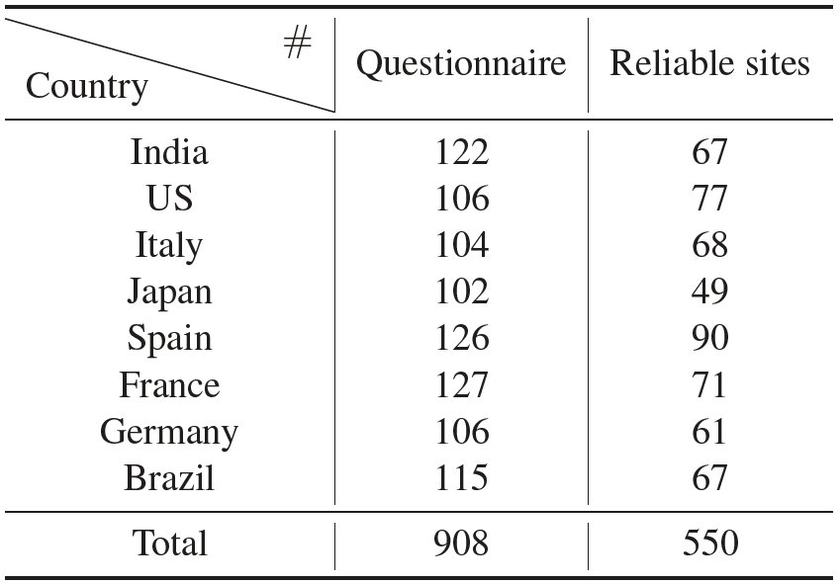
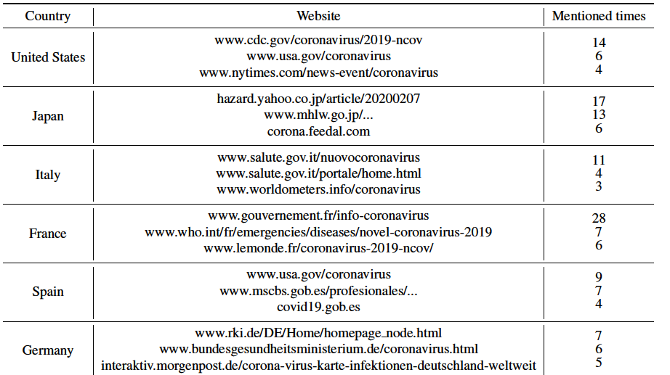
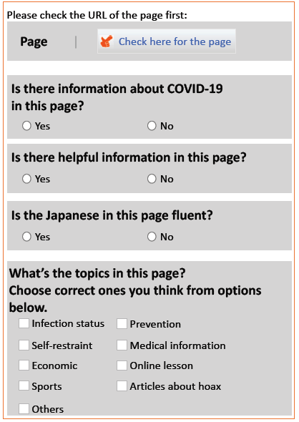
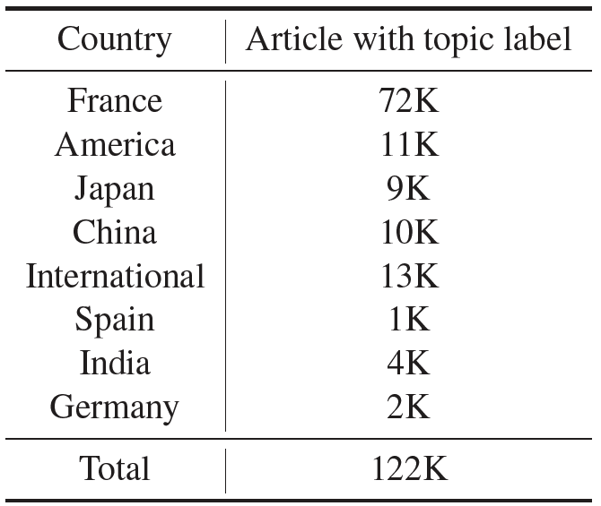
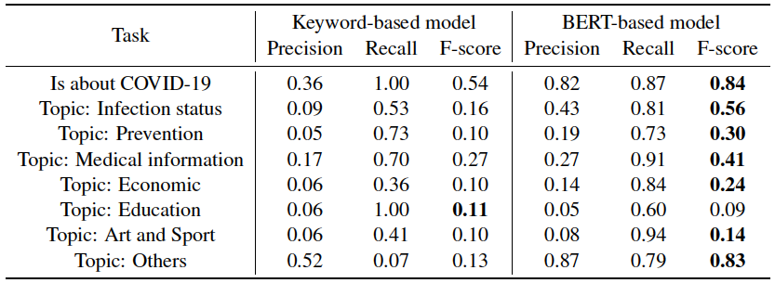
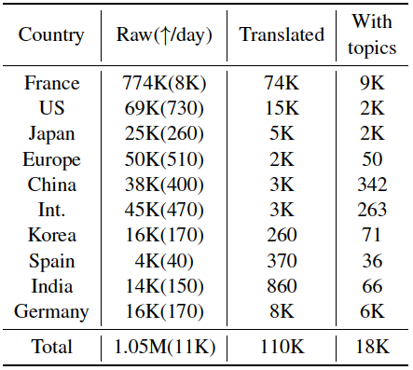


A System for Worldwide COVID-19 Information Aggregation
Akiko Aizawa³, Frederic Bergeron¹, Junjie Chen⁵, Fei Cheng¹, Katsuhiko Hayashi⁵, Kentaro Inui⁴, Hiroyoshi Ito⁶, Daisuke Kawahara⁷, Masaru Kitsuregawa³, Hirokazu Kiyomaru¹, Masaki Kobayashi⁶, Takashi Kodama¹,
Sadao Kurohashi¹, Qianying Liu¹, Masaki Matsubara⁶, Yusuke Miyao⁵, Atsuyuki Morishim⁶, Yugo Murawaki¹,
Kazumasa Omura¹, Haiyue Song¹, Eiichiro Sumita², Shinji Suzuki⁸, Ribeka Tanaka¹, Yu Tanaka¹,
Masashi Toyoda⁸, Nobuhiro Ueda¹, Honai Ueoka¹, Masao Utiyama², Ying Zhong⁶ (in alphabetical order)
¹Kyoto University ²NICT ³NII ⁴Tohoku University ⁵The University of Tokyo ⁶The University of Tsukuba ⁷Waseda University ⁸Institute of Industrial Science, the University of Tokyo
The System
Challenges & Solutions
People pay attention to COVID-19 news of various topics.
The COVID-19 condition is very different among the countries.
Getting first-hand information from other countries is essential.
The reliability of news sources.
Translation quality to the local language.
Topic classification for efficient searching.
Robust multilingual reliable website collection via crowdsourcing.
A high-quality machine translation system.
A BERT-based topic classifier
And a user-friendly web interface.
A System for Worldwide COVID-19 Information Aggregation with Various Topics.
http://lotus.kuee.kyoto-u.ac.jp/NLPforCOVID-19
Reliable Website Collection
Crawl, Filter and Translation for Information Localization
To avoid rumors and high-quality, reliable information, we use multiple crowdsourcing services and limit the workers’ nationality, assuming that local citizens know the reliable websites in their country.
Crawl COVID-19 related articles from 35 reliable websites.
Keyword filtering for most related articles.
Multilingual machine translation to Japanese by Tex-Tra*.
Crowdworkers give trusted websites with reasons to choose it and what kind of information they can obtain from it.
Totally 908 questionnaire results from 8 countries with totally 550 websites.
Rumors are rampant in this era. The reliable websites dataset can help people to protect themselves.
Statistics of the number of questionnaires and reliable websites collected from each country.
Top 3 most mentioned reliable websites of each country
Topic-classification
*https://mt-auto-minhon-mlt.ucri.jgn-x.jp
System database
Article-topics dataset
of different languages
Topic-classification result of BERT-based model and keyword-based model.
Totally 122K article-topics pairs through crowdsourcing.
BERT-based model outperforms the keyword-based model in most tasks.
BERT-based topic-classifier is then applied to generate topic labels for other articles.
Crawled, translated and labeled articles.
Article-topics annotation through crowdsourcing
Totally 1.05M pages with 110K of them translated and 18K with topic labels. Still growing.
Notes:
I’m Haiyue Song from Kyoto University. I’ll present a system for worldwide COVID-19 information aggregation.
Getting first-hand information from different countries about different topics is important
thus we build our system by collecting reliable websites, crawling and translating them into Japanese and adding topic labels.
We use crowdsourcing to collect reliable websites, the workers provide not only the trusted websites but also the reason to select it and what kind of topics of information it contains.
Then we crawl, filter related ones, and translate them into Japanese for information localization.
For topic-classification, we build an article-topics dataset through crowdsourcing and use it to train a BERT-based classifier. It outperforms a keyword-based baseline model and we use it to label the other articles.
And here’s our large database of the system. It contains more than 1 million pages and still growing everyday. Any feedback about the system would be appreciated.

