Slide 1
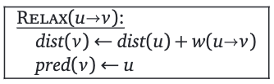
5
2
3
90
16A
u
v
单源最短路
Your mind will answer most questions if you learn to relax and wait for the answer. Like one of those thinking machines, you feed in your question, sit back, and wait...
--- William S. Burroughs,
Naked Lunch (1959)

Slide 2
Relax

Slide 3
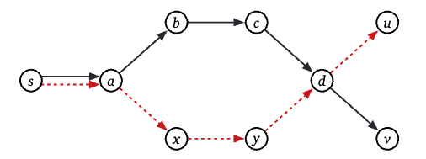
Single Source Shortest Path
从一个顶点, 到达其他顶点的最短距离是什么?
if shortest paths are unique, they form a tree
multiple: shortest path to each vertex, union get a tree
meet, diverge, meet: modify path without changing the length

Slide 4
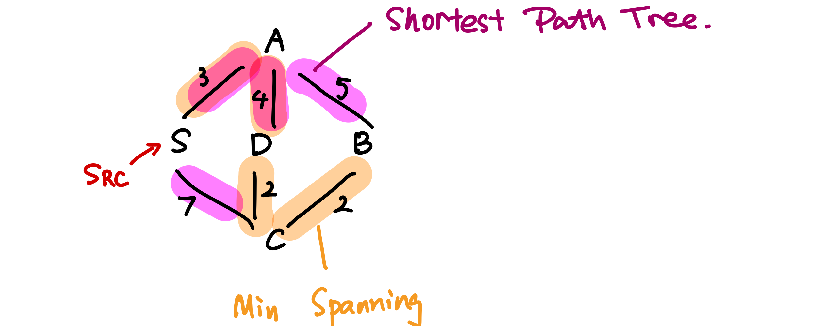
Shortest Path Tree vs. MST
shortest path tree
rooted and directed
minimal spanning tree
unrooted and undirected

Slide 5
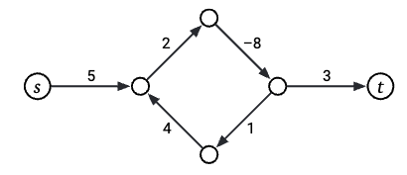
负权边
带有负环的图没有最短路
怎么找负环? (stay tuned)

Slide 6
The only SSSP algorithm

Slide 7
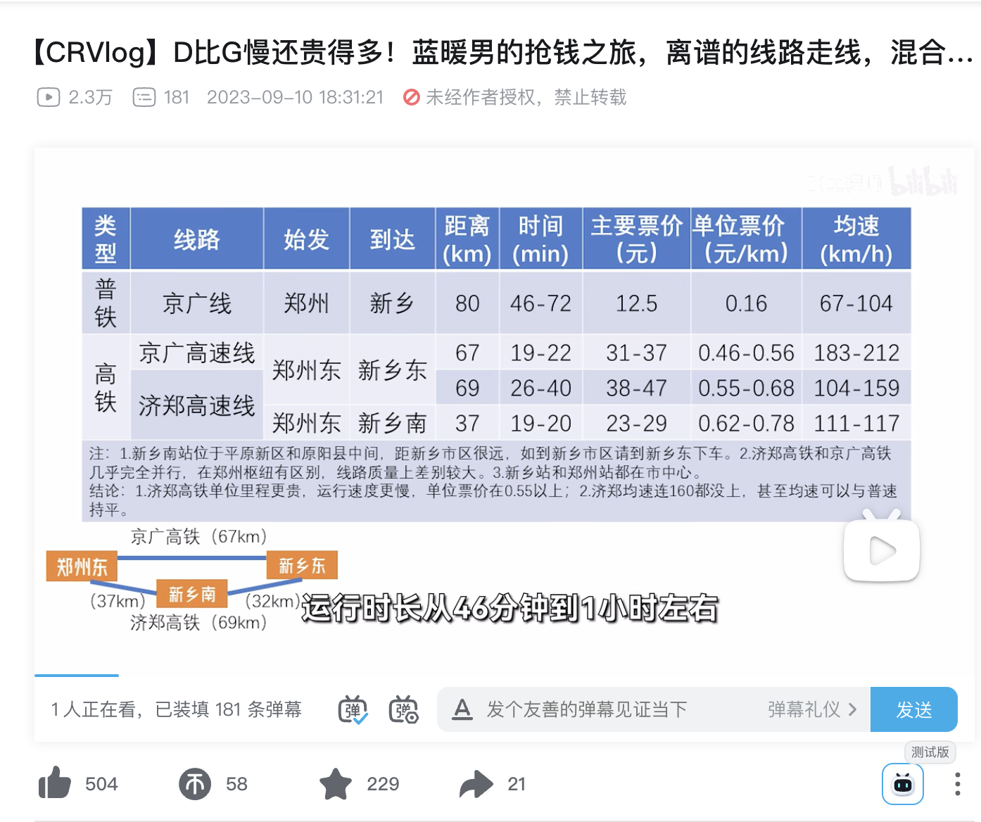
Relax(松弛)

Slide 8
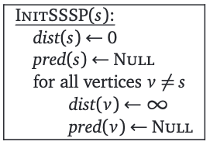
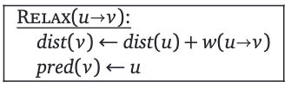
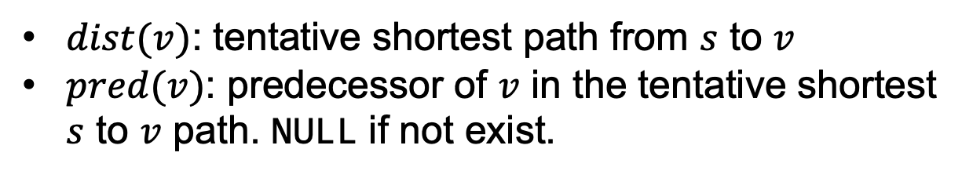
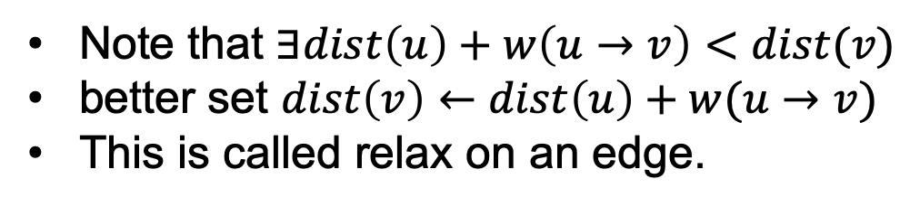
每个节点
$dist(v)$: tentative shortest path from $s$ to $v$
$pred(v)$: predecessor of $v$ in the tentative shortest $s$ to $v$ path. NULL if not exist.
Note that $∃dist\left(u\right)+w\left(u→v\right)<dist(v)$
better set $dist\left(v\right)←dist\left(u\right)+w(u→v)$
This is called relax on an edge.
As long as we relax all edges…

Slide 9
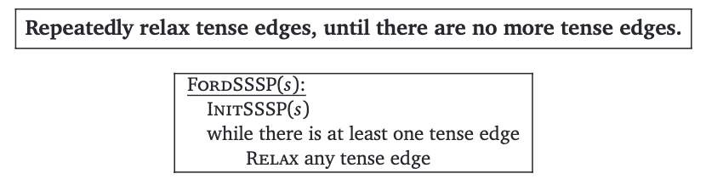
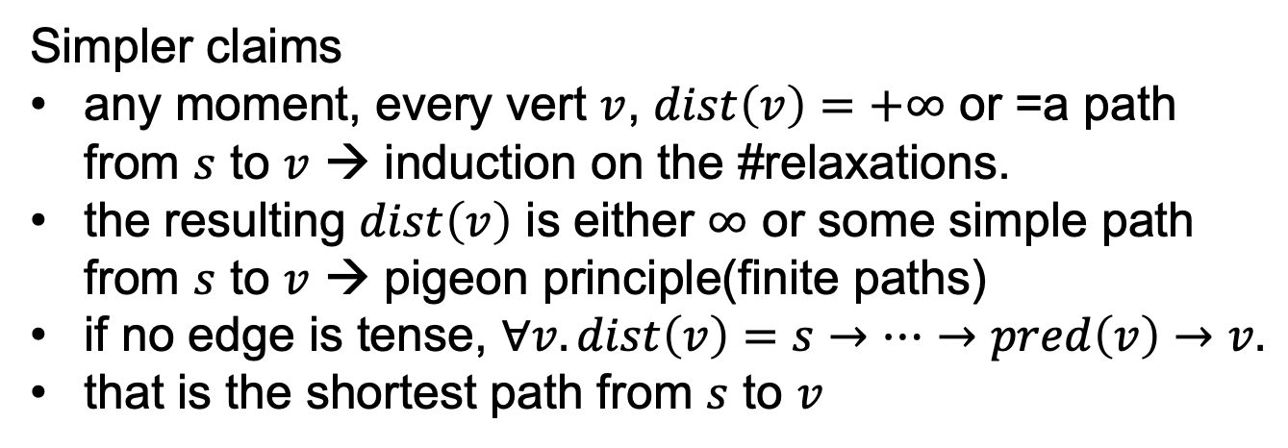
Ford’s algorithm
Without negative cycle, FordSSSP will terminate.
Simpler claims
any moment, every vert $v$, $dist\left(v\right)=+∞$ or =a path from $s$ to $v$ → induction on the #relaxations.
the resulting $dist\left(v\right)$ is either $∞$ or some simple path from $s$ to $v$ → pigeon principle(finite paths)
if no edge is tense, $∀v.dist\left(v\right)=s→…→pred\left(v\right)→v.$
that is the shortest path from $s$ to $v$

Slide 10
Relaxing edges
find? how to relax?
depends on
the property of the graph
negative cycle? weighted? …
4 variants
Unweighted graphs – Breadth First Search
Directed Acyclic Graphs – Depth First Search
Best First – Dijkstra's Algorithm
Relax all edges – Bellman-Ford

Slide 11
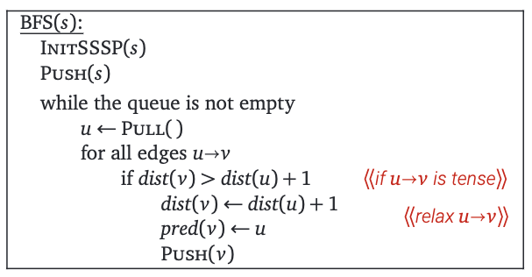

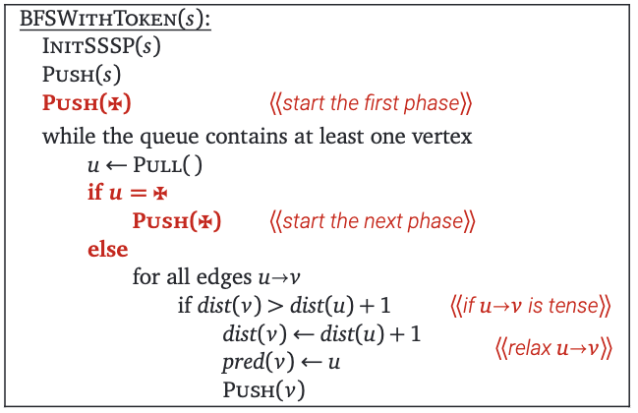
Unweighted Graphs
为方便分析: 在每一 “层” 结束之前插入一个虚拟的记号

Slide 12
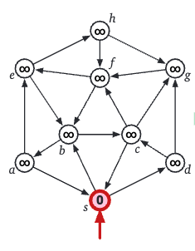
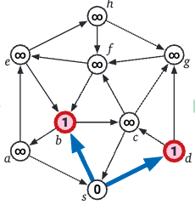


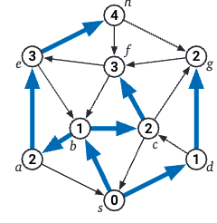
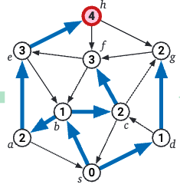
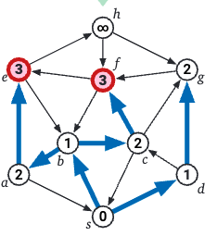
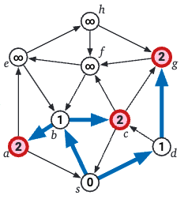



例子

Slide 13

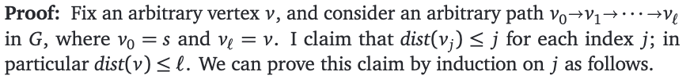
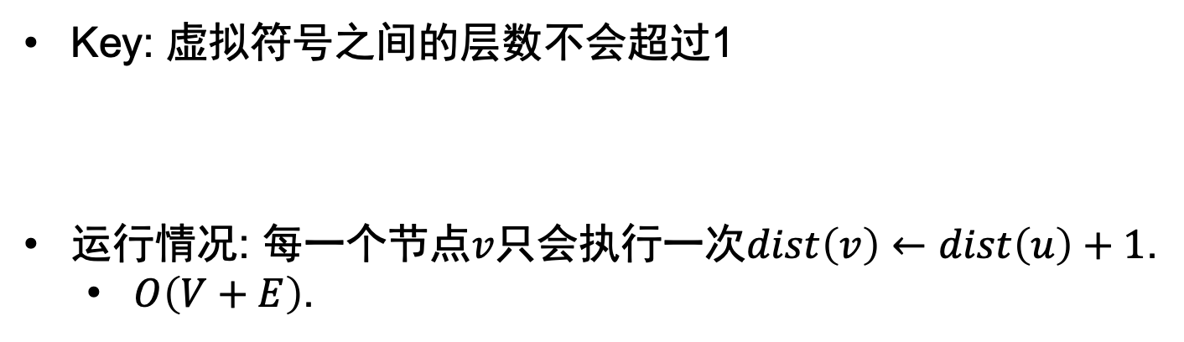
为什么正确?
Key: 虚拟符号之间的层数不会超过1
运行情况: 每一个节点$v$只会执行一次$dist\left(v\right)←dist\left(u\right)+1$.
$O\left(V+E\right)$.
…

Slide 14
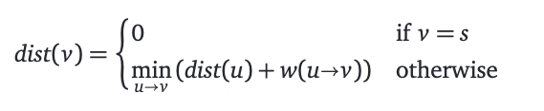
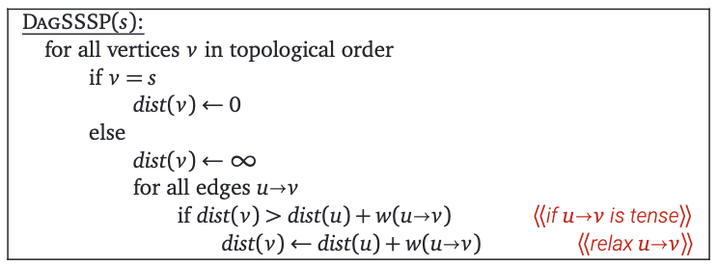
DAG: 深度优先搜索
DAG方便我们递归

Slide 15
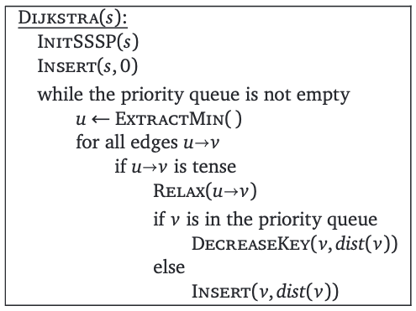
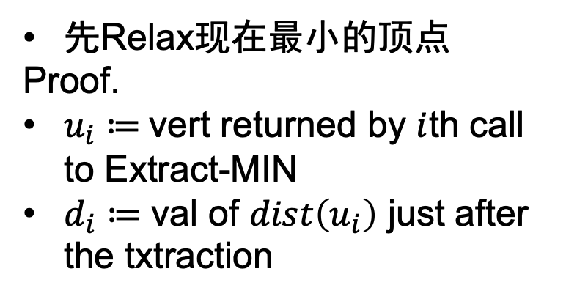
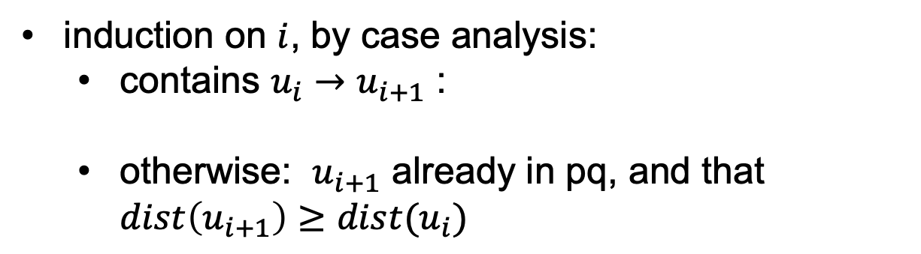
Dijkstra算法
先Relax现在最小的顶点
Proof.
$u_{i}≔$vert returned by $i$th call to Extract-MIN
$d_{i}≔$ val of $dist\left(u_{i}\right)$ just after the txtraction
induction on $i$, by case analysis:
contains $u_{i}→u_{i+1}$ :
otherwise: $u_{i+1}$ already in pq, and that $dist\left(u_{i+1}\right)≥dist(u_{i})$

Slide 16
Dijkstra算法
先Relax现在最小的顶点
Proof.
$u_{i}≔$vert returned by $i$th call to Extract-MIN
$d_{i}≔$ val of $dist\left(u_{i}\right)$ just after the txtraction
more than once, reinserted, must somehow make it decreased
negative edge, contradiction!

Slide 17
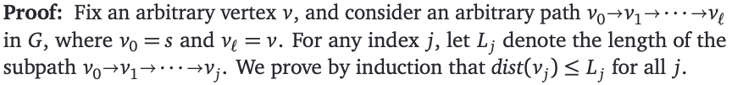
Dijkstra算法
先Relax现在最小的顶点
Proof.
$u_{i}≔$vert returned by $i$th call to Extract-MIN
$d_{i}≔$ val of $dist\left(u_{i}\right)$ just after the txtraction
…(like before)

Slide 18
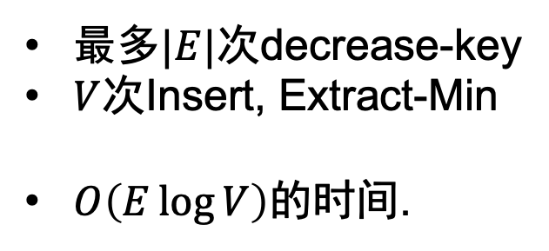
Dijkstra算法: 时间复杂度
最多$|E|$次decrease-key
$V$次Insert, Extract-Min
$O\left(E\log{V}\right)$的时间.

Slide 19
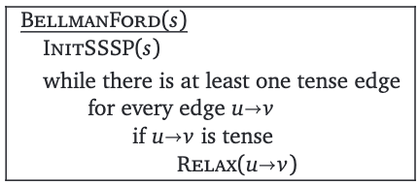

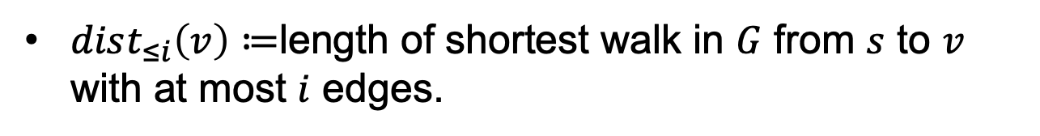
Bellman-Ford算法
how many?
$dist_{≤i}\left(v\right)≔$length of shortest walk in $G$ from $s$ to $v$ with at most $i$ edges.

Slide 20
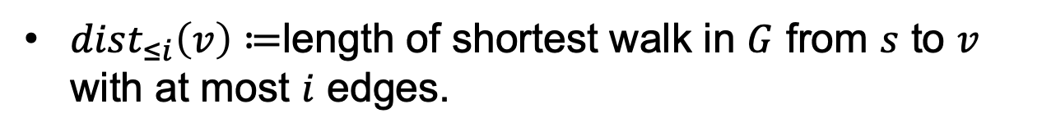

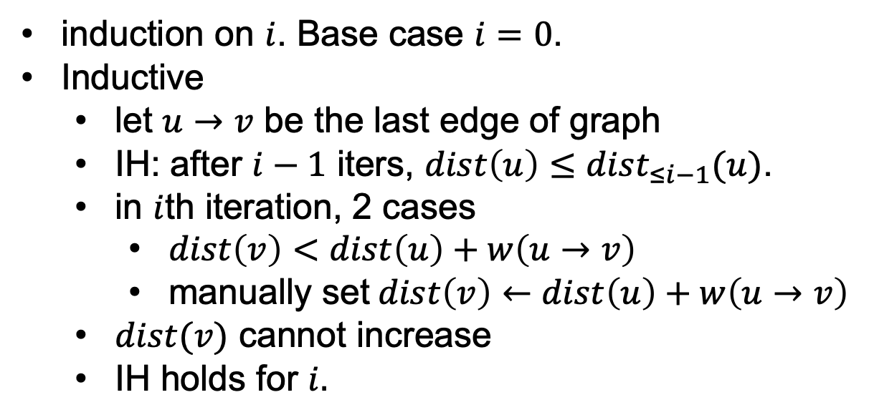
Relax $i$ 次就足够了
$dist_{≤i}\left(v\right)≔$length of shortest walk in $G$ from $s$ to $v$ with at most $i$ edges.
induction on $i$. Base case $i=0$.
Inductive
let $u→v$ be the last edge of graph
IH: after $i−1$ iters, $dist\left(u\right)≤dist_{≤i−1}(u)$.
in $i$th iteration, 2 cases
$dist\left(v\right)<dist\left(u\right)+w\left(u→v\right)$
manually set$dist\left(v\right)←dist\left(u\right)+w\left(u→v\right)$
$dist(v)$ cannot increase
IH holds for $i.$

Slide 21
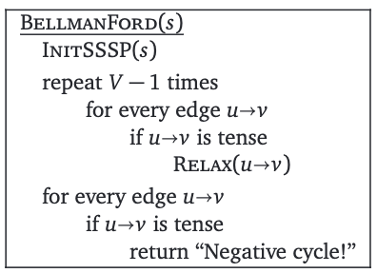
另一个作用: 找到负环
有负环→可以一直松弛

Slide 22
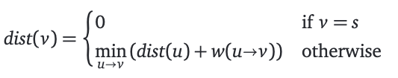
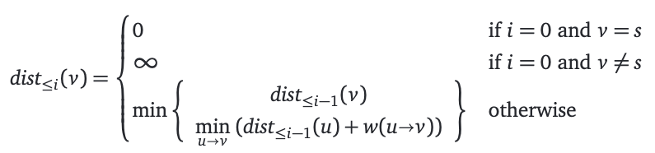
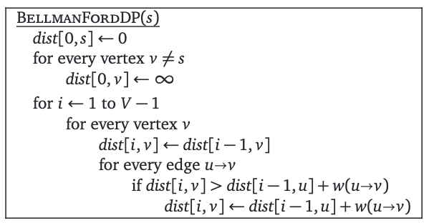

另一个视角: 动态规划的式子
不是DAG, 不管用
限制走过的边数!
$$O\left(VE\right)$$
和Bellman Equation有什么关系?

Slide 23
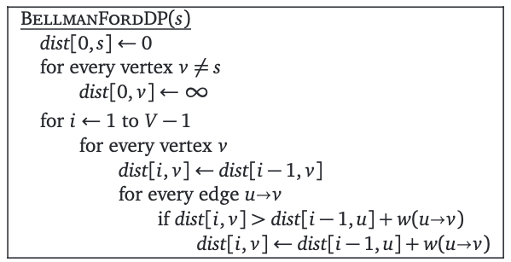
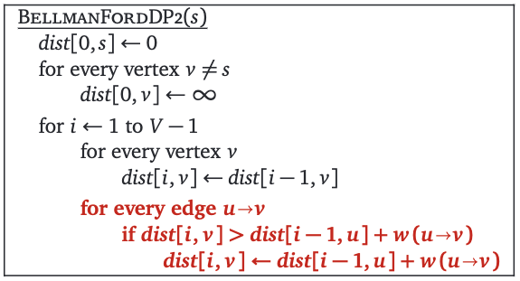
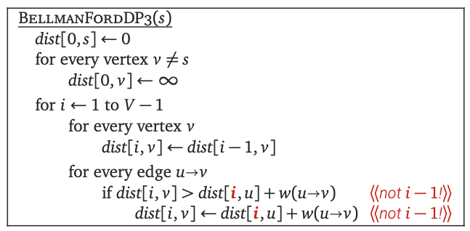
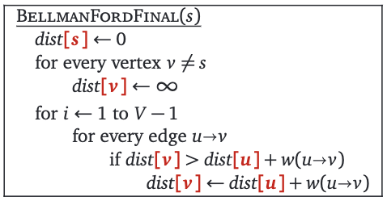
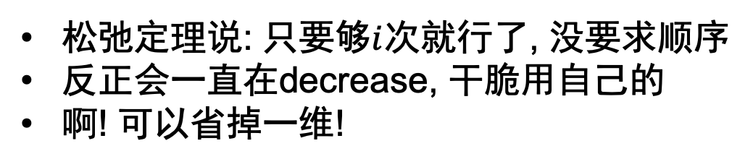
一点变化
松弛定理说: 只要够$i$次就行了, 没要求顺序
反正会一直在decrease, 干脆用自己的
啊! 可以省掉一维!

Slide 24
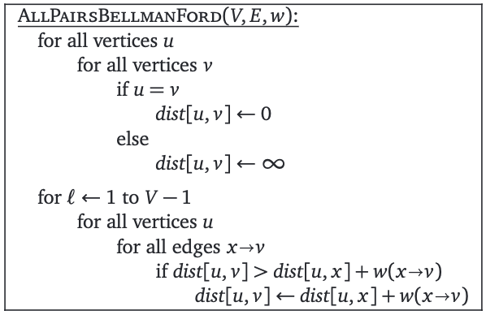
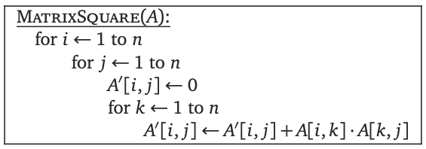
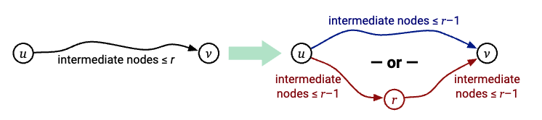
16B
全源最短路
合抱之木，生于毫末；
九層之台，起于纍土；
千里之行，始于足下。
–––– 老子,《道德经》第六十四章

Slide 25
Bellman的动态规划方法

Slide 26

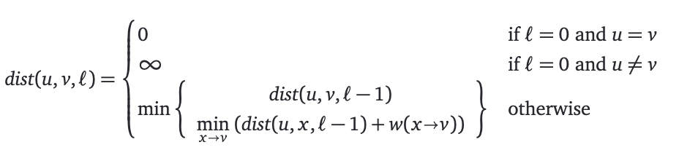
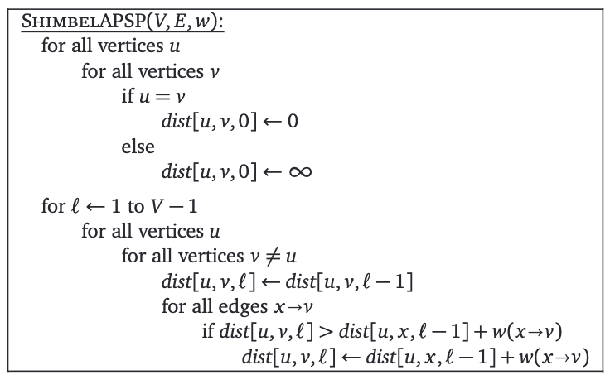
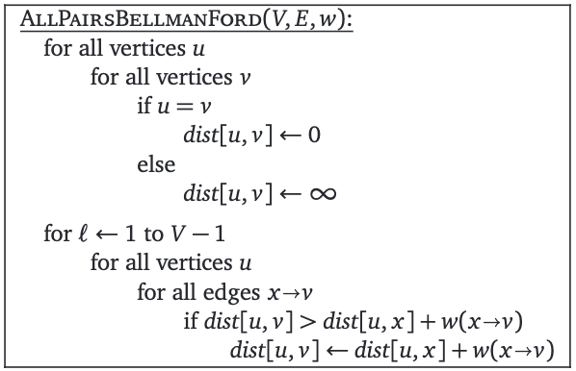
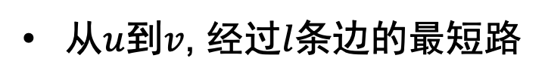
再来改一改
从$u$到$v$, 经过$l$条边的最短路

Slide 27
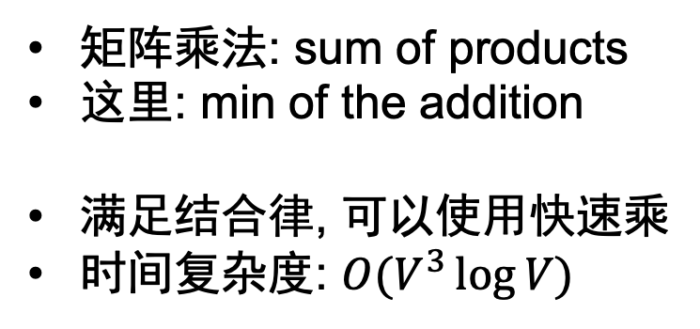
有点像矩阵乘法
矩阵乘法: sum of products
这里: min of the addition
满足结合律, 可以使用快速乘
时间复杂度: $O(V^{3}\log{V})$

Slide 28
Kleene-Roy-Floyd-Warshall-Ingerman算法

Slide 29

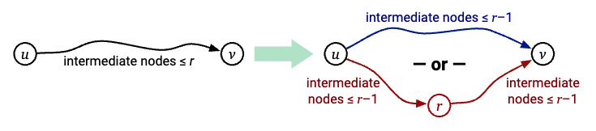

Floyd的观察
给每个点编号$1…V$
是具有optimal substructure的

Slide 30



这样定义的最优子结构

Slide 31


然后就有
编号是任意的, 可以省去

Slide 32


QQ: 2095728218
gwzhang@cug.edu.cn

