Slide 1
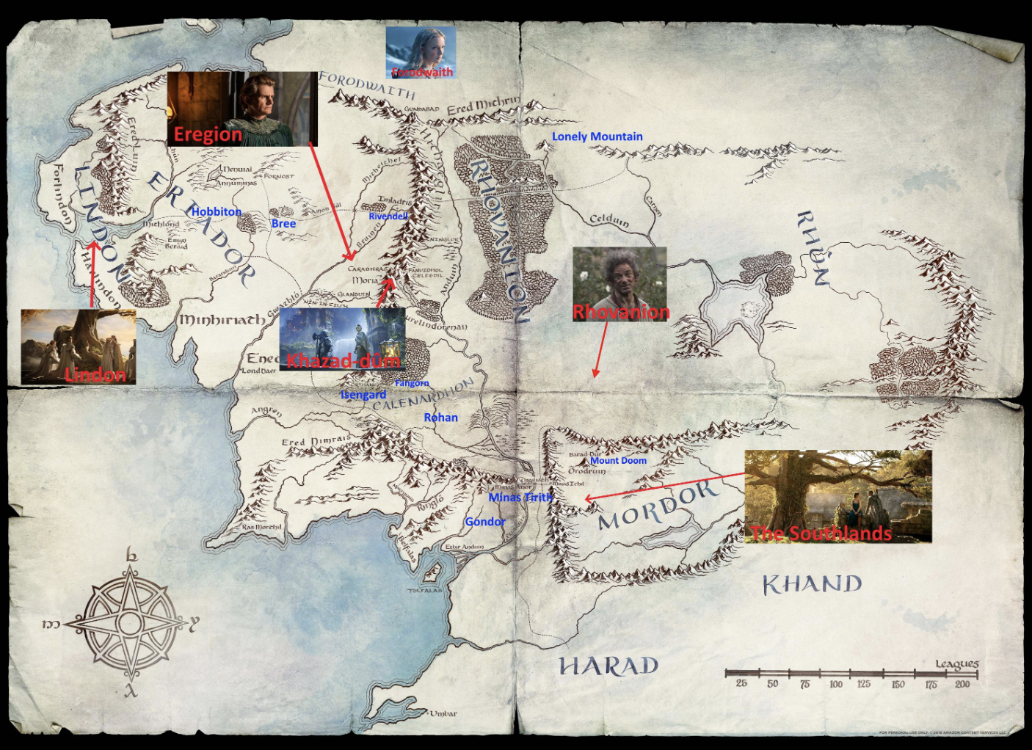
在计算机中, 一般会从0开始计数. 因此, 我们也从0开始作为第一个话题
Topic 0
概览
You must have a map, no matter how rough. Otherwise you wander all over the place. In The Lord of the Rings I never made anyone go farther than he could on a given day.
by J. R. R. Tolkien

Slide 2
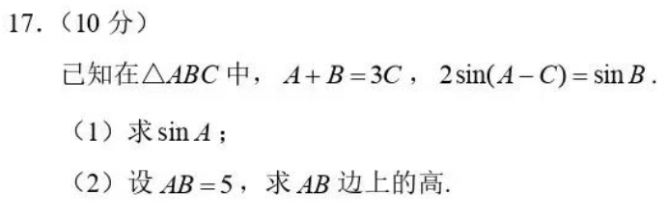
例子(1)
提问:你知道: 已知在三角形ABC中，A+B=3C， 2sin(A-C) = sin B. 这个如何用Wolfram Mathematica翻译吗?

