Slide 1
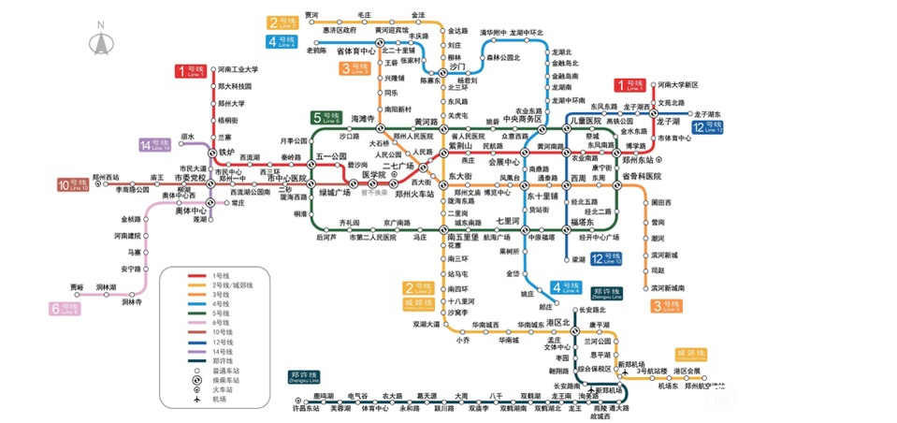
13
图: 定义、存储以及遍历
[T]he distributions and partitions of knowledge are not like several lines that meet in one angle, and so touch but in a point, but are like branches of a tree that meet in a stem, which hath a dimension and quantity of entireness and continuance before it come to discontinue and break itself into arms and boughs.
--- Francis Bacon, The advancement of Learning(1605)

Slide 2
常用术语

Slide 3
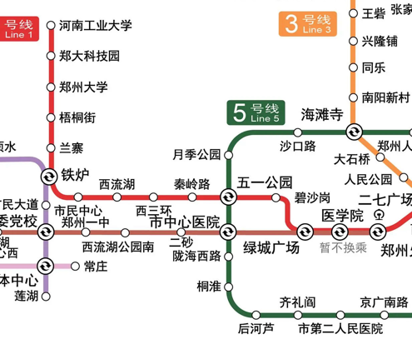
常用术语
顶点(vertex)
自身:度
与其他顶点: 相邻

Slide 4
各种各样的图

Slide 5
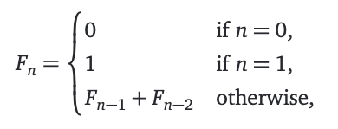
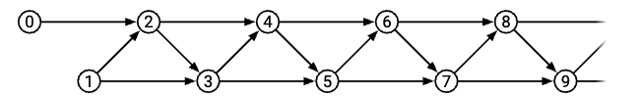
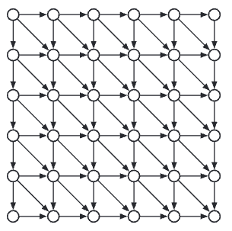
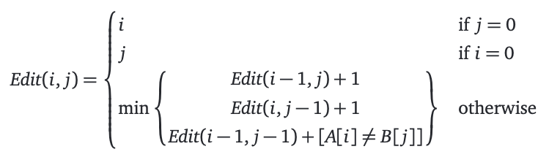
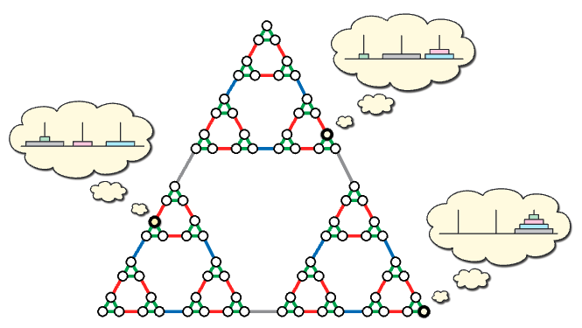
调用关系图

Slide 6
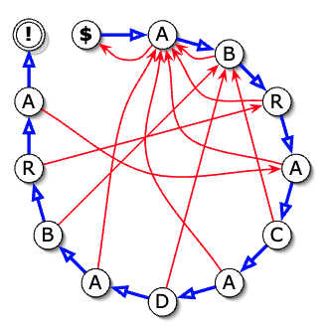
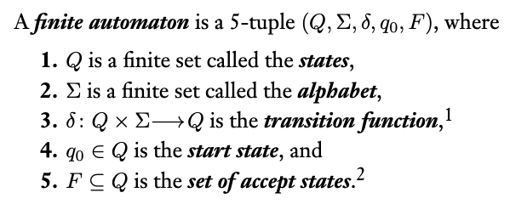
字符串匹配的 “自动机”

Slide 7
图的存储

Slide 8
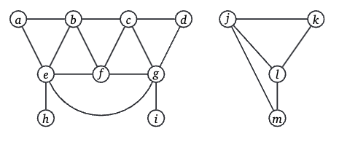


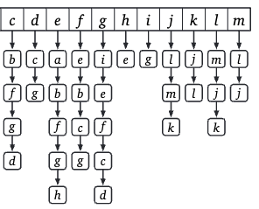
Take 1:回顾二叉树
链表: 有一个next
二叉树: 有两个next(left, right)
图: 我也不知道有几个next
干脆把这 “不知道几个next” 给串成链表!

Slide 9
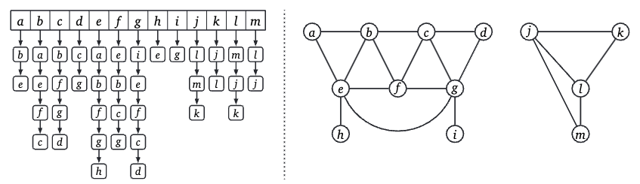
Take 1: Adjacency Lists
Adjacency = list if adjacent

Slide 10
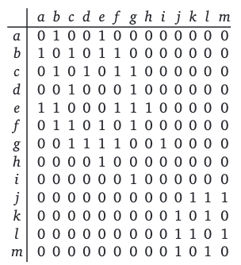
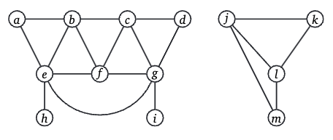
Take 2: 枚举所有可能的边

Slide 11
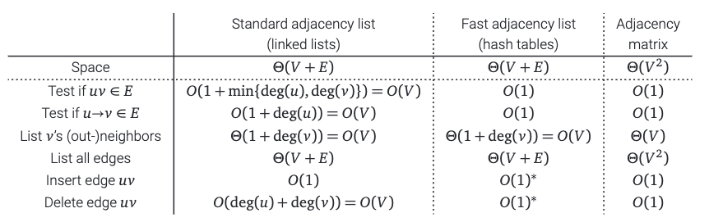
比较: 谁更好?

Slide 12
遍历与可达性

Slide 13
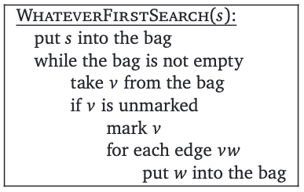
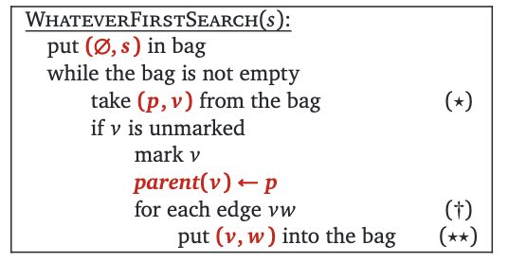
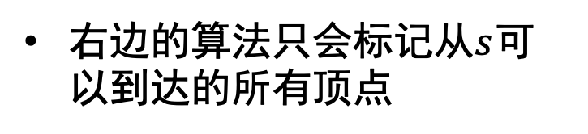

通用的算法 – XX优先遍历
右边的算法只会标记从$s$可以到达的所有顶点
如何说明? 看看每个节点的父亲
父亲的父亲的父亲的…一定是$s$

Slide 14

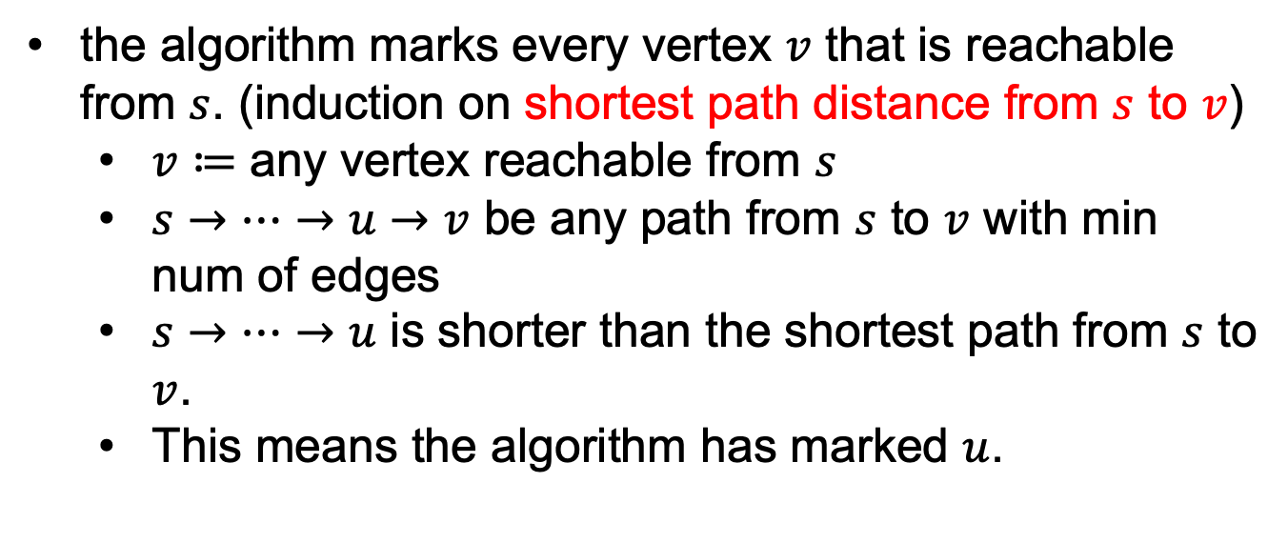
证明: XX优先遍历是完全的
the algorithm marks every vertex $v$ that is reachable from $s$. (induction on shortest path distance from $s$ to $v$)
$v≔$ any vertex reachable from $s$
$s→…→u→v$ be any path from $s$ to $v$ with min num of edges
$s→…→u$ is shorter than the shortest path from $s$ to $v$.
This means the algorithm has marked $u$.

Slide 15
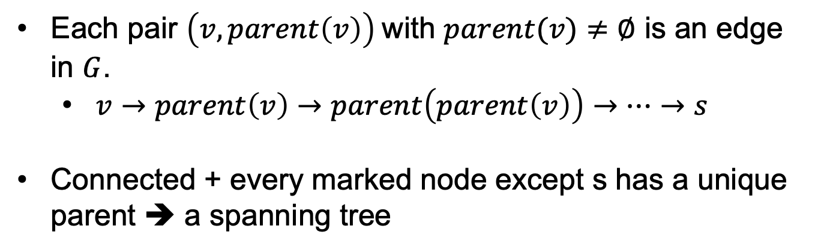
证明: XX优先遍历是完全的(继续)
Each pair $\left(v,parent\left(v\right)\right)$with $parent(v)≠∅$ is an edge in $G$.
$v→parent\left(v\right)→parent\left(parent\left(v\right)\right)→…→s$
Connected + every marked node except s has a unique parent ➔ a spanning tree

Slide 16
看看那个 bag 怎么实现?
item’
栈
push
pop
item’
item
item
O(1)
Depth First
More on this on Section 14.
队列
dequeue
enqueue
item’
item
item
item
item’
Breadth First

Slide 17
看看那个 bag 怎么实现? (继续)
优先队列
item
Extract-Min
item
item
Insert
item
Best First
More on this on Section 15.

Slide 18
BFS例子

Slide 19
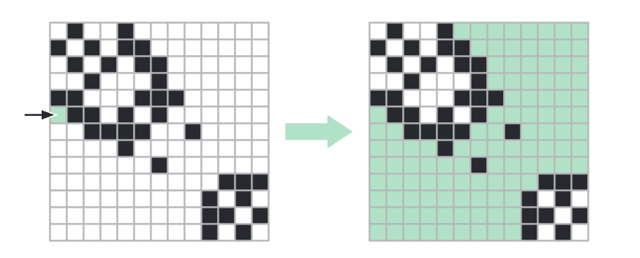
Floodfill: 实例

Slide 20
状态表示与寻路

Slide 21
按照依赖关系排序(Topological Sort)
Idea:
先 “学习” 没有前置课程的课程(没有入度)
然后, 去掉这些, 看看还有哪些节点没有入度

Slide 22


QQ: 2095728218
gwzhang@cug.edu.cn

