Slide 1


QQ: 2095728218
gwzhang@cug.edu.cn

Slide 2
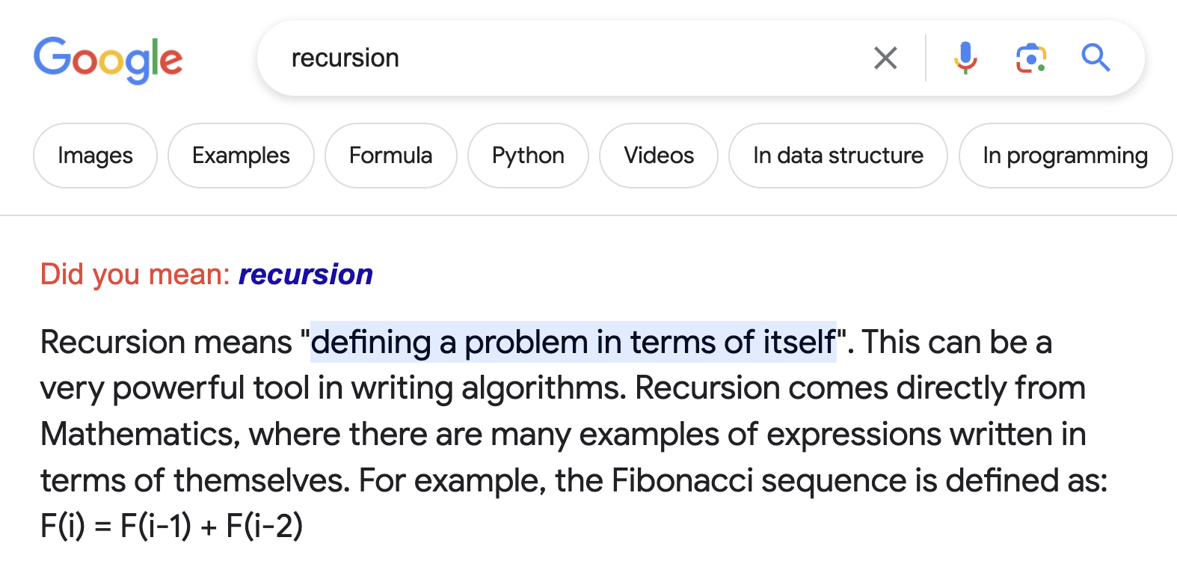
3
递归地求解问题
If you already know what recursion is, just remember the answer. Otherwise, find someone who is standing closer to Douglas Hofstadter than you are; then ask him or her what recursion is.
by Andrew Plotkin

Slide 3
热身练习

Slide 4
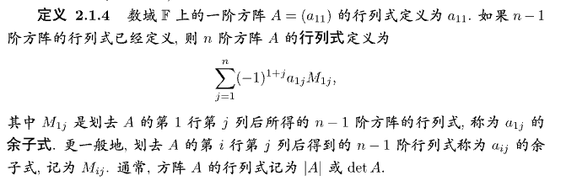
Warmup
base case
行列式的定义
Fibonacci数列的定义
base case

Slide 5
Hanoi塔问题
peg(柱子)
1
2
3
Rule:
Only one disk can be moved at a time
Each move consists of taking the upper disk from one of the stacks and placing it on top of another stack or on an empty rod.
No disk may be placed on top of a disk that is smaller than it.

Slide 6
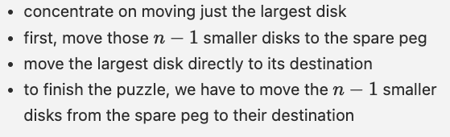
Hanoi塔问题: 解决
STOP THINKING ABOUT n-1 PILLARS!!!
WE ARE DONE SO FAR!
recursion/hanoi-tower.c

Slide 7
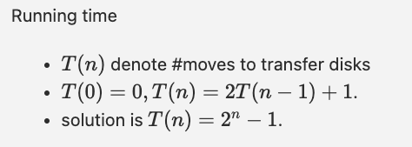
花了多少时间?
(高中数列问题)

Slide 8
排序问题回顾I: MergeSort

Slide 9
排序问题: Revisited
Divide the input array into two subarrays of roughly equal size.
Recursively sort each of the subarrays.
Merge the newly-sorted subarrays into a single sorted array.
(how?)

Slide 10
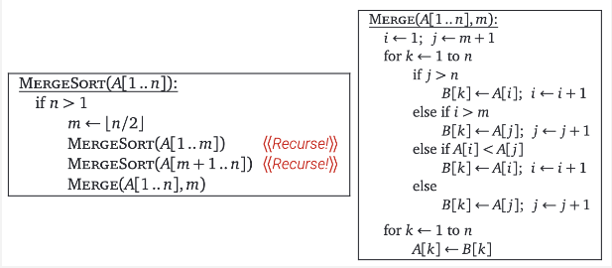
大致思路

Slide 11
正确性证明
归纳法永远是你的好朋友
Merge过程是对的
MergeSort是对的
Jeff Erickson Chapter 2
Lemma X.XX

Slide 12
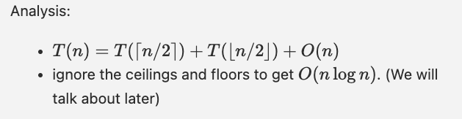
用多少时间?
为什么可以去掉取整记号?
太小了? 有多小? 误差会累计吗?
Aside: O本身就是一个非常粗略的记号

Slide 13
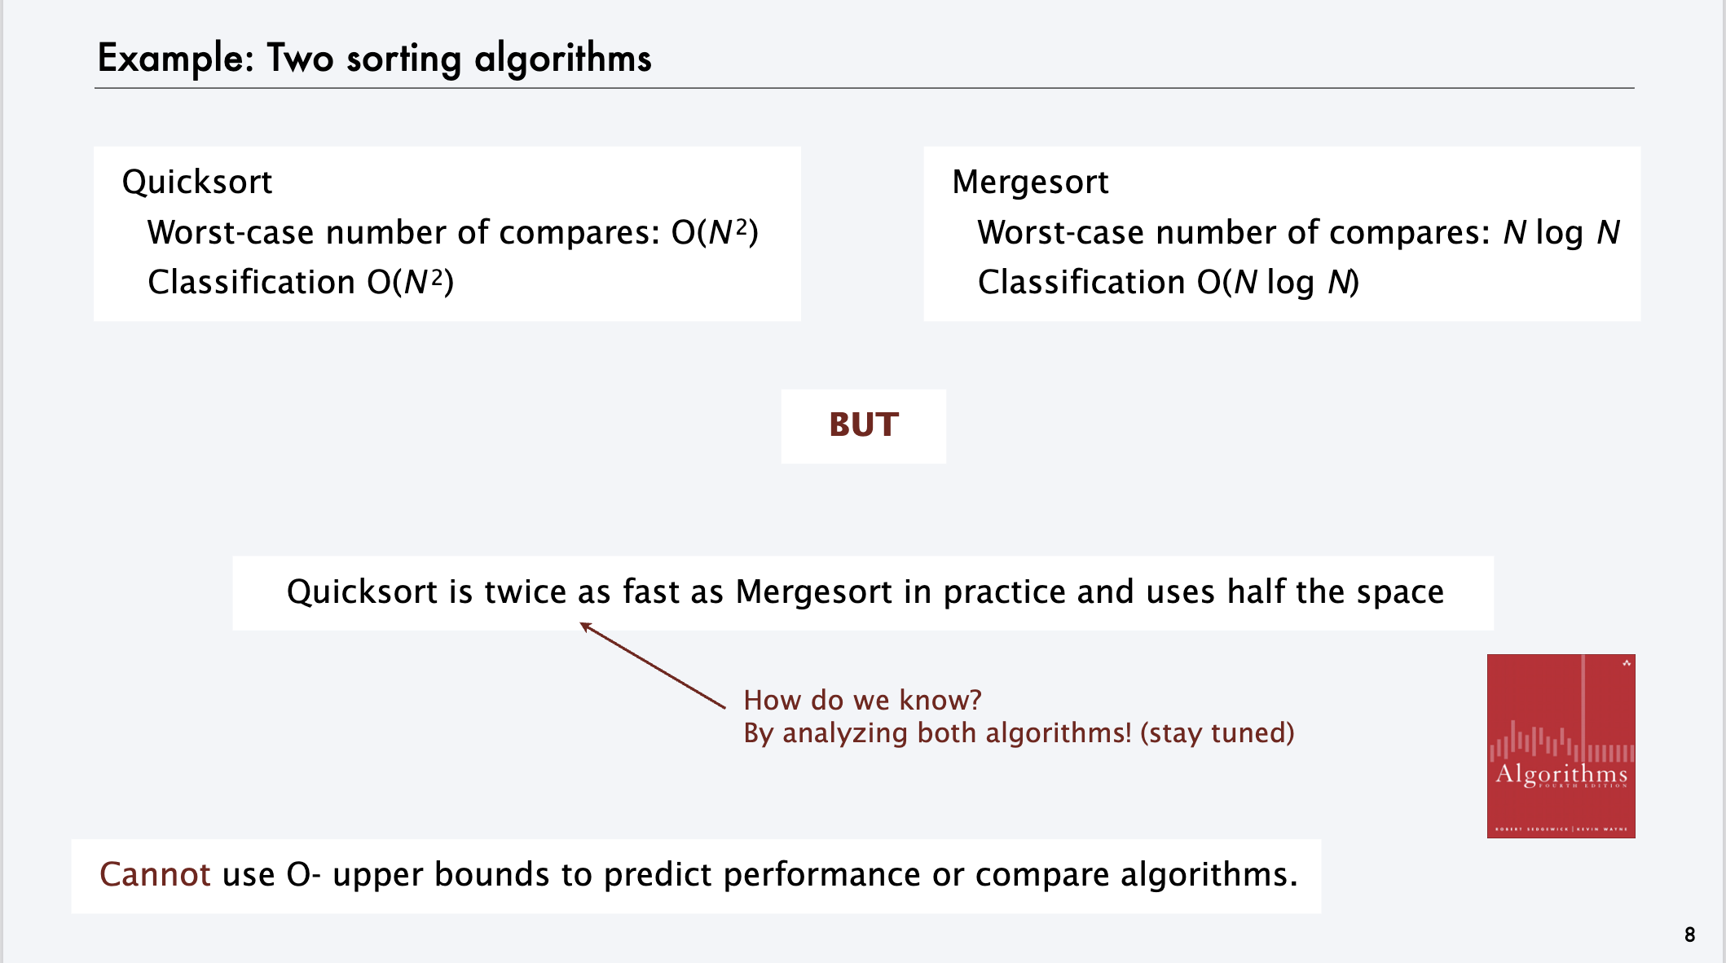
Aside: 大O记号是一个非常粗略的估计
选自Analysis of Algorithms (Coursera)

Slide 14
排序问题

