Slide 1

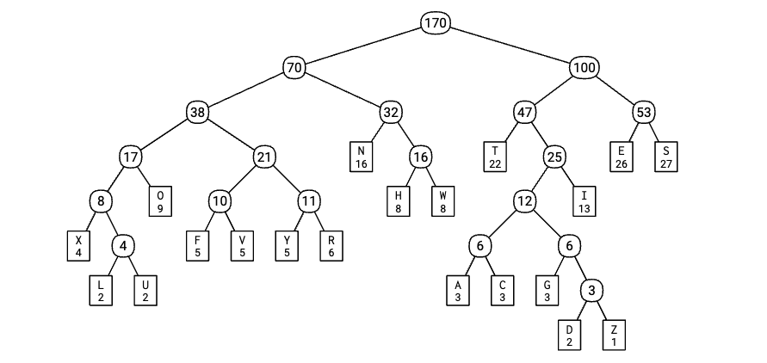
11
贪心算法
最优编码的Huffman树
Huffman decided to solve the problem as a class project, instead of taking a final exam, not realizing that the problem was open, or that Fano and Shannon had already tried and failed to solve it. After several months of fruitless effort, Huffman eventually gave up and decided to take the final exam after all. As he was throwing his notes in the trash, the solution dawned on him. Huffman would later describe the epiphany as "the absolute lightning of sudden realization".
--- Jeff Erickson, Algorithms

Slide 2
回顾: 最优子结构

Slide 3
例子: 编辑距离 – 介绍
The edit distance between 2 strings is the min number of
letter insertions
letter deletions
letter substitutions
required to transform one string to another.

Slide 4
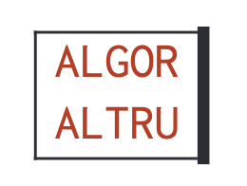
例子: 编辑距离 – 递归
The edit distance between 2 strings is the min number of
letter insertions
letter deletions
letter substitutions
required to transform one string to another.
💡 remove the last column
remaining columns must represent the shortest edit sequence for the remaining prefixes.
(optimal consists of optimal) → Optimal substructure

Slide 5
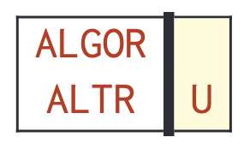

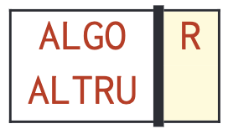

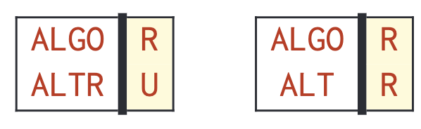

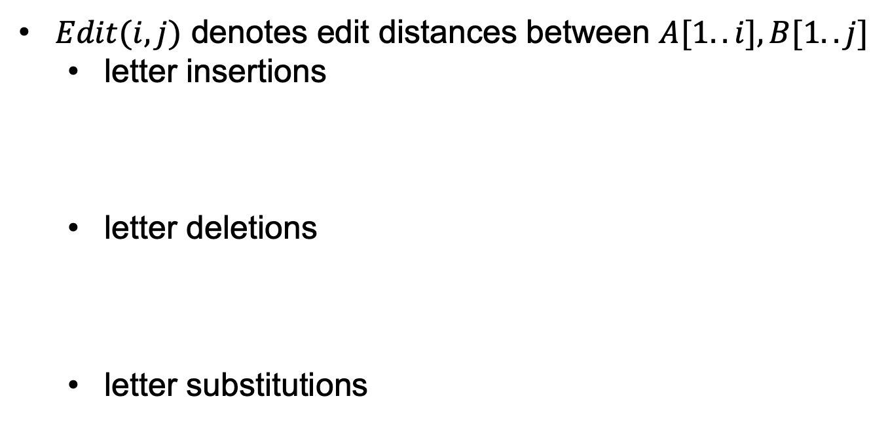
例子: 编辑距离 – 递归(继续)
$Edit(i,j)$ denotes edit distances between $A[1..i], B[1..j]$
letter insertions
letter deletions
letter substitutions

Slide 6
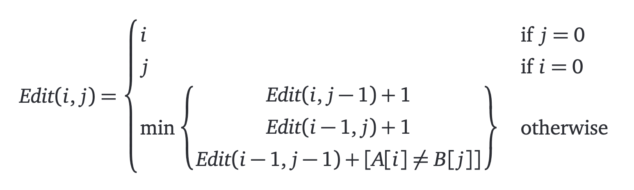
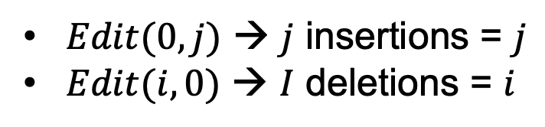
例子: 编辑距离 – 递归(Base case)
$Edit(0,j)$ → $j$ insertions = $j$
$Edit(i,0)$ → $I$ deletions = $i$

Slide 7
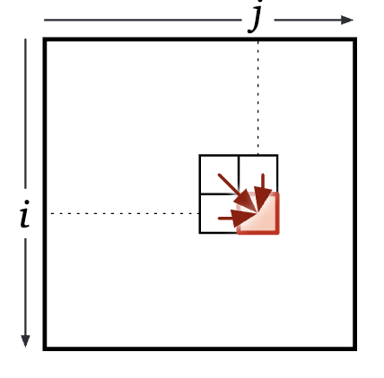
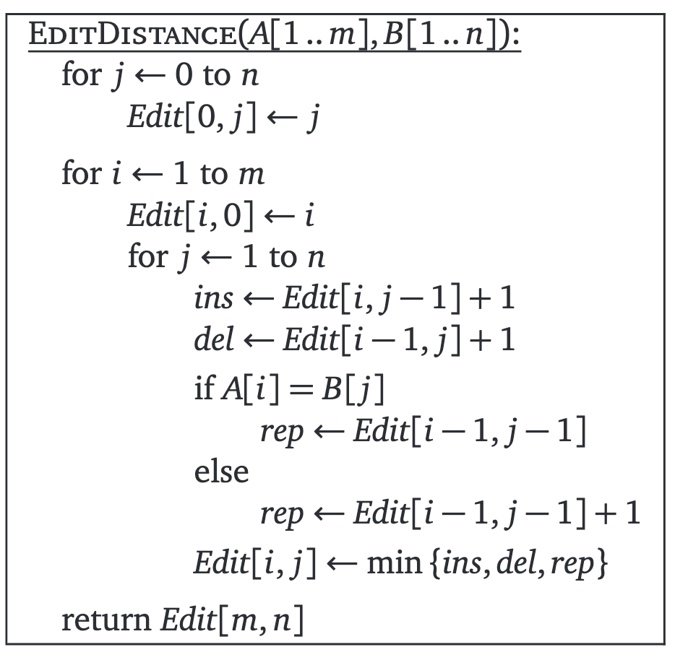
例子: 编辑距离 – 动态规划
Formulate the problem recursively
Specification
Solution
Build your solution from bottom up
Subproblems?
how to memorize?
dependencies?
evaluation order?
space and running time
write down your algorithm
2D array

Slide 8
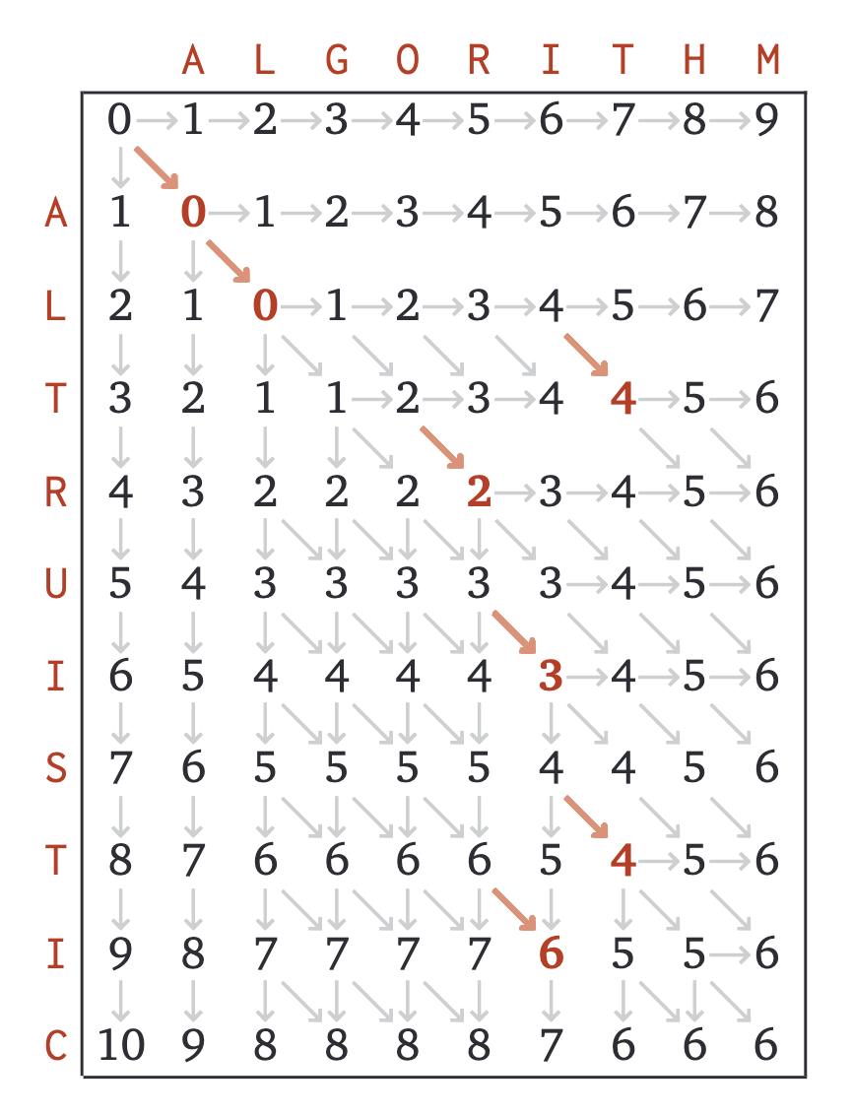
编辑距离 – 运行的例子
Optimal substructure
a problem is said to have optimal substructure if an optimal solution can be constructed from optimal solutions of its subproblems

Slide 9
一些例子

Slide 10
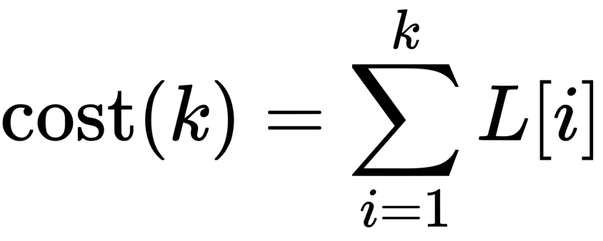
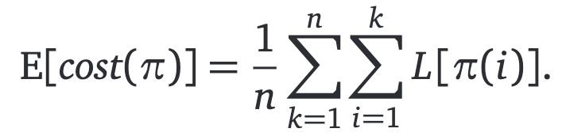
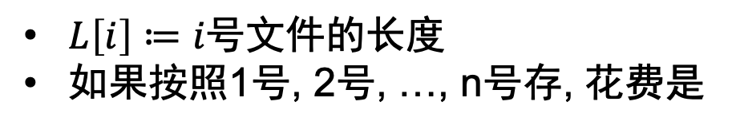
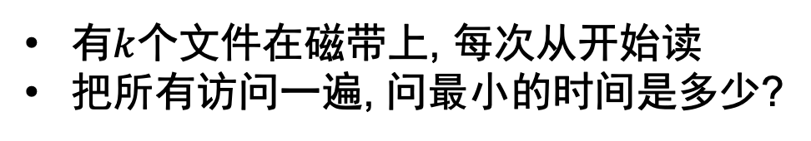
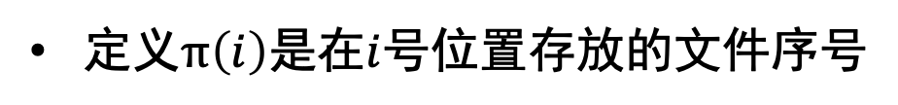
Storing file on a tape
有$k$个文件在磁带上, 每次从开始读
把所有访问一遍, 问最小的时间是多少?
$L\left[i\right]≔i号文件的长度$
如果按照1号, 2号, …, n号存, 花费是
定义$π\left(i\right)$是在$i$号位置存放的文件序号

Slide 11


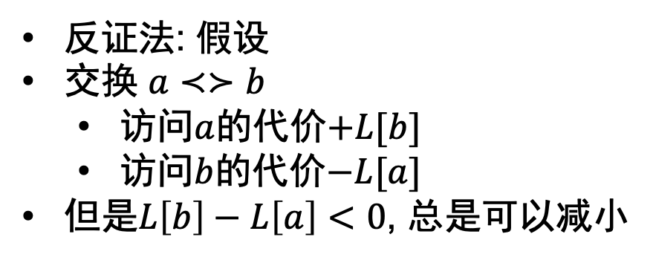
最小化?
a
b
反证法: 假设
交换 $a≺≻b$
访问$a$的代价$+L[b]$
访问$b$的代价$−L[a]$
但是$L\left[b\right]−L\left[a\right]<0$, 总是可以减小
更进一步: 还有$F\left[1..n\right]$表示$i号$文件会被访问$F\left[i\right]次.$

Slide 12



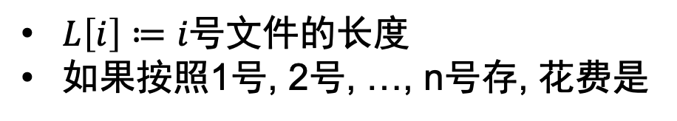
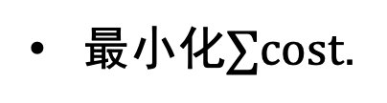
Storing file on a tape II
$L\left[i\right]≔i号文件的长度$
如果按照1号, 2号, …, n号存, 花费是
更进一步: 还有$F\left[1..n\right]$表示$i号$文件会被访问$F\left[i\right]次.$
最小化$∑cost$.
性价比?
总是improvement

Slide 13

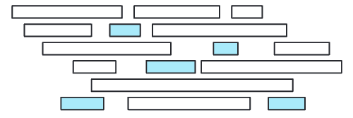
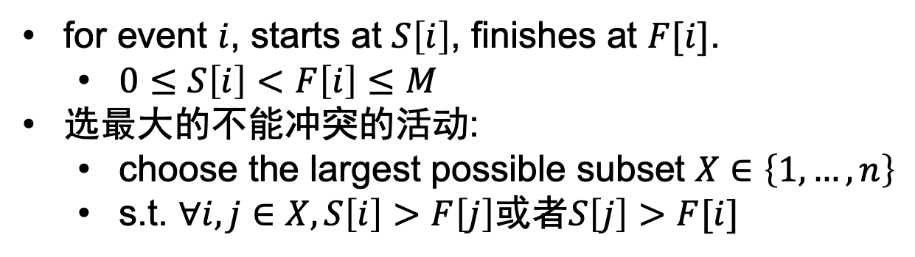
活动安排
I can solve it!
for event $i$, starts at $S\left[i\right]$, finishes at $F[i]$.
$0≤S\left[i\right]<F\left[i\right]≤M$
选最大的不能冲突的活动:
choose the largest possible subset $X∈\left\{1,…,n\right\}$
s.t. $∀i,j∈X,S\left[i\right]>F\left[j\right]$或者$S\left[j\right]>F[i]$

Slide 14
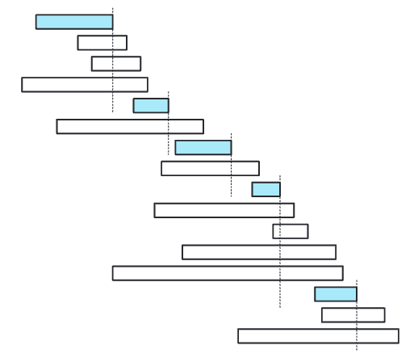
活动安排: 最优子结构
面对一门课: 选不选?
选 → 只能选结束的比这门课早/开始的比这门课晚的课
不选 → 可以看看下一门课
Idea1. 定义SelectClass(number, start, end)
Idea2. 让第一门课结束地越早越好
Scan through the classes in order of finish time;
whenever you encounter a class that doesn’t conflict with your latest class so far, take it

Slide 15
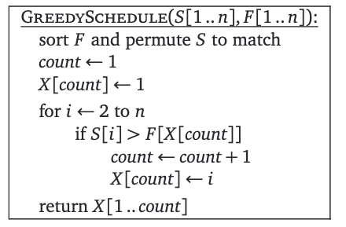



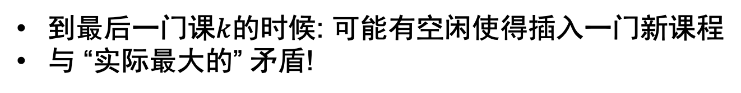
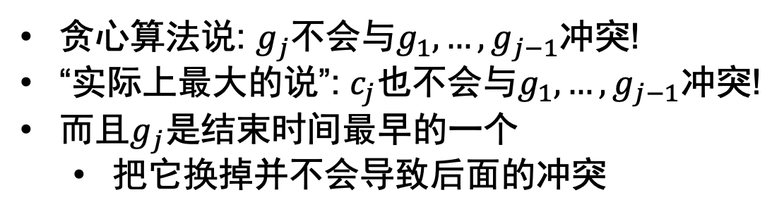
活动安排: 证明
g for greedy
假设贪心算法选的:
“实际最大的”却是:
和贪心算法不一样
贪心算法说: $g_{j}$不会与$g_{1},…,g_{j−1}$冲突!
“实际上最大的说”: $c_{j}$也不会与$g_{1},…,g_{j−1}$冲突!
而且$g_{j}$是结束时间最早的一个
把它换掉并不会导致后面的冲突
到最后一门课$k$的时候: 可能有空闲使得插入一门新课程
与 “实际最大的” 矛盾!

Slide 16
General Pattern

Slide 17
How to proof correctness?
Inductive change argument
Assume that there is an optimal solution that is different from the greedy solution.
Find the “first” difference between the two solutions.
Argue that we can exchange the optimal choice for the greedy choice without making the solution worse (although the exchange might not make it better).
Must contains Optimal Substructure!
this makes induction work.

Slide 18
例子: Huffman编码

Slide 19
需求: 压缩文件
“映射”: 字母→0,1编码的code
尽可能短:出现的越频繁 → code越短
可以恢复: no code is a prefix of any other(prefix-free)
a=10
b=101

Slide 20
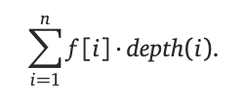
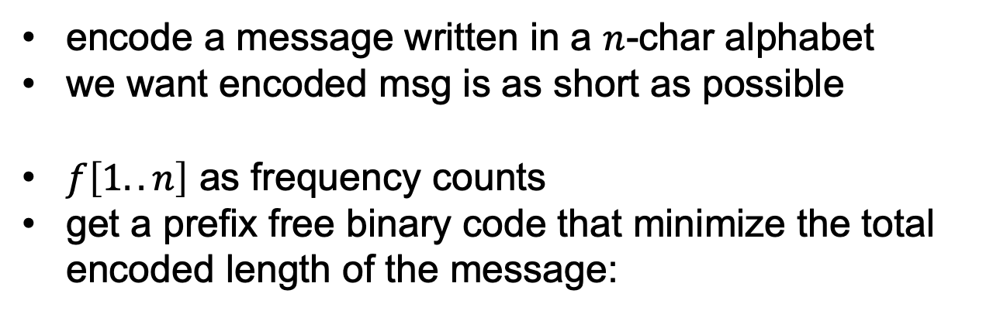
正式地描述
encode a message written in a $n$-char alphabet
we want encoded msg is as short as possible
$f\left[1..n\right]$ as frequency counts
get a prefix free binary code that minimize the total encoded length of the message:
0
1

Slide 21


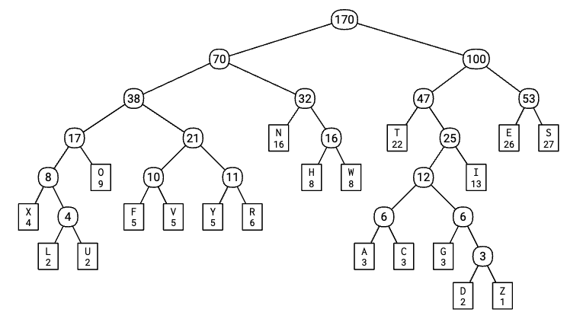
Huffman’s Insight
…

Slide 22
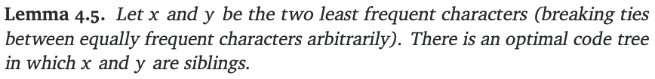

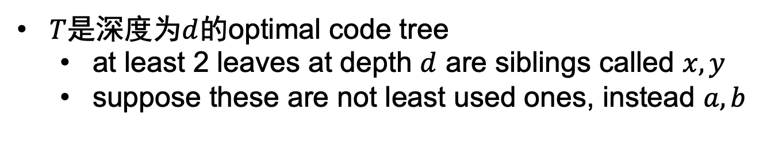




But you have to prove it!
$T$是深度为$d$的optimal code tree
at least 2 leaves at depth $d$ are siblings called $x,y$
suppose these are not least used ones, instead $a,b$
??????????????
$$x$$
$$y$$
$$a$$
$$b$$
贪心算法
“最优的”
$$≠x,y$$

Slide 23

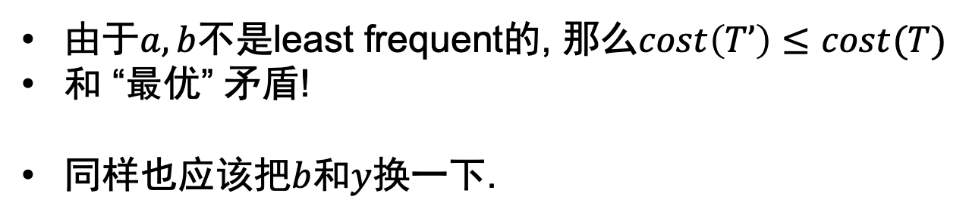
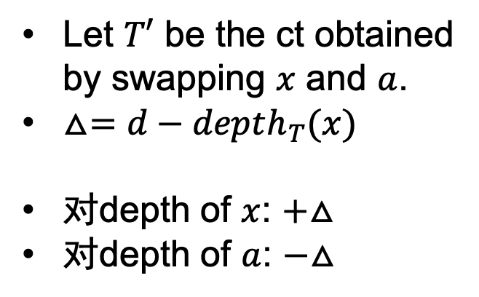


Proof(cont’d)
T’
Let $T′$ be the ct obtained by swapping $x$ and $a$.
$△=d−depth_{T}(x)$
对depth of $x$: $+△$
对depth of $a$: $−△$
??????????????
$$x$$
$$b$$
“最优的”
$$a y$$
由于$a,b$不是least frequent的, 那么$cost\left(T’\right)≤cost(T)$
和 “最优” 矛盾!
同样也应该把$b$和$y$换一下.

Slide 24
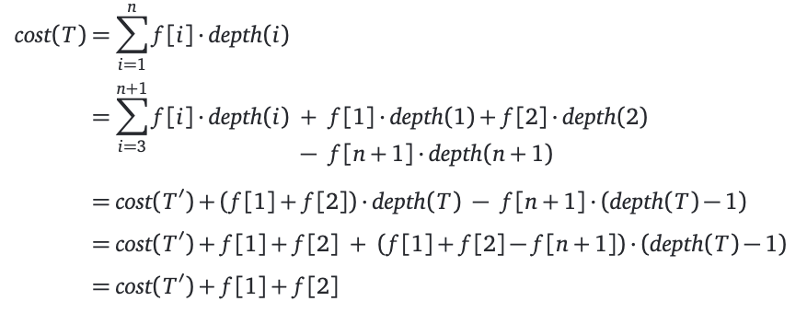
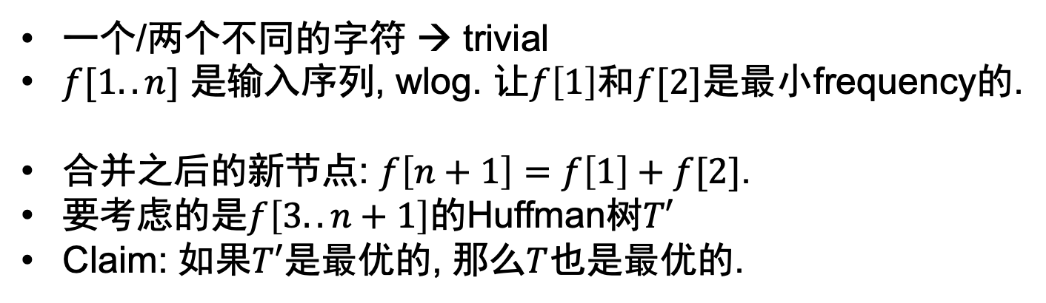
那么是最优的prefix-free的01code吗?
一个/两个不同的字符 → trivial
$f[1..n]$ 是输入序列, wlog. 让$f\left[1\right]和f[2]$是最小frequency的.
合并之后的新节点: $f\left[n+1\right]=f\left[1\right]+f[2]$.
要考虑的是$f\left[3..n+1\right]$的Huffman树$T′$
Claim: 如果$T′$是最优的, 那么$T$也是最优的.

Slide 25
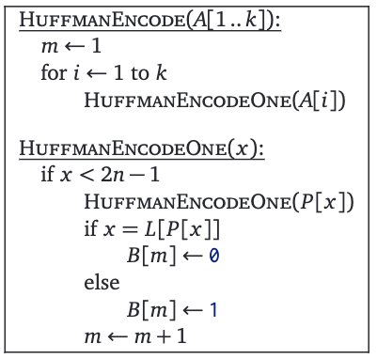
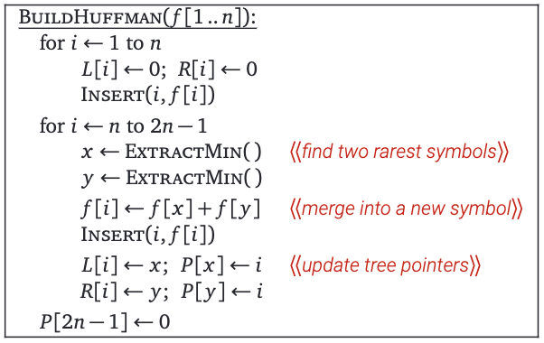
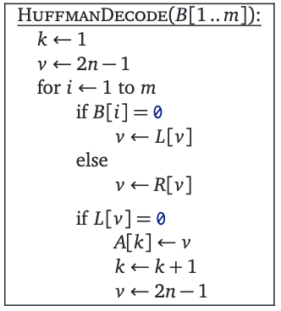
Code

Slide 26


QQ: 2095728218
gwzhang@cug.edu.cn

