Slide 1
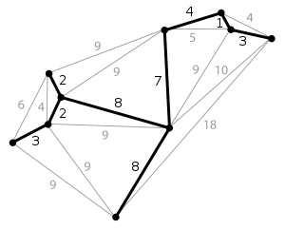
15
最小生成树
I remember seeking advice from someone-who could it have been?-about whether this work was worth submitting for publication; the reasoning it uses is so very simple.... Fortunately he advised me to go ahead, and many years passed before another of my publications became as well-known as this very simple one.
--- Joseph Kruskal,
describing his shortest-spanning-subtree algorithm (1997)

Slide 2
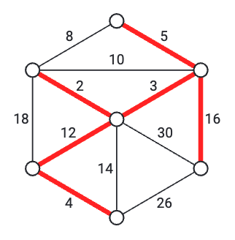
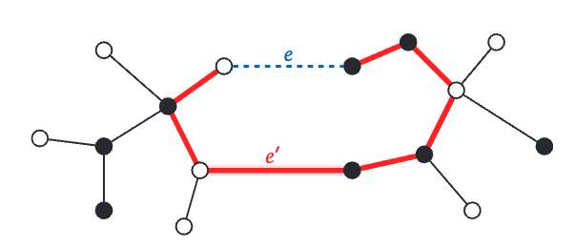
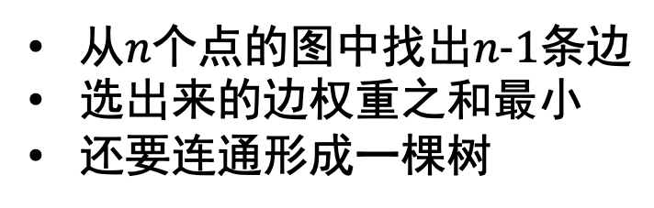
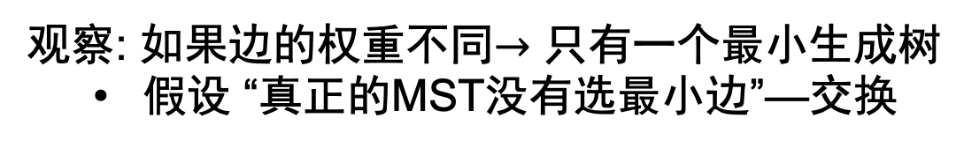
问题描述
从$n个点的$图中找出$n−1条边$
选出来的边权重之和最小
还要连通形成一棵树
观察: 如果边的权重不同$→只有一个最小生成树$
假设 “真正的MST没有选最小边”—交换

Slide 3
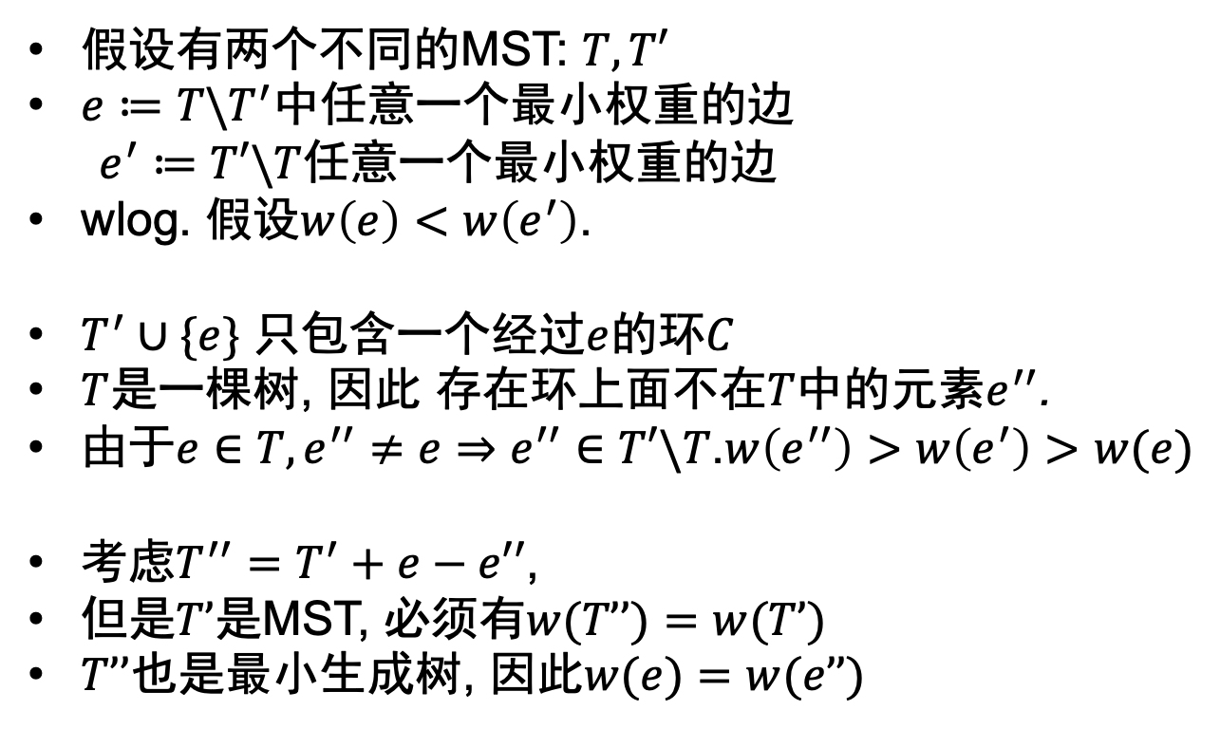
边权相同, MST唯一
假设有两个不同的MST: $T,T′$
$e≔T\backslash T^{′}中\text{任意一个最小权重的边}$
$e^{′}≔T′\backslash T$任意一个最小权重的边
wlog. 假设$w\left(e\right)<w\left(e^{′}\right)$.
$T^{′}∪\{e\}$ 只包含一个经过$e$的环$C$
$T$是一棵树, 因此 存在环上面不在$T$中的元素$e^{′′}$.
由于$e∈T,e^{′′}≠e⇒e^{′′}∈T′\backslash T$.$w\left(e^{′′}\right)>w\left(e^{′}\right)>w(e)$
考虑$T^{′′}=T^{′}+e−e′′$,
但是$T’$是MST, 必须有$w(T’’)=w(T’)$
$T’’$也是最小生成树, 因此$w(e)=w(e’’)$

Slide 4

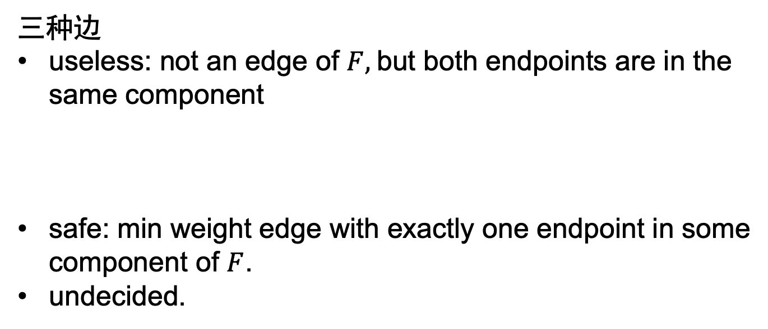
MST算法的逻辑
intermediate spanning forest
三种边
useless: not an edge of $F,$but both endpoints are in the same component
safe: min weight edge with exactly one endpoint in some component of $F$.
undecided.
useless
114
1
safe
514

Slide 5
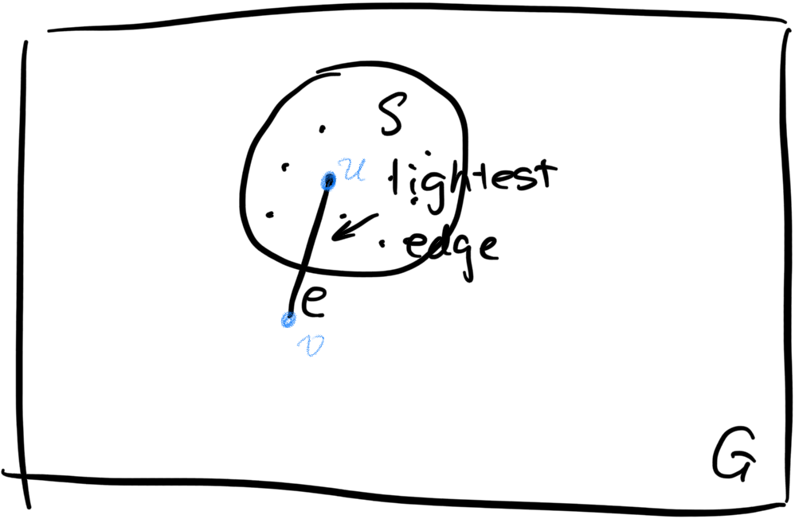
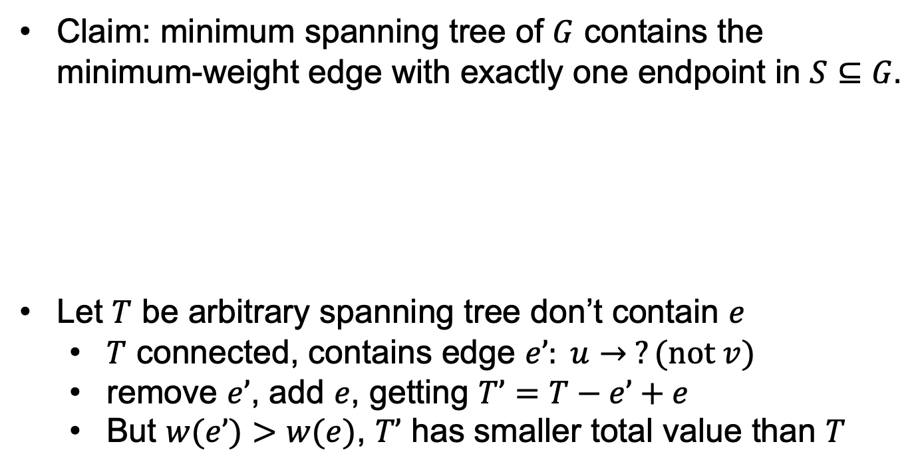
MST包含所有的safe边
Claim: minimum spanning tree of $G$ contains the minimum-weight edge with exactly one endpoint in $S⊆G.$
Let $T$ be arbitrary spanning tree don’t contain $e$
$T$ connected, contains edge $e’: u→ ?(not v)$
remove $e’$, add $e$, getting $T’=T−e’+e$
But $w(e’)>w(e)$, $T’$ has smaller total value than $T$

Slide 6
MST不包含任何一个useless边
不然就会得到一个环
MST算法一直加safe边来得到森林F
不联通 → 至少还有一个safe边
无论如何最后总是会使图连通

Slide 7
MST的算法

Slide 8

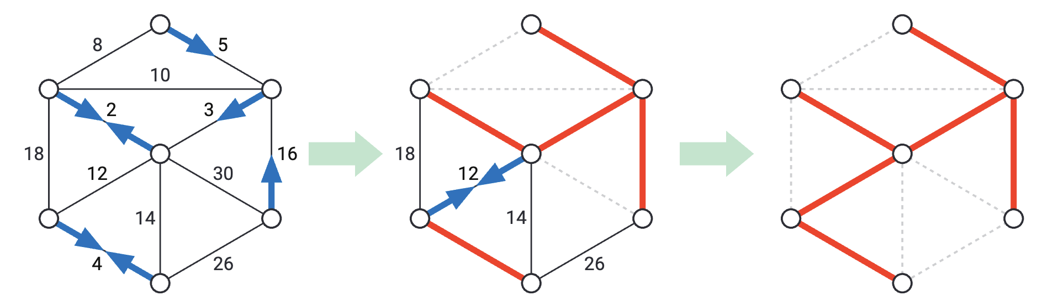
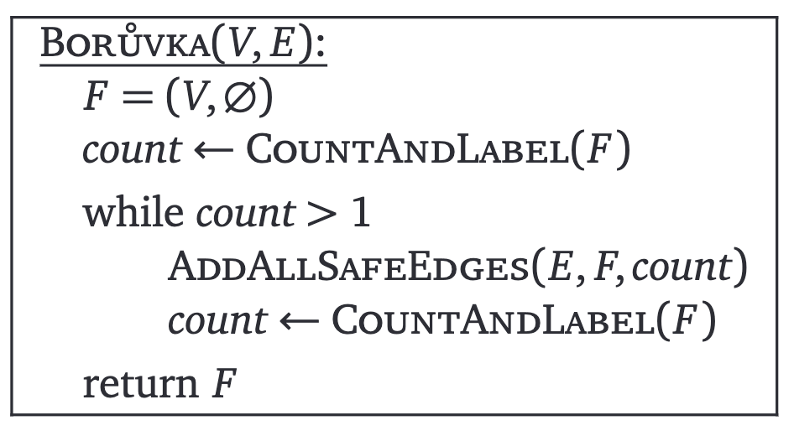
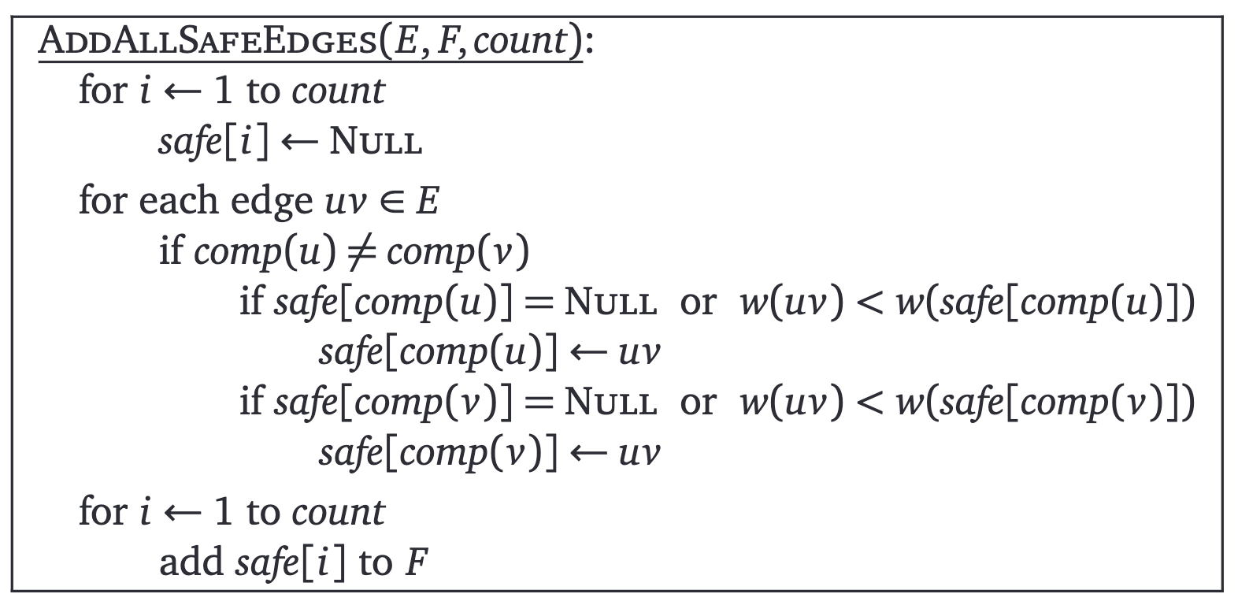
算法1: Boruvka

Slide 9

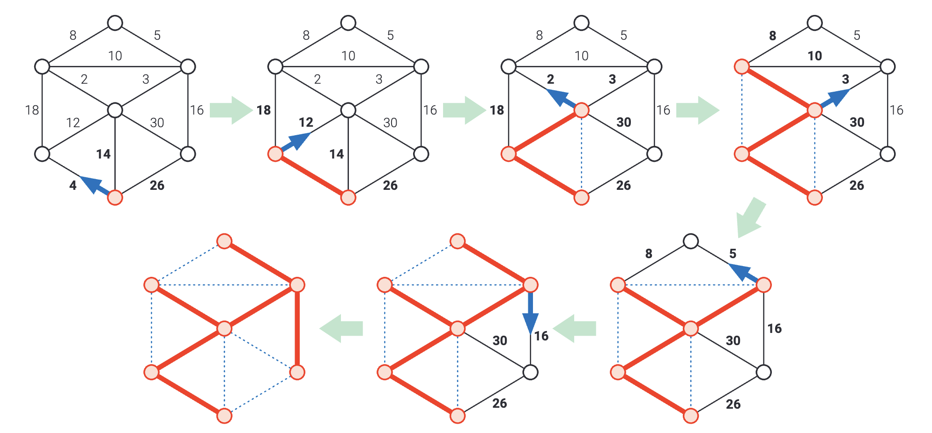
算法2: Jarnik(Prim)

Slide 10
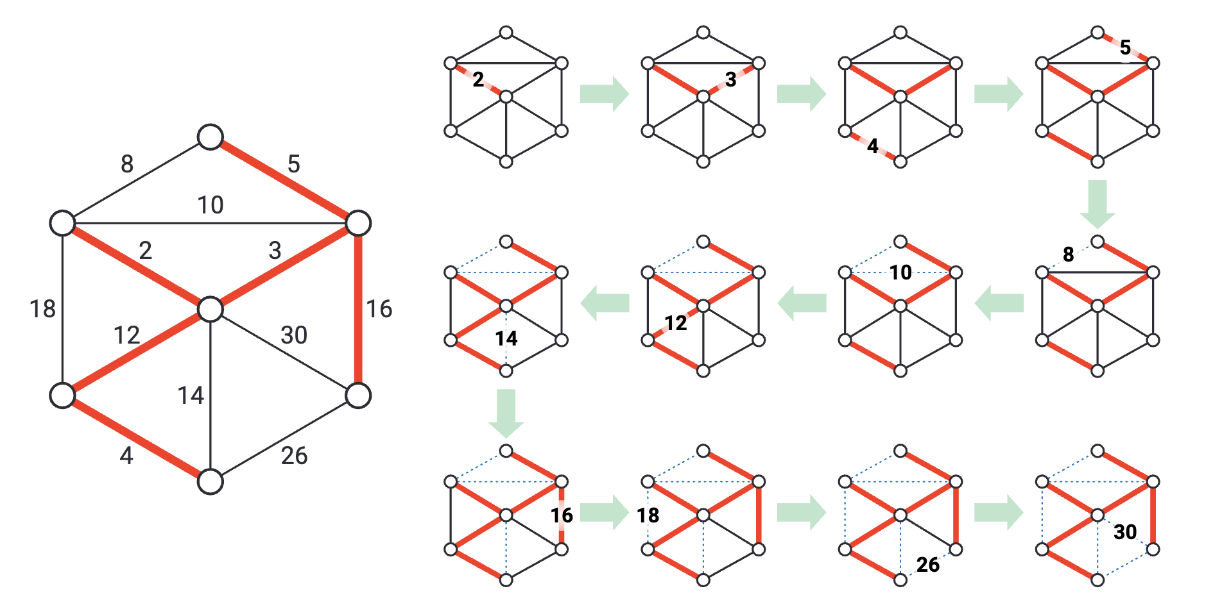
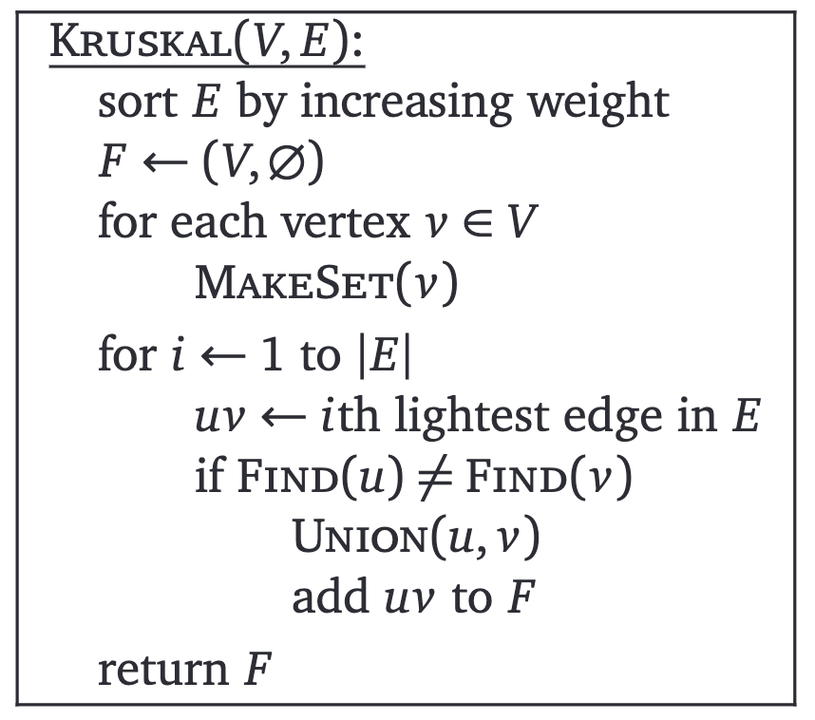
算法3: Kruskal

Slide 11
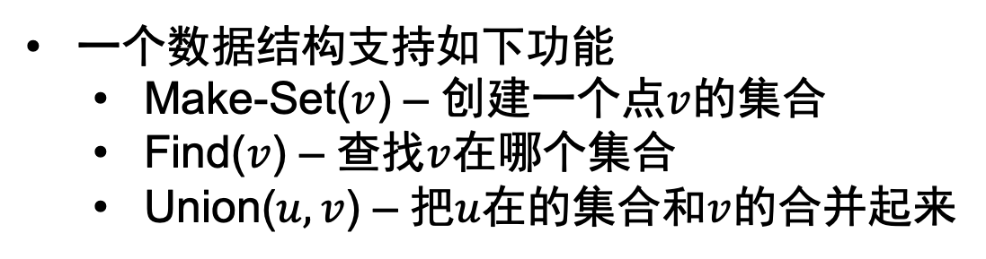
问题: 怎么判断是不是有环?
一个数据结构支持如下功能
Make-Set($v$) – 创建一个点$v$的集合
Find($v$) – 查找$v$在哪个集合
Union($u,v$) – 把$u$在的集合和$v$的合并起来

Slide 12
合并-查询集

Slide 13
基本操作

Slide 14


QQ: 2095728218
gwzhang@cug.edu.cn

