Slide 1
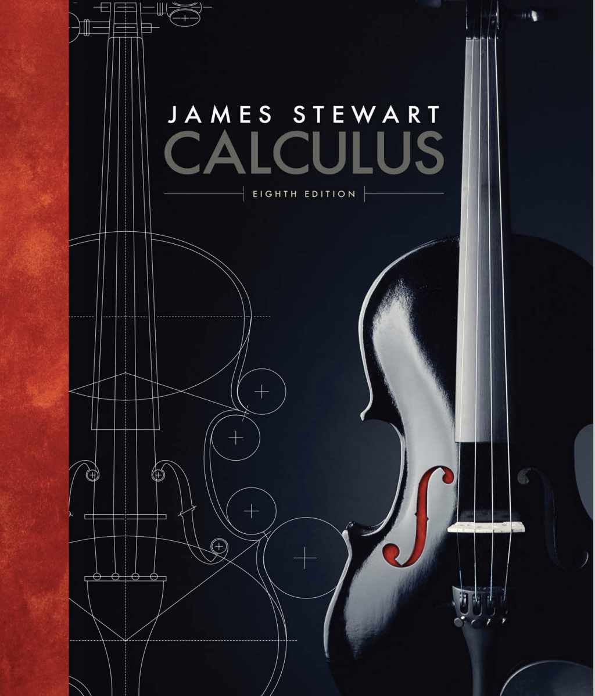
Calculus
12
Vectors and the Geometry
Of the space
Introductory problems

Slide 2
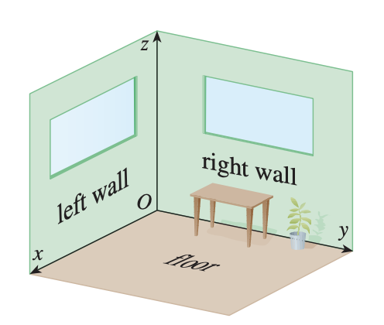
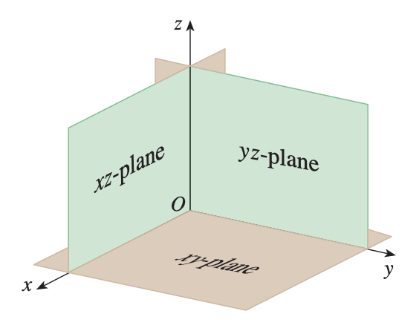
I. The 3D coordinate system
Q1. After observing a room, what kind of mathematical structure can you abstract?
What are the basic elements of that?

Slide 3
I. The 3D coordinate system
Q2. Can we swap the labels for each axes? Can we get the coordinate system merely by rotating in the space?
z
z
y
x
x
y

Slide 4
I. The 3D coordinate system
Q3. Recall how the graph is represented in 2D coordinate system. For example, why is this a circle?
What’s the connection between left and right?
#include <iostream>
#include <cmath>
using namespace std;
bool f(int x, int y){
// your function here
return ((x-3)*(x-3)+(y-3)*(y-3))<25;
}
int main(){
for(int i=-10; i<=10; i++){
for(int j=-20; j<=30; j++){
if(f(i,j)) cout<<"*";
else cout<<" ";
}
cout<<endl;
}
return 0;
}
y
.
(a,b)
x
(x-a)²+(y-b)²=r²

Slide 5
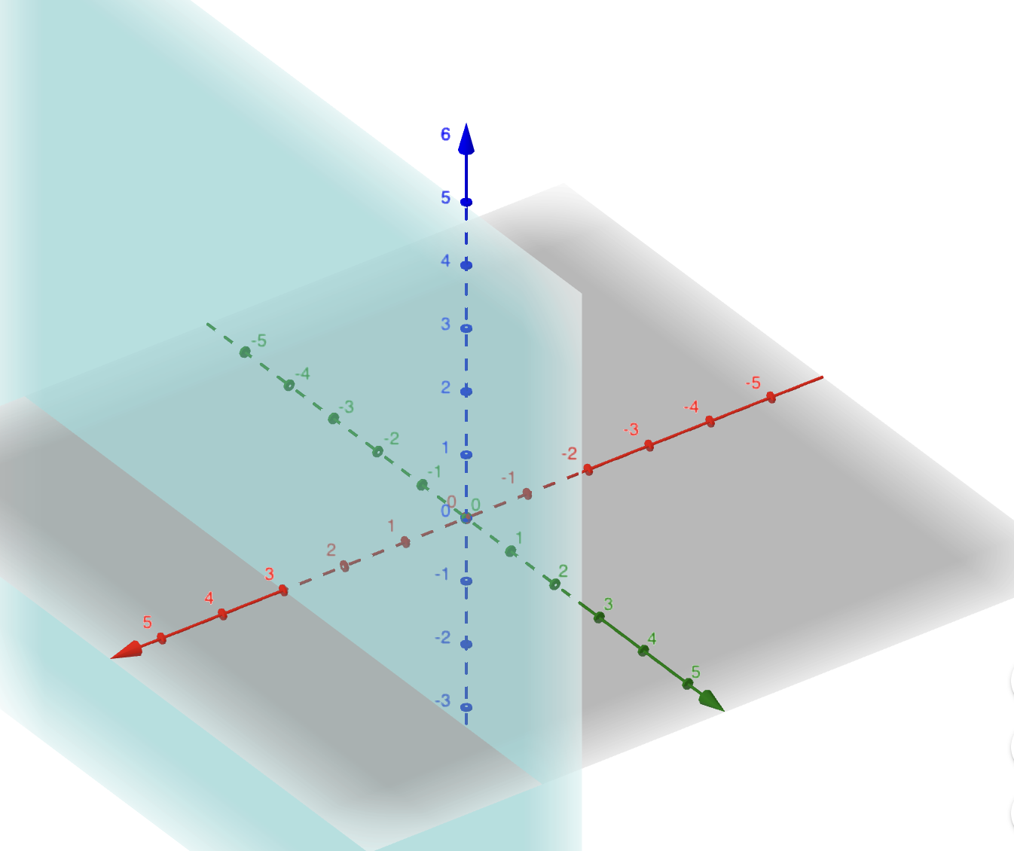
I. The 3D coordinate system
Q4. How do we plot 3D graphs?
(geogebra.org/3d)
First we will try some things out…
(1) x=3
z
y
3
x
the context matters!

Slide 6
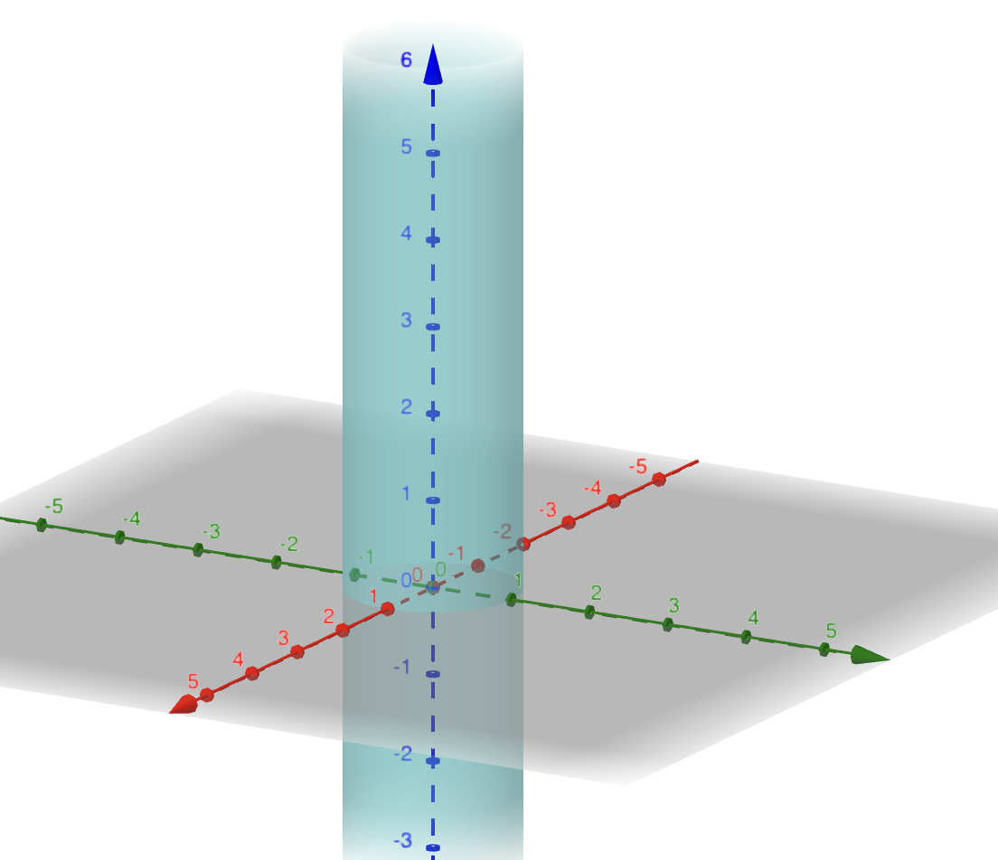
I. The 3D coordinate system
Q4. How do we plot 3D graphs?
(geogebra.org/3d)
First we will try some things out…
(2) x²+y²=1
z
y
x

Slide 7
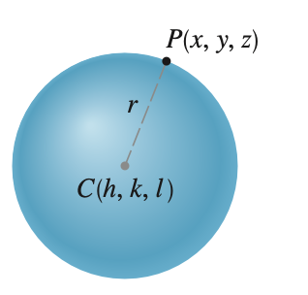
I. The 3D coordinate system
Q4. How do we plot 3D graphs?
(geogebra.org/3d)
First we will try some things out…
(3) x²+y²+z²=1
z
y
x

Slide 8
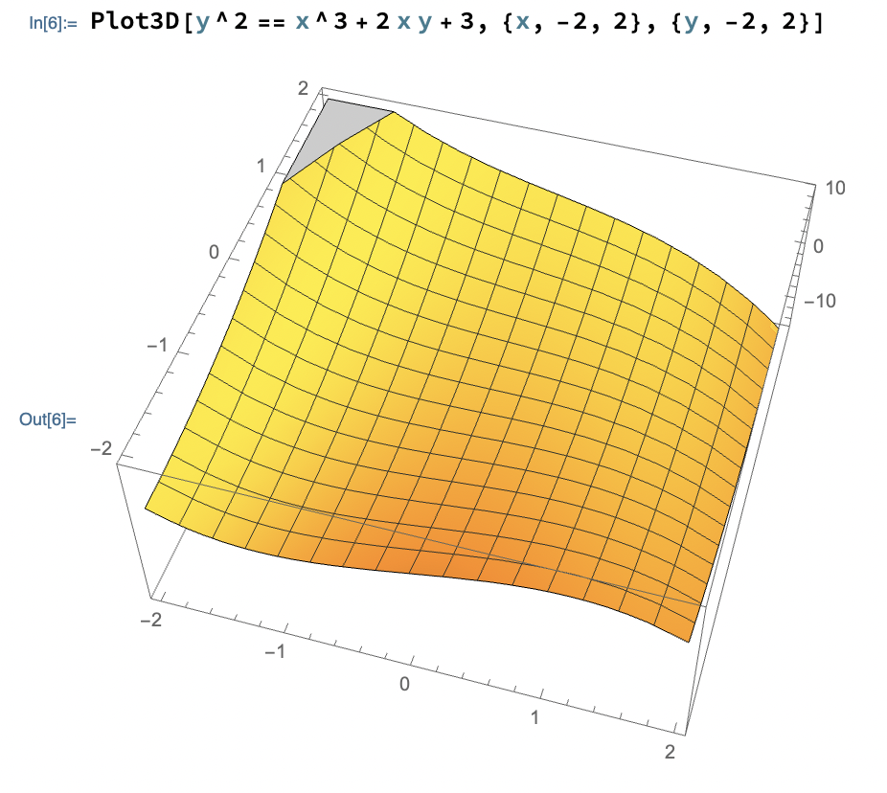
I. The 3D coordinate system
1. Use CAS system to plot the graph of y²=x³+2xy+3.
Mathematica: Plot3D[y^2 == x^3 + 2 x y + 3, {x, -2, 2}, {y, -2, 2}]

Slide 9
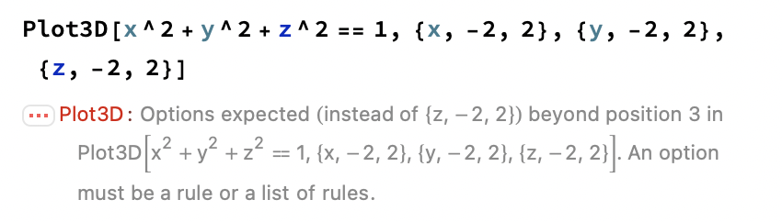
I. The 3D coordinate system
2. Use CAS system to plot the graph of x²+y²+z²=1.
Mathematica:
Plot3D[x^2+y^2+z^2==1, {x, -2, 2}, {y, -2, 2}, {z, -2, 2}]
Reason: Sphere don’t meet the condition of function.
z
for a point d(x,y), there are 2 point satisfying
the condition
y
x

Slide 10
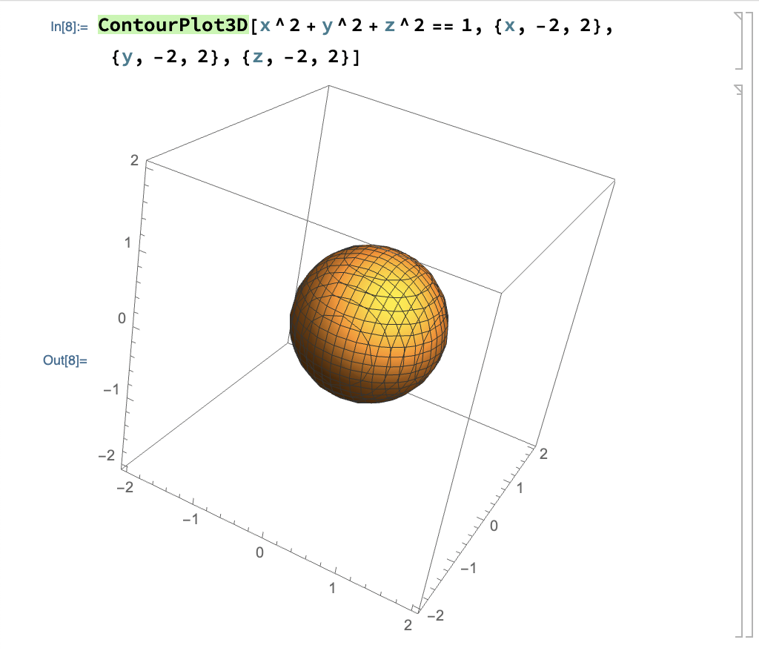
I. The 3D coordinate system
2. Use CAS system to plot the graph of x²+y²+z²=1.
Mathematica:
ContourPlot3D[x^2+y^2+z^2==1, {x, -2, 2}, {y, -2, 2}, {z, -2, 2}]

Slide 11
II. Vectors
Q5. Why using vectors?
real-world things
vector in ℝ², ℝ³
Structure
Math object
forms of representation
Operation/Relation

Slide 12
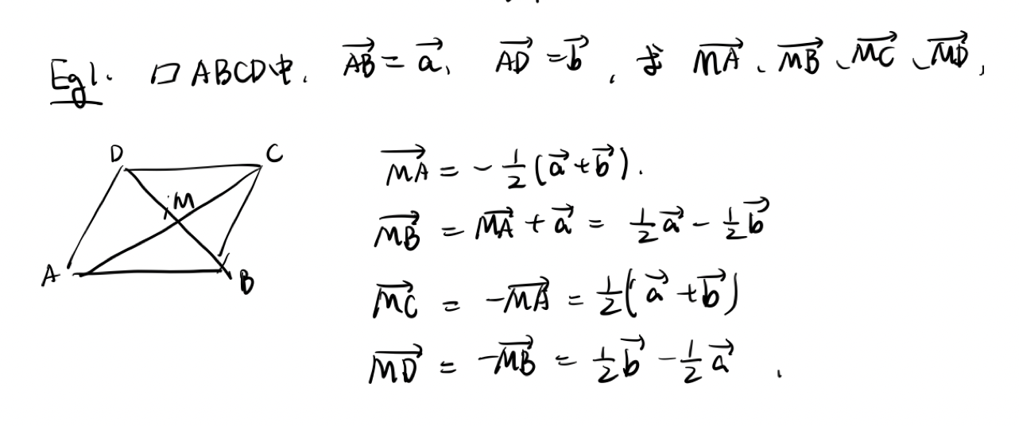
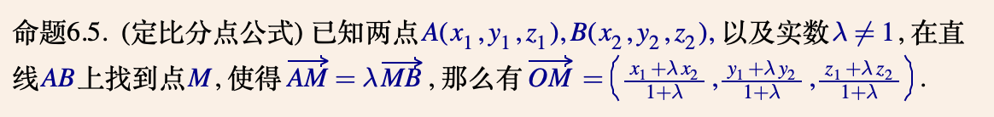
II. Vectors
1.
2.
y
A
B
x

Slide 13
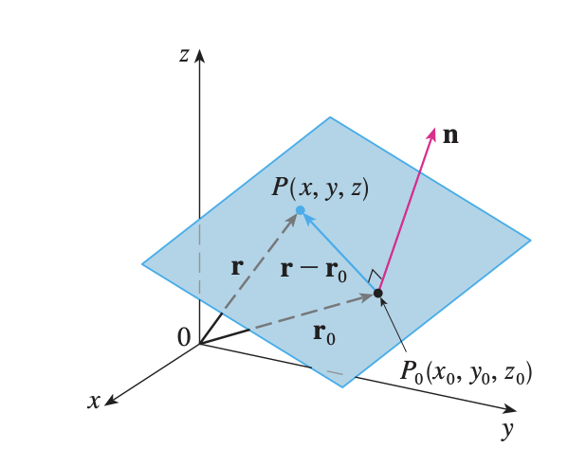
III. Equation of basic elements
Q6. What are the structure of a plane? How can we get the equation of a plane?
real-world things
Structure
Math object
forms of representation
Operation/Relation
a direction
a point

Slide 14
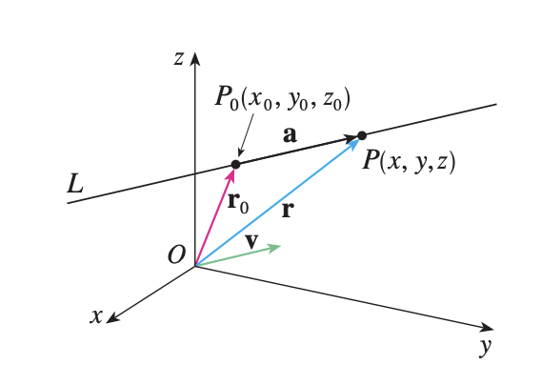
III. Equation of basic elements
Q7. What are the structure of a line? How can we get the equation of a line?
real-world things
Structure
Math object
forms of representation
Operation/Relation
a direction
a point

Slide 15
III. Equation of basic elements
Q8. What kind of techniques do you think is helpful?
real-world things
Structure
Math object
forms of representation
Operation/Relation
a direction
a direction
a point
a point

Slide 16
III. Equation of basic elements
Q9. Are there any relations between line object and plane object?
real-world things
Structure
Structure
Math object1
forms of representation
Math object2
forms of representation
Operation/Relation
Operation/Relation
perpendicular
parallel
a direction
a direction
a point
angle
a point
projection
…

Slide 17
IV. Cylinders and Quadratic spaces
Q9. Are there any relations between line object and plane object?
real-world things
Structure
Structure
Math object1
forms of representation
Math object2
forms of representation
Operation/Relation
Operation/Relation
perpendicular
parallel
a direction
a direction
a point
angle
a point
projection
…

