Slide 1
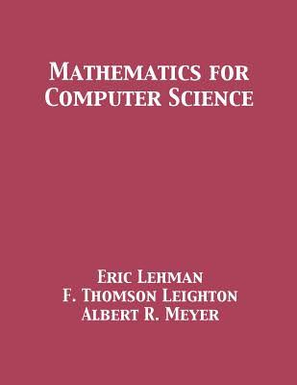
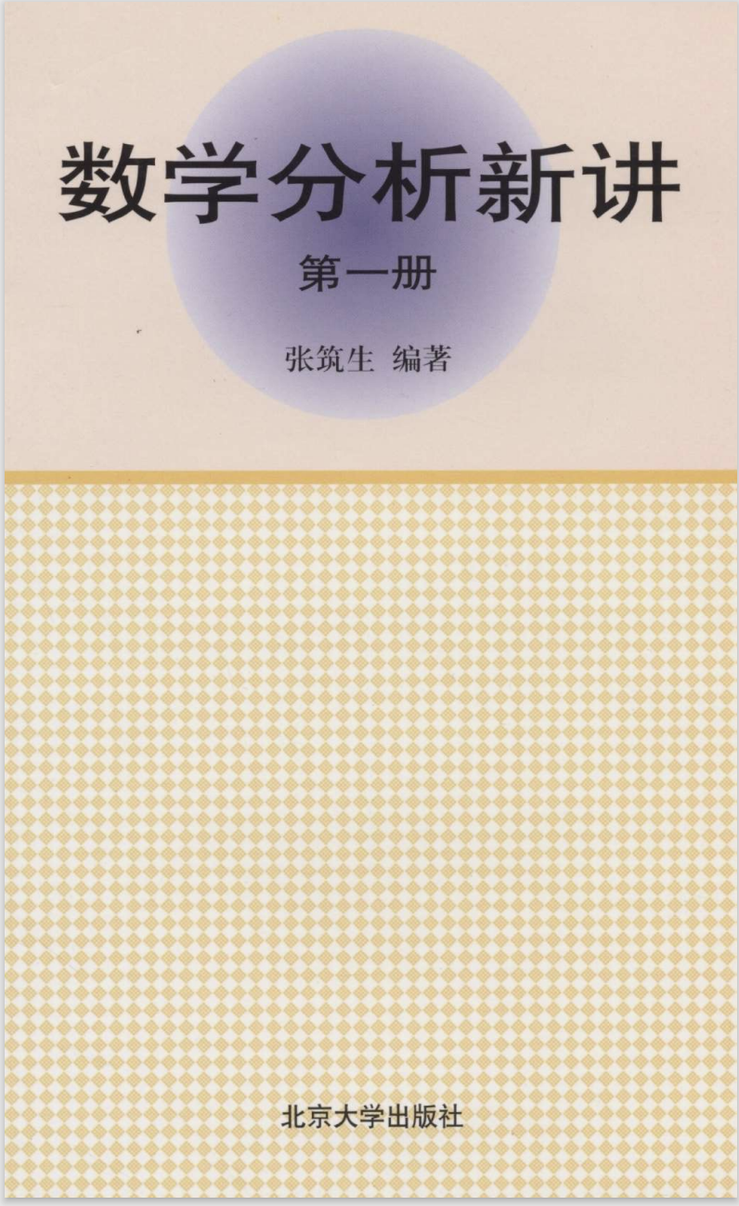
Chapter R
A Review on
Discrete Maths
离散数学复习
§R.1记号与逻辑
§R.2 谓词逻辑

