Slide 1
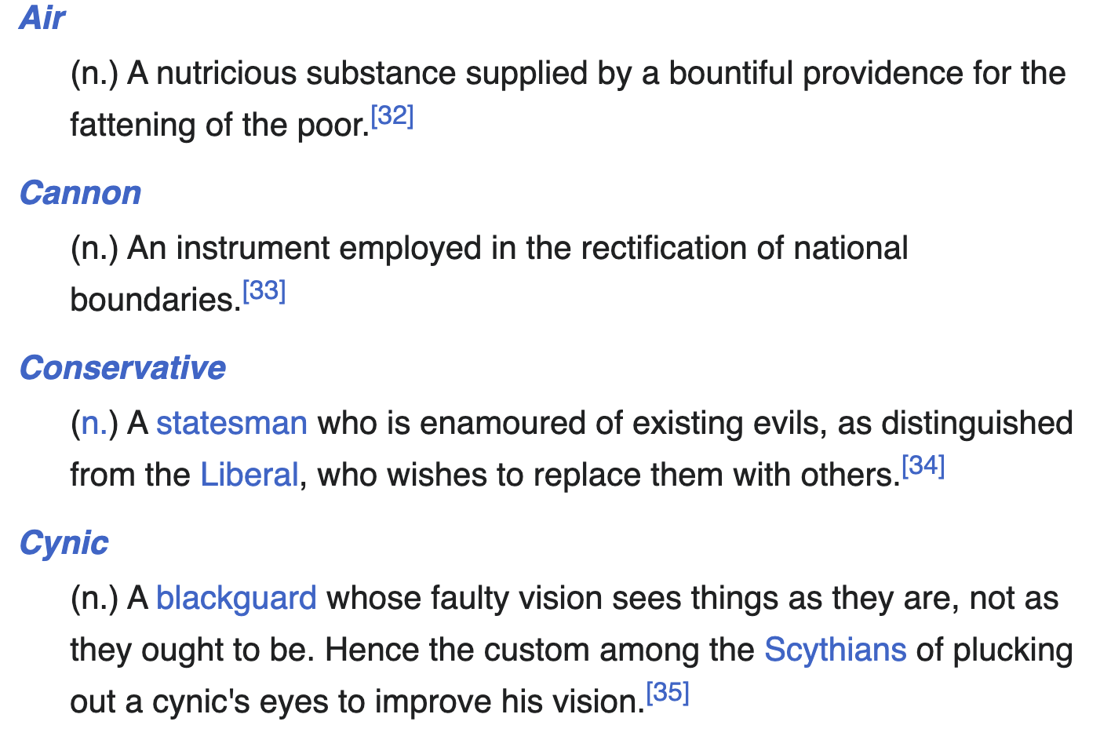
Philosophers gathered from far and near
To sit at his feet and hear and hear,
Though he never was heard
To utter a word
But “Abracadabra, abracadab,
Abracada, abracad,
Abraca, abrac, abra, ab!”
’Twas all he had,
’Twas all they wanted to hear, and each
Made copious notes of the mystical speech,
Which they published next –
A trickle of text
In the meadow of commentary.
Mighty big books were these,
In a number, as leaves of trees;
In learning, remarkably – very!
10
字符串匹配
--- Jamrach Holobom
Quoted by AMBROSE BIERCE
The Devil’s dictionary (1911)

Slide 2
naïve的想法

Slide 3
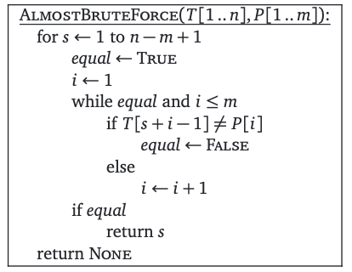
最简单的想法
Text
STRINGMATCHINGBRUTEFORCETHEBASICOBJECTTHATWECO
FORCE
Pattern
从左往右挪动, 一个字母一个字母匹配
不匹配 → pattern往右挪动, 重新匹配
匹配 → 继续下一个text和pattern, 看看是不是匹配

Slide 4
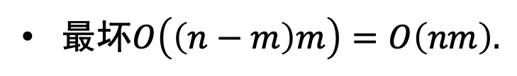
最坏情况复杂度多少?
AAAAAAAAAAAAAAAAAAAAAAAAAAAAAAAAAAAAAAAAAAB
AAAAAB
最坏$O\left(\left(n−m\right)m\right)=O\left(nm\right).$
怎么还往后一个一个地匹配?
人类: 直接看最后啊!
目标: 减少重复的比较

Slide 5


再来几个例子
上一步已经匹配了
这一步是不是有点抽风, 用B匹配A?
💡 text里面的每个字符只要被匹配上过一遍就够了!
借此优化原先的 “暴力” 算法
猜想1: 推到第一个字符重新来?

Slide 6


怎么移动?
AAAAAABAAAAB
AAAAAB
AAAAAB
我们错过了这个!
AAAAAB
前缀的结束位置
开始最靠前的不是整个子串的(后缀=前缀)
移动的也不能太夸张
💡规则: 移动蓝色的字符串到前缀的结束位置:
开始最靠前不是子串的(后缀=前缀)的长度(1)

Slide 7

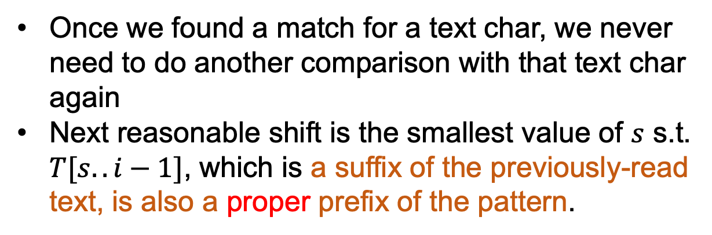
Pin down our thoughts
T []
$$i$$
P[]
?
Moving P[]
Once we found a match for a text char, we never need to do another comparison with that text char again
Next reasonable shift is the smallest value of $s$ s.t. $T[s..i−1]$, which is a suffix of the previously-read text, is also a proper prefix of the pattern.

Slide 8
更深入些: 有限状态机
Finite State Machine

Slide 9


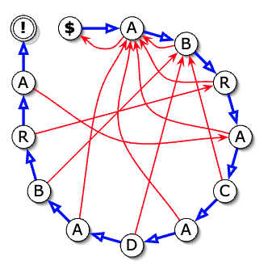
有没有系统的手段?
对于pattern的每一个字符有两种状态
匹配(成功)、失配(失败)
匹配成功!
开始状态
成功边
怎么读
读入一个节点
走对应转移到新节点
看到哪里去
失败边

Slide 10
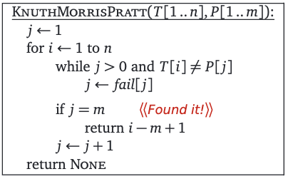
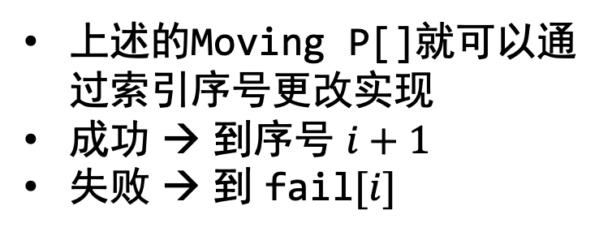
fail函数
上述的Moving P[]就可以通过索引序号更改实现
成功 → 到序号 $i+1$
失败 → 到 fail$[i]$
成功边
失败边

Slide 11
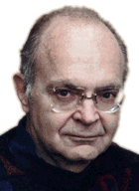

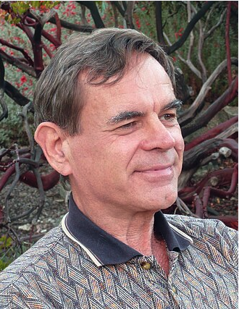
Aside: 他们是谁?
Donald E. Knuth
James H. Morris
Vaughan Pratt
@Standord University
@Carnegie Mellon University
@Standord University
MIT
(till 2024.1.24)
aged 86
aged 83
aged 79

Slide 12
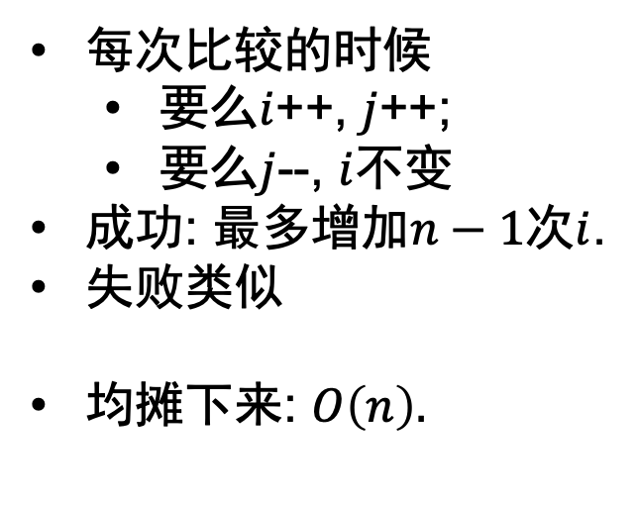
有了fail函数后的时间复杂度
每次比较的时候
要么$i$++, $j$++;
要么$j$--, $i$不变
成功: 最多增加$n−1$次$i$.
失败类似
均摊下来: $O\left(n\right).$

Slide 13
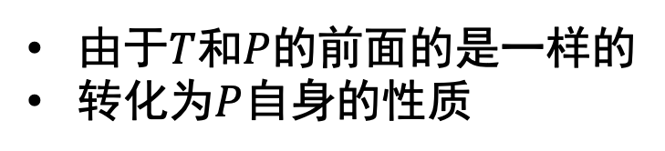
问题: 计算失败函数
回顾失败函数的定义
由于$T$和$P$的前面的是一样的
转化为$P$自身的性质

Slide 14
计算失败函数

Slide 15
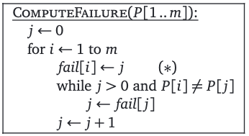
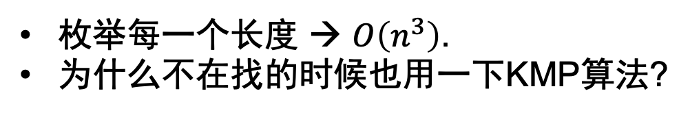
暴力求解
枚举每一个长度 → $O\left(n^{3}\right)$.
为什么不在找的时候也用一下KMP算法?

Slide 16
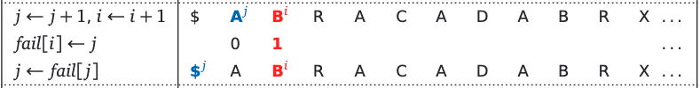
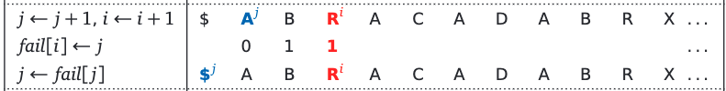
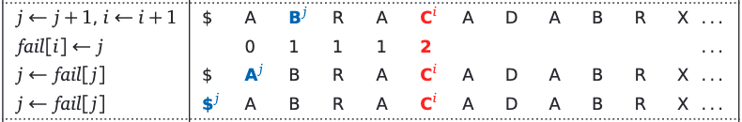
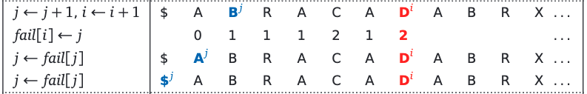
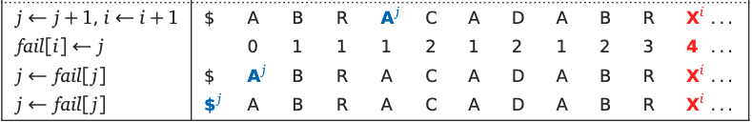
动手模拟

Slide 17
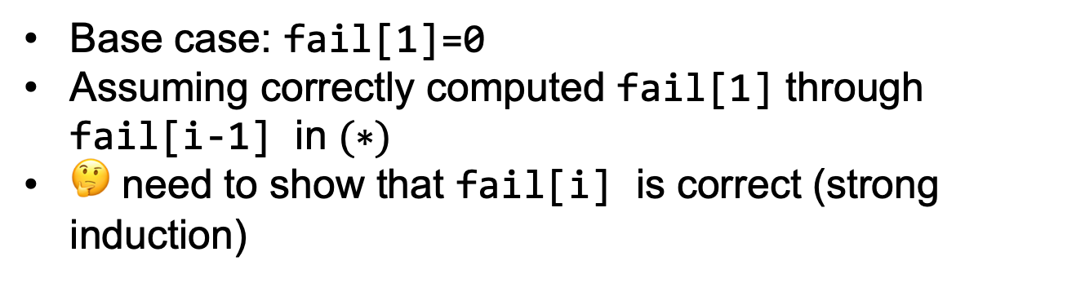
ComputeFailure 正确性证明
Base case: fail[1]=0
Assuming correctly computed fail[1] through fail[i-1] in $(∗)$
🤔 need to show that fail[i] is correct (strong induction)

Slide 18

ComputeFailure 正确性证明(继续)
after ith iteration, j=fail[i]
P[1..j-1] is the longest proper prefix of P[1..i-1]
is also a suffix
Define iterated failure functions

Slide 19
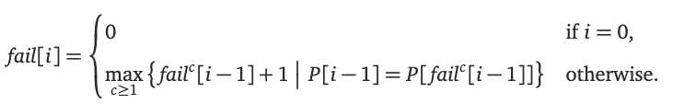


ComputeFailure 正确性证明(继续)
after ith iteration, j=fail[i]
P[1..j-1] is the longest proper prefix of P[1..i-1]
is also a suffix
Define iterated failure functions
$$j$$
$$i$$

Slide 20
Reference
Jeff E. Algorithms Director’s Cut #7.

Slide 21


QQ: 2095728218
gwzhang@cug.edu.cn

