Slide 1


QQ: 2095728218
gwzhang@cug.edu.cn

Slide 2
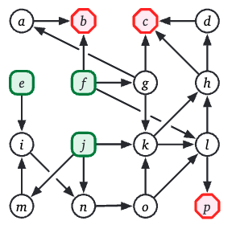
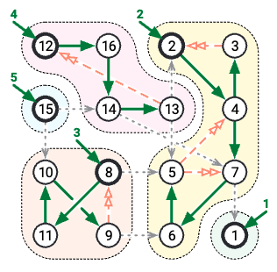
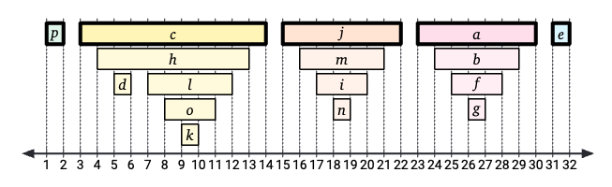
14
DFS
(Depth-first Search)
According to legend, Kosaraju apparently discovered his algorithm during an algorithms lecture. He was supposed to present Tarjan's algorithm, but he forgot his notes, so he had to make up something else on the fly. The only aspect of this story that I find surprising is that nobody tells it about Sharir or Tarjan.
--- Jeff Erickson, Algorithms

