Slide 1


QQ: 2095728218
gwzhang@cug.edu.cn

Slide 2
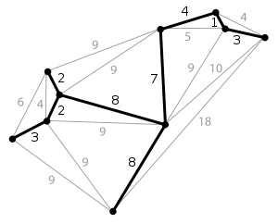
15
最小生成树
I remember seeking advice from someone-who could it have been?-about whether this work was worth submitting for publication; the reasoning it uses is so very simple.... Fortunately he advised me to go ahead, and many years passed before another of my publications became as well-known as this very simple one.
--- Joseph Kruskal,
describing his shortest-spanning-subtree algorithm (1997)

