Slide 1
Samples
49 BTN samples
2 samples caused software to crash

Slide 2
Results
Predicted epitopes: 28612
Median per sample: 586
Affected genes: 9763
Gene name | Predicted epitopes | Unique mutations
NEB | 65 | 22
HOXA4 | 52 | 3
FLG | 46 | 22
HRNR | 38 | 13
MUC17 | 35 | 23
EPPK1 | 35 | 22

Slide 3
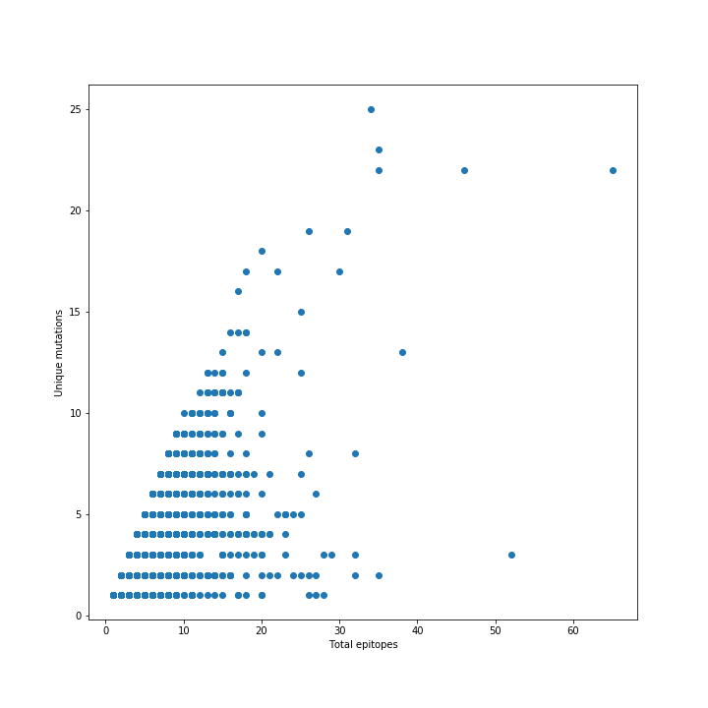
PLEC
MUC17
FLG
NEB
EPPK1
HOXA4

Slide 4
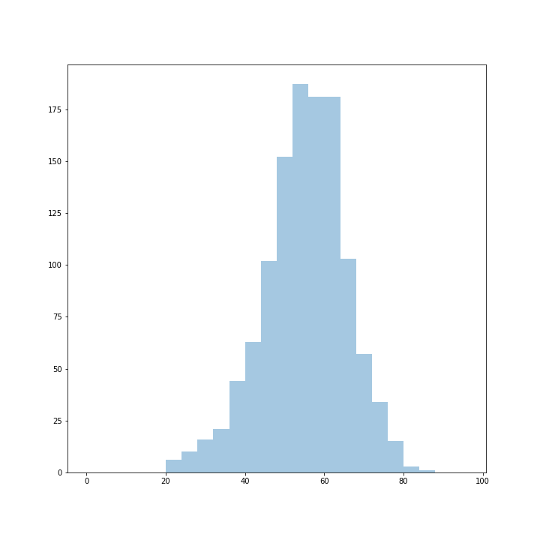
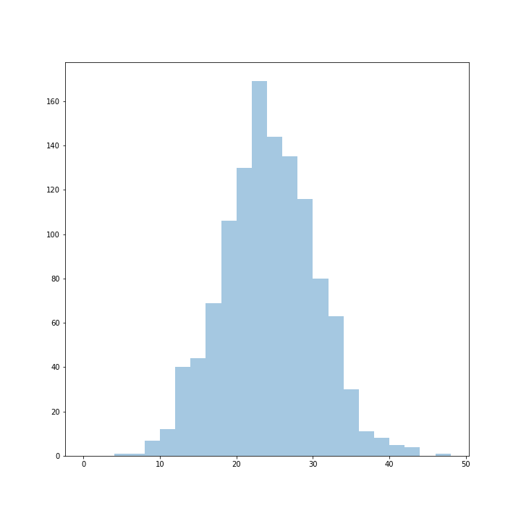
Common genes and mutations
Histogram of genes reported in common between every pair of samples
Histogram of mutations reported in common between every pair of samples

Slide 5
Cumulative frequency of IC50 score for every predicted epitope.
Approximately 10.5% of predicted epitopes have IC50 below 500.
Frequency
IC50-score MT [x100]
(0-100, 100-200, 200-300, ...)

Slide 6
Prediction methods
Prediction method | Number of times with lowest IC50 score
MHCnuggetsII | 21415
MHCnuggetsI | 3056
NNalign | 1791
MHCflurry | 714
NetMHC | 482
SMM | 360
SMMPMBEC | 309
PickPocket | 266
SMMalign | 218

Slide 7
Detected variants
Variant | Occurrences
Missense | 27261
Frame shift | 634
Inframe insertion | 476
Inframe deletion | 240

Slide 8
Epitopes per chromosome

