Slide 1
Fruit Image Classifier with CNNs
Name: Siddhant Das
Track: Machine Learning & Deep Learning (Image Classification)

Slide 2
Problem Statement
Problem: Automatic Fruit Image Classifier from images.
Importance:
- Agriculture (sorting fruits)
- Retail (inventory automation)
- Quality control
- Efficiency improvement

Slide 3
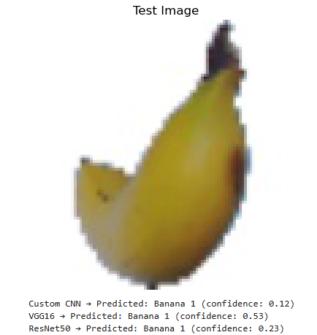
Project Outcome
We built and compared three models:
- Custom CNN
- VGG16
- ResNet50
All models were trained, evaluated, and tested.

Slide 4
Objectives
1. Build a simple CNN from scratch
2. Implement & compare CNN, VGG16 and ResNet50
3. Compare performance of all models
4. Visualize results with plots and confusion matrix

Slide 5
Methodology
Dataset: Fruits-360 (10 selected classes)
Preprocessing: Resize to 128x128, Augmentation
Models: CNN, VGG16, ResNet50
Tools: Python, TensorFlow, Keras
Evaluation: Training, Validation, Testing

Slide 6
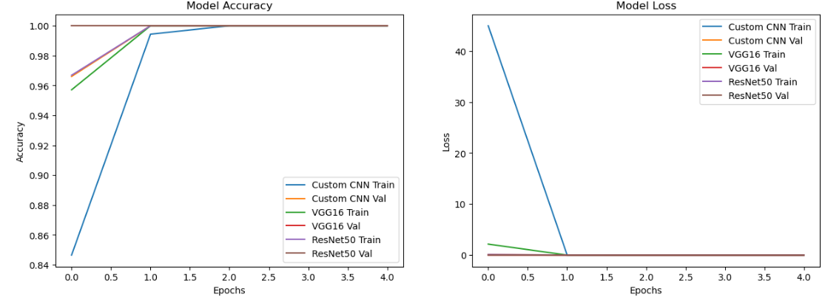
Implementation
1. Preprocessed dataset (resize, normalization, augmentation)
2. Built models (CNN, VGG16, ResNet50)
3. Trained with accuracy/loss tracking
4. Evaluated using test set

Slide 7
Demo/Working
Demo tested with unseen images.
Sample Result:
Custom CNN → Banana (conf: 0.12)
VGG16 → Banana (conf: 0.53)
ResNet50 → Banana (conf: 0.23)

Slide 8
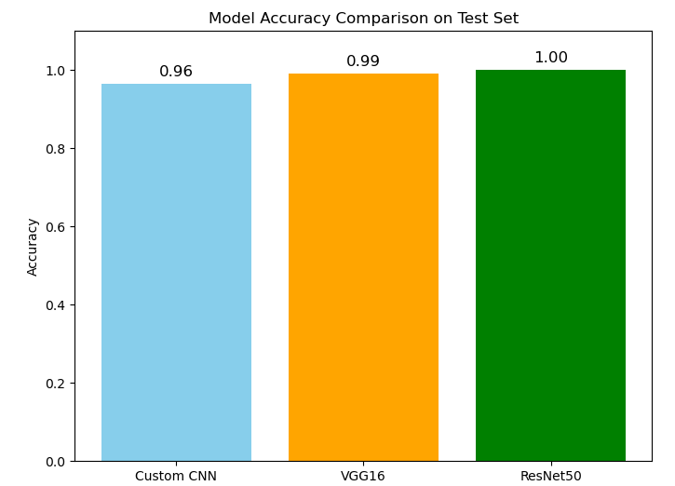
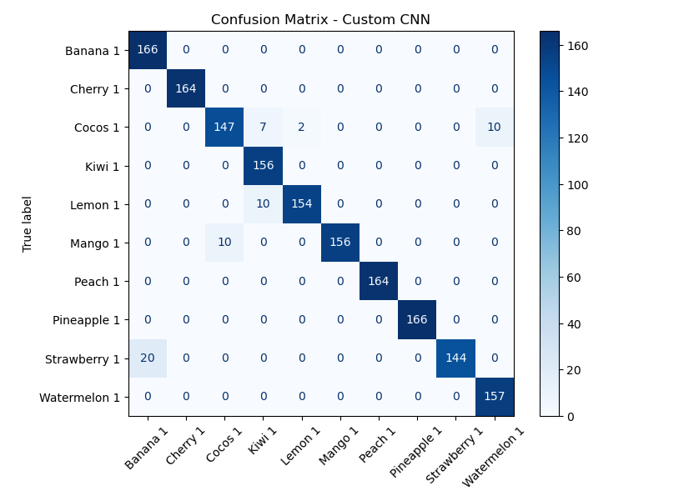
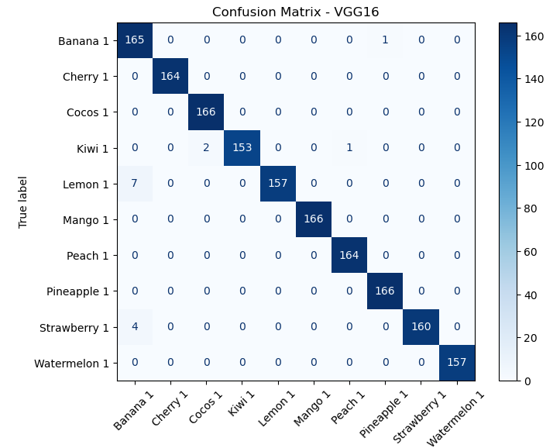

Results & Observations
Test Accuracy:
- Custom CNN: 0.96
- VGG16: 0.99
- ResNet50: 1.00

Slide 9
Conclusion & Future Work
Conclusion:
- All models performed well, with ResNet50 highest accuracy.
- Custom CNN worked but with lower accuracy.
Future Work:
- Expand dataset
- Improve augmentation
- Real-time mobile/web deployment
Thank You

