Slide 1




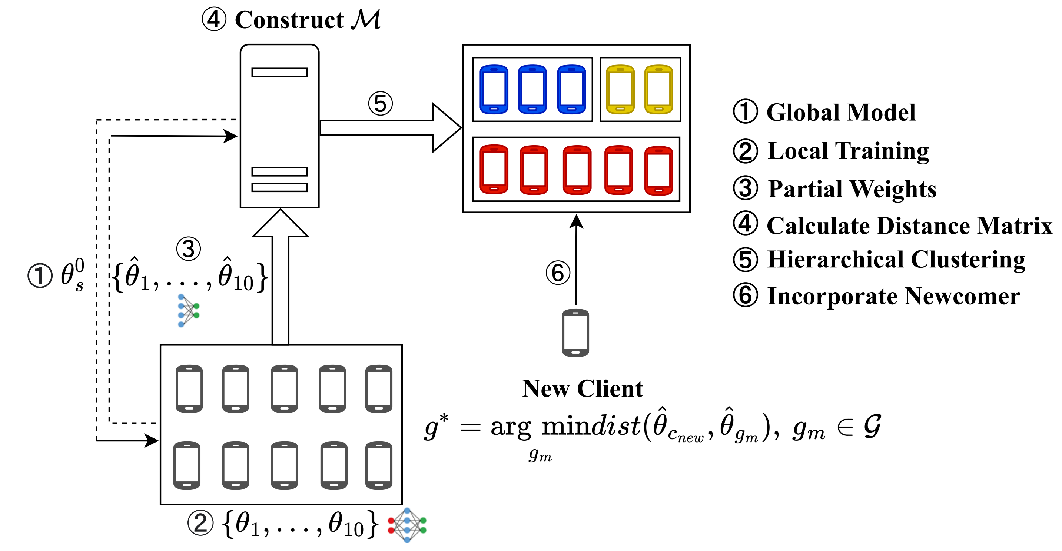
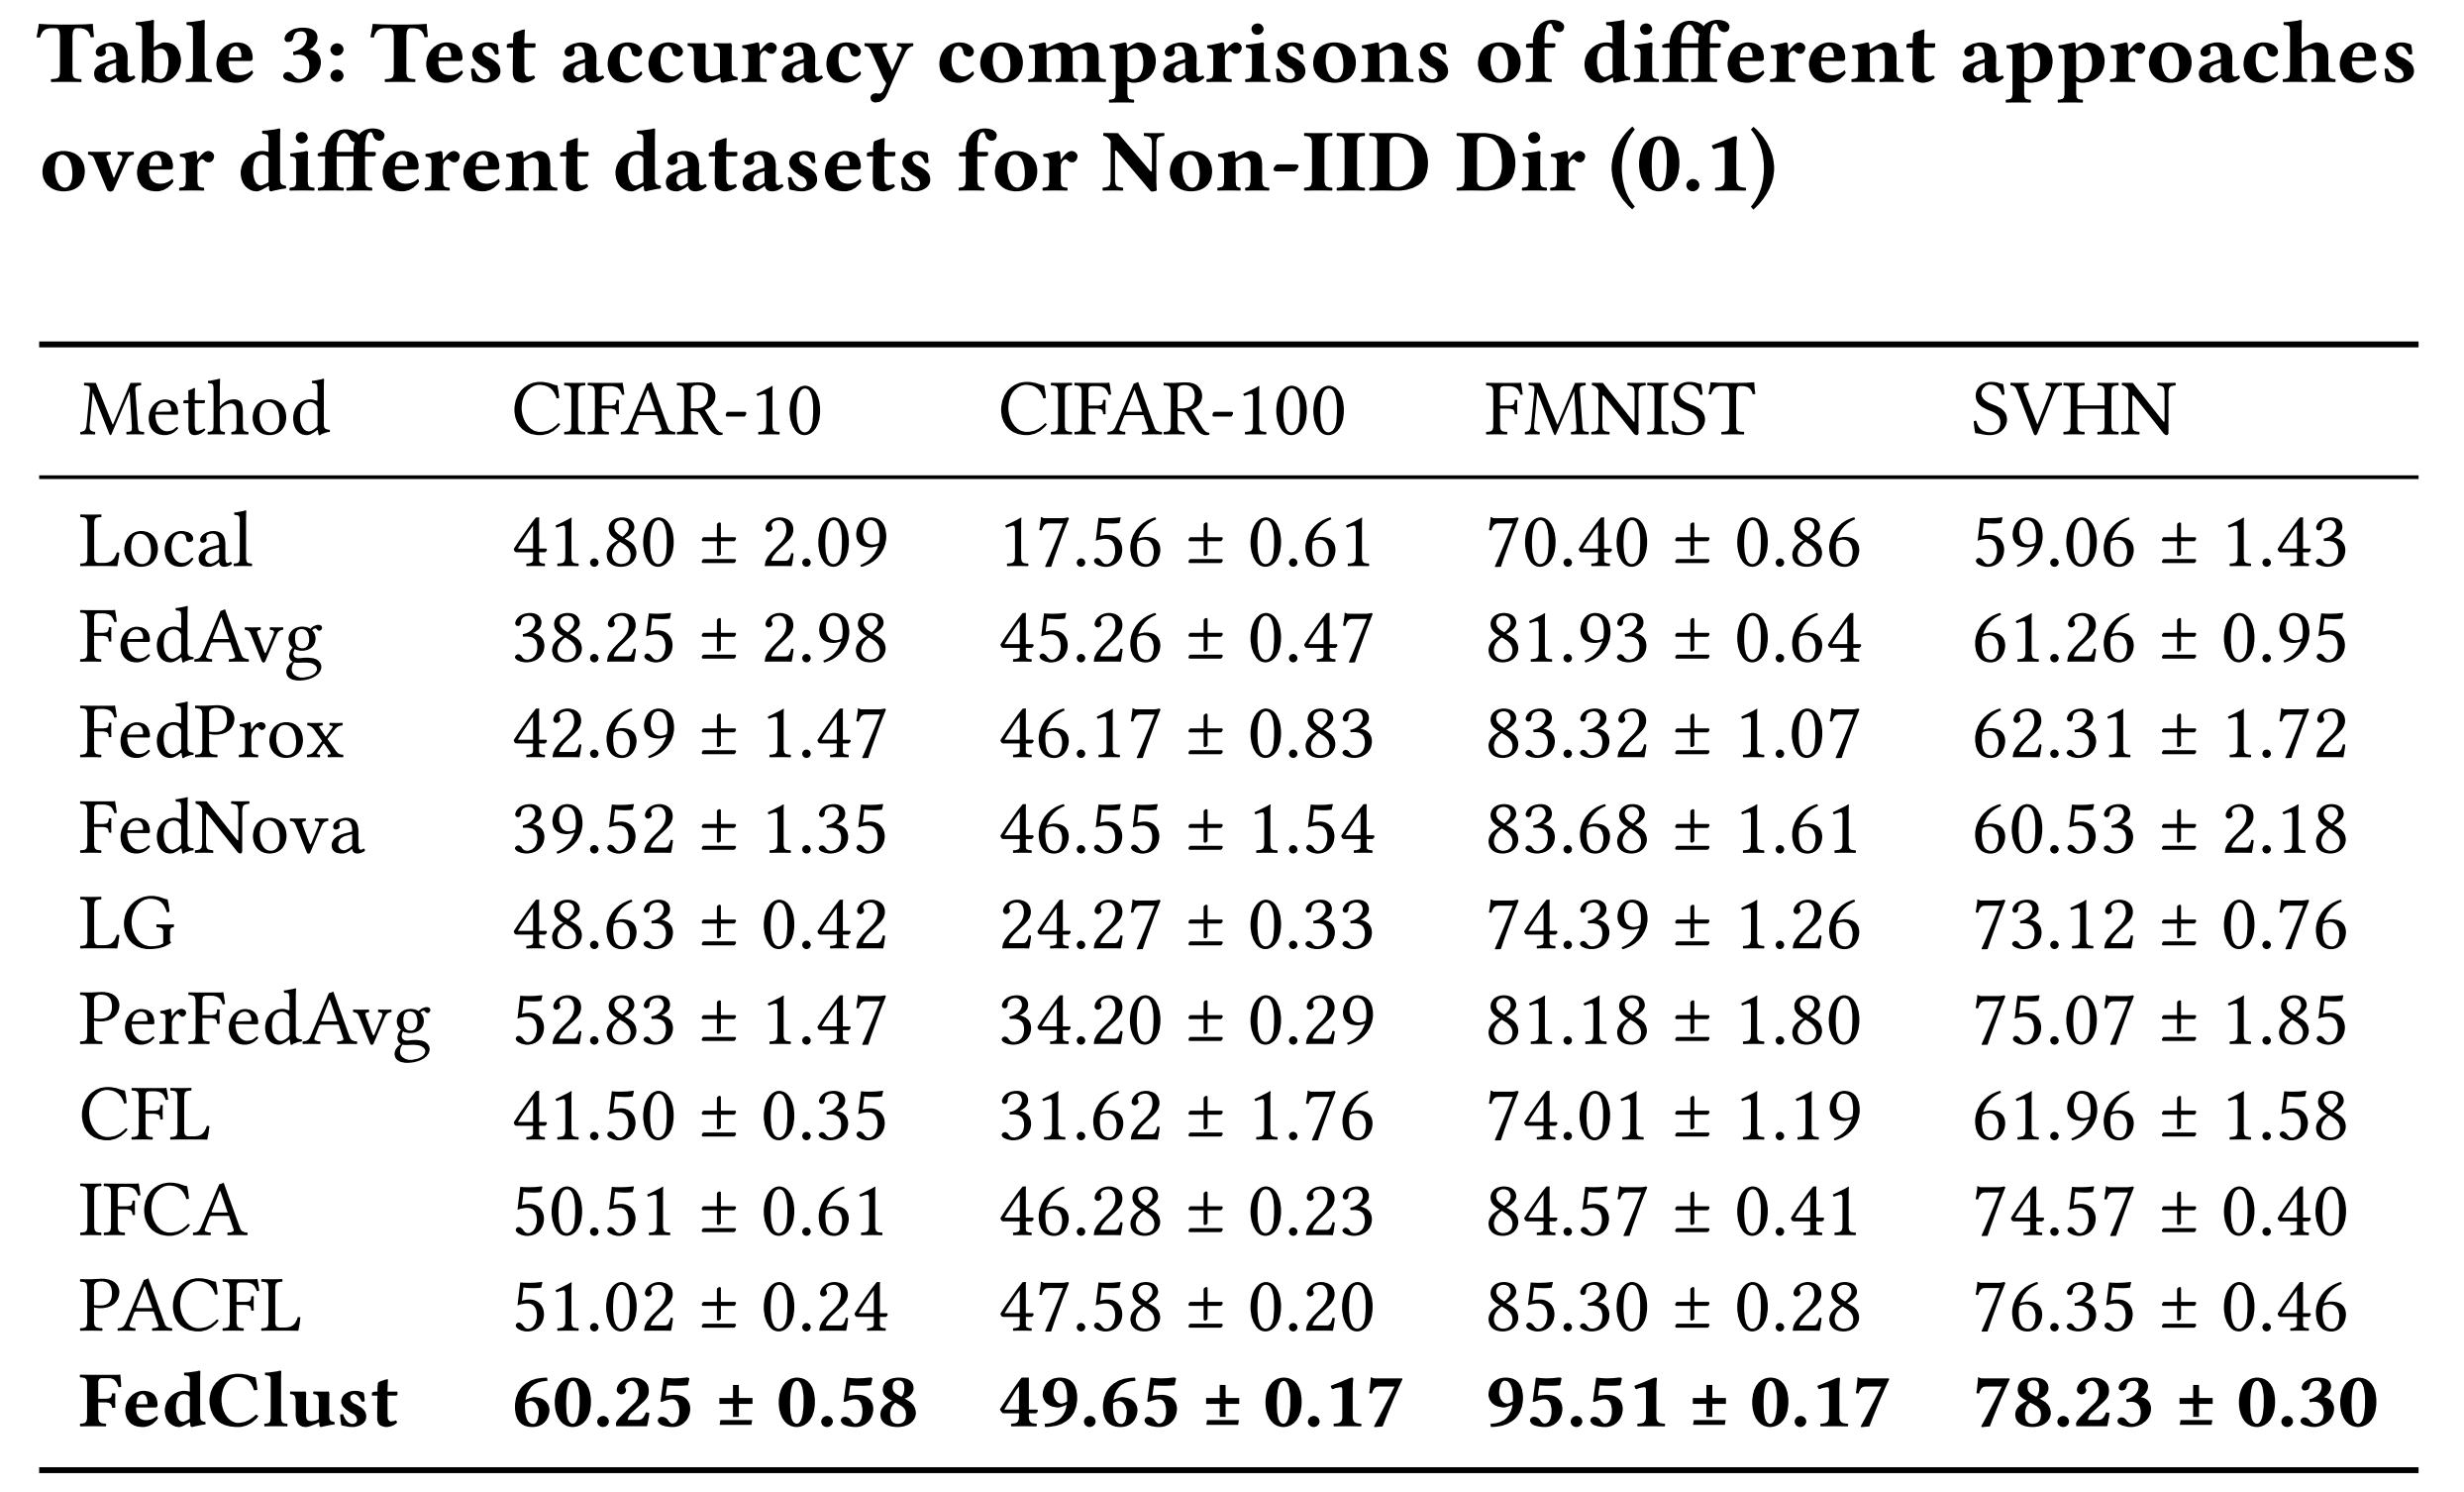
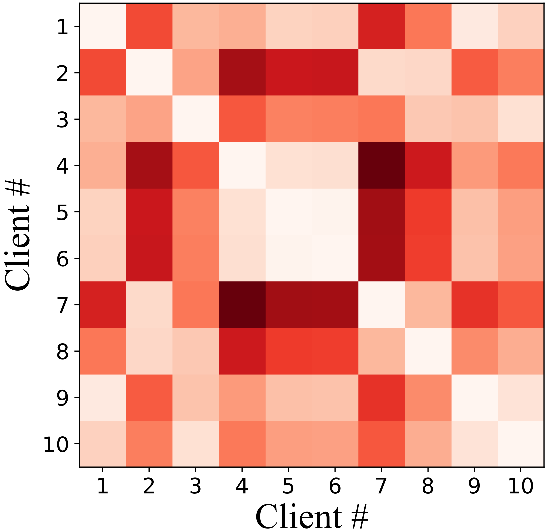
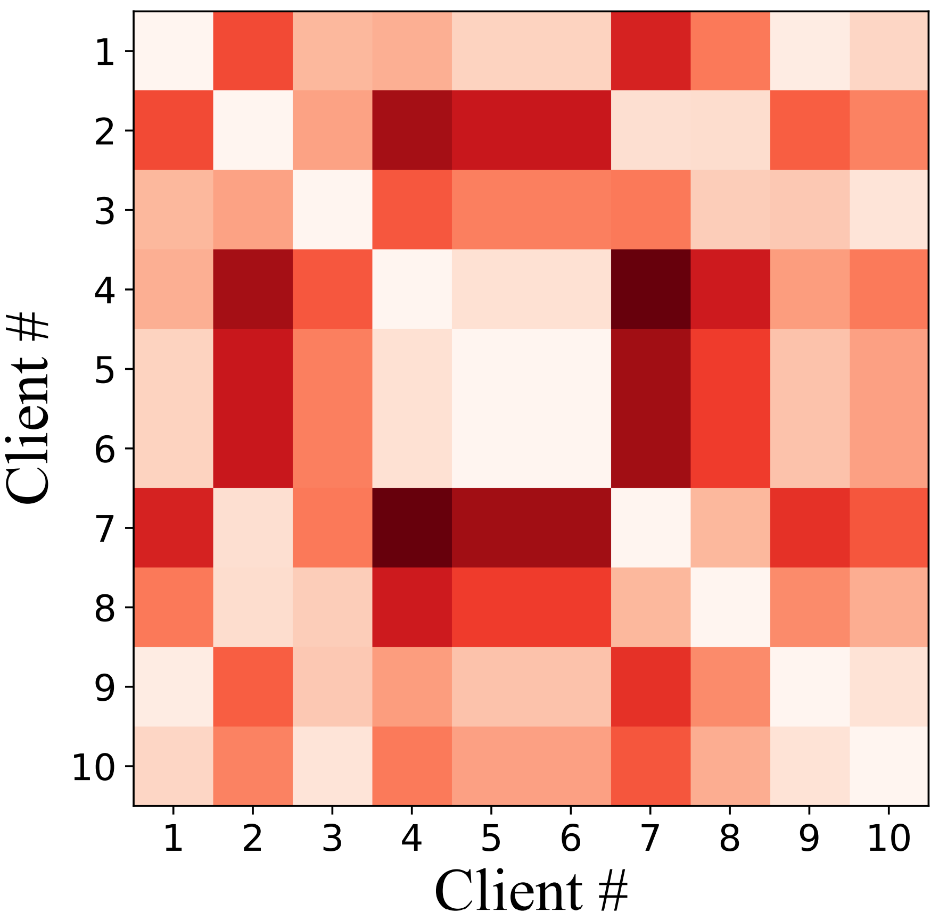
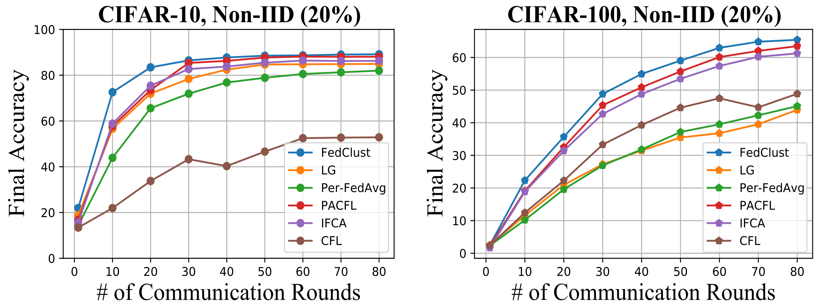
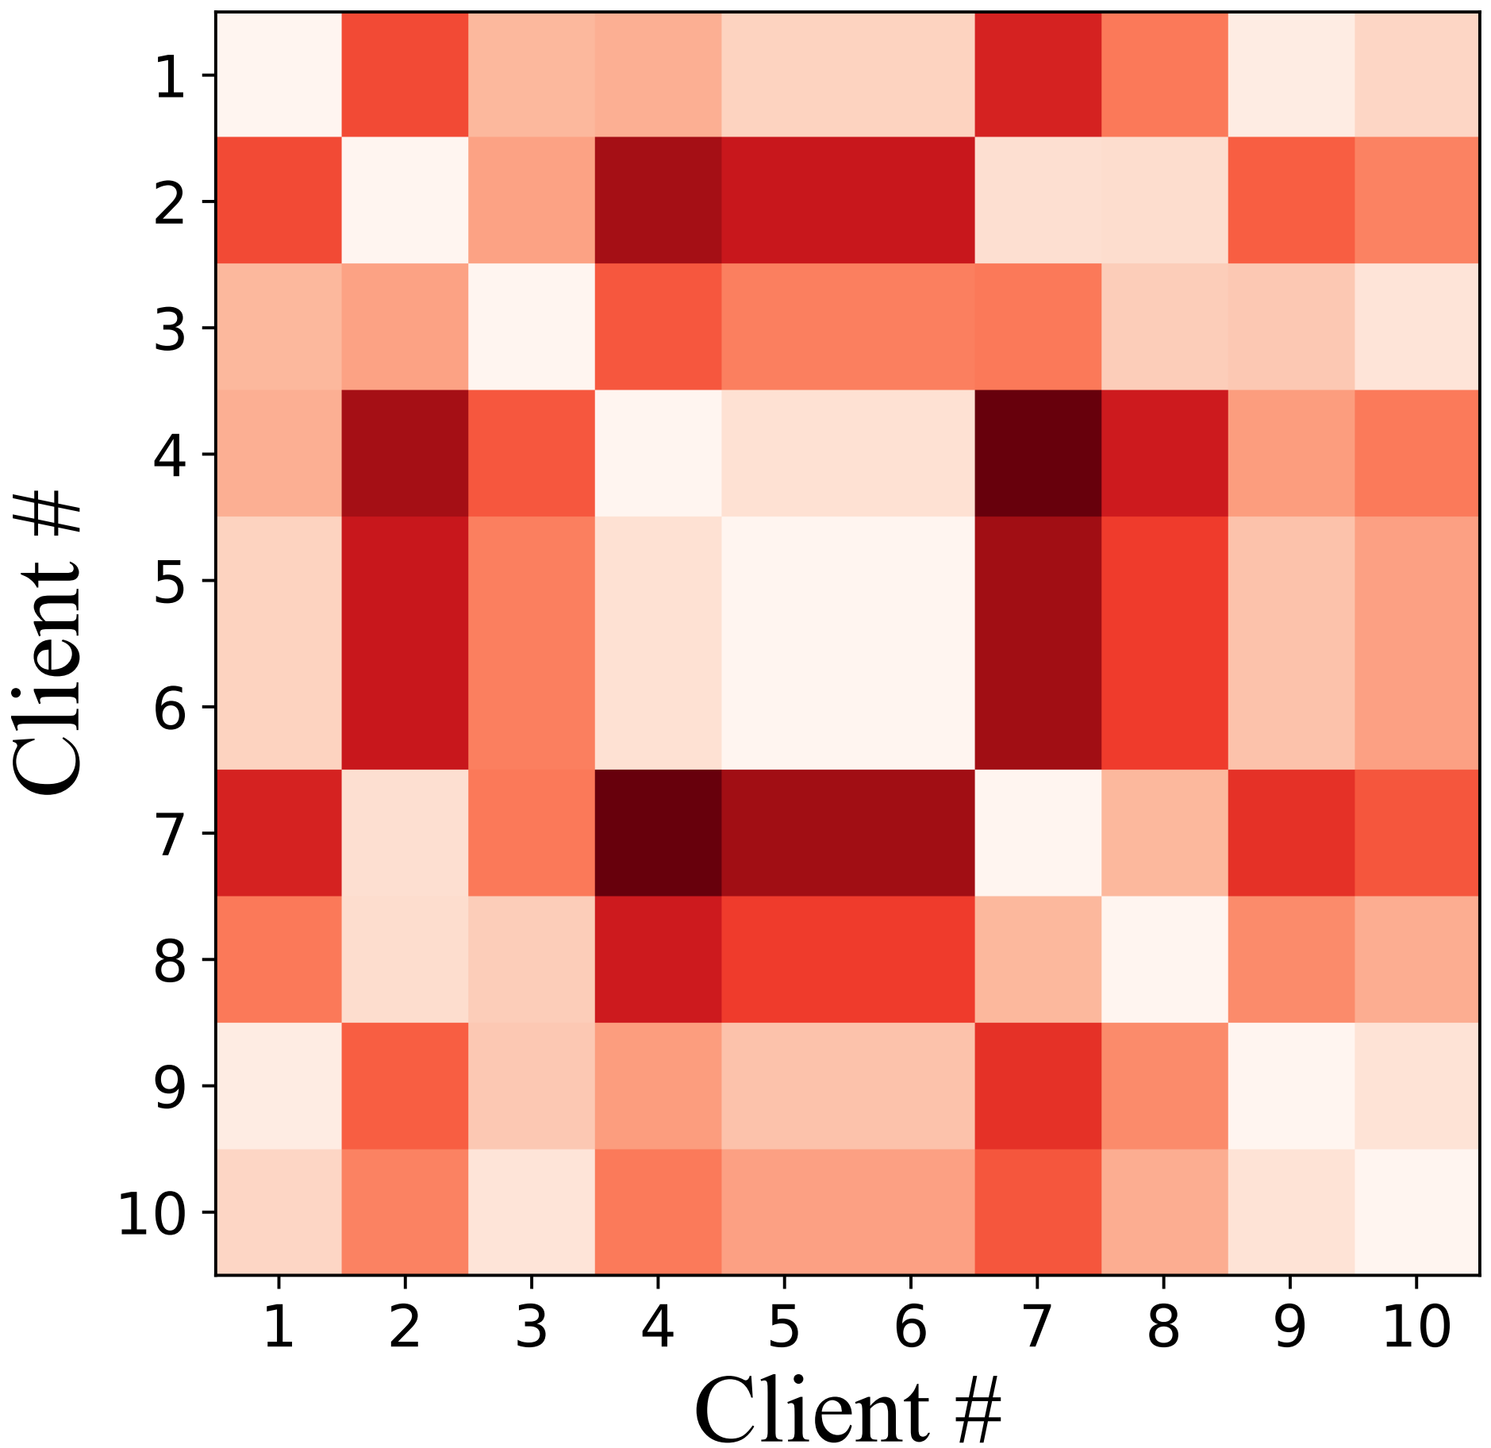
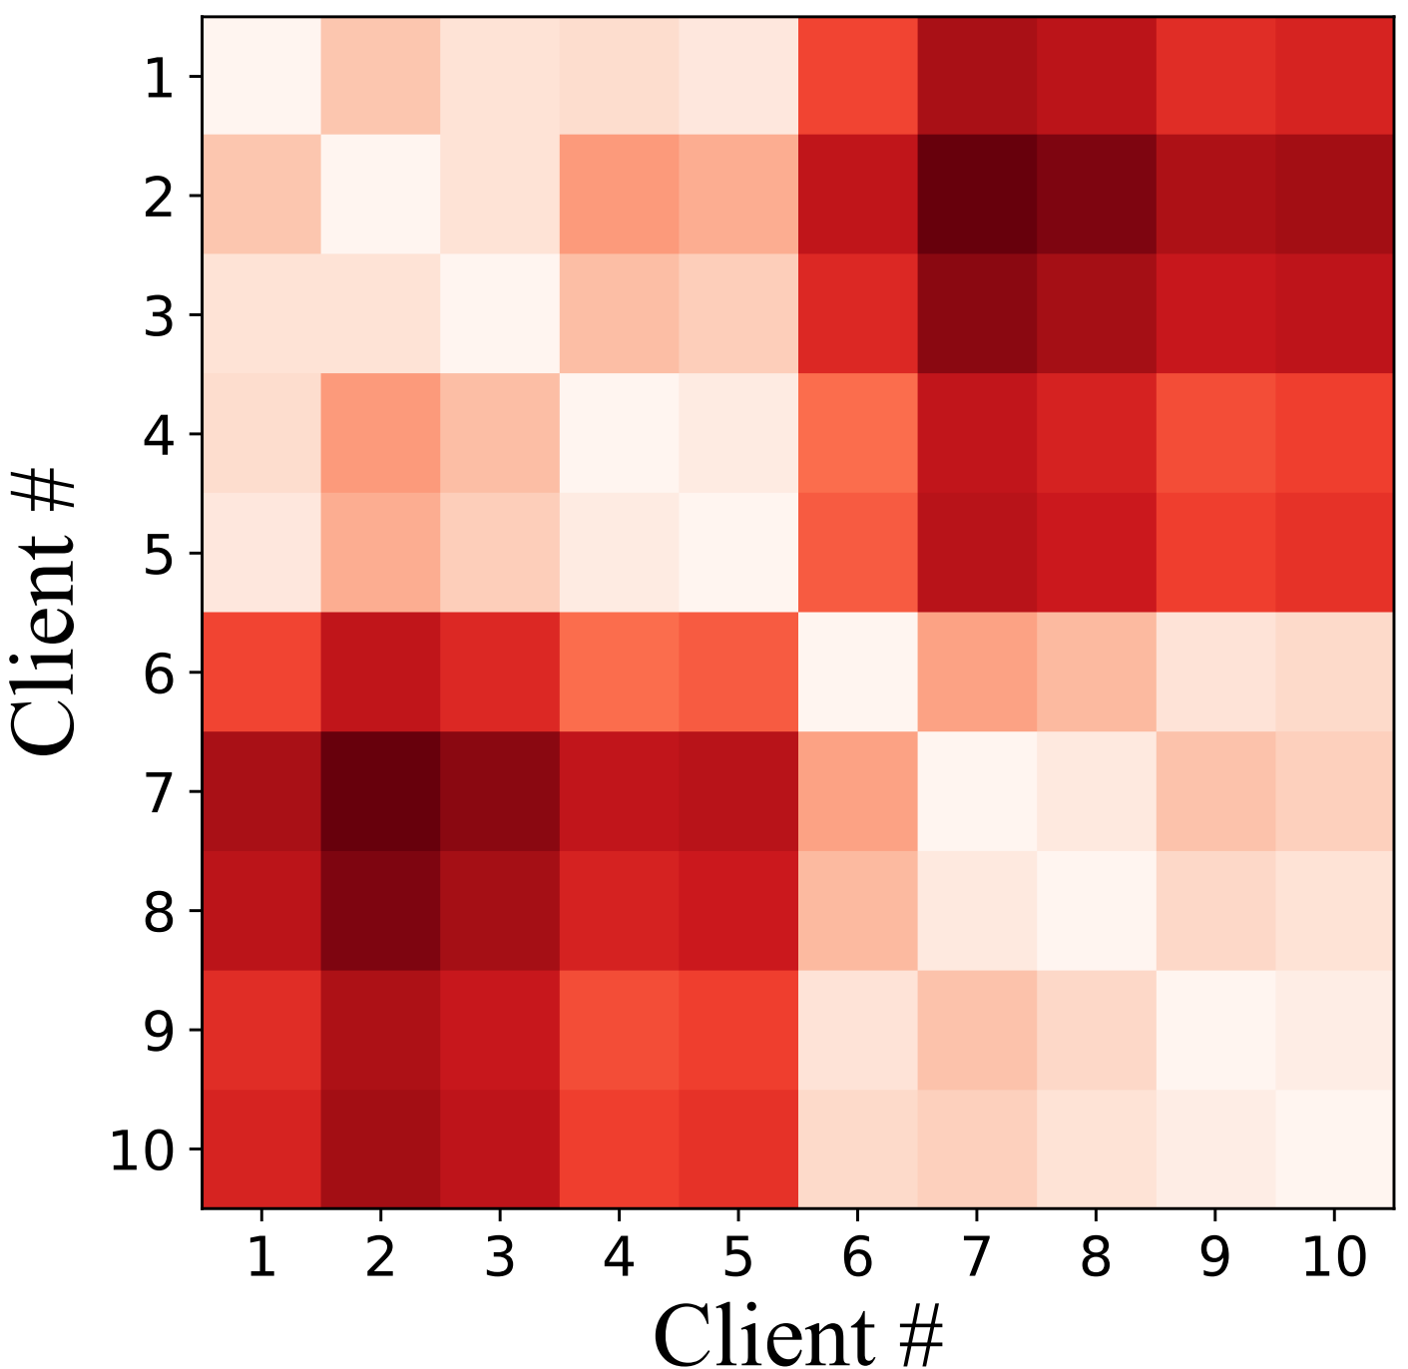
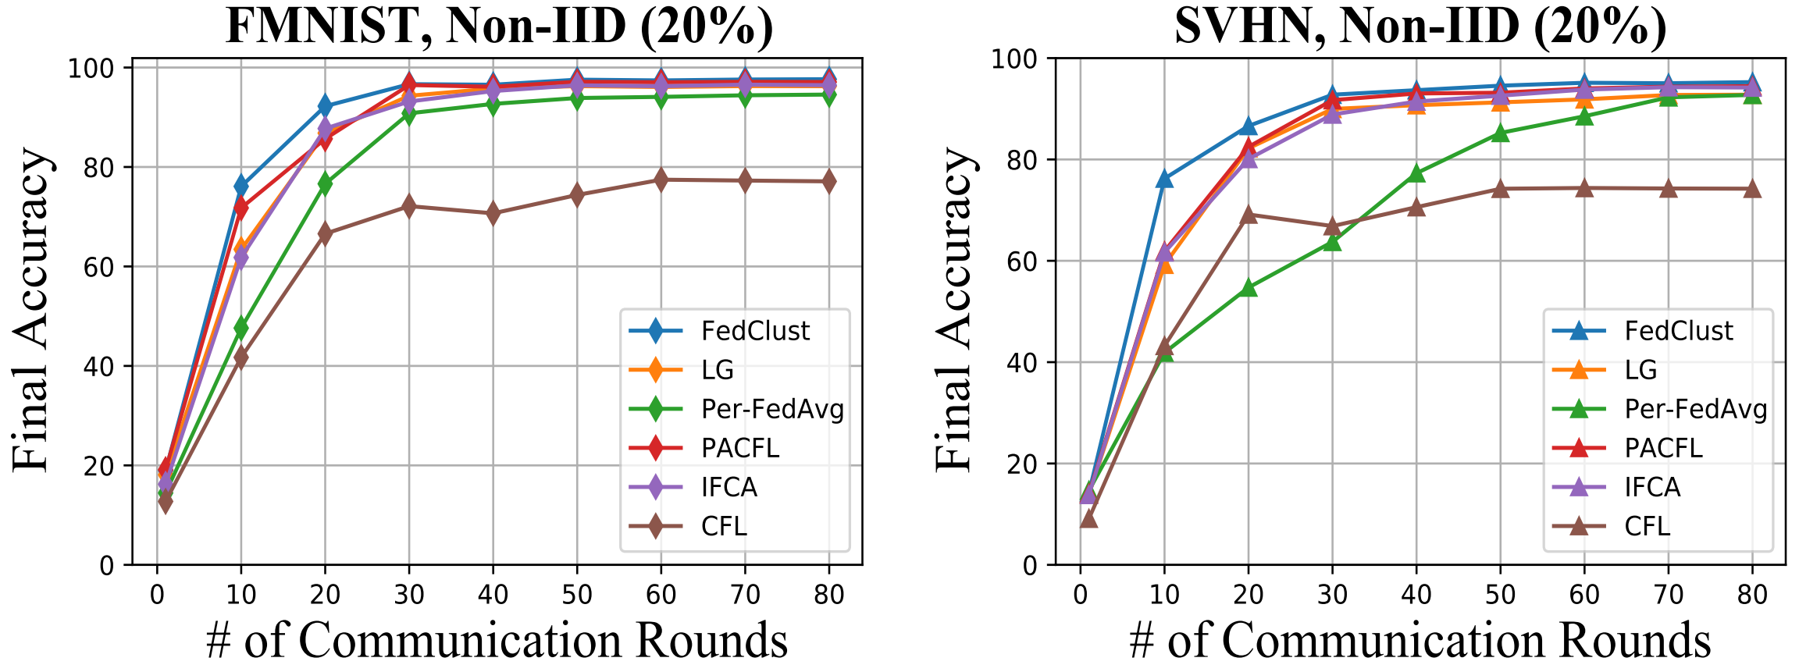





FedClust: Optimizing Federated Learning on Non-IID Data through Weight-Driven Client Clustering
Md Sirajul Islam¹, Simin Javaherian¹, Fei Xu², Xu Yuan³, Li Chen¹, Nian-Feng Tzeng¹
¹University of Louisiana at Lafayette, ²East China Normal University, ³University of Delaware
Introduction
Our Proposed Approach
Federated Learning (FL) enables collaborative training of machine learning models over decentralized devices without exposing their local data.
One of the major challenges in FL is the presence of non-IID data across client devices.
Clustered federated learning (CFL) has gained significant attention as a promising solution to address data heterogeneity in FL.
Research Gap
Several existing CFL approaches require a predetermined number of clusters, which is challenging to determine without knowledge of the actual data distributions across clients.
Some existing CFL methods (e.g., FMTL, IFCA) require larger communication rounds to form stable clusters
Many current CFL strategies leverage full model weights to calculate model similarity, imposing significant pressure on the server.
Existing techniques incur higher communication costs to determine optimal number of clusters.
Experimental Results
Overall Performance
Preliminary Insights
(a) Layer 1
(b) Layer 7
(c) Layer 14
(d) Layer 16
Investigate the implications of different layer model weights on the underlying data distribution
Above figure illustrates distance matrices calculated using different layer weights of the VGG-16 model
Final layer weights implicitly represent the underlying data distribution of clients
Final layer or the layer with the classifier function reflects the model differences caused by non-IID data
Conclusion
This work introduces FedClust, a novel clustered federated learning framework designed to address the data heterogeneity issue.
FedClust leverages the implicit correlation between local model weights and the underlying data distribution of clients.
It efficiently groups clients with non-IID data into an appropriate number of clusters based on the similarity among strategically selected partial weights of locally trained models.
The effectiveness of FedClust has been demonstrated through experimental evaluations over four popular datasets with a broad range of performance metrics.
Challenges
Identifying data distribution similarity among clients without exposing any sensitive information
Forming an optimal number of clusters while minimizing communication costs
Developing an effective weight selection strategy to reduce the communication and computation overhead to determine the similarity
Future Work
This article includes a statistical analysis of FedClust. The convergence analysis of FedClust is left for future work.
Take a picture to
download the full paper

