Slide 1
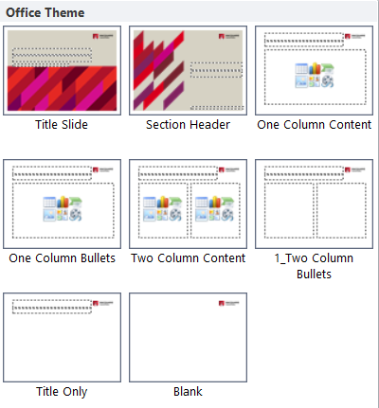
Instructions
BASIC POWERPOINT TEMPLATE
FOOTERS
To update the footer on all slides complete the following:
On any slide go to Insert | Header & Footer
Click in the Footer Section to replace OFFICE | FACULTY | DEPARTMENT with the correct information.
Ensure capitals are used.
Click the checkbox next to Don’t show on title slide.
Click Apply to all.
Be sure to apply the appropriate layout to take full advantage of the template masters provided.
With a slide selected, click the ‘Layout’ button from the ‘Home’ tab.
Select the layout that is most appropriate for the content existing on the slide.
Master slides have been set up for custom slides (shown on right).
A slide has been created in this deck with tables that are editable (no master slide created for these).

Slide 2
Assignment 2- COMP3210 BIG DATA
Group : Sia Duggal , Abiola olatunji, Gursant Singh
Date: 02/06/2024

Slide 3

Content
Introduction
Report
Task1 : BF Search
Task2 : BBS Search

Slide 4
Introduction
Brief description about the assignment 2

Slide 5
Input Files and Parameters
Content
We will require a python supportive environment
A data set
parking_dataset.txt for Nearest Neighbor
City1.txt for Skyline search
The Report is based on a sample dataset
A query point(or data set) for Nearest Neighbor
We are using output_files for storing our solutions

Slide 6
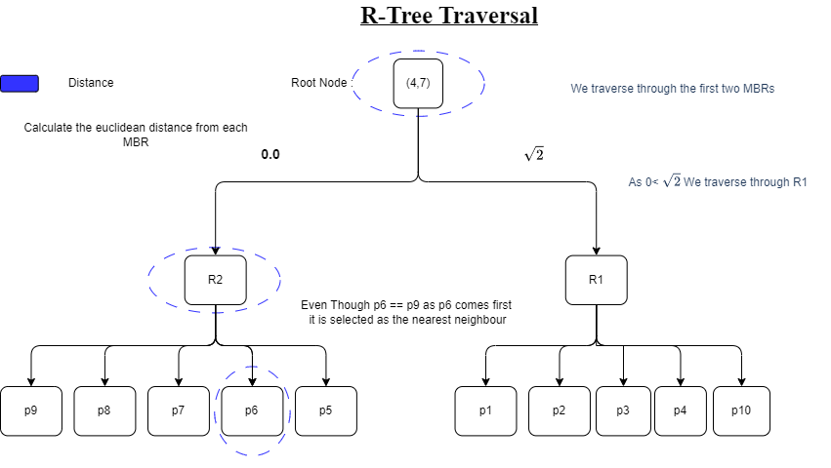
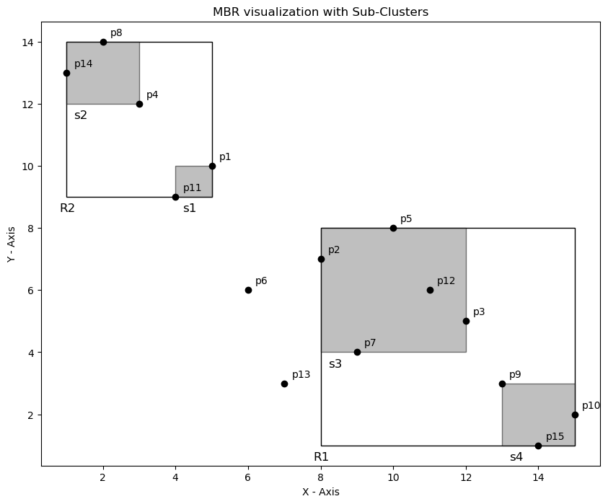
Introduction
R-tree & mbr
In this task we were assigned to implement search algorithms on given dataset. The motive was to construct the R-tree , find the Nearest Neighbour and Skyline points
R-tree is also known as a regression tree , which arranges the dataset into a hierarchical structure to make it easier to run the search algorithm . It is used to increase the efficiency of the algorithm. The figure shows a R-tree example
The R-tree can be constructed using the Minimum bound rectangles. The mbr is the smalled rectangle that covers all the points. We can use clustering to find the MBRs. The figure shows a MBR structural visualization.

Slide 7
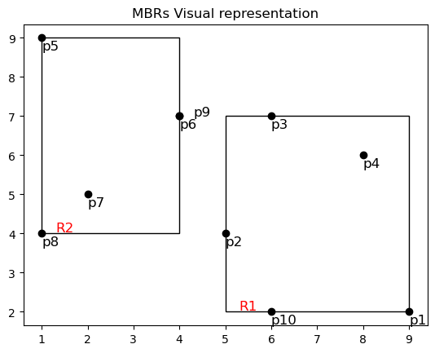
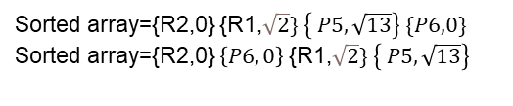
Report: Nearest Neighbour
Sample Dataset with Visualization
Nearest Neighbour
The data set given had a query point and we were assigned to find the nearest neighbour to that query point. We had to find it by applying the Best First algorithm
We also had to apply Divide & conquer to get more Efficient Results
Sorted array={R2,0} {R1,$\sqrt{2}\} \left\{ P5, \sqrt{13}\right\} \{P6,0\}$
Sorted array={R2,0} $\left\{P6, 0\right\}${R1,$\sqrt{2}\} \left\{ P5, \sqrt{13}\right\}$

Slide 8
Divide And Conquer
BF search and BF search with divide and conquer
The Divide and Conquer is that you divide the dataset into half analyze the R-tree and then continue the search on both the trees and get the results and merge accordingly . You can notice that comparatively the results of the best first algorithm is significantly calculated faster using the divide and conquer approach :
Facility ID: 6, Distance: 0.0
Nearest neighbor found!
The time taken for the complete search is using Best First Search: 0.11418008804321289 seconds
Facility ID: 6, Distance: 0.0
Nearest neighbor found in second subset!
The time taken for the complete search is Best First Search with Divide-and-Conquer: 0.02745532989501953 seconds

Slide 9
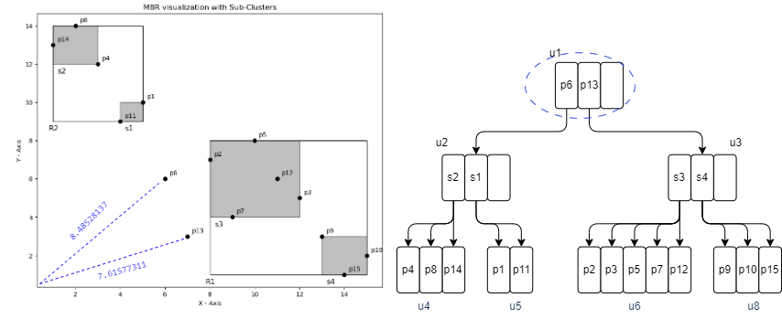
Report: Skyline Search
Sample Dataset with Visualization
Skyline Search
The data set given had a set of datapoints and we were required to find the skyline points . This approach helps us to reduce the dataset widely as the points dominated can be discarded.
We also had to apply Divide & conquer to get more Efficient Results
Priority List ={[p13, 7.61] ,[ p6 , 8.48]}
As point 6 and 13 are not dominated by any points
Skyline points ={[p13, 7.61] ,[ p6 , 8.48]}
Priority List = { [p6, 8.48] , [s3 , 8.94], [s4, 13.34] }
Priority List = { [s3 , 8.94] ,[s4, 13.34] , [s1, 13.45] ,[ s2, 17.69]}
Final skyline points= { [p13, 7.61] , [ p6 , 8.48] , [p11, 9.84] , [p4 , 12.36 ] ,[p15, 14.03 ] , [p8 , 14.14] }

Slide 10
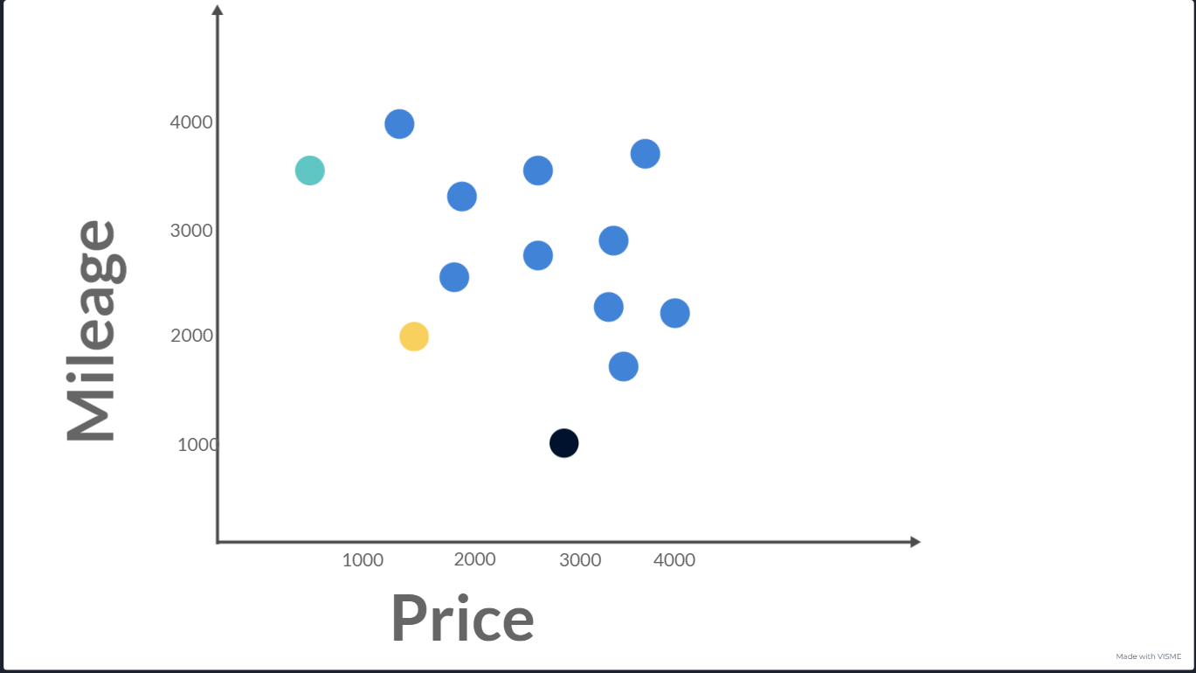
Section Three
Skyline Search
Skyline search is used majorly to search in a multi dimensional space. Skyline search majorly uses the idea of dominance and the final result are the points that are not dominated by any other points in the dataset.
Example : A user wants to buy a used bike that is cheap and also has a very low mileage.
It is very difficult for traditional queries to solve and give results to the example above that is where skyline search comes in.

Slide 11
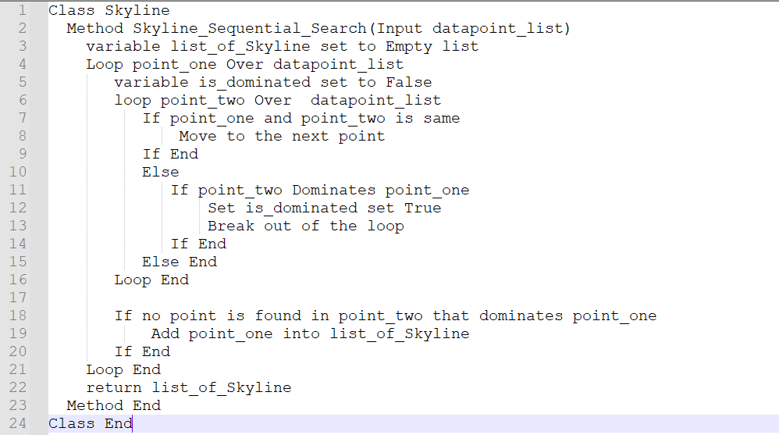
Section Three
Sequential Pseudocode Skyline

Slide 12
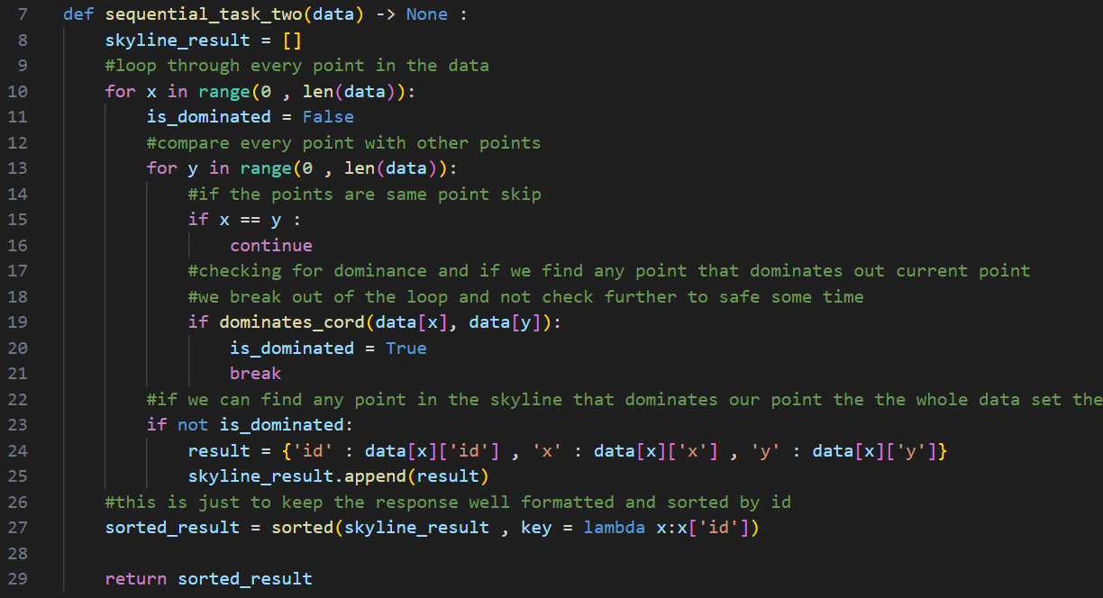
Section Three
Sequential Skyline Code

Slide 13
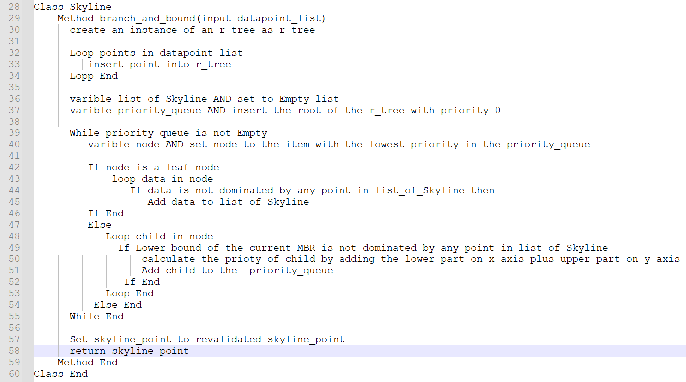
Section Three
Branch and bound skyline(bbs) Pseudocode

Slide 14
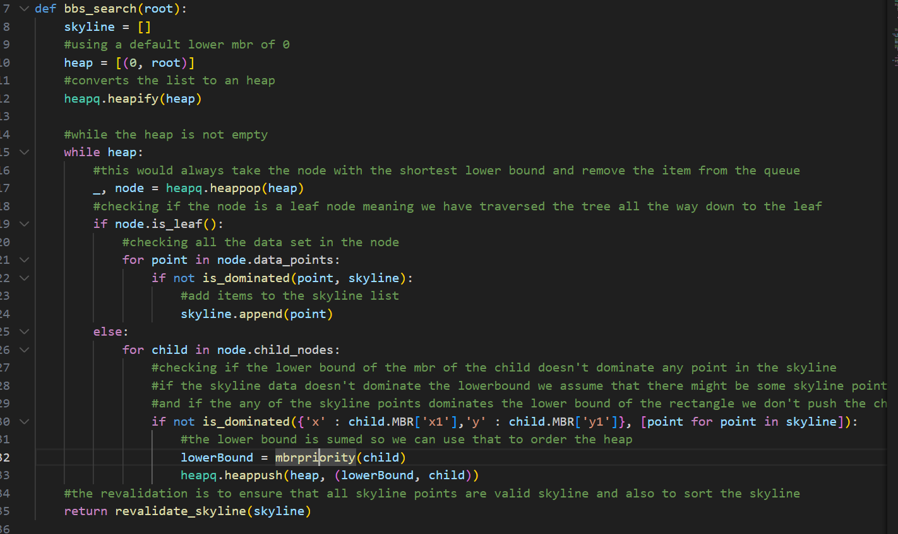
Section Three
Branch and bound skyline(bbs) Pseudocode

Slide 15
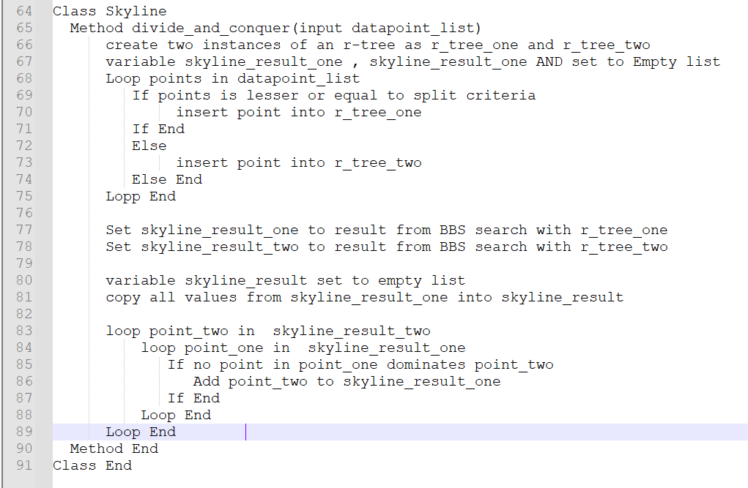
Section Three
Divide and conquer Pseudocode

Slide 16
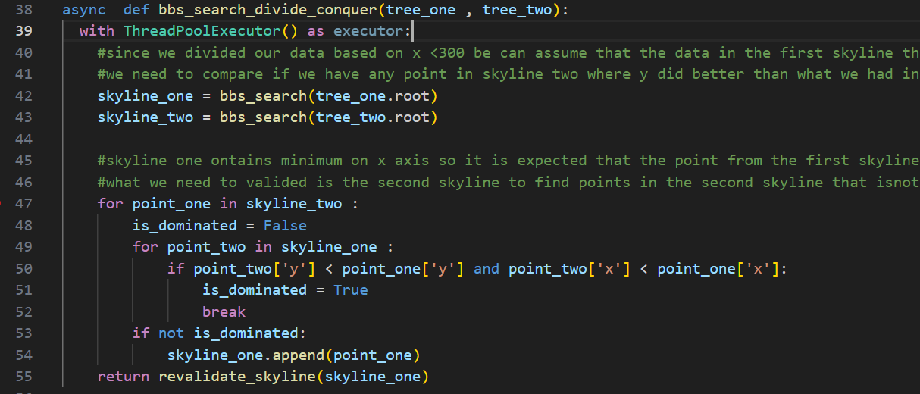
Section Three
Divide and conquer Code

