Slide 1
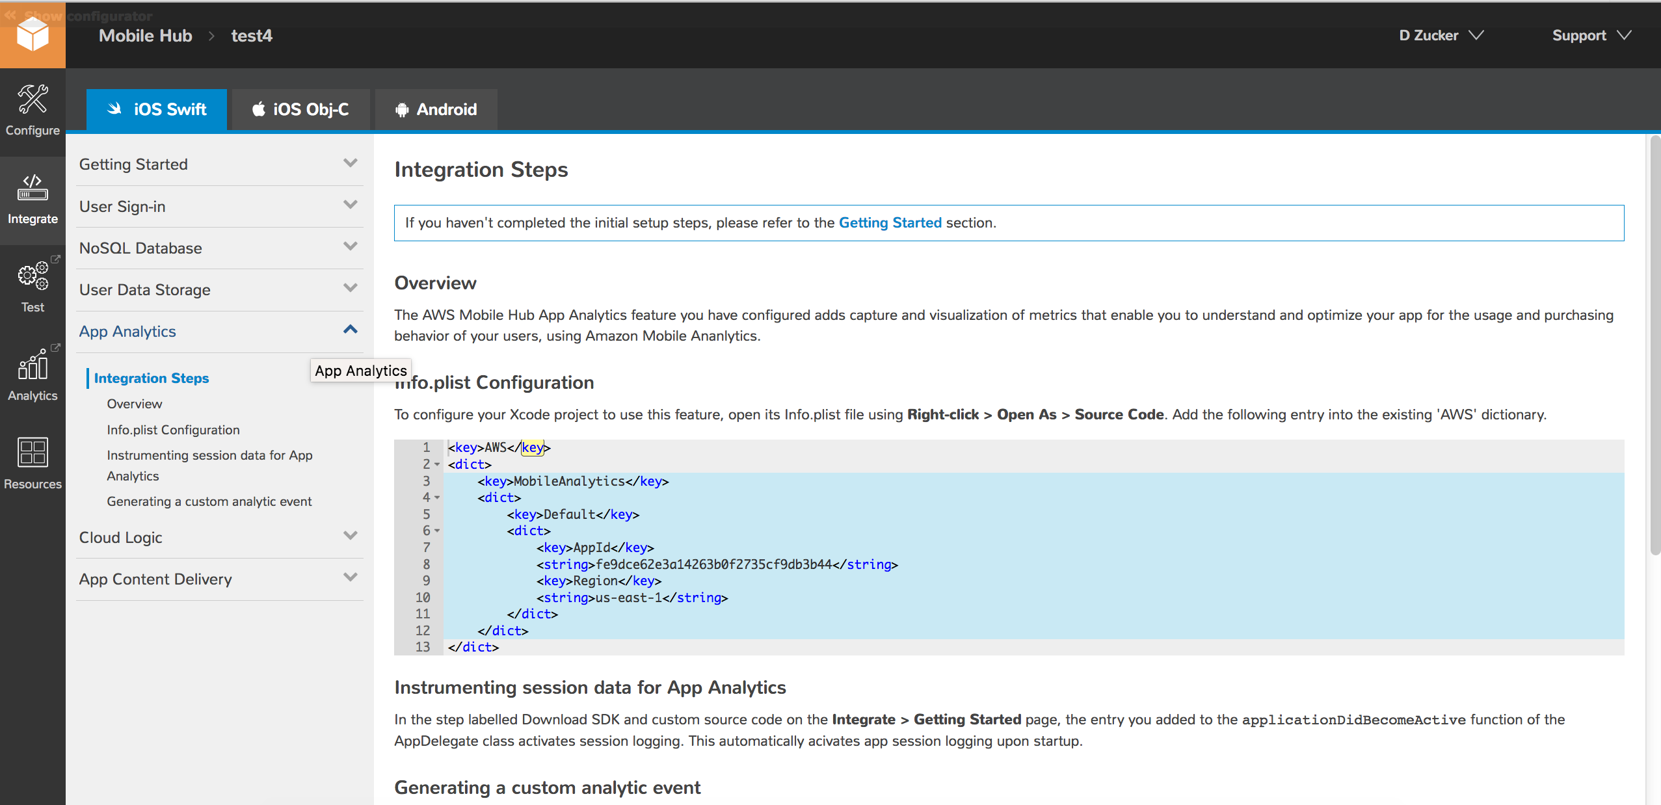
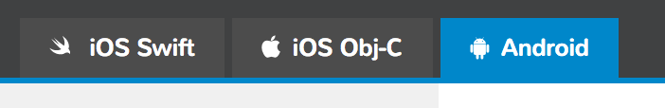
test4 Resource Identifier Values
Resource IDs
The following table provides a listing of all AWS resource identifier values associated with your test 4Mobile Hub Project.
Resource IDs
Identifier Name | ID value
User Agent | MobileHub 1f665636-1cac-42d5-9a0e-41287b37test4
Amazon Cognito Identity Pool | us-east-1:f1d9541e-a26c-4be7-94f8-007a3c258753
Amazon Cognito Region | Regions.fromName("us-east-1"
Amazon Mobile Analytics App | fe9dce62e3a14263b0f2735cf9db3b44
Amazon mobile Analytics Region | Regions.US_EAST_1
Google Cloud Messenger Sender | 1023452361049
Notes:
Resource Identifier Values

