Slide 1
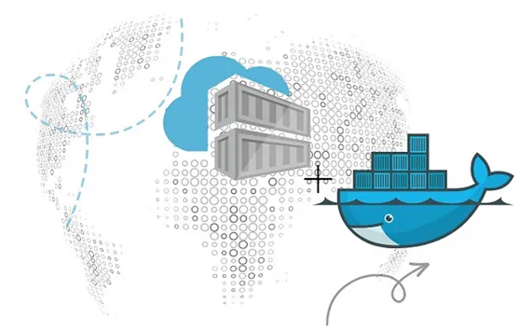



PDS
Computer Vision
Chapter 5-2:
Artificial Neural Network
https://github.com/siagianp
https://github.com/amelcharolinesgn2/IoT_simulator-mqtt-NodeRed
https://www.youtube.com/@AmelOline/videos
Notes:
https://medium.com/buildpiper/simplifying-containerization-with-docker-run-command-2f74e114f42a
https://github.com/IBA-Group-IT/IoT-data-simulator
https://www.bevywise.com/blog/docker-mqtt-broker-easy-service-manageability/

Slide 2
Artificial Neural Networks
Learn to build neural network from scratch.
Focus on multi-level feedforward neural networks (multi-level perceptrons)
Training large neural networks is one of the most important workload in large scale parallel and distributed systems
Programming assignments throughout the semester will use this.

Slide 3
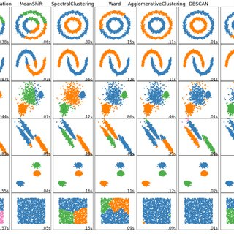
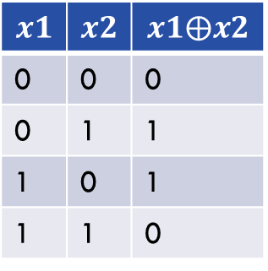

What do (deep) neural networks do?
Learning (highly) non-linear functions.
$$x1$$ | $$x2$$ | $$x1⨁x2$$
0 | 0 | 0
0 | 1 | 1
1 | 0 | 1
1 | 1 | 0
(0, 1)
(1, 1)
(0, 0)
(1, 0)
Logic XOR ($⨁$) operation

Slide 4
Artificial neural network example
A neural network consists of layers of artificial neurons and connections between them.
Each connection is associated with a weight.
Training of a neural network is to get to the right weights (and biases) such that the error across the training data is minimized.
Input
layer
Hidden
layer 1
Hidden
layer 2
Hidden
layer 3
Output
layer

Slide 5
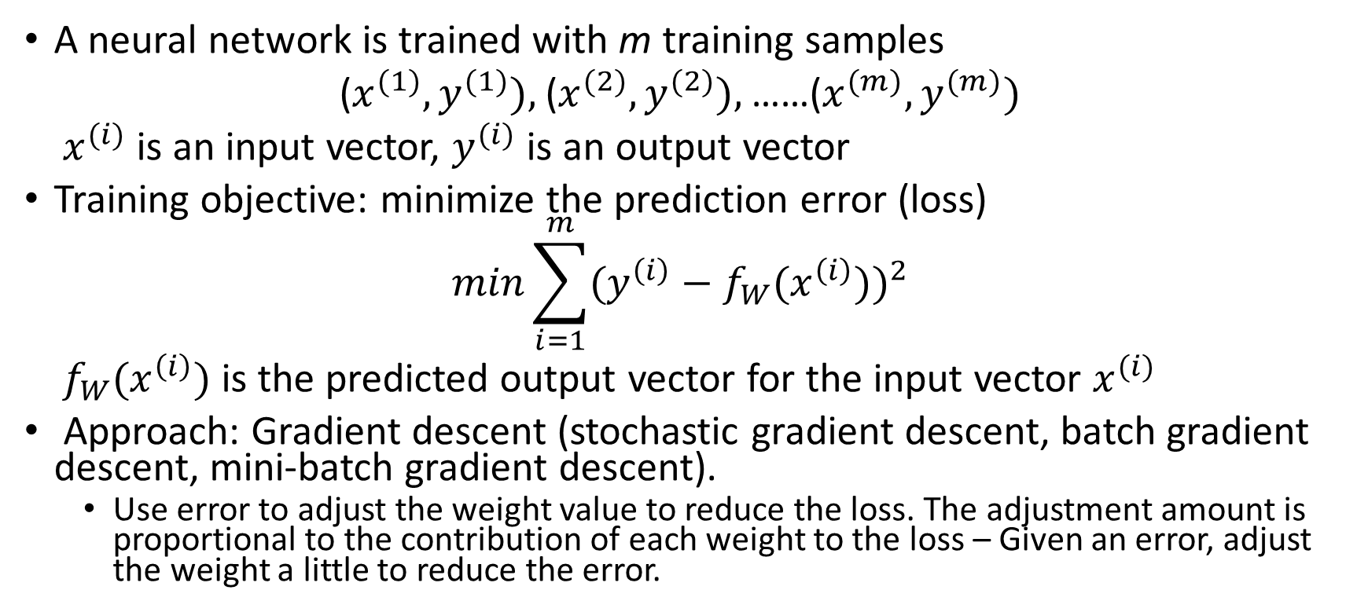
Training a neural network
A neural network is trained with m training samples
($x^{(1)}, y^{(1)}),$($x^{(2)}, y^{(2)}),$……($x^{(m)}, y^{(m)})$
$x^{(i)}$ is an input vector, $y^{(i)}$ is an output vector
Training objective: minimize the prediction error (loss)
$$min\sum_{i=1}^{m}{(y^{\left(i\right)}−f_{W}(x^{\left(i\right)}))^{2}}$$
$f_{W}(x^{\left(i\right)})$ is the predicted output vector for the input vector $x^{(i)}$
Approach: Gradient descent (stochastic gradient descent, batch gradient descent, mini-batch gradient descent).
Use error to adjust the weight value to reduce the loss. The adjustment amount is proportional to the contribution of each weight to the loss – Given an error, adjust the weight a little to reduce the error.

Slide 6
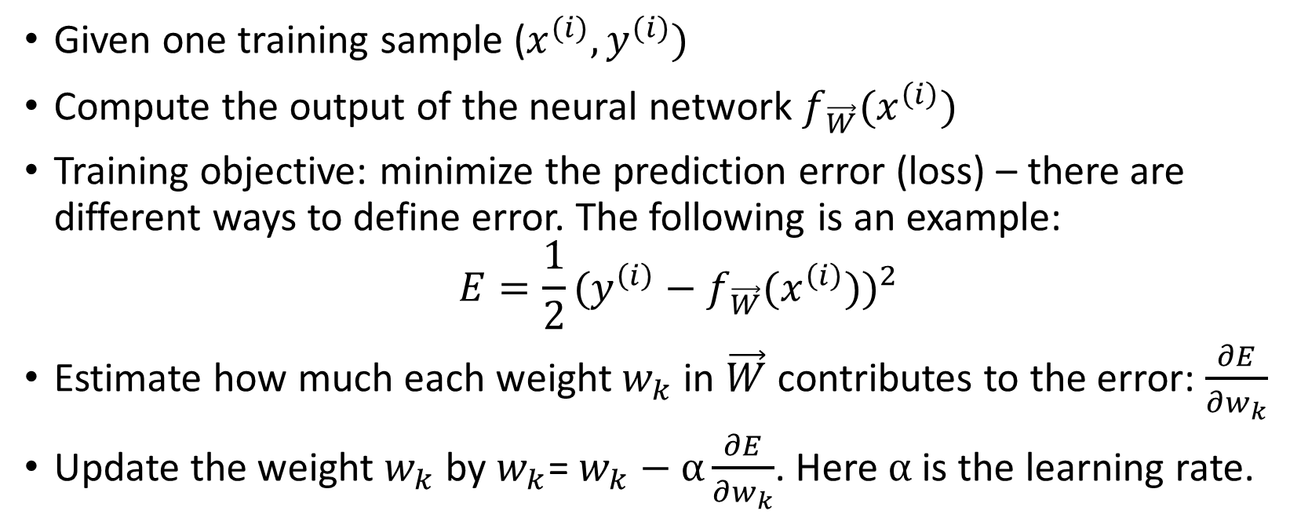
Stochastic gradient descent
Given one training sample ($x^{(i)}, y^{(i)})$
Compute the output of the neural network $f_{\vec{W}}(x^{\left(i\right)})$
Training objective: minimize the prediction error (loss) – there are different ways to define error. The following is an example:
$$E=\frac{1}{2}(y^{\left(i\right)}−f_{\vec{W}}(x^{\left(i\right)}))^{2}$$
Estimate how much each weight $w_{k}$ in $\vec{W}$ contributes to the error: $\frac{∂E}{∂w_{k}}$
Update the weight $w_{k}$ by $w_{k}$=$w_{k}−α\frac{∂E}{∂w_{k}}$. Here $α$ is the learning rate.

Slide 7
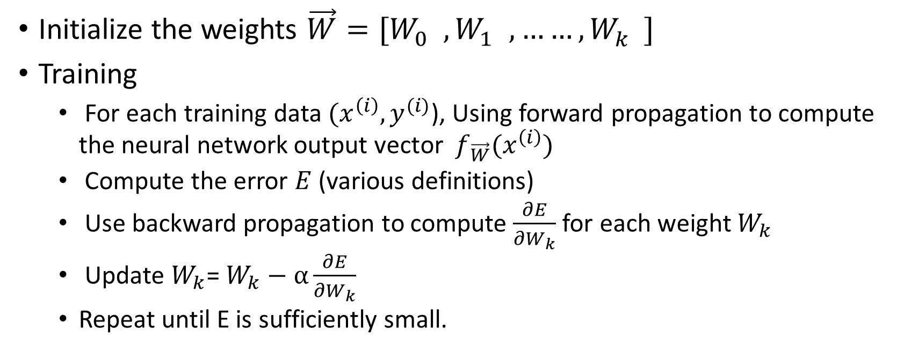
Algorithm for learning artificial neural network
Initialize the weights $\vec{W}=[W_{0}^{}, W_{1}^{}, ……, W_{k}^{}]$
Training
For each training data $(x^{\left(i\right)},y^{(i)}$), Using forward propagation to compute the neural network output vector $f_{\vec{W}}(x^{\left(i\right)})$
Compute the error $E$ (various definitions)
Use backward propagation to compute $\frac{∂E}{∂W_{k}}$ for each weight $W_{k}$
Update $W_{k}$=$W_{k}−α\frac{∂E}{∂W_{k}}$
Repeat until E is sufficiently small.

Slide 8



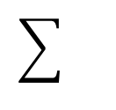
A single neuron
b
$$X_{1}^{(i)}$$
w1
Neuron
$$X_{m}^{(i)}$$
wm
${w1∗X}_{1}^{(i)}+…+wm∗X_{m}^{(i)}$+b
Activation function
An artificial neuron has two components: (1) weighted sum and activation function.
Many activation functions: Sigmoid, ReLU, etc.

Slide 9
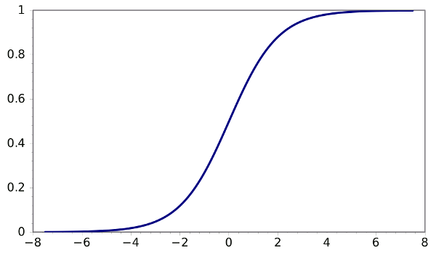
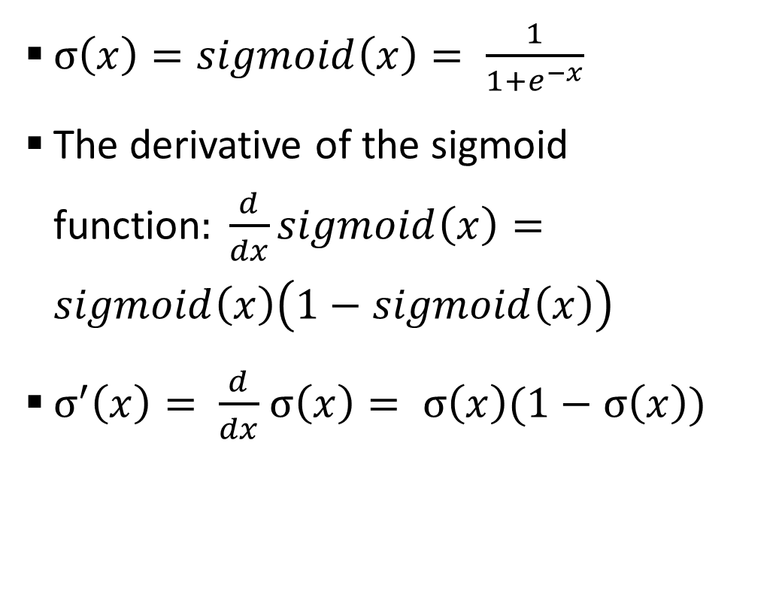
Sigmoid function
$σ\left(x\right)=sigmoid\left(x\right)= \frac{1}{1+e^{−x}}$
The derivative of the sigmoid function$: \frac{d}{dx}sigmoid\left(x\right)=sigmoid\left(x\right)\left(1−sigmoid\left(x\right)\right)$
$σ^{′}\left(x\right)= \frac{d}{dx}$ $σ\left(x\right)= σ\left(x\right)(1−σ\left(x\right))$

Slide 10
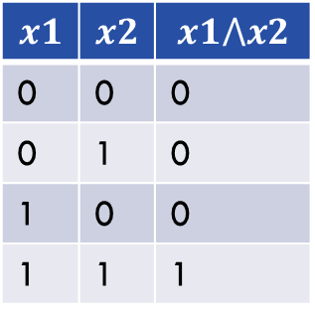

Training for the logic AND with a single neuron
In general, one neuron can be trained to realize a linear function.
Logic AND function is a linear function:
$$x1$$ | $$x2$$ | $$x1⋀x2$$
0 | 0 | 0
0 | 1 | 0
1 | 0 | 0
1 | 1 | 1
(0, 1)
(1, 1)
(0, 0)
(1, 0)
Logic AND ($⋀$) operation

Slide 11


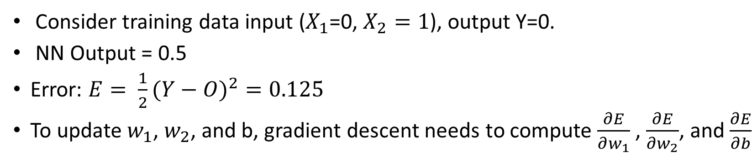



Training for the logic AND with a single neuron
b=0
$X_{1}$=0
$w_{1}$=0
∑
Sigmoid(s)
O=Sigmoid(0)=0.5
$$X_{2}=1$$
$w_{2}$=0
$s=X_{1}w_{1}$+$X_{2}w_{2}+b=0$
Activation function
Consider training data input ($X_{1}$=0, $X_{2}=1$), output Y=0.
NN Output = 0.5
Error: $E= \frac{1}{2}(Y−O)^{2}=0.125$
To update $w_{1}$, $w_{2}$, and b, gradient descent needs to compute $\frac{∂E}{∂w_{1}}$ , $\frac{∂E}{∂w_{2}}$, and $\frac{∂E}{∂b}$

Slide 12

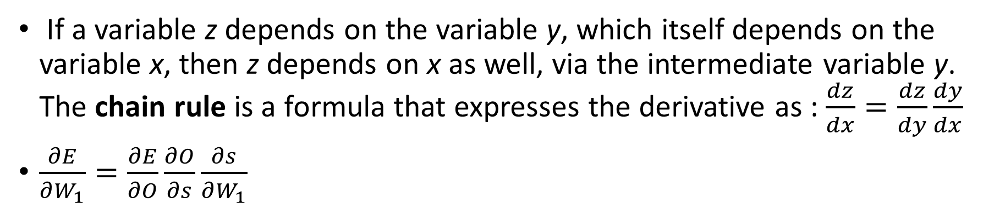





Chain rules for calculating $\frac{∂E}{∂w_{1}}$ , $\frac{∂E}{∂w_{2}}$, and $\frac{∂E}{∂b}$
b=0
$X_{1}$=0
$w_{1}$=0
$s=X_{1}w_{1}$+$X_{2}w_{2}+b=0$
∑
Sigmoid(s)
O=Sigmoid(0)=0.5
$$X_{2}=1$$
$w_{2}$=0
Activation function
If a variable z depends on the variable y, which itself depends on the variable x, then z depends on x as well, via the intermediate variable y. The chain rule is a formula that expresses the derivative as : $\frac{dz}{dx}=\frac{dz}{dy}\frac{dy}{dx}$
$\frac{∂E}{∂W_{1}}=\frac{∂E}{∂O}\frac{∂O}{∂s}\frac{∂s}{∂W_{1}}$

Slide 13
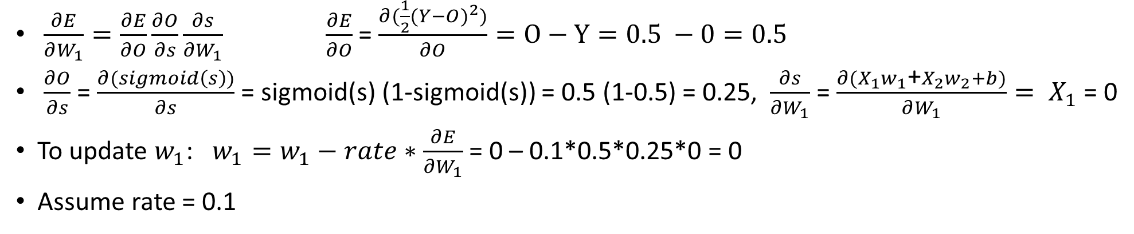
Training for the logic AND with a single neuron
b=0
$X_{1}$=0
$w_{1}$=0
∑
Sigmoid(s)
O=Sigmoid(0)=0.5
$$X_{2}=1$$
$w_{2}$=0
$s=X_{1}w_{1}$+$X_{2}w_{2}+b=0$
Activation function
$\frac{∂E}{∂W_{1}}=\frac{∂E}{∂O}\frac{∂O}{∂s}\frac{∂s}{∂W_{1}} \frac{∂E}{∂O}$ = $\frac{∂(\frac{1}{2}(Y−O)^{2})}{∂O}=O−Y=0.5 −0=0.5$
$\frac{∂O}{∂s}$ = $\frac{∂(sigmoid\left(s\right))}{∂s}$ = sigmoid(s) (1-sigmoid(s)) = 0.5 (1-0.5) = 0.25, $\frac{∂s}{∂W_{1}}$ = $\frac{∂{(X}_{1}w_{1}\text{+}X_{2}w_{2}+b)}{∂W_{1}}= X_{1}$ = 0
To update $w_{1}$: $w_{1}=w_{1}−rate∗\frac{∂E}{∂W_{1}}$ = 0 – 0.1*0.5*0.25*0 = 0
Assume rate = 0.1

Slide 14
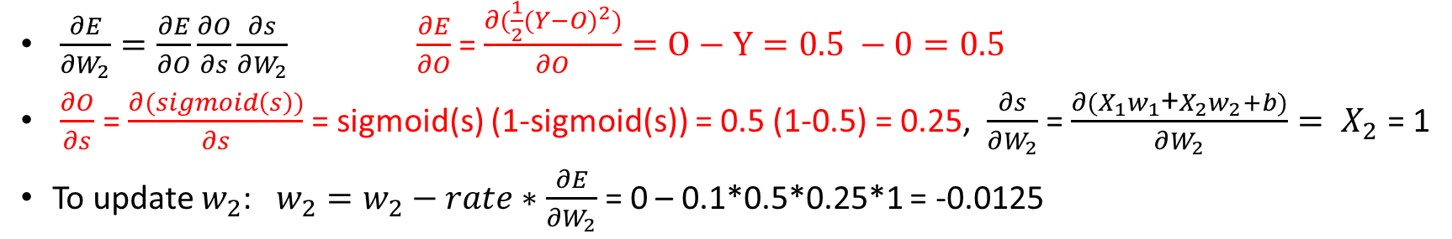
Training for the logic AND with a single neuron
b=0
$X_{1}$=0
$w_{1}$=0
∑
Sigmoid(s)
O=Sigmoid(0)=0.5
$$X_{2}=1$$
$w_{2}$=0
$s=X_{1}w_{1}$+$X_{2}w_{2}+b=0$
Activation function
$\frac{∂E}{∂W_{2}}=\frac{∂E}{∂O}\frac{∂O}{∂s}\frac{∂s}{∂W_{2}} \frac{∂E}{∂O}$ = $\frac{∂(\frac{1}{2}(Y−O)^{2})}{∂O}=O−Y=0.5 −0=0.5$
$\frac{∂O}{∂s}$ = $\frac{∂(sigmoid\left(s\right))}{∂s}$ = sigmoid(s) (1-sigmoid(s)) = 0.5 (1-0.5) = 0.25, $\frac{∂s}{∂W_{2}}$ = $\frac{∂{(X}_{1}w_{1}\text{+}X_{2}w_{2}+b)}{∂W_{2}}= X_{2}$ = 1
To update $w_{2}$: $w_{2}=w_{2}−rate∗\frac{∂E}{∂W_{2}}$ = 0 – 0.1*0.5*0.25*1 = -0.0125

Slide 15
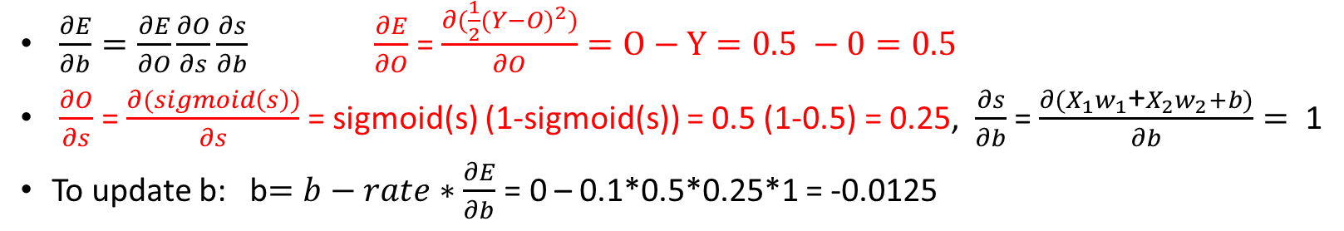
Training for the logic AND with a single neuron
b=0
$X_{1}$=0
$w_{1}$=0
∑
Sigmoid(s)
O=Sigmoid(0)=0.5
$$X_{2}=1$$
$w_{2}$=0
$s=X_{1}w_{1}$+$X_{2}w_{2}+b=0$
Activation function
$\frac{∂E}{∂b}=\frac{∂E}{∂O}\frac{∂O}{∂s}\frac{∂s}{∂b} \frac{∂E}{∂O}$ = $\frac{∂(\frac{1}{2}(Y−O)^{2})}{∂O}=O−Y=0.5 −0=0.5$
$\frac{∂O}{∂s}$ = $\frac{∂(sigmoid\left(s\right))}{∂s}$ = sigmoid(s) (1-sigmoid(s)) = 0.5 (1-0.5) = 0.25, $\frac{∂s}{∂b}$ = $\frac{∂{(X}_{1}w_{1}\text{+}X_{2}w_{2}+b)}{∂b}=$ 1
To update b: b$=b−rate∗\frac{∂E}{∂b}$ = 0 – 0.1*0.5*0.25*1 = -0.0125

Slide 16

Training for the logic AND with a single neuron
b=-0.0125
$X_{1}$=0
$w_{1}$=0
∑
Sigmoid(s)
O=Sigmoid(0)=0.5
$$X_{2}=1$$
$w_{2}$=-0.0125
Activation function
$s=X_{1}w_{1}$+$X_{2}w_{2}+b=0$
This process is repeated until the error is sufficiently small
The initial weight should be randomized. Gradient descent can get stuck in the local optimal.
Training the logic AND operation with a single neuron.
Note: Logic XOR operation is non-linear and cannot be trained with one neuron.

Slide 17
Multi-level feedforward neural networks
A multi-level feedforward neural network is a neural network that consists of multiple levels of neurons. Each level can have many neurons and connections between neurons in different levels do not form loops.
Information moves in one direction (forward) from input nodes, through hidden nodes, to output nodes.
One artificial neuron can only realize a linear function
Many levels of neurons can combine linear functions can train arbitrarily complex functions.
One hidden layer (with infinite number of neurons) can train for any continuous function.

Slide 18
Multi-level feedforward neural networks examples
A layer of neurons that do not directly connect to outputs is called a hidden layer.
Input
layer
Hidden
layer 1
Hidden
layer 2
Hidden
layer 3
Output
layer

Slide 19
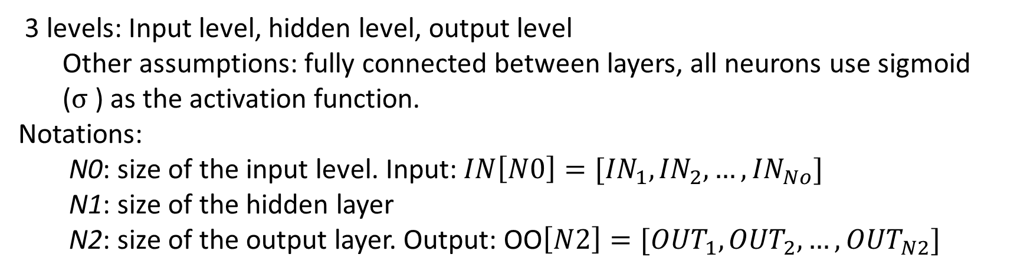
Build a 3-level neural network from scratch
3 levels: Input level, hidden level, output level
Other assumptions: fully connected between layers, all neurons use sigmoid ($σ$) as the activation function.
Notations:
N0: size of the input level. Input: $IN\left[N0\right]=[{IN}_{1},{IN}_{2},…,{IN}_{No}]$
N1: size of the hidden layer
N2: size of the output layer. Output: OO$\left[N2\right]=[{OUT}_{1},{OUT}_{2},…,{OUT}_{N2}]$

Slide 20
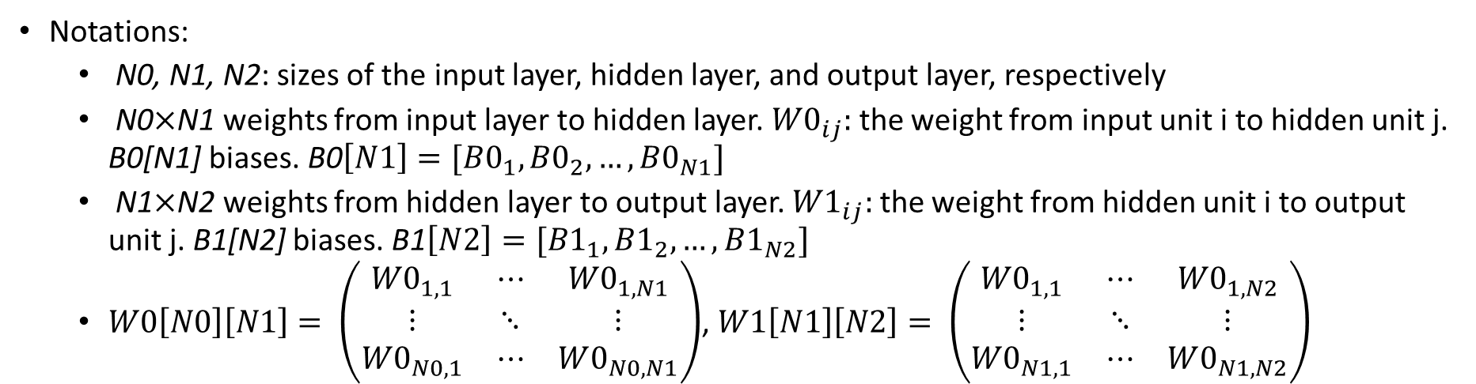
Build a 3-level neural network from scratch
Notations:
N0, N1, N2: sizes of the input layer, hidden layer, and output layer, respectively
N0$×$N1 weights from input layer to hidden layer. ${W0}_{ij}:$ the weight from input unit i to hidden unit j. B0[N1] biases. B0$\left[N1\right]=[{B0}_{1},{B0}_{2},…,{B0}_{N1}]$
N1$×$N2 weights from hidden layer to output layer. ${W1}_{ij}:$ the weight from hidden unit i to output unit j. B1[N2] biases. B1$\left[N2\right]=[{B1}_{1},{B1}_{2},…,{B1}_{N2}]$
$W0\left[N0\right]\left[N1\right]= \left(\begin{matrix}{W0}_{1, 1} & ⋯ & {W0}_{1,N1} \\ ⋮ & ⋱ & ⋮ \\ {W0}_{N0, 1} & ⋯ & W0_{N0, N1}\end{matrix}\right)$, $W1\left[N1\right]\left[N2\right]= \left(\begin{matrix}{W0}_{1, 1} & ⋯ & {W0}_{1,N2} \\ ⋮ & ⋱ & ⋮ \\ {W0}_{N1, 1} & ⋯ & W0_{N1, N2}\end{matrix}\right)$

Slide 21
3-level feedforward neural network
Output: OO[N2]
Output layer
1
2
N2
Hidden layer biases: B2[N2]
Weight: W1[N1][N2]
Hidden layer
Output: HO[N1]
Hidden layer
1
2
N1
Hidden layer biases: B1[N1]
Weight: W0[N0][N1]
Input layer
1
2
N0
Hidden layer weighted sum: HS[N1]
Output layer weighted sum: HS[N2]
Input: IN[N0]

Slide 22
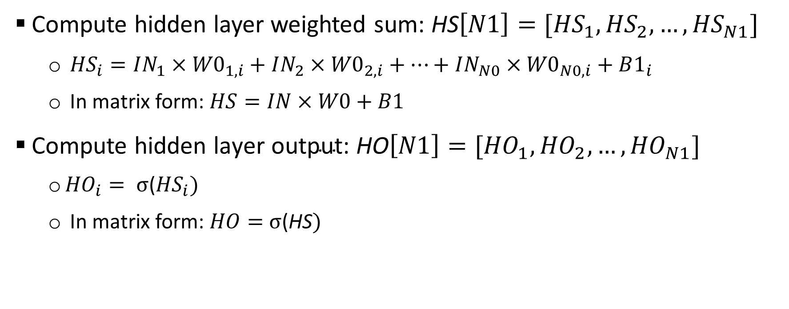
Forward propogation (compute OO and E)
Compute hidden layer weighted sum: HS$\left[N1\right]=[{HS}_{1},{HS}_{2},…,{HS}_{N1}]$
${HS}_{i}=IN_{1}×{W0}_{1, i}+IN_{2}×{W0}_{2, i}+…+IN_{N0}×{W0}_{N0, i}+B1_{i}$
In matrix form: $HS=IN×W0+B1$
Compute hidden ${\text{layer} \text{output}\text{: }\text{HO}\left[N1\right]=[{HO}_{1},{HO}_{2},…,HO}_{N1}]$
${HO}_{i}= σ$(${HS}_{i})$
In matrix form: $HO=$ $σ$(HS$)$

Slide 23
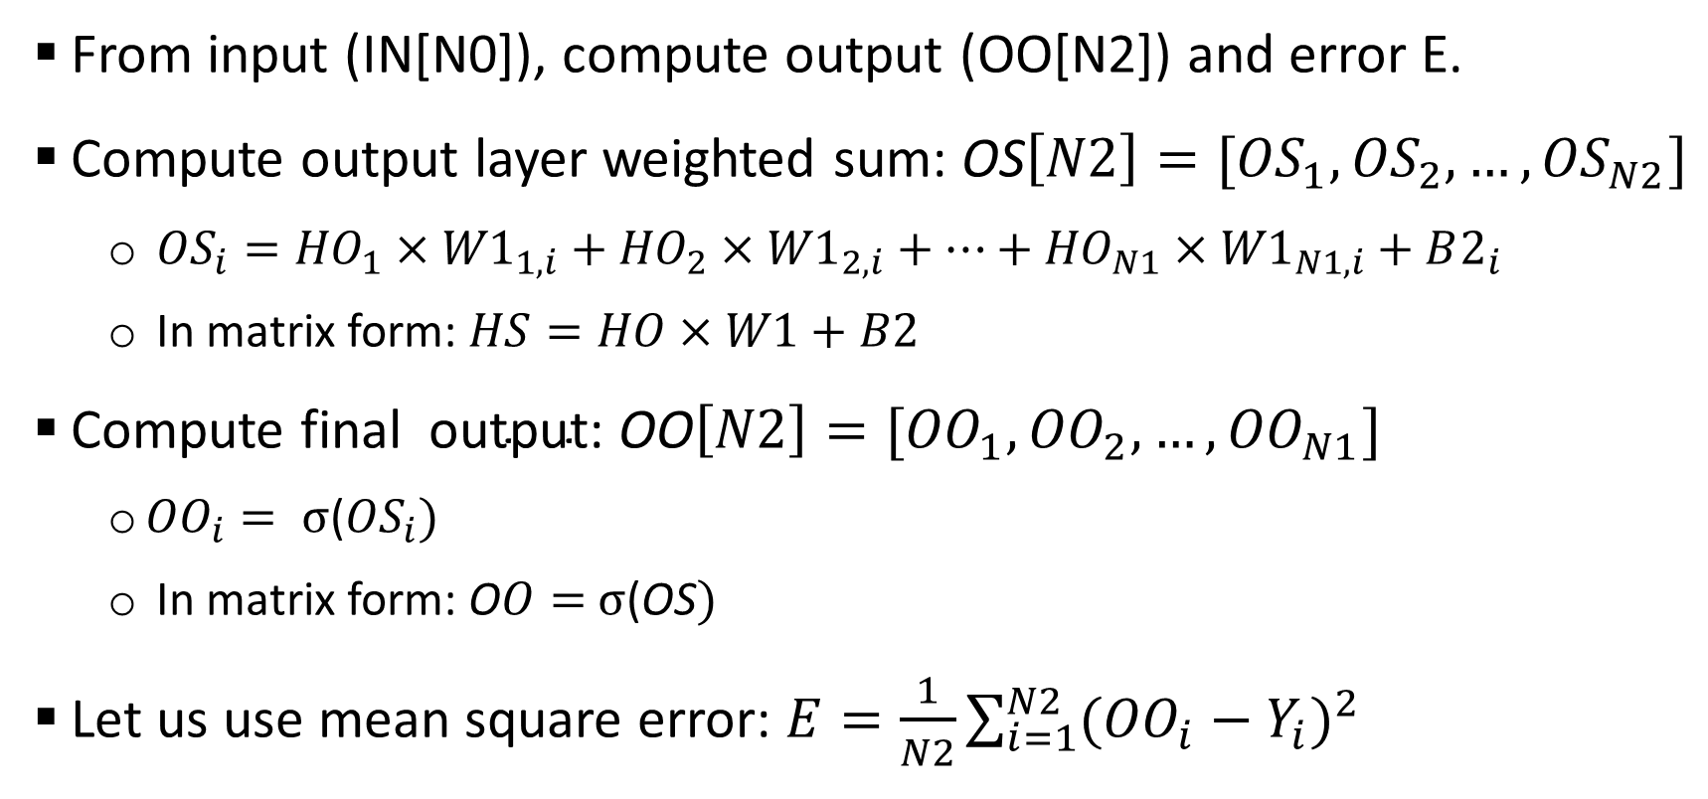
Forward propogation
From input (IN[N0]), compute output (OO[N2]) and error E.
Compute output layer weighted sum: OS$\left[N2\right]=[{OS}_{1},{OS}_{2},…,{OS}_{N2}]$
${OS}_{i}={HO}_{1}×{W1}_{1, i}+{HO}_{2}×{W1}_{2, i}+…+{HO}_{N1}×{W1}_{N1, i}+B2_{i}$
In matrix form: $HS=HO×W1+B2$
Compute final ${ \text{output}\text{: }\text{O}\text{O}\left[N2\right]=[{OO}_{1},{OO}_{2},…,OO}_{N1}]$
${OO}_{i}= σ$(${OS}_{i})$
In matrix form: O$O=$ $σ$(OS$)$
Let us use mean square error: $E=\frac{1}{N2}\sum_{i=1}^{N2}{{({OO}_{i}−Y_{i})}^{2}}$

Slide 24
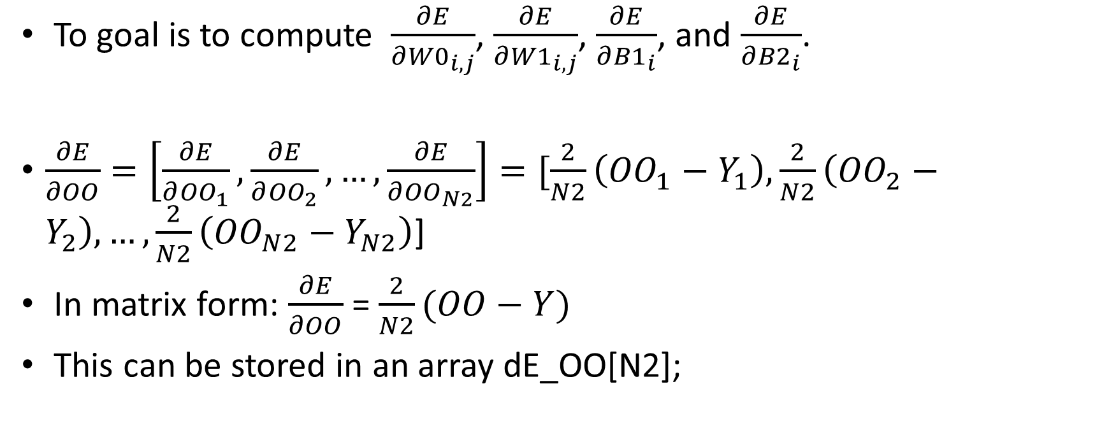
Backward propogation
To goal is to compute $\frac{∂E}{∂{W0}_{i, j}}$, $\frac{∂E}{∂{W1}_{i, j}}$, $\frac{∂E}{∂{B1}_{i}}$, and $\frac{∂E}{∂{B2}_{i}}$.
$\frac{∂E}{∂OO}=\left[\frac{∂E}{∂{OO}_{1}}, \frac{∂E}{∂{OO}_{2}}, …,\frac{∂E}{∂{OO}_{N2}}\right]=[\frac{2}{N2}\left({OO}_{1}−Y_{1}\right), \frac{2}{N2}\left({OO}_{2}−Y_{2}\right), …,\frac{2}{N2}\left({OO}_{N2}−Y_{N2}\right)$]
In matrix form: $\frac{∂E}{∂OO}$ = $\frac{2}{N2}(OO−Y)$
This can be stored in an array dE_OO[N2];

Slide 25
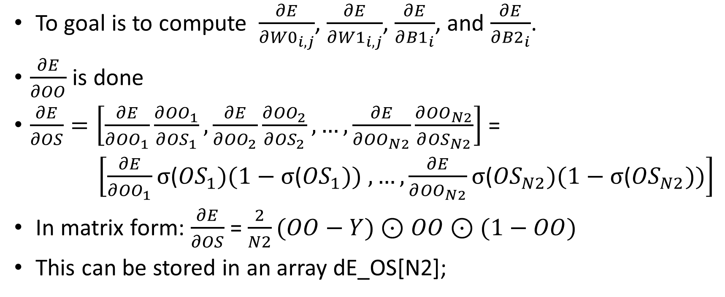
Backward propogation
To goal is to compute $\frac{∂E}{∂{W0}_{i, j}}$, $\frac{∂E}{∂{W1}_{i, j}}$, $\frac{∂E}{∂{B1}_{i}}$, and $\frac{∂E}{∂{B2}_{i}}$.
$\frac{∂E}{∂OO}$ is done
$\frac{∂E}{∂OS}=\left[\frac{∂E}{∂{OO}_{1}}\frac{∂{OO}_{1}}{∂{OS}_{1}}, \frac{∂E}{∂{OO}_{2}}\frac{∂{OO}_{2}}{∂{OS}_{2}}, …,\frac{∂E}{∂{OO}_{N2}}\frac{∂{OO}_{N2}}{∂{OS}_{N2}}\right]$ =
$\left[\frac{∂E}{∂{OO}_{1}}σ\text{(}{OS}_{1})(1−σ\text{(}{OS}_{1})) , …,\frac{∂E}{∂{OO}_{N2}}σ\text{(}{OS}_{N2})(1−σ\text{(}{OS}_{N2}))\right]$
In matrix form: $\frac{∂E}{∂OS}$ = $\frac{2}{N2}(OO−Y)⊙$ $OO$ $⊙$ $(1−OO)$
This can be stored in an array dE_OS[N2];

Slide 26
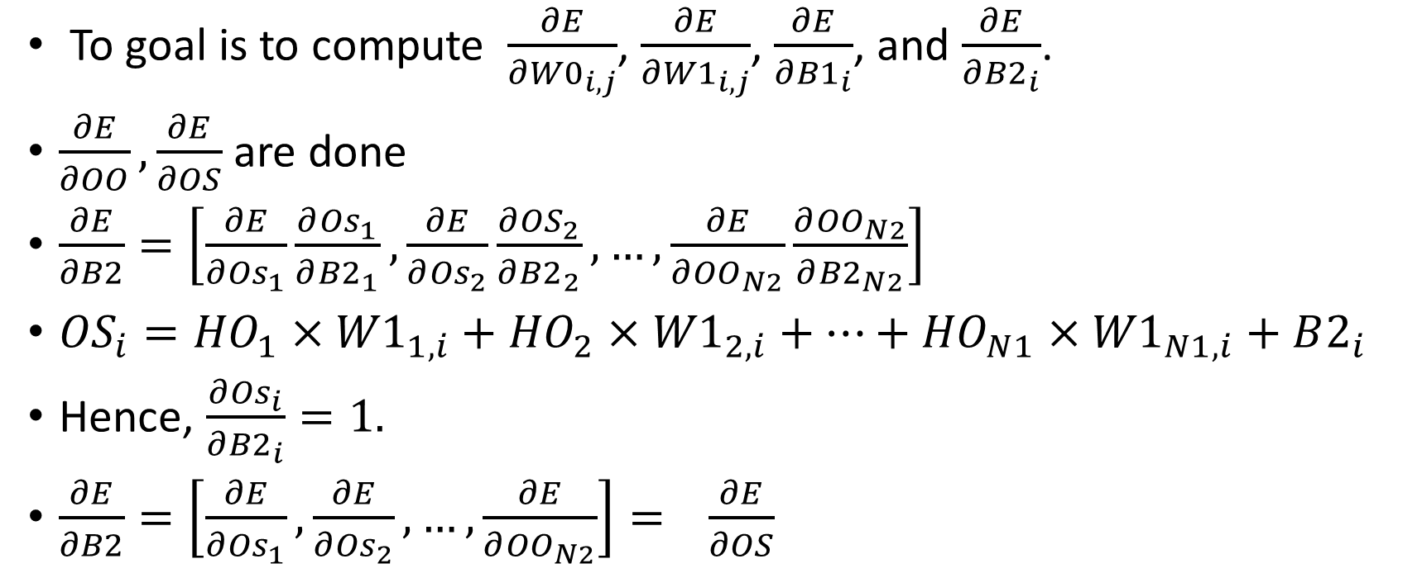
Backward propogation
To goal is to compute $\frac{∂E}{∂{W0}_{i, j}}$, $\frac{∂E}{∂{W1}_{i, j}}$, $\frac{∂E}{∂{B1}_{i}}$, and $\frac{∂E}{∂{B2}_{i}}$.
$\frac{∂E}{∂OO}, \frac{∂E}{∂OS}$ are done
$\frac{∂E}{∂B2}=\left[\frac{∂E}{∂{Os}_{1}}\frac{∂{Os}_{1}}{∂{B2}_{1}}, \frac{∂E}{∂{Os}_{2}}\frac{∂{OS}_{2}}{∂{B2}_{2}}, …,\frac{∂E}{∂{OO}_{N2}}\frac{∂{OO}_{N2}}{∂{B2}_{N2}}\right]$
${OS}_{i}={HO}_{1}×{W1}_{1, i}+{HO}_{2}×{W1}_{2, i}+…+{HO}_{N1}×{W1}_{N1, i}+B2_{i}$
Hence, $\frac{∂{Os}_{i}}{∂{B2}_{i}}=1.$
$\frac{∂E}{∂B2}=\left[\frac{∂E}{∂{Os}_{1}}, \frac{∂E}{∂{Os}_{2}}, …,\frac{∂E}{∂{OO}_{N2}}\right]=$ $\frac{∂E}{∂OS}$

Slide 27

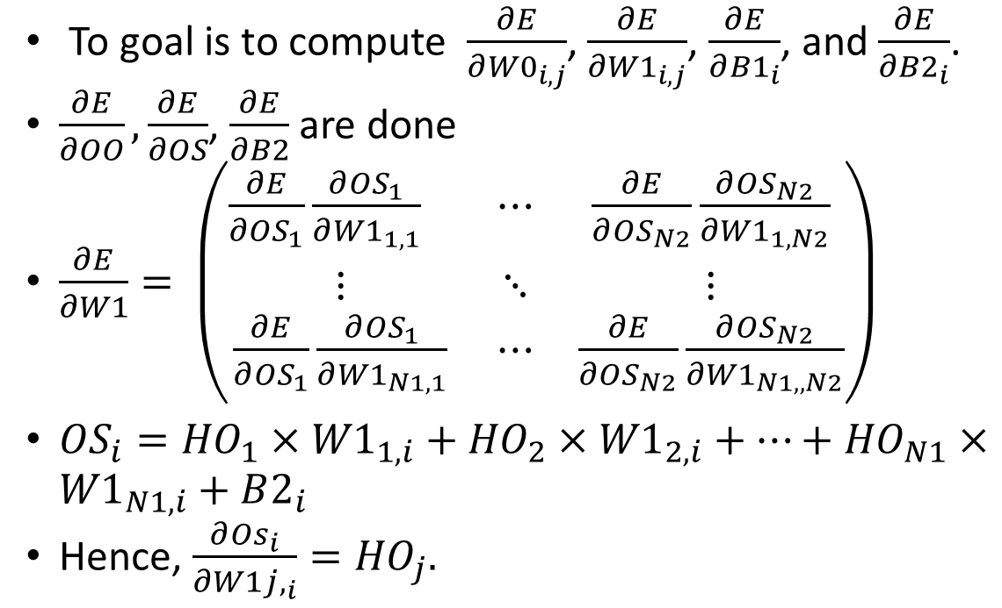


Backward propogation
To goal is to compute $\frac{∂E}{∂{W0}_{i, j}}$, $\frac{∂E}{∂{W1}_{i, j}}$, $\frac{∂E}{∂{B1}_{i}}$, and $\frac{∂E}{∂{B2}_{i}}$.
$\frac{∂E}{∂OO}, \frac{∂E}{∂OS}$, $\frac{∂E}{∂B2}$ are done
$\frac{∂E}{∂W1}= \left(\begin{matrix}{\frac{∂E}{∂{OS}_{1}}\frac{∂{OS}_{1}}{∂{W1}_{1,1}}}_{} & ⋯ & \frac{∂E}{∂{OS}_{N2}}\frac{∂{OS}_{N2}}{∂{W1}_{1,N2}} \\ ⋮ & ⋱ & ⋮ \\ \frac{∂E}{∂{OS}_{1}}\frac{∂{OS}_{1}}{∂{W1}_{N1,1}} & ⋯ & \frac{∂E}{∂{OS}_{N2}}\frac{∂{OS}_{N2}}{∂{W1}_{N1,,N2}}\end{matrix}\right)$
${OS}_{i}={HO}_{1}×{W1}_{1, i}+{HO}_{2}×{W1}_{2, i}+…+{HO}_{N1}×{W1}_{N1, i}+B2_{i}$
Hence, $\frac{∂{Os}_{i}}{∂{W1j,}_{i}}={HO}_{j}.$
$${OS}_{i}$$
i
$${W1}_{1,i}$$
$${W1}_{N2,i}$$

Slide 28
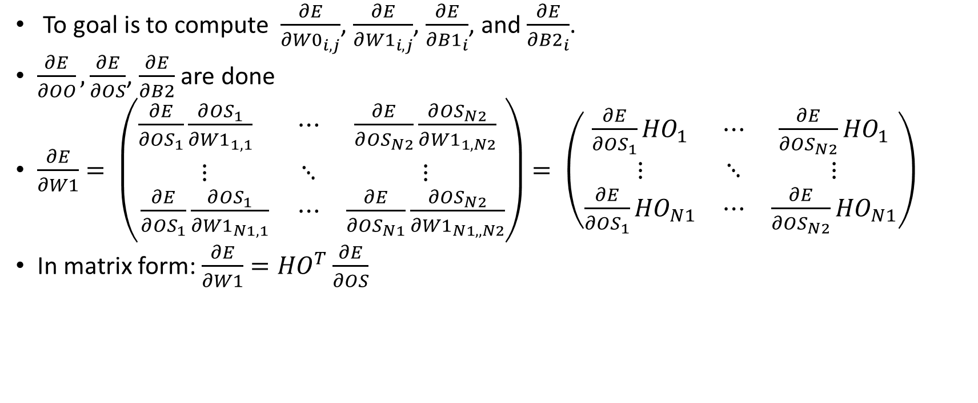
Backward propogation
To goal is to compute $\frac{∂E}{∂{W0}_{i, j}}$, $\frac{∂E}{∂{W1}_{i, j}}$, $\frac{∂E}{∂{B1}_{i}}$, and $\frac{∂E}{∂{B2}_{i}}$.
$\frac{∂E}{∂OO}, \frac{∂E}{∂OS}$, $\frac{∂E}{∂B2}$ are done
$\frac{∂E}{∂W1}= \left(\begin{matrix}{\frac{∂E}{∂{OS}_{1}}\frac{∂{OS}_{1}}{∂{W1}_{1,1}}}_{} & ⋯ & \frac{∂E}{∂{OS}_{N2}}\frac{∂{OS}_{N2}}{∂{W1}_{1,N2}} \\ ⋮ & ⋱ & ⋮ \\ \frac{∂E}{∂{OS}_{1}}\frac{∂{OS}_{1}}{∂{W1}_{N1,1}} & ⋯ & \frac{∂E}{∂{OS}_{N1}}\frac{∂{OS}_{N2}}{∂{W1}_{N1,,N2}}\end{matrix}\right)= \left(\begin{matrix}{\frac{∂E}{∂{OS}_{1}}HO}_{1} & ⋯ & \frac{∂E}{∂{OS}_{N2}}{HO}_{1} \\ ⋮ & ⋱ & ⋮ \\ \frac{∂E}{∂{OS}_{1}}{HO}_{N1} & ⋯ & \frac{∂E}{∂{OS}_{N2}}{HO}_{N1}\end{matrix}\right)$
In matrix form: $\frac{∂E}{∂W1}={HO}^{T}\frac{∂E}{∂OS}$

Slide 29
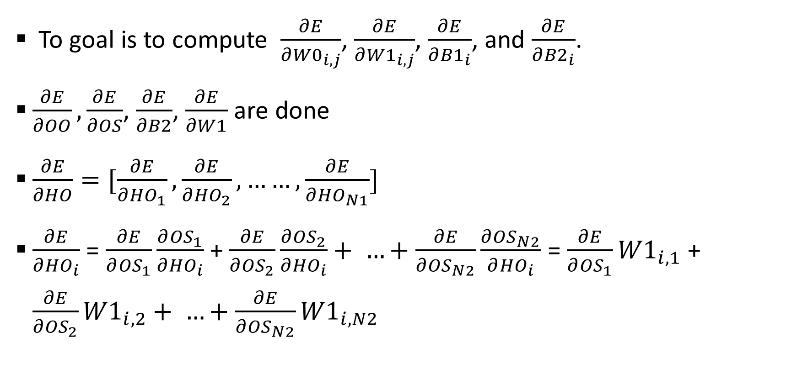
Backward propogation
To goal is to compute $\frac{∂E}{∂{W0}_{i, j}}$, $\frac{∂E}{∂{W1}_{i, j}}$, $\frac{∂E}{∂{B1}_{i}}$, and $\frac{∂E}{∂{B2}_{i}}$.
$\frac{∂E}{∂OO}, \frac{∂E}{∂OS}$, $\frac{∂E}{∂B2}$, $\frac{∂E}{∂W1}$ are done
$\frac{∂E}{∂HO}=[\frac{∂E}{∂{HO}_{1}}, \frac{∂E}{∂{HO}_{2}}, ……,\frac{∂E}{∂{HO}_{N1}}]$
$\frac{∂E}{∂{HO}_{i}}$ = $\frac{∂E}{∂{OS}_{1}}\frac{∂{OS}_{1}}{∂{HO}_{i}}$ + $\frac{∂E}{∂{OS}_{2}}\frac{∂{OS}_{2}}{∂{HO}_{i}}+ …+\frac{∂E}{∂{OS}_{N2}}\frac{∂{OS}_{N2}}{∂{HO}_{i}}$ = $\frac{∂E}{∂{OS}_{1}}{W1}_{i,1}$ + $\frac{∂E}{∂{OS}_{2}}{W1}_{i,2}+ …+\frac{∂E}{∂{OS}_{N2}}{W1}_{i, N2}$

Slide 30
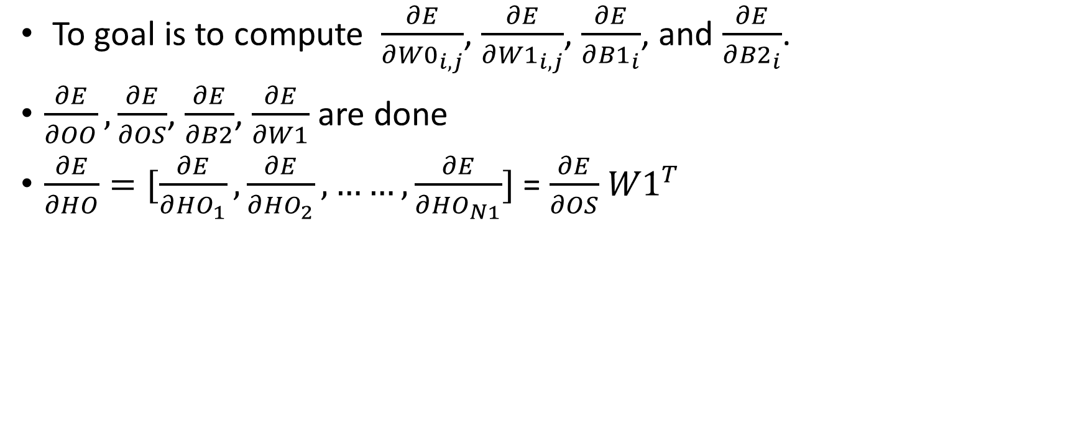
Backward propogation
To goal is to compute $\frac{∂E}{∂{W0}_{i, j}}$, $\frac{∂E}{∂{W1}_{i, j}}$, $\frac{∂E}{∂{B1}_{i}}$, and $\frac{∂E}{∂{B2}_{i}}$.
$\frac{∂E}{∂OO}, \frac{∂E}{∂OS}$, $\frac{∂E}{∂B2}$, $\frac{∂E}{∂W1}$ are done
$\frac{∂E}{∂HO}=[\frac{∂E}{∂{HO}_{1}}, \frac{∂E}{∂{HO}_{2}}, ……,\frac{∂E}{∂{HO}_{N1}}]$ = $\frac{∂E}{∂OS}$ ${W1}^{T}$

Slide 31
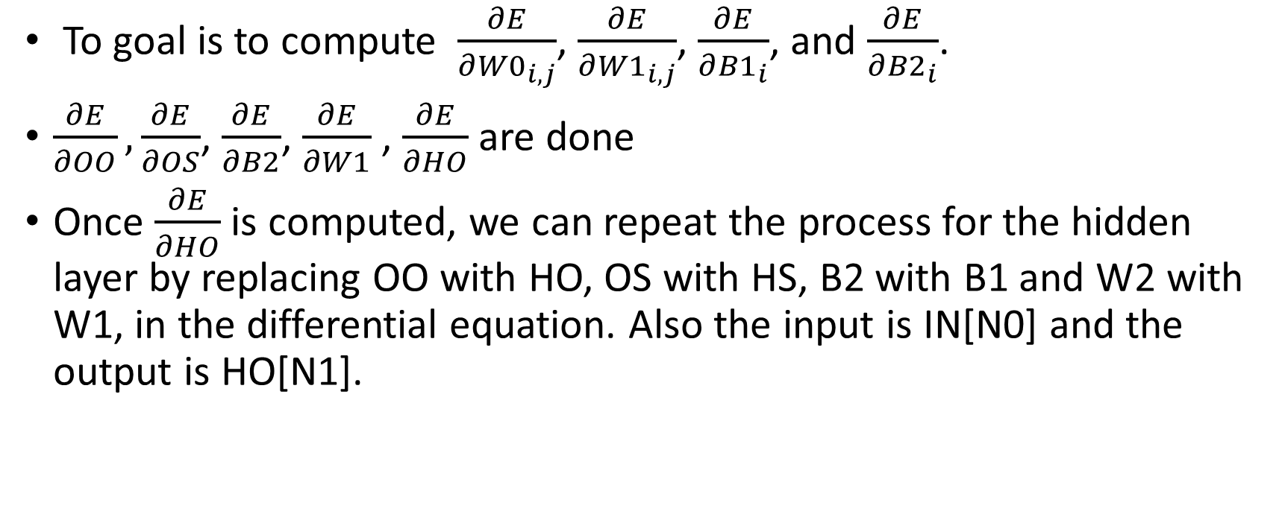
Backward propogation
To goal is to compute $\frac{∂E}{∂{W0}_{i, j}}$, $\frac{∂E}{∂{W1}_{i, j}}$, $\frac{∂E}{∂{B1}_{i}}$, and $\frac{∂E}{∂{B2}_{i}}$.
$\frac{∂E}{∂OO}, \frac{∂E}{∂OS}$, $\frac{∂E}{∂B2}$, $\frac{∂E}{∂W1}$ , $\frac{∂E}{∂HO}$ are done
Once $\frac{∂E}{∂HO}$ is computed, we can repeat the process for the hidden layer by replacing OO with HO, OS with HS, B2 with B1 and W2 with W1, in the differential equation. Also the input is IN[N0] and the output is HO[N1].

Slide 32
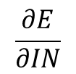
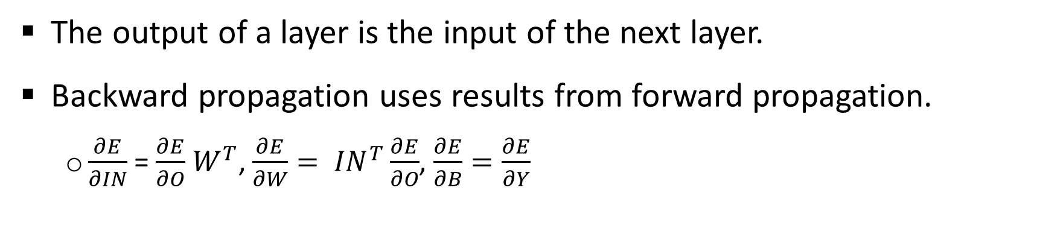

Summary
H1
H2
IN
layer
O
X
Layer 1
Layer 2
Layer 3
Y
$$\frac{∂E}{∂IN}$$
layer
$$\frac{∂E}{∂O}$$
The output of a layer is the input of the next layer.
Backward propagation uses results from forward propagation.
$\frac{∂E}{∂IN}$ = $\frac{∂E}{∂O}$ $W^{T}$, $\frac{∂E}{∂W}= {IN}^{T}\frac{∂E}{∂O}$, $\frac{∂E}{∂B}=\frac{∂E}{∂Y}$

Slide 33
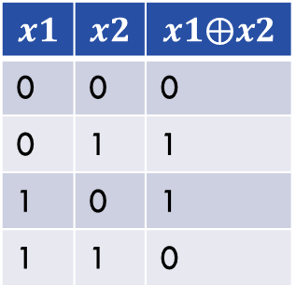

Training for the logic XOR and AND with a 6-unit 2-level nueral network
Logic XOR function is not a linear function (can’t train with lect8/one.cpp). See 3level.cpp
$$x1$$ | $$x2$$ | $$x1⨁x2$$
0 | 0 | 0
0 | 1 | 1
1 | 0 | 1
1 | 1 | 0
(0, 1)
(1, 1)
AND
XOR
(0, 0)
(1, 0)
Logic XOR ($⨁$) operation

Slide 34
Summary
Briefly discuss multi-level feedforward neural networks
The training of neural networks
Following 3level.cpp, one should be able to write a program for any multi-level feedforward neural networks.

Slide 35
Thank you!
PDS
SDN
NFV
Computer Vision
Thank you For being a great class!
https://github.com/siagianp
https://github.com/amelcharolinesgn2/IoT_simulator-mqtt-NodeRed
https://www.youtube.com/@AmelOline/videos
Notes:
https://medium.com/buildpiper/simplifying-containerization-with-docker-run-command-2f74e114f42a
https://github.com/IBA-Group-IT/IoT-data-simulator
https://www.bevywise.com/blog/docker-mqtt-broker-easy-service-manageability/

