Slide 1




Slide 2

Course Code:IT 200
Project Tittle:Library Management
with C++.

Slide 3



Slide 4

This is a programming of a Library management written in C++ programming language.The output of the program shows a dialogue box with flashing nameplates of the program name and a chronological steps of different sections of library work .By clicking each steps we can get access to that particular procedure of the program and conduct every possible works needed to perform in a library management.The program permits writing and deleting necessary input orders for it to be accessible later for other executions.

Slide 5

The code was written on the basis of the outline algorithm and flowchart of the expected project features.Then the program was written in different blocks of modules for better performance.The program is later further revised to match up with the desired output model.

Slide 6

1.Turbo C 3.0++ Compiler
2.32 bit windows operating system
3.A keyboard
4.Monitor for display

Slide 7

Start
Main Screen
Switch 1
True
1. List Of Books
False
Switch 2
True
2.List of Issued
Books
False
Switch 3
3.List of Returned
Books
True
False
1
2

Slide 8
1
2
Switch 4
True
4.Book Issue
False
Switch 5
True
5. Book
Return
False
Switch 6
True
6. Book
Purchase
False
Switch 7
True
7. Modify
Purchase
False
Switch 8
True
8. Delete Return
False
1
2

Slide 9
2
1
True
Switch 9
Query By
Student
False
True
Switch 10
About
Application
False
End

Slide 10
Header Files
#include<iostream.h>
#include<stdio.h>
#include<conio.h>
#include<string.h>
#include<process.h>
#include <stdlib.h>
#include <ctype.h>
#include <graphics.h>
#include<dos.h>
#include<iomanip.h>

Slide 11

1.void boxb();
2.int menu();
3.void about();
4.void bookpurchase();
5.void booklist();

Slide 12

6.void bookissue();
7.void issuelist();
8.void bookreturn();
9.void returnlist();
10.void querybystd();
11.void delreturn();=
12.void modifyentry();=
13.void flash();=

Slide 13

boxb()
menu()
about()
bookpurchase()
booklist()
bookissue()
issuelist()

Slide 14
bookreturn()
returnlist()
querybystd()
delreturn()
modifyentry()
flash()

Slide 15

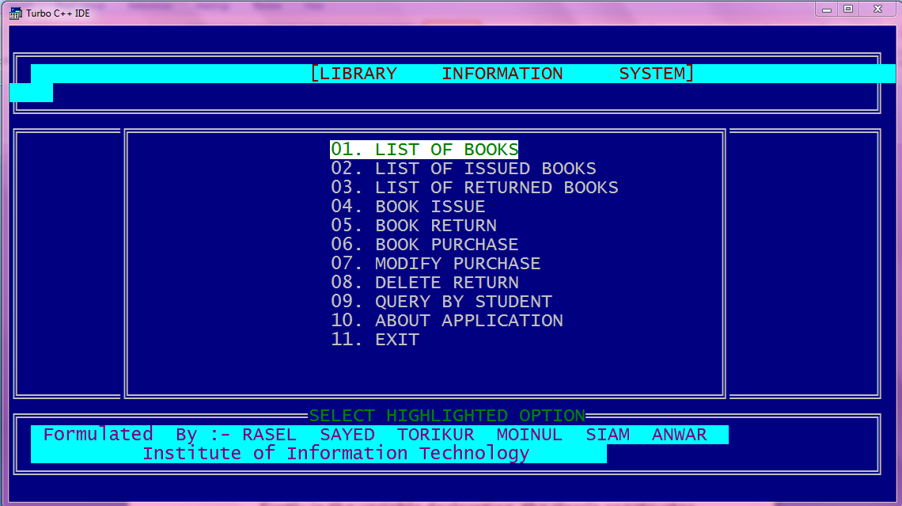

Slide 16
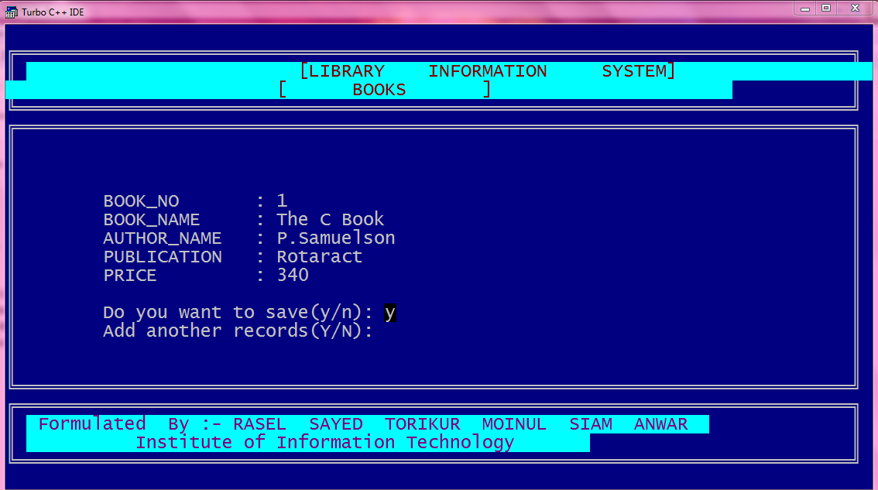

Slide 17
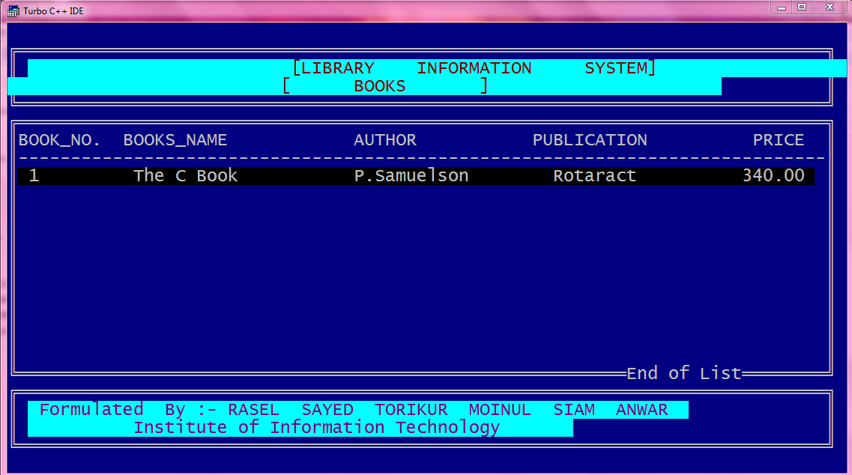

Slide 18
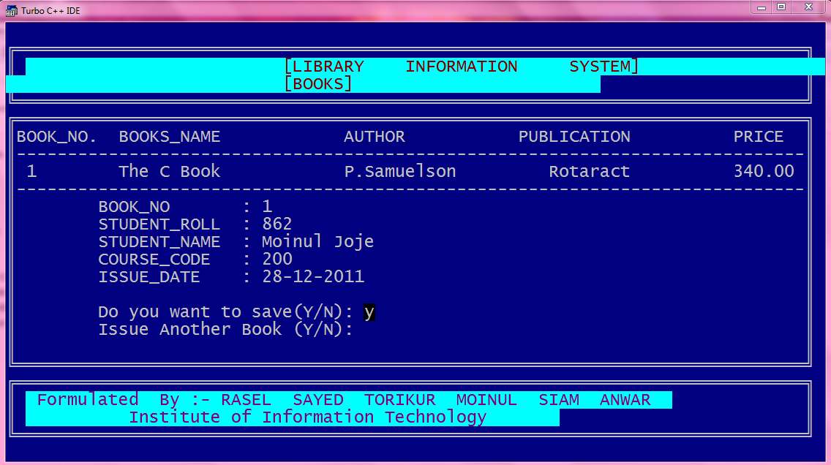

Slide 19
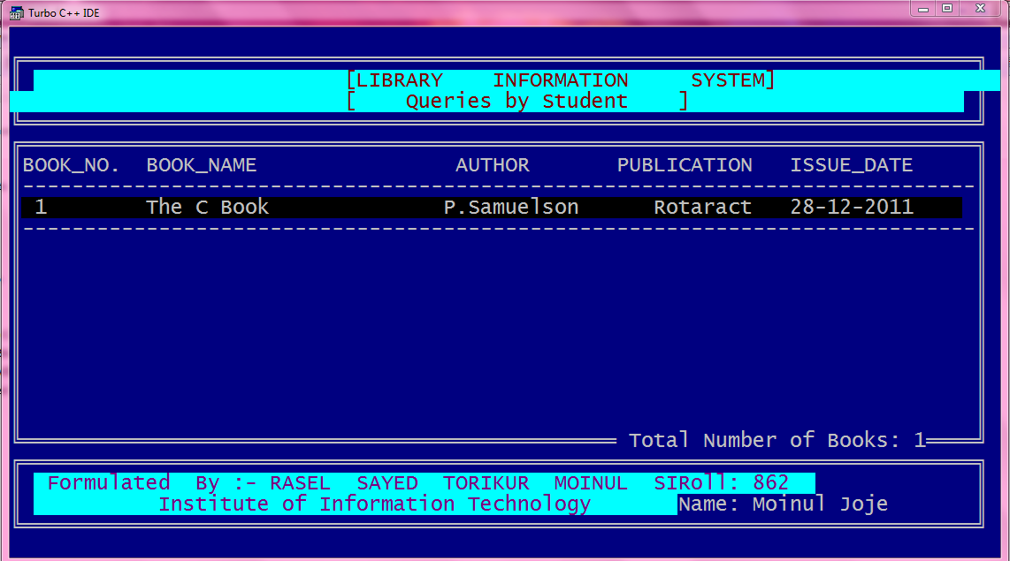

Slide 20
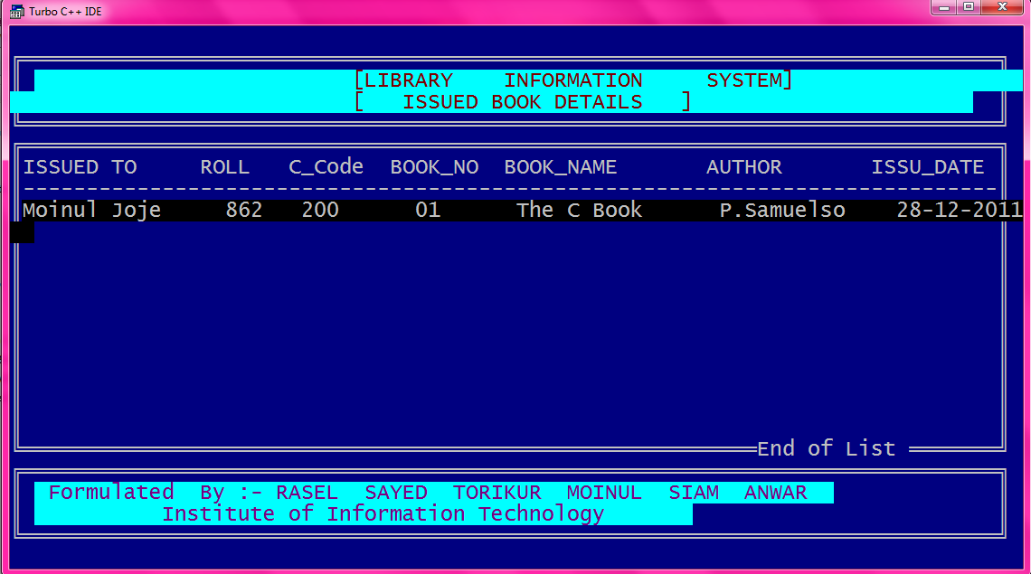

Slide 21
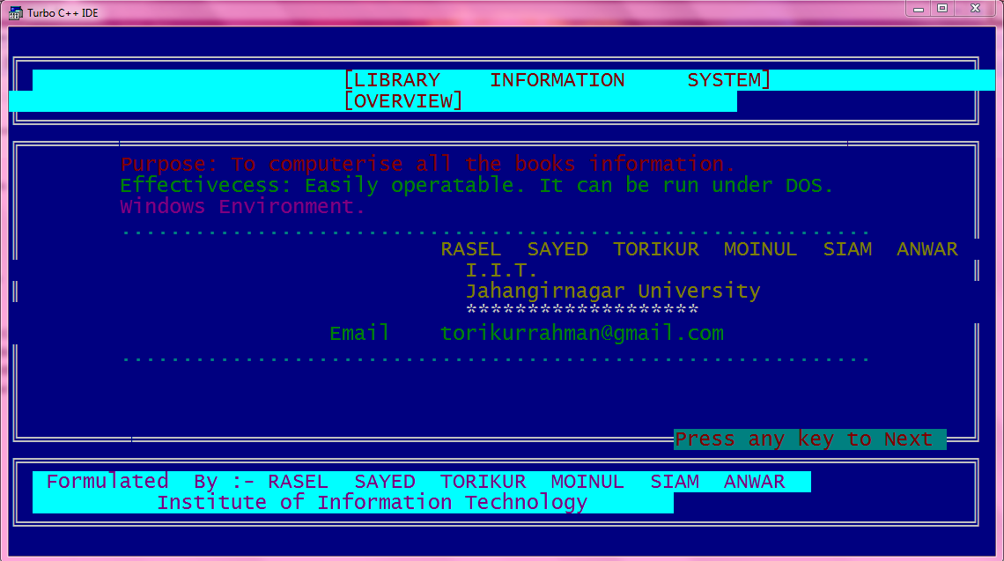

Slide 22

C++ is a great programming language that can make programming a lot of fun. All throughout the project it was a great experience of teamwork and enthusiasm.The programming project we made was the result of our co-operativeness.We also the thank our project supervisior for his support.The project may have some limitations.

Slide 23
But the inspiration and motivation that is provided through this project will help us in near future to improve on what we have done.In the end we thank all related to the project for their support.

Slide 24


