Slide 1
Design Pattern

Slide 2
Observer Pattern
It is mainly used to implement distributed event handling systems, in "event driven" software.
A one-to-many dependency between objects should be defined without making the objects tightly coupled.
It should be ensured that when one object changes state an open-ended number of dependent objects are updated automatically.
It should be possible that one object can notify an open-ended number of other objects.

Slide 3
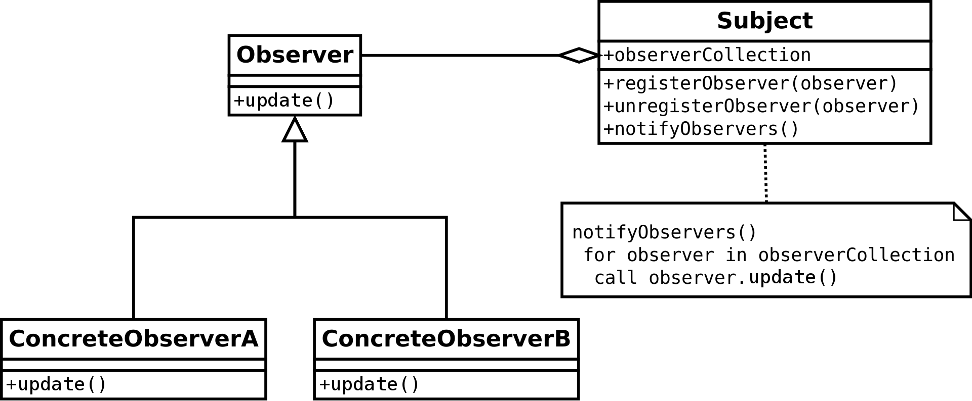
Observer Pattern

Slide 4
Observer Pattern
The Observer design pattern is one of the twenty-three well-known "Gang of Four" design patterns
Describe how to solve recurring design problems to design flexible and reusable object-oriented software
Objects that are easier to implement, change, test, and reuse.

Slide 5
Design Principles

Slide 6
1. DRY (Don't repeat yourself)
Don't write duplicate code, instead use Abstraction to abstract common things in one place
If you have a block of code in more than two places consider making it a separate method
If you use a hard-coded value more than one time make them public final constant

Slide 7

DRY
"Every piece of knowledge must have a single, unambiguous, authoritative representation within a system".

Slide 8

2. Encapsulate What Changes
The benefit of this OOP Design principle is that It's easy to test and maintain proper encapsulated code

Slide 9
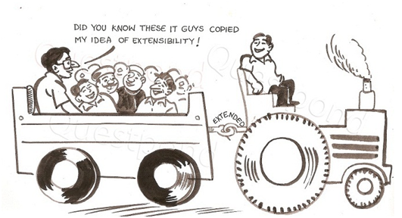
3. Open Closed Design Principle
Classes, methods or functions should be Open for extension (new functionality) and Closed for modification.

Slide 10
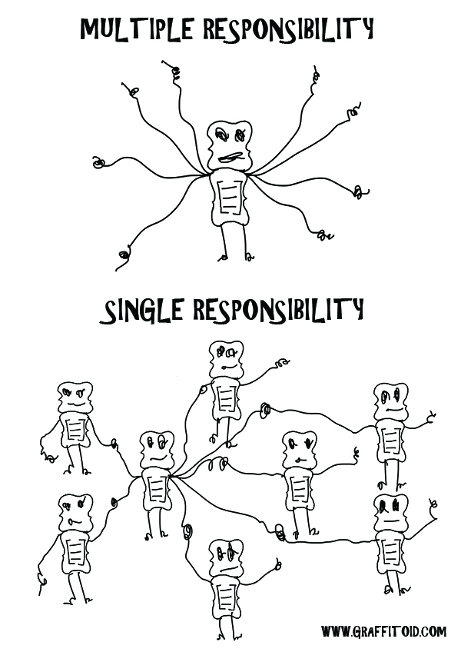
Single Responsibility Principle (SRP)

Slide 11
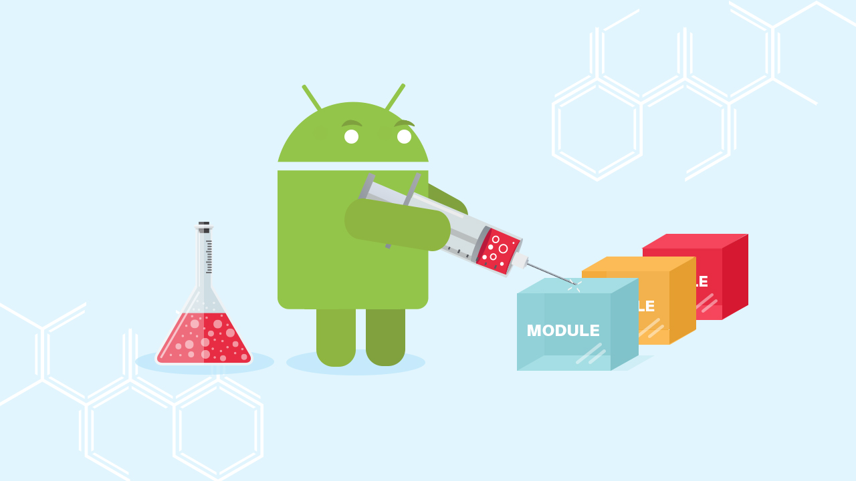
5. Dependency Injection or Inversion principle
The beauty of this design principle is that any class which is injected by DI framework is easy to test with the mock object
Because object creation code is centralized in the framework and client code is not littered with that.

Slide 12
Favor Composition over Inheritance
Always favor composition over inheritance, if possible.
Flexibility to replace with better implementation any time.

Slide 13
Liskov Substitution Principle (LSP)
According to the Liskov Substitution Principle, Subtypes must be substitutable for supertype i.e. methods or functions which uses superclass type must be able to work with the object of subclass without any issue".
LSP is closely related to Single responsibility principle and Interface Segregation Principle. If a class has more functionality than subclass might not support some of the functionality and does violate LSP.
subclass and superclass are related to each other by Inheritance which provides IS-A property

Slide 14
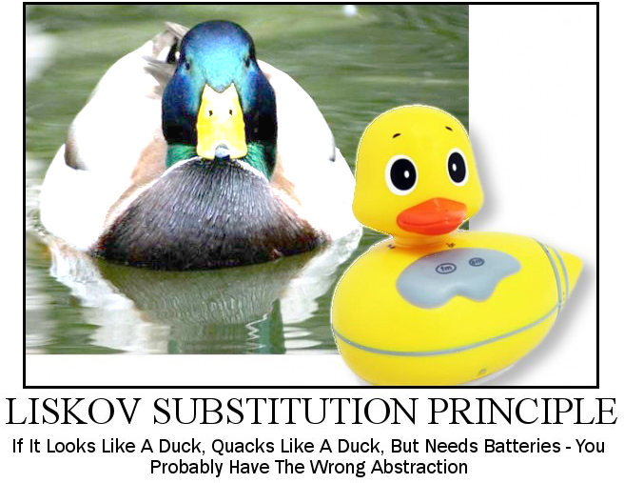
Liskov Substitution Principle

Slide 15
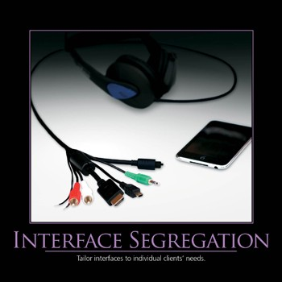
8. Interface Segregation Principle (ISP)
a client should not implement an interface if it doesn't use that.

Slide 16
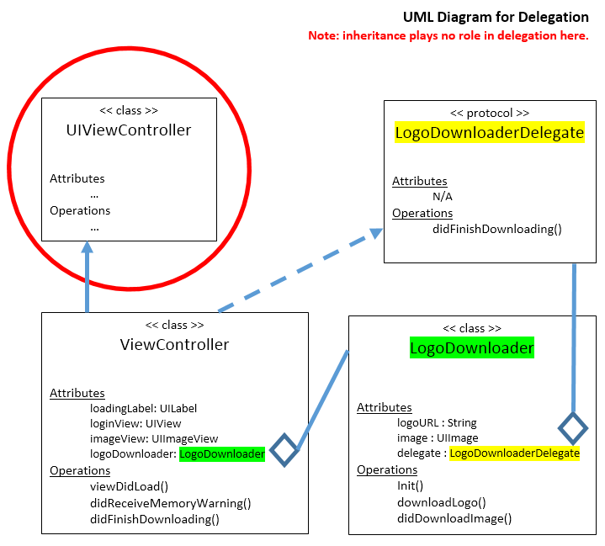
10. Delegation principles

Slide 17
Grady Booch Defination of delegation
Delegation is a way to make composition as powerful for reuse as inheritance.
In delegation, two objects are involved in handling a request: a receiving object delegates operations to its delegate.
This is analogous to subclasses deferring requests to parent classes. But with inheritance, an inherited operation can always refer to the receiving object through the this member variable in C++ and self in Smalltalk.
To achieve the same effect with delegation, the receiver passes itself to the delegate to let the delegated operation refer to the receiver.

Slide 18
9. Programming for Interface not implementation
Client program is not worried about implementation and the interface signature determines what all operations can be done. This can be used to change the behavior of a program at run-time.
It also helps you to write far better programs from the maintenance point of view.

Slide 19
SOLID
SRP – Single Responsibility Principle
OCP – Open/Closed Principle
LSP – Liskov Substitution Principle
ISP – Interface Segregation Principle
DIP – Dependency Inversion Principle

