Slide 1

Welcome to our project
MEDICAL STORE MANAGEMENT SYSTEM
Team Members
Md. Mostafijur Rahman
ID 1902073
Al Mahmud Siam
ID 1902062

Slide 2

Outline of our Project
Introduction
Objective
Requirement of the project
Output of the Project
Advantage
Limitations of this project
Future Plan
Conclusion

Slide 3
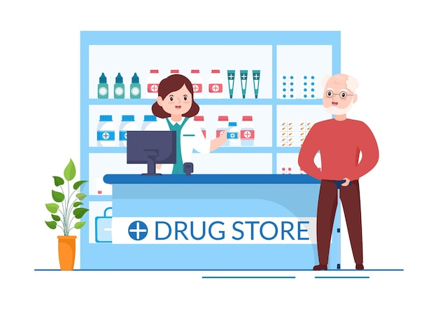
Introduction
This project is mainly used for medical stores to maintain the details of medical store such as stock and account.
This medical shop management software is so designed as to ease the work load of medical shop professionals to find out the medicine form the stack.
The main feature includes inventory and stock control, accounting and company details.

Slide 4
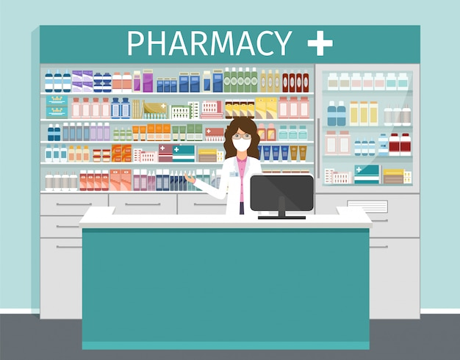
Objective
As this is a simple software can be easily used by the retailers and wholesalers to automate the process of manually maintaining the records.
Whenever user need to update if any missing information there is an update option.
Delete option is used for any redundant information which not need for the owner.
This software show the warning of expire date of medicine.

Slide 5

Objective
So that organization can manage their record in efficient and organized form.
The main goal of this project is to maintain the records of purchase , sale and stock details with cash transaction maintenance.
Medical store management software is very needy for Medical Store. This software help the shop owner to maintain day to day transaction in computer.

Slide 6
Requirement of the Project
NetBeans
Java Language
Server XAMPP
Database
Connector
MYSQL

Slide 7
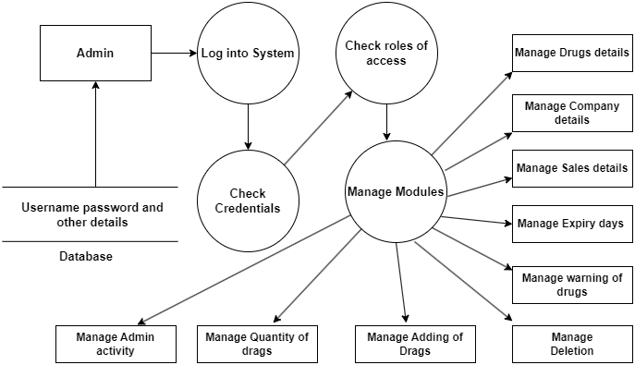
Level 1 DFD

Slide 8
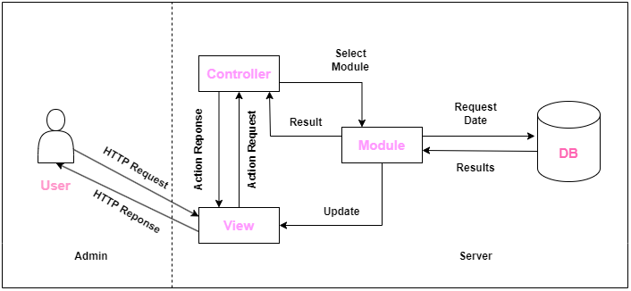
MVC Architecture of MSMS

Slide 9
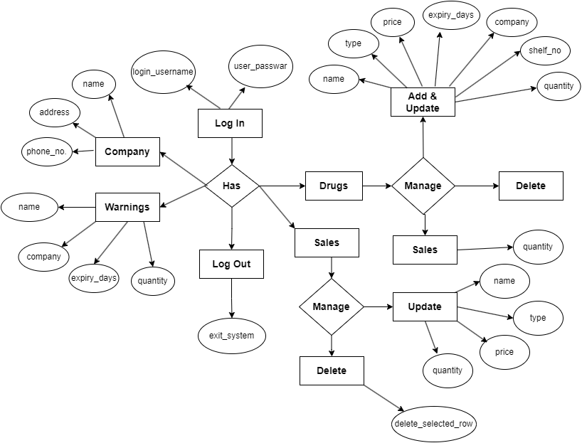
ER Diagram

Slide 10
Output of the project

Slide 11
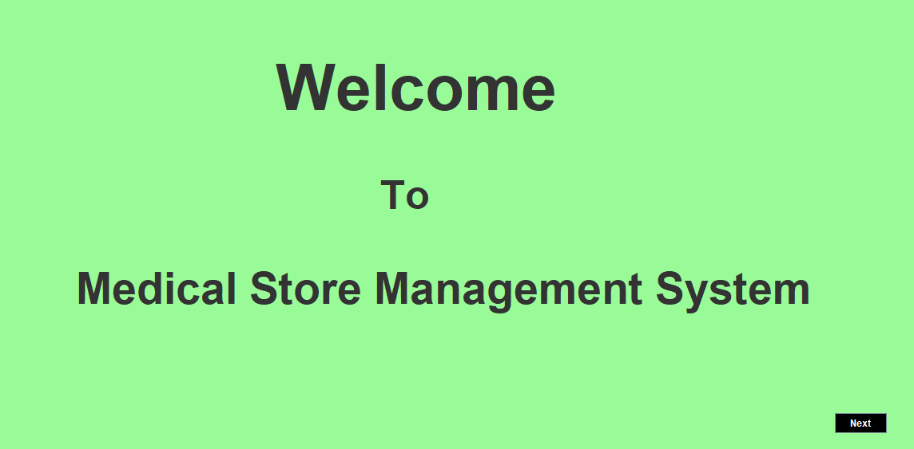
This is the Welcome page

Slide 12
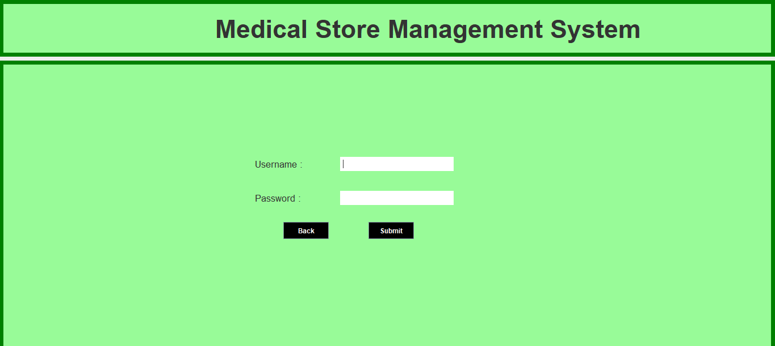
Admin Page

Slide 13
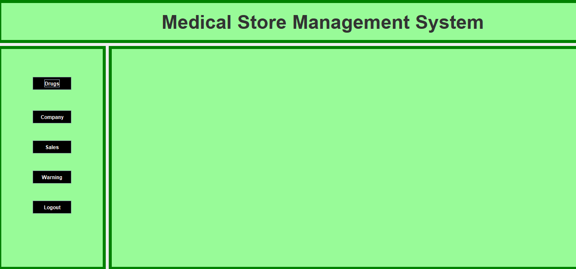
Home Page

Slide 14
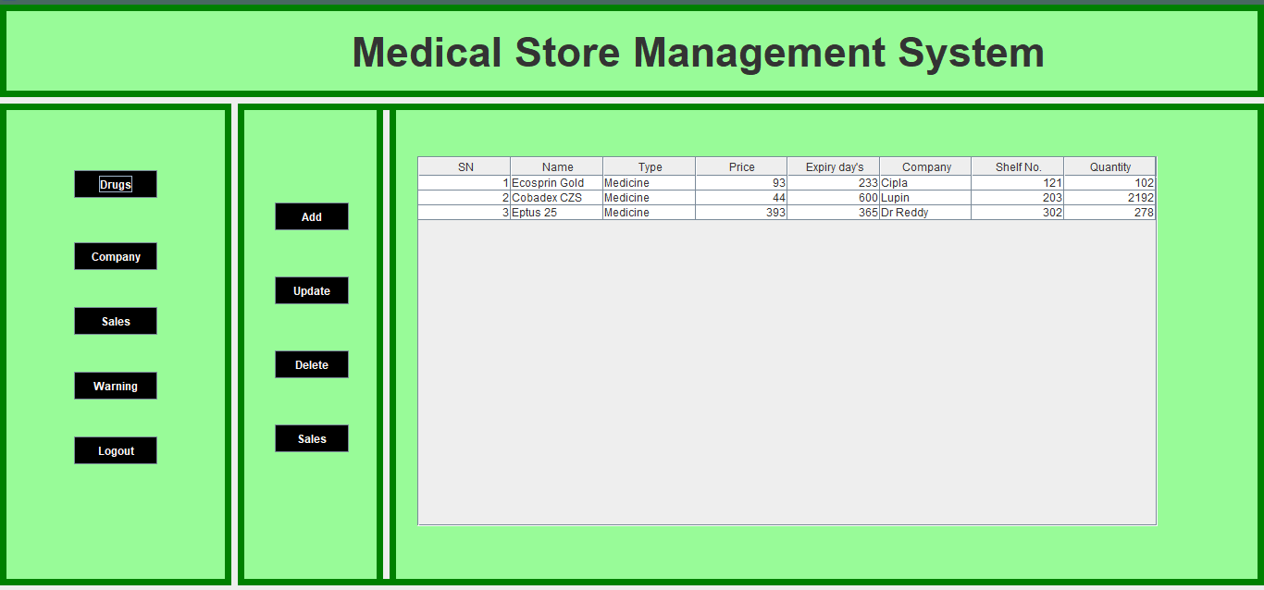
Drugs List

Slide 15
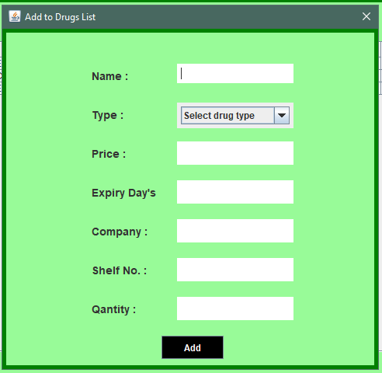
Addition of Drugs

Slide 16
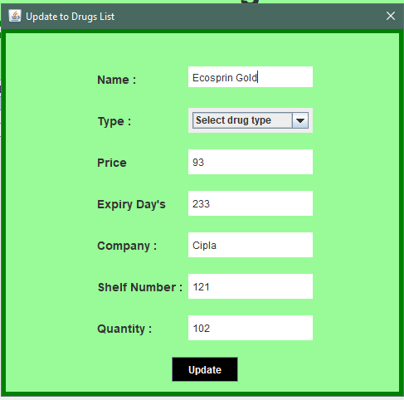
Update of Drugs

Slide 17
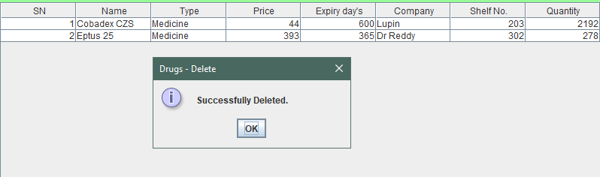
Deletion of Drugs

Slide 18
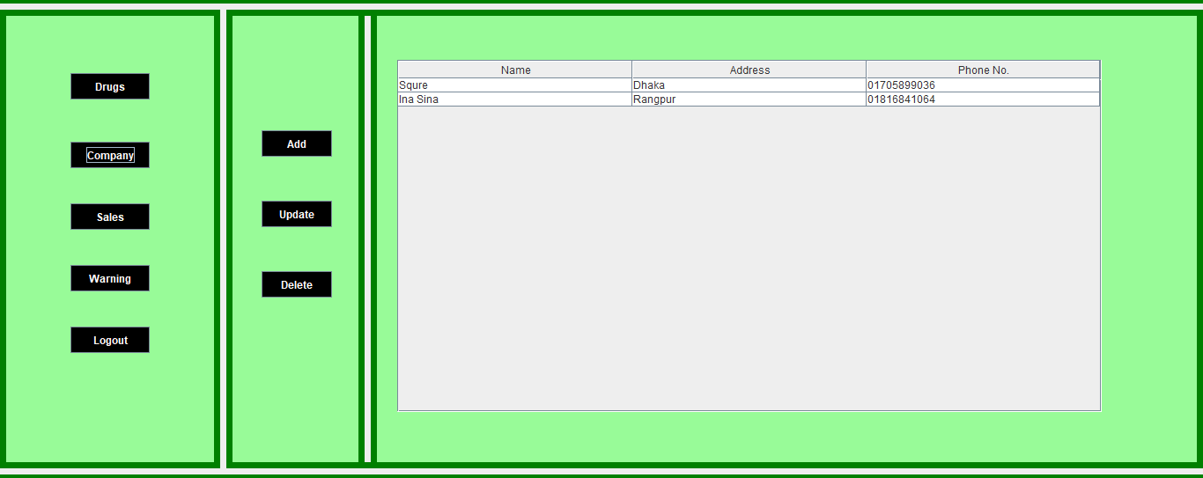
Company list

Slide 19
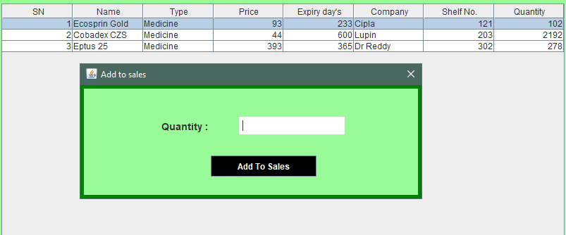
Drug Sales

Slide 20
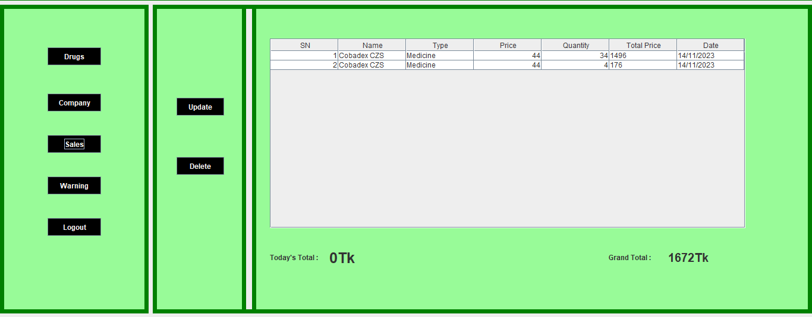
Sales Details

Slide 21
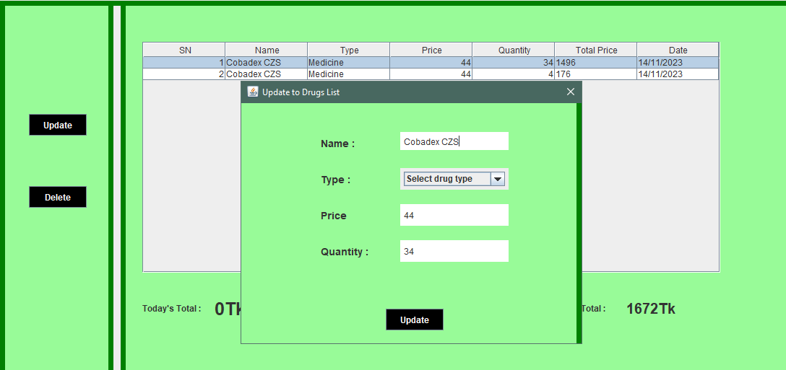
Update Sales

Slide 22
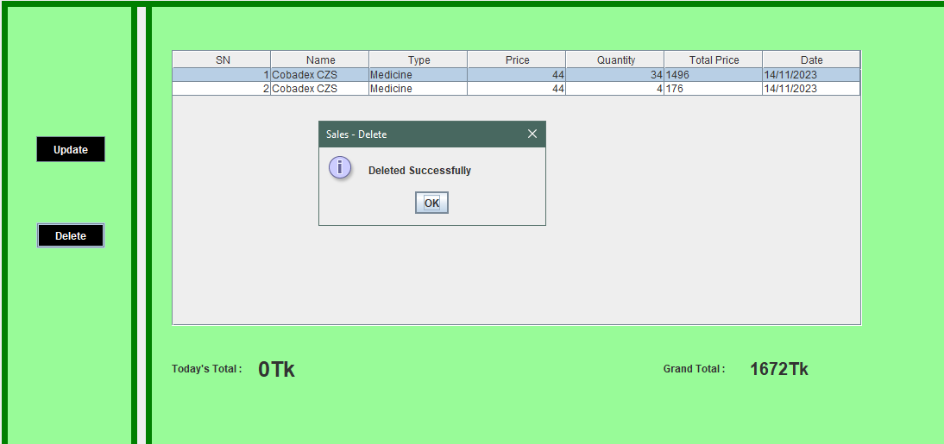
Delete Sells

Slide 23
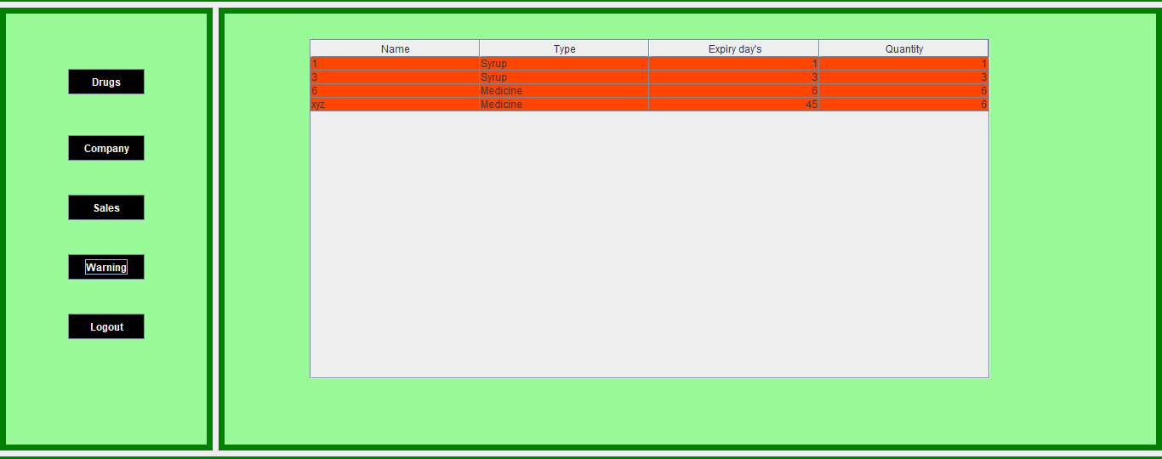
Warnings of Drugs

Slide 24
Advantages
Easily find out any medicine on a fixed stack where it keep.
Don’t require more labour cost.
Save time.
Easily know the quantity of drugs , its expire date.
If any information need to change this has update option.
For any contract it has company name and their mobile number.
Can easily calculate the total price of drugs.
Less time consuming and easy to use. Avoid data inconsistency and redundancy. More efficient and reliable. Fast calculate and accuracy level is high.

Slide 25
Limitations of this project
This software only build for the shop owners so customers can’t take any advantage.
It’s security system is very simple as it build only for the normal user who haven’t much knowledge about computer.
Their have not any discount offer for the registered customer.
Problem to Maintain record of monthly and yearly transactions.

Slide 26
Future Plan
In future we update our project so that customer can also use this project.
We will put the option of discount for the registered.
Must work for strong security system.
We will add the calculate of net profit and loss option so that owners can easily get idea about his plan of work.

Slide 27
Conclusion
Though the drawback of existing system this will give a lot of benefits which consists quick relation between owners and the company.
This system save time and money.
Unexpired medicine easily identify which is harmful for health.
This system is simple and it would make everyone works to become easier.

Slide 28


