Slide 1

A presentation on
Deployment of Thesis Work on a Cloud Platform
Course : Cloud Computing
Course Code:CSE-462
Presented by
Md Mostafijur(1902073)
Al Mahmud Siam(1902061)
Department of Computer Science and Engineering
Hajee Mohammad Danesh Science & Technology University, Dinajpur.

Slide 2

Outline
Introduction
Why need?
Choosing Cloud Platform
Google Colab
Deployment Steps
Results
Challenges faced
Solutions
Benefits of Deployment
Limitations
Future Improvements
Conclusion
2

Slide 3
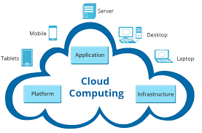
Introduction to Cloud Computing (1)
Cloud computing is the delivery of computing services.
Such as servers, storage, databases, networking, software, analytics, intelligence, and more, over the cloud (internet).
Work as a service rather than a product, whereby shared resources, software, and information are provided to computers as a metered service over a network.
Premises datacenter, manage everything, such as
Purchasing and installing hardware,
Virtualization
Installing the operating system and required applications
Setting up the network,
Configuring the firewall, and setting up storage for data.
3

Slide 4
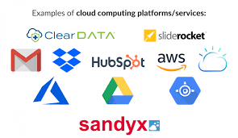
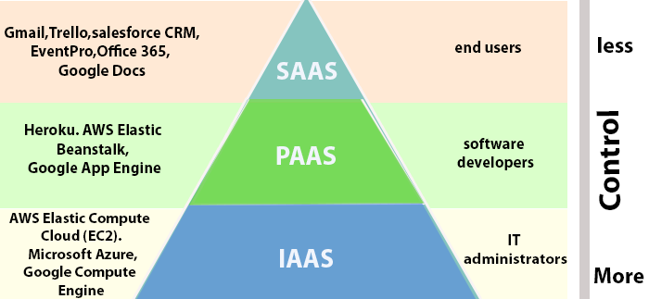
Introduction to Cloud Computing(2)
The cloud environment provides an easily accessible online portal that makes handy for the user to manage the compute, storage, network, and application resources.
Types of cloud services
Infrastructure as a service (iaas)
Platform as a service (paas)
Software as a service (saas)
4

Slide 5

Thesis Overview -1
Thesis title: Comparative Study of Machine Learning Algorithms for Credit Card Fraud Detection
Overview:
Applying different methods on the proposed dataset.
Appling feature selection techniques to the collected dataset(credit card transactions) to reduce less important features.
Select the best method and apply machine learning algorithm.
Deploying the processed dataset into machine learning models.
To Compare that models performance using evaluation matrices and pick the best one.
By Minimizing financial losses for both cardholders and card issuers by quickly identifying and stopping unauthorized or suspicious transactions.
5

Slide 6
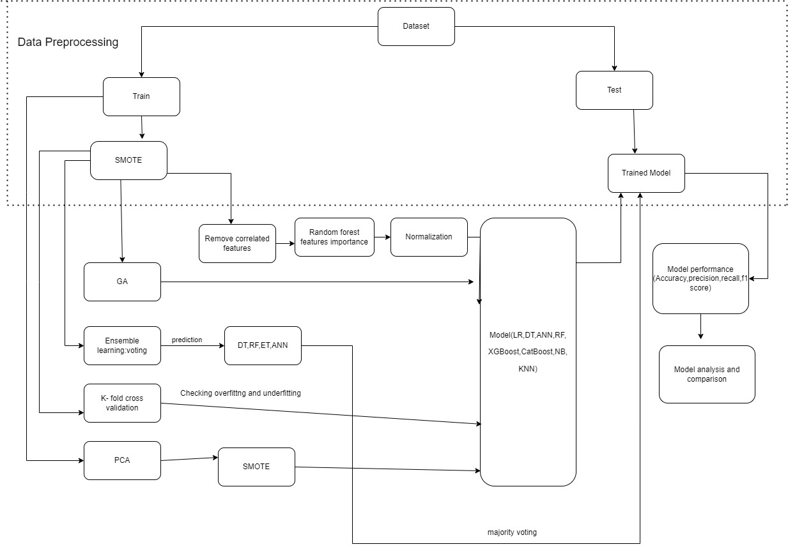
Framework of Our Thesis work

Slide 7
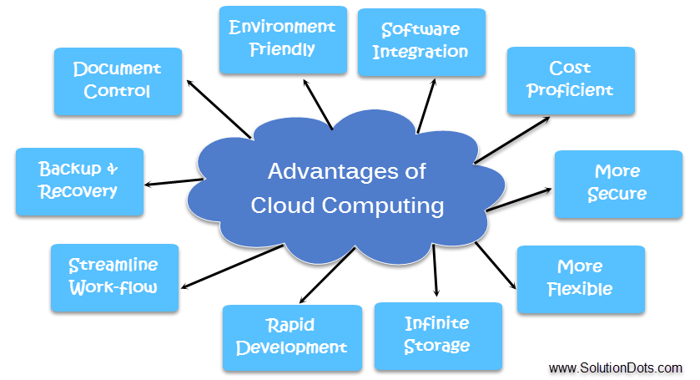
Why Cloud Deployment?
Advantages of cloud computing
Cost
Speed
Scalability.
Productivity
Reliability
Security.
More Flexible
Infinite Storage
Automatic Software Integration
Effective Monitoring
Document Control
6

Slide 8
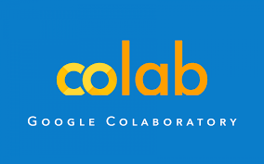
Choosing the Cloud Platform
Google Colab, short for Google Colaboratory, is a free cloud-based platform provided by Google
It allows users to write and execute Python code in a Jupyter Notebook-like interface. It is designed for data science and machine learning tasks and has gained popularity for several reasons
Google Colab provides easy access to external data.
We can import datasets from your computer or from URLs, making it easier to access the data we need for our projects, including accessing files stored on your Google Drive.
7

Slide 9
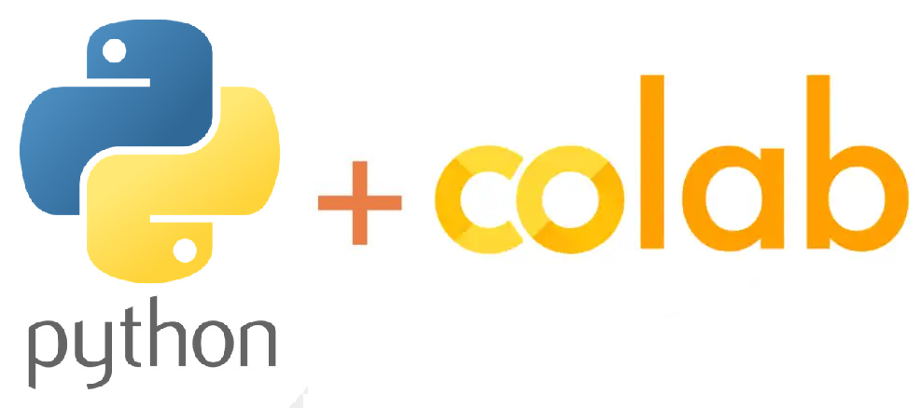
Google Colab
It offers a number of advantages, including:
Accessibility
Free Access to GPU and TPU
No Setup Required
Collaboration
Integration with Google Drive
Rich Documentation
Cost
Library and Package Integration.
Access to Large Datasets
Resource Availability:
Experimentation
8

Slide 10

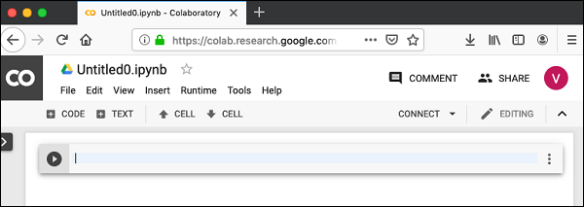
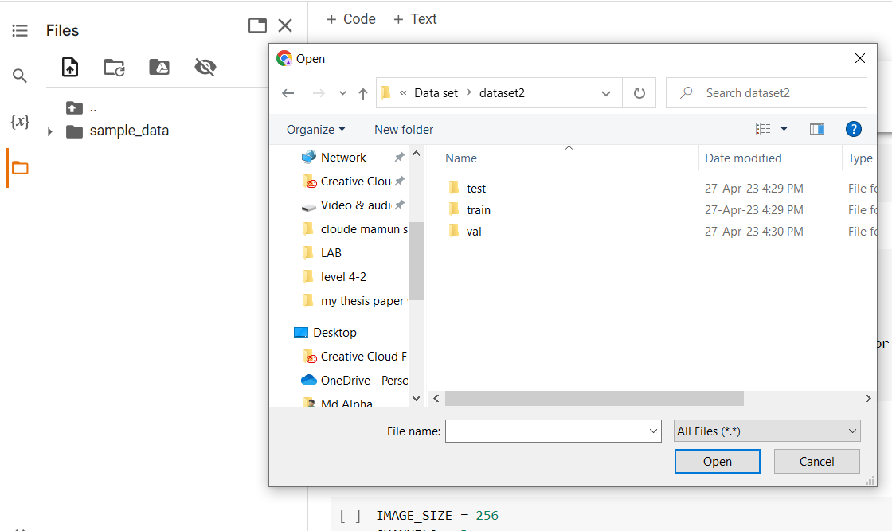
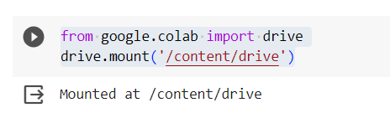
Deployment Steps
Deployment Steps
Launch Google Colab
Create a New Notebook
Mount Google Drive
Upload the Folder
Verify the Upload
Implementation the ML model
Test the model with the test dataset
9

Slide 11
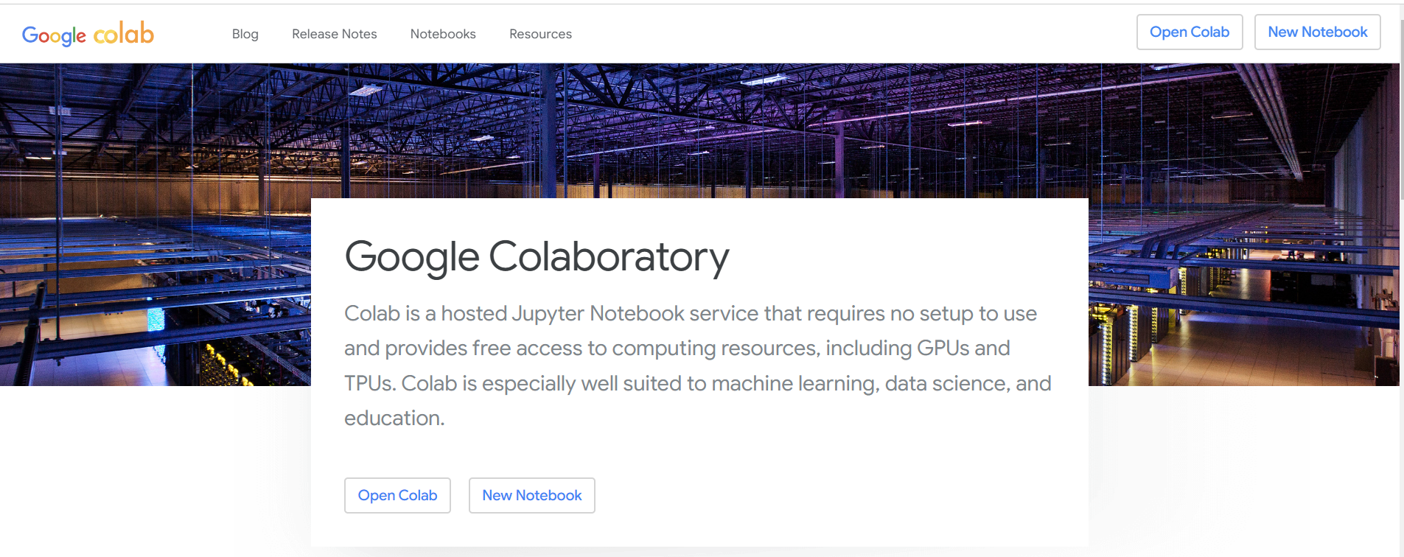
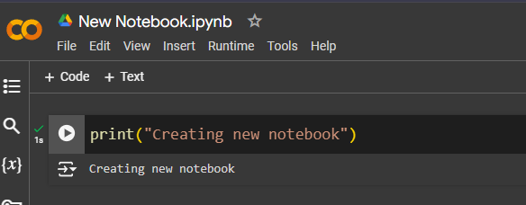
Deployment Steps
Step 1: Launch Google Colab
First, we need to launch Google Colab going to https://colab.research.google.com/ and signing in with our Google account. Once we are signed in, we will be taken to the Colab home page.
Step 2: Create a New Notebook
Next, we need to create a new notebook. To do this, click on the “New Notebook” button in the top left corner of the screen. This will open a new notebook in a new tab. We can rename the default notebook
10

Slide 12
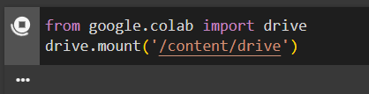
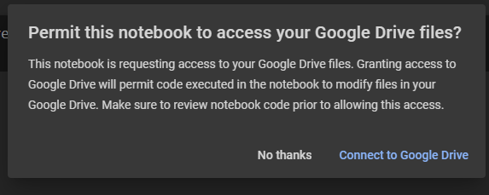
Deployment Steps
Step 3: Mount Google Drive
In order to upload a folder in Google Colab, you need to first mount your Google Drive. This will allow you to access your files and folders in Google Drive directly from Colab.
This will prompt you to enter an authorization code. Follow the prompts to enter the code and authenticate your Google Drive account
12

Slide 13
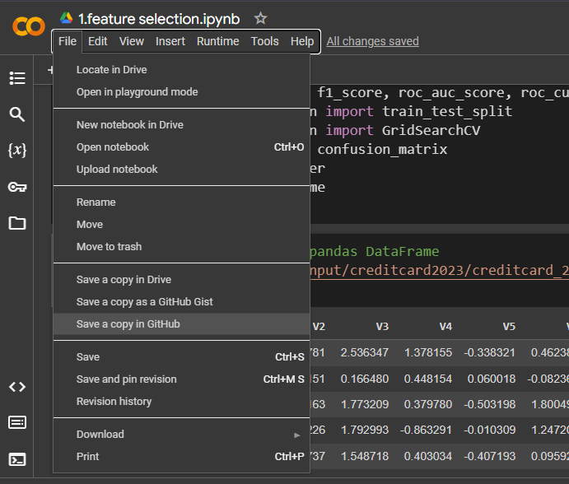
Deployment Steps
Step 4: Upload the Folder
Once our Google Drive is mounted, we can upload our folder to Colab. To do this, click on the “Files” tab in the left sidebar. This will open the file browser.
Next, click on the “Upload” button in the top right corner of the file browser. This will open a file upload dialog.
Navigate to the folder we want to upload and select it. Then click on the “Open” button to start the upload.
12

Slide 14
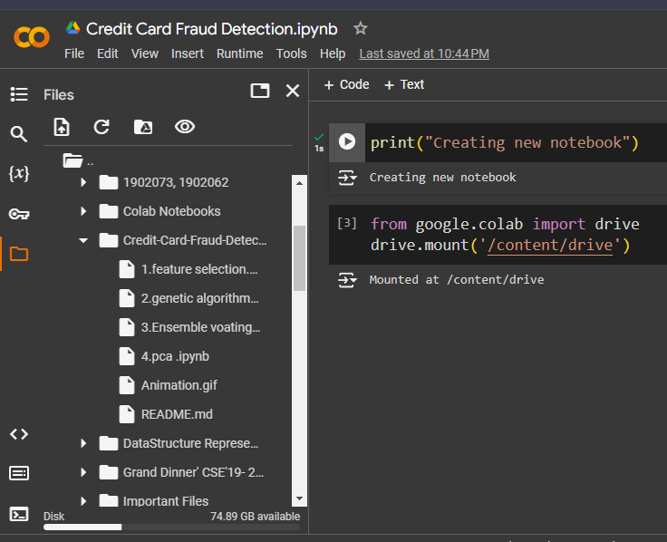
Deployment Steps
13
Step 5: Verify the Upload
Once the upload is complete, we should see our folder listed in the file browser under the “Files” tab. You can click on the folder to open it and verify that all the files are present.

Slide 15

Challenges
Runtime Disconnection: In Google Colab notebooks, there is an idle timeout of 90 minutes and an absolute timeout of 12 hours. If a user does not interact with their Google Colab notebook for over 90 minutes, the instance will be terminated automatically.
Internet Speed: Slower internet connection affects the working performance
And many problem arise with collaborating work.
Adaptation: Adaptation with the new environment on colab cloud a bit challenging with new rules and different technology.
13

Slide 16

Solutions
Solution 1: Keep the notebook active
Solution 2: Use a browser extension
Solution 3: Edit the JavaScript code
Solution 4: Use a VPN
Solution 5: Connect with Reliable & Faster Internet Connection.
14

Slide 17

Benefits of Cloud Deployment
Accessibility: Cloud-hosted projects can be accessed from anywhere with an internet connection.
Easy collaboration: Cloud platforms often have collaboration tools that make it easier to work with team members, advisors of thesis project.
Accessibility
Scalability
Cost-Efficiency: We only pay for the resources we use, which can be more cost-effective than maintaining physical hardware or data centers.
Cost effective
Cloud
Security: Cloud providers typically invest heavily in security measures, helping protect your project's data from various threats.
Security
Collaboration
Scalability: Cloud platforms can easily scale resources up or down based on demand.
15

Slide 18

Limitation of Clouds
Internet Dependency: Cloud deployment relies on an internet connection. If the internet connection is unreliable or slow, it can impact the accessibility and performance of project.
Recourse Limits: Cloud providers impose resource limits on an accounts. Such as google cloud provide 15GB free storage and virtual machine.
Latency and Performance: Cloud resources might introduce some latency compared to local on-premises resources.
Data Privacy: Could be a threats working with the credential data.
16

Slide 19

Conclusion
In conclusion, the deployment of projects and thesis on the cloud offers a multitude of benefits, including enhanced accessibility, scalability, cost-efficiency, reliability, security, and collaboration. These advantages can help development, improve resource utilization, and foster collaboration among team members. However, it's crucial to be aware of the limitations associated with cloud deployment, such as potential costs, data privacy concerns, and internet dependency. A proper planning is needed.
17

Slide 20
Thank You

