Slide 1
Software development project
Submitted By : Abdullah Al Siam Submitted to: Shariful Islam
ID:192-35-462 Department of SWE(DIU)

Slide 2
Contents
Project Name : Proposing a girl.
Tools : CodeBlocks ( Windows BGI)
graphics.h header file.
Language : C++
Description : In this project there is a girl,a boy & animation character.This project A boy will give a flower to a girl in graphical program C++. I used BGI's graphic.h library for this program.

Slide 3
Initializing Graphics
❏ The initgraph function is used to switch the output from text mode to graphics mode
❏ The initgraph function takes three arguments
❏ Syntax: – intigraph(&graphics_driver,&graphics_mode,Path _to_driver);
Closing Graphics Mode
❏ Graphics mode must be closed at the end
❏ For that function closegraph() is used
❏ Syntax: – closegraph();

Slide 4
Some Functions in “graphics.h” this project
void line(int x1, int y1, int x2, int y2)
❏ Remarks ➔ line draws a line from (x1, y1) to (x2, y2) using the current color line()
❏ line function is used to draw a line from a point(x1,y1) to point(x2,y2)

Slide 5
void circle(int x, int y, int radius);
● (x , y) -> Center point of circle ● radius-> Radius of circle circle()
❏ Circle function is used to draw a circle with center (x,y) and third parameter specifies the radius of the circle.

Slide 6
Ellipse ()
void ellipse(int x, int y, int stangle, int endangle, int xradius, int y radius); ellipse()
❏ Ellipse function is used to draw an ellipse, (x,y) are coordinates of center of the ellipse, stangle is the starting angle, end angle is the ending angle, and fifth and sixth parameters specifies the X and Y radius of the ellipse.

Slide 7
Setbkcolor()
❏ setbkcolor function changes current background color e.g. setbkcolor(YELLOW) changes the current background color to YELLOW
. ❏ Remember that default drawing color is WHITE and background color is BLACK.
❏ Syntax :- void setbkcolor(int color);

Slide 8
outtextxy()
❏ outtextxy displays a string at the specified location (graphics mode)
❏ Remarks: outtextxy() display a text string, using the current justification settings and the current font, direction, and size.(CP) outtextxy() displays text string in the viewport at the position (x, y)
void outtextxy(x, y, char *text string);

Slide 9
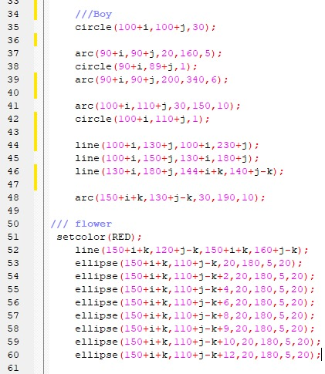

Working function

Slide 10
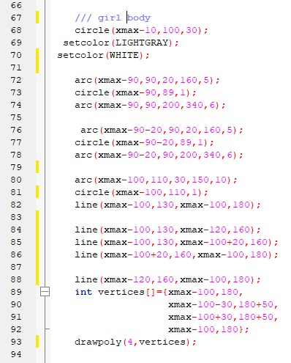

Working Function

Slide 11

Overview the Project

Slide 12
Thanks to All

