Slide 1
Lecture 08 Dynamic Programming
CSE373: Design and Analysis of Algorithms

Slide 2
Longest increasing subsequence (LIS)
The longest increasing subsequence is to find a longest increasing subsequence of a given sequence of distinct integers a₁a₂…a_{n} .
e.g. 9 2 5 3 7 11 8 10 13 6
2 3 7
5 7 10 13
9 7 11
5 3 11 13
are increasing subsequences.
We want to find a longest one.
are not increasing subsequences.

Slide 3
A Naive Approach for LIS
Let L[i] be the length of a longest increasing subsequence ending at position i.
L[i] = 1 + max _{j = 0..i-1}{L[j] | a_{j} < a_{i}} (use a dummy a₀ = minimum, and L[0]=0)
Index | 0 | 1 | 2 | 3 | 4 | 5 | 6 | 7 | 8 | 9 | 10
Input | 0 | 9 | 2 | 5 | 3 | 7 | 11 | 8 | 10 | 13 | 6
Length | 0
Prev | -1
1
1
2
2
3
4
4
5
6
3
0
0
2
2
4
5
5
7
8
4
The subsequence 2, 3, 7, 8, 10, 13 is a longest increasing subsequence.
This method runs in O(n²) time.

Slide 4
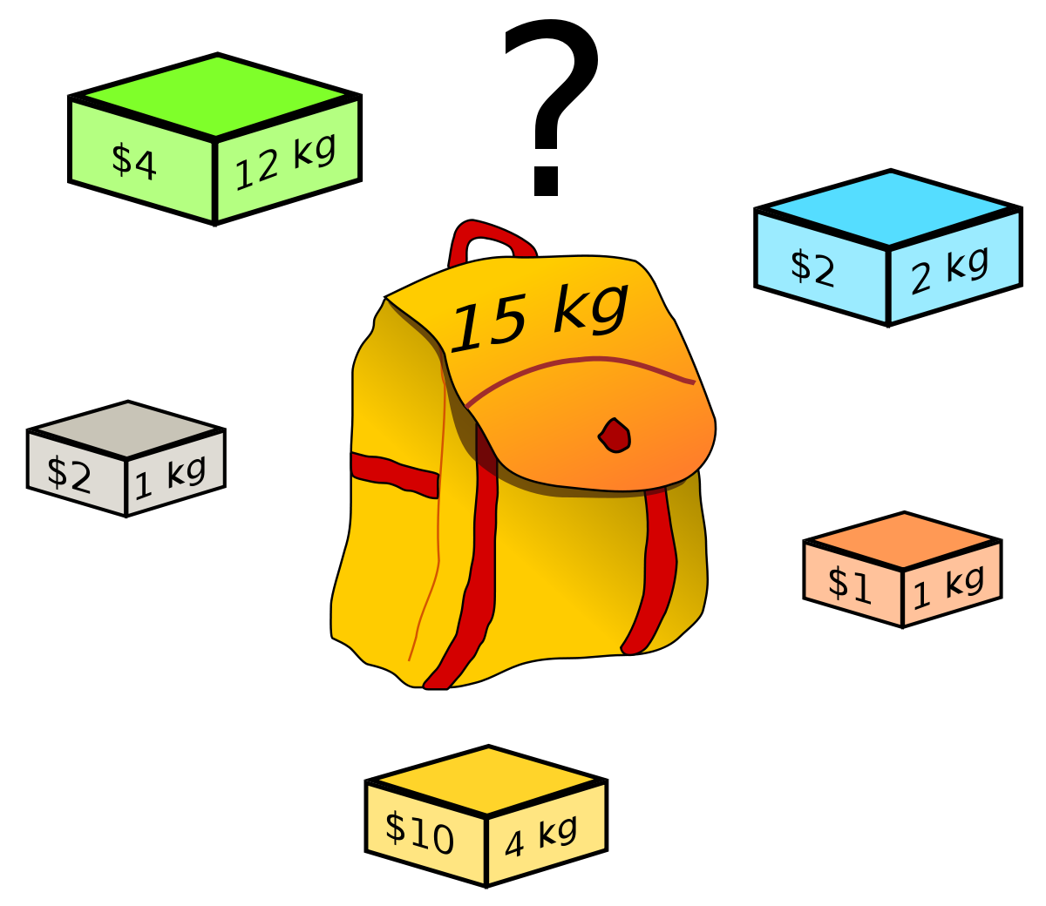
The Knapsack Problem
The 0-1 knapsack problem
A thief robbing a store finds n items: the i-th item is worth v_{i} dollars and weights w_{i} pounds (v_{i}, w_{i} integers)
The thief can only carry W pounds in his knapsack
Items must be taken entirely or left behind
Which items should the thief take to maximize the value of his load?
The fractional knapsack problem
Similar to above
The thief can take fractions of items

Slide 5
The 0-1 Knapsack Problem
Thief has a knapsack of capacity W
There are n items: for i-th item value v_{i} and weight w_{i}
Goal:
find x_{i} such that for all x_{i} = {0, 1}, i = 1, 2, .., n
∑ w_{i}x_{i} ≤ W and
∑ x_{i}v_{i} is maximum

Slide 6
0-1 Knapsack - Greedy Strategy
E.g.:
50
50
50
30
Item 3
$120
+
Item 2
30
20
$100
+
Item 1
20
20
$100
10
10
$60
$60
$100
$120
$160
$220
$6/pound
$5/pound
$4/pound
None of the solutions involving the greedy choice (item 1) leads to an optimal solution
The greedy choice property does not hold

Slide 7
0-1 Knapsack – Divide and Conquer
P(i, w) – the maximum profit that can be obtained from items 1 to i, if the knapsack has size w
Case 1: thief takes item i
P(i, w) =
Case 2: thief does not take item i
P(i, w) =
v_{i} + P(i - 1, w-w_{i})
P(i - 1, w)
Item i was taken
Item i was not taken
P(i, w) = max {v_{i} + P(i - 1, w-w_{i}), P(i - 1, w) }

Slide 8
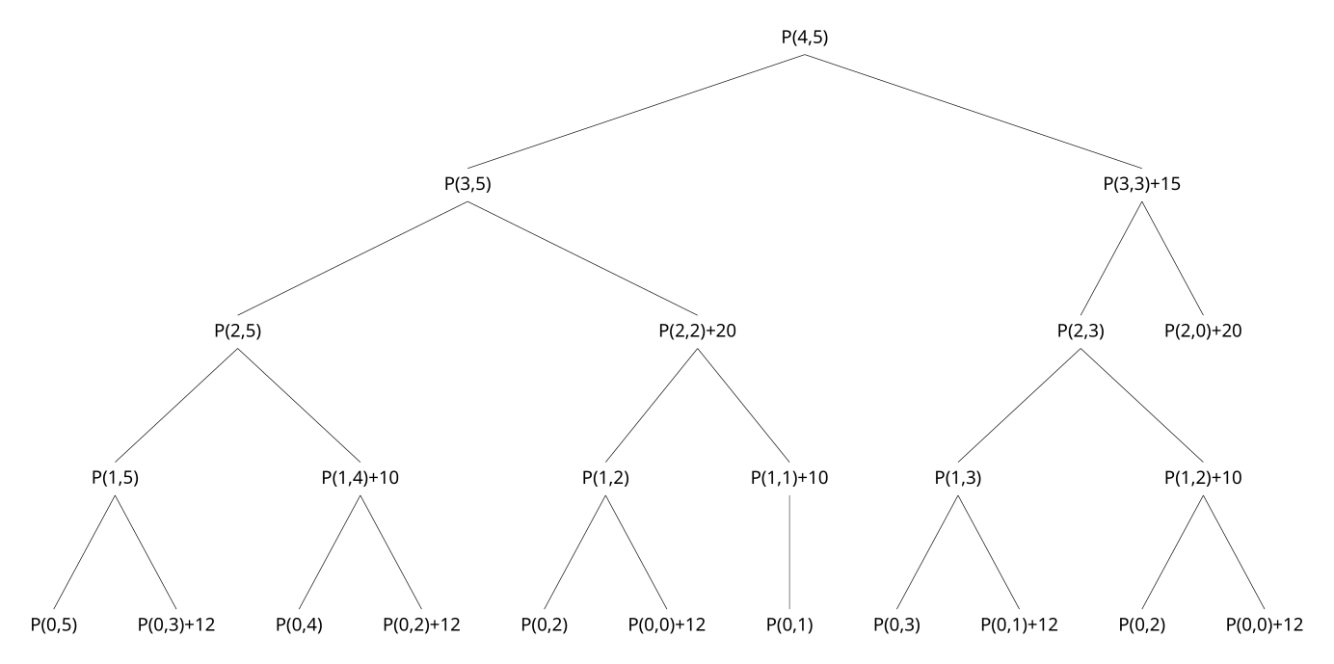
0-1 Knapsack – Divide and Conquer
Item | Weight | Value
1 | 2 | 12
2 | 1 | 10
3 | 3 | 20
4 | 2 | 15
W = 5

Slide 9
0-1 Knapsack - Dynamic Programming
P(i, w) = max {v_{i} + P(i - 1, w-w_{i}), P(i - 1, w) }
Item i was taken
Item i was not taken
0:
1
w - w_{i}
w
W
0
0 | 0 | 0 | 0 | 0 | 0 | 0 | 0 | 0 | 0 | 0
0
0
0
0
0
0
first
second
i-1
i
n

Slide 10
Example:
W = 5
Item | Weight | Value
1 | 2 | 12
2 | 1 | 10
3 | 3 | 20
4 | 2 | 15
P(i, w) = max {v_{i} + P(i - 1, w-w_{i}), P(i - 1, w) }
0
1
2
3
4
5
0
0 | 0 | 0 | 0 | 0 | 0
0
0
0
0
P(1, 1) =
P(0, 1) = 0
1
0
12
12
12
12
P(1, 2) =
max{12+0, 0} = 12
2
10
12
22
22
22
P(1, 3) =
max{12+0, 0} = 12
3
10
12
22
30
32
P(1, 4) =
max{12+0, 0} = 12
4
10
15
25
30
37
P(1, 5) =
max{12+0, 0} = 12
P(2, 1)=
max{10+0, 0} = 10
P(3, 1)=
P(2,1) = 10
P(4, 1)=
P(3,1) = 10
P(2, 2)=
max{10+0, 12} = 12
P(3, 2)=
P(2,2) = 12
P(4, 2)=
max{15+0, 12} = 15
P(2, 3)=
max{10+12, 12} = 22
P(3, 3)=
max{20+0, 22}=22
P(4, 3)=
max{15+10, 22}=25
P(2, 4)=
max{10+12, 12} = 22
P(3, 4)=
max{20+10,22}=30
P(4, 4)=
max{15+12, 30}=30
P(2, 5)=
max{10+12, 12} = 22
P(3, 5)=
max{20+12,22}=32
P(4, 5)=
max{15+22, 32}=37

Slide 11
Reconstructing the Optimal Solution
0
1
2
3
4
5
0
0 | 0 | 0 | 0 | 0 | 0
0
0
0
0
Item 4
1
0
12
12
12
12
Item 2
2
10
12
22
22
22
3
10
12
22
30
32
Item 1
4
10
15
25
30
37
Start at P(n, W)
When you go left-up ⇒ item i has been taken
When you go straight up ⇒ item i has not been taken

