Slide 1
From raw files to published datasets
FAIRmat tutorial 16
February 26, 2025

Slide 2
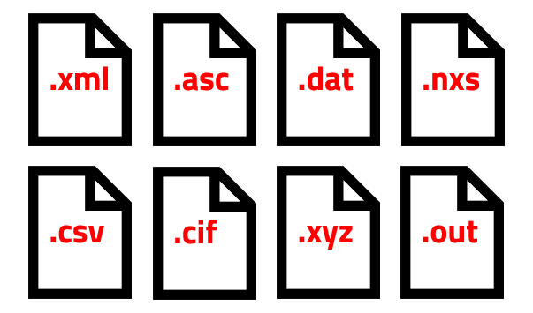



Publishing your data with NOMAD
To get started in the journey of uploading raw files to publishing datasets with a digital object identifiers (DOI), you will need to understand the key NOMAD elements involved in this process.
raw data files
published datasets

Slide 3




The key elements in NOMAD
NOMAD user
uploads
project 1
project 2
project 3
entries
datasets
dataset 1
dataset 2

Slide 4
NOMAD uploads
NOMAD user
uploads
project 1
project 2
project 3
NOMAD users organize their files and data inside uploads.
You can create an upload for each project and structure it into nested folder directories for better organization.
Each upload can contain multiple files and entries.
Uploads can be shared and published.

Slide 5
NOMAD entries
NOMAD user
uploads
project 1
project 2
project 3
entries
Entries are automatically generated by NOMAD from uploaded raw files or instantiated schemas.
Entries can be searched and viewed through dedicated pages.
Files are processed into entries when a built-in parser exists.

Slide 6
Datasets in NOMAD
NOMAD user
uploads
project 1
project 2
project 3
entries
datasets
Datasets group related entries either from one upload or several uploads.
A dataset can be published with a DOI.
dataset 1
dataset 2

Slide 7

Create a NOMAD users account
To create a user account, follow the steps on this link.
steps to create an account

Slide 8

Creating and managing uploads
Hands-on tasks:
Create your first upload in NOMAD.
Rename your upload.
Understand the elements and views of the upload page.
Share your upload with a collaborator.
Publish your upload.
Lets go to NOMAD, click here!

Slide 9
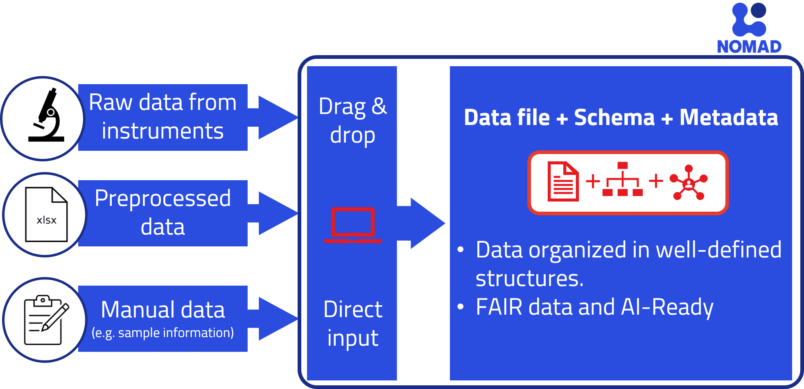
Uploading files into NOMAD
Files can be uploaded to NOMAD in various ways.
Whether they are processed into entries or not depends on their format.

Slide 10
Uploaded raw files: entries vs. files
NOMAD Entries
Originate from files that have built-in parser in NOMAD exists.
Other Files
Originate from files that do not have a built-in parser in NOMAD.
NOMAD extracts the data based on the data schema.
They are stored as part of your upload, and can be downloaded or shared.
NOMAD cannot automatically extract and structure their data.
This allows for searchability, analysis and generating visualizations.

Slide 11
Uploading raw files to NOMAD
Hands-on tasks:
Add files to your upload in different possible ways.
Distinguish between generated entries and stored files.
Preview and visualize your uploaded files/entries.

Slide 12

Exercise 1: uploading miscellaneous files
In this exercise, we will use files that are not processed into entries in NOMAD, such as, .zip, .pdf, .jpg, .txt, and .csv.
Hands-on tasks:
Add files to your upload by drag-and-drop and by file browser.
View and organize your files in your upload.
Preview the files contents in the GUI.
Download the files! click here!
Lets go to NOMAD, click here!

Slide 13
Exercise 2: uploading computations data files
In this exercise, we will use input and output files of a DFT calculation for Iron(III) Oxide.
These calculations were preformed using a code that is supported by NOMAD, i.e. the FHI-aims code.
NOMAD has a parser for the FHI-aims code. This means it will create an entry for these data.
Download the files! click here!

Slide 14
Exercise 2: uploading computations data files
Hands-on tasks:
Add files to your upload by drag-and-drop.
Explore the generated entry page from the files.
Provide additional metadata to the entry.
Lets go to NOMAD, click here!

Slide 15
Exercise 3: uploading experimental data files
In this exercise, we will upload files of an x-ray photoelectron spectroscopy (XPS) measurement.
NOMAD supports .nxs experimental data files.
Most scientific instruments generate raw files in other formats, such as .xml (from SPECS spectrometer).
Other formats are supported via conversion using NexusDataConverter.
Download the files! click here!

Slide 16
Exercise 3: uploading experimental data files
In this exercise, we will upload files of x-ray photoelectron spectroscopy (XPS) measurement on polymers.
Hands-on tasks:
Add .nxs files to your upload by drag-and-drop.
Explore the generated entry page from the files.
Use the NexusDataConverter to upload files with other formats, such as .xml.
Lets go to NOMAD, click here!

Slide 17
Creating and publishing datasets
Datasets are used to group entries, making it easier to manage related data.
Datasets can include entries from several uploads.
The same entry can be in several datasets.
Datasets have no influence on the processing of data.
Users can get a DOI for their datasets.

Slide 18
Creating and publishing datasets
Hands-on tasks:
Create a new dataset, and include entries into that dataset.
Explore and manage datasets.
Assign a DOI to your datasets.
Lets go to NOMAD, click here!

