Slide 1
Taking Bengali Regional Languge Global: Efficient IPA Transcription With FineTuned ByT5
নড়াইল
চট্টগ্রাম
রংপুর
Team_Khita_Kortesi
Final Standing (Private Score) : 0.02019 (3rd)

Slide 2
Our team
Abdullah Ibne Hanif Arean
Ashraful Islam Shanto Sikder
Computer Science & Engineering, University of Dhaka
Institute of Information Technology, University of Dhaka
Nazmus Sakib Ahmed
Institute of Information Technology, University of Dhaka

Slide 3
Agenda
01
02
03
04
Introduction
Analysis & Methodology
Future Work
Conclusion

Slide 4
01
Introduction

Slide 5
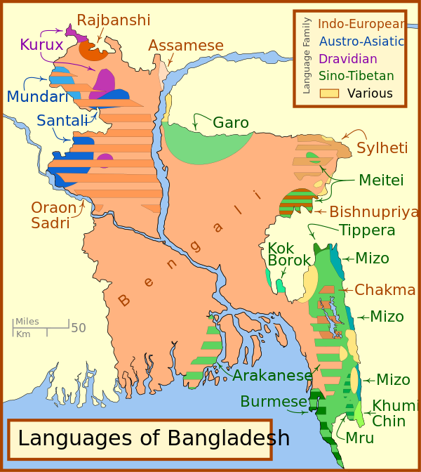
Problem Dimension : Linguistic Exploration
Engaged in a comprehensive study of Bengali's linguistic nuances, delving into its regional orthography, phonetics, and the International Phonetic Alphabet (IPA).
Through rigorous analysis, uncovered the diverse linguistic landscape of Bengali across different regions of Bangladesh.
Source: https://en.wikipedia.org/wiki/Languages_of_Bangladesh

Slide 6
Problem Dimension : Cultural Revelation
A platform to unearth the cultural resonances embedded within Bengali speech.
illuminated the social dynamics, geographical contexts, and historical narratives reflected in the language, showcasing the rich tapestry of Bangladesh's heritage.
Source: https://sylhetiproject.wordpress.com/nagri-lessons/

Slide 7
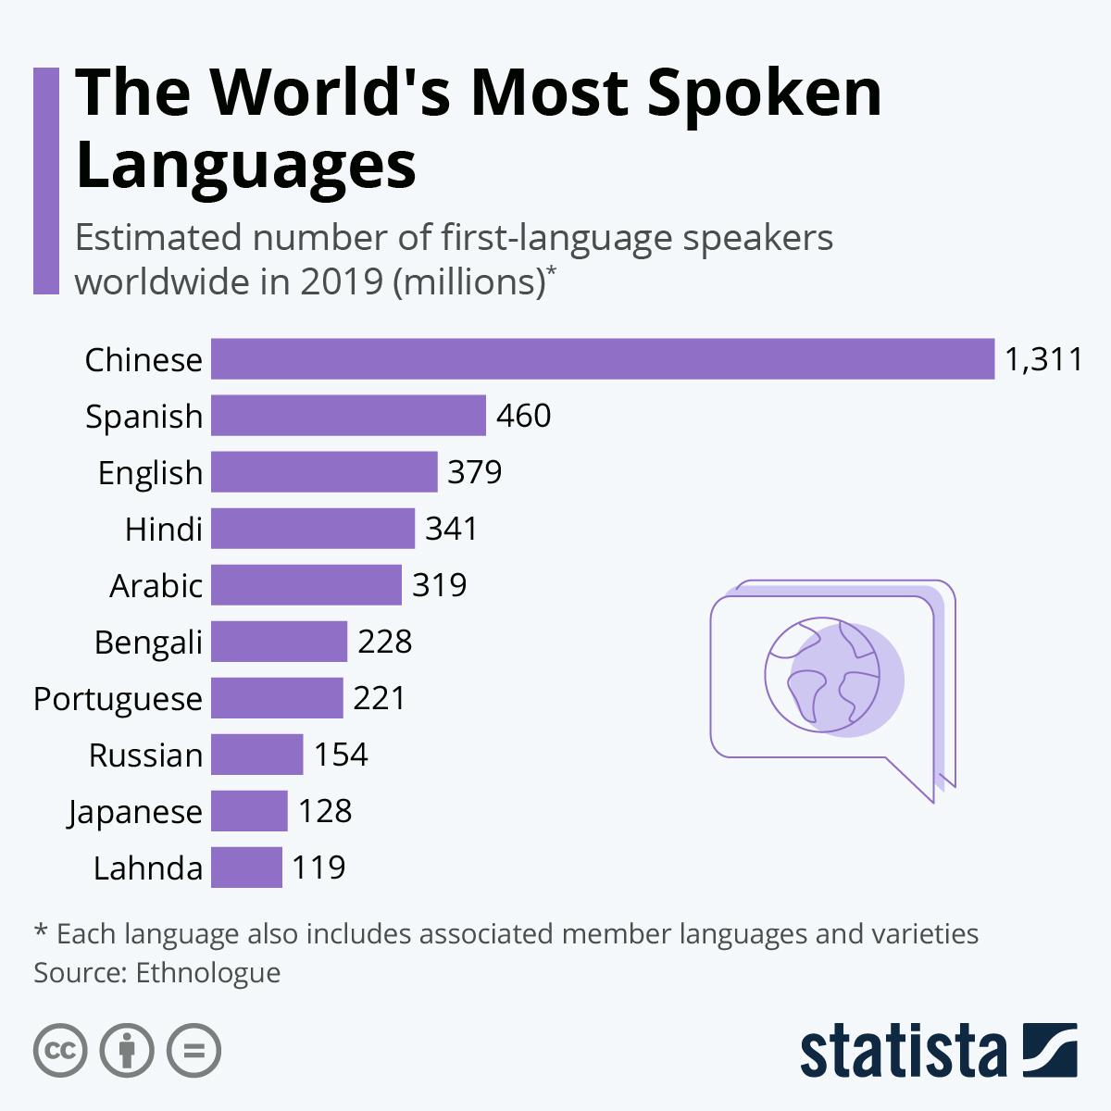
Problem Dimension : Technological Advancement
Development of innovative solutions capable of handling linguistic intricacies and transcribing Bengali texts into IPA, participants contribute to the advancement of open-resource technologies in Bengali language processing.
Elevating Bengali from its perception as a language with limited resources to one that is universally accessible and inclusive

Slide 8
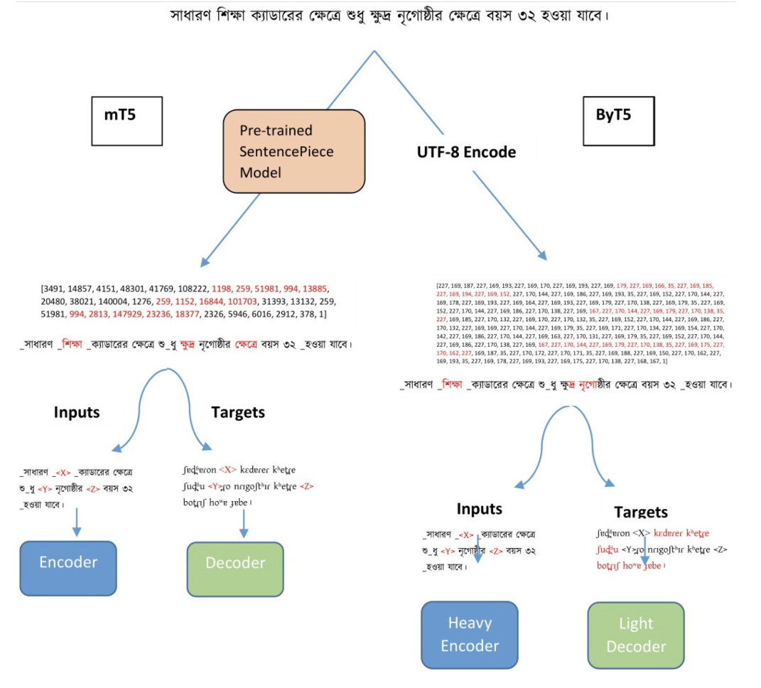
Back To The Basics
T5 (Text-To-Text Transfer Transformer) is a versatile language model by Google
Research, which approaches all NLP tasks as text-to-text transformations.
MT5 (Multilingual T5) extends T5's capabilities to handle multilingual tasks, enabling high-quality translations and multilingual text generation.
ByT5 operates at the byte level, beneficial for languages with complex scripts and tasks like code generation, showcasing T5's adaptability to diverse linguistic and computational challenges.

Slide 9
02
Analysis & Methodology

Slide 10
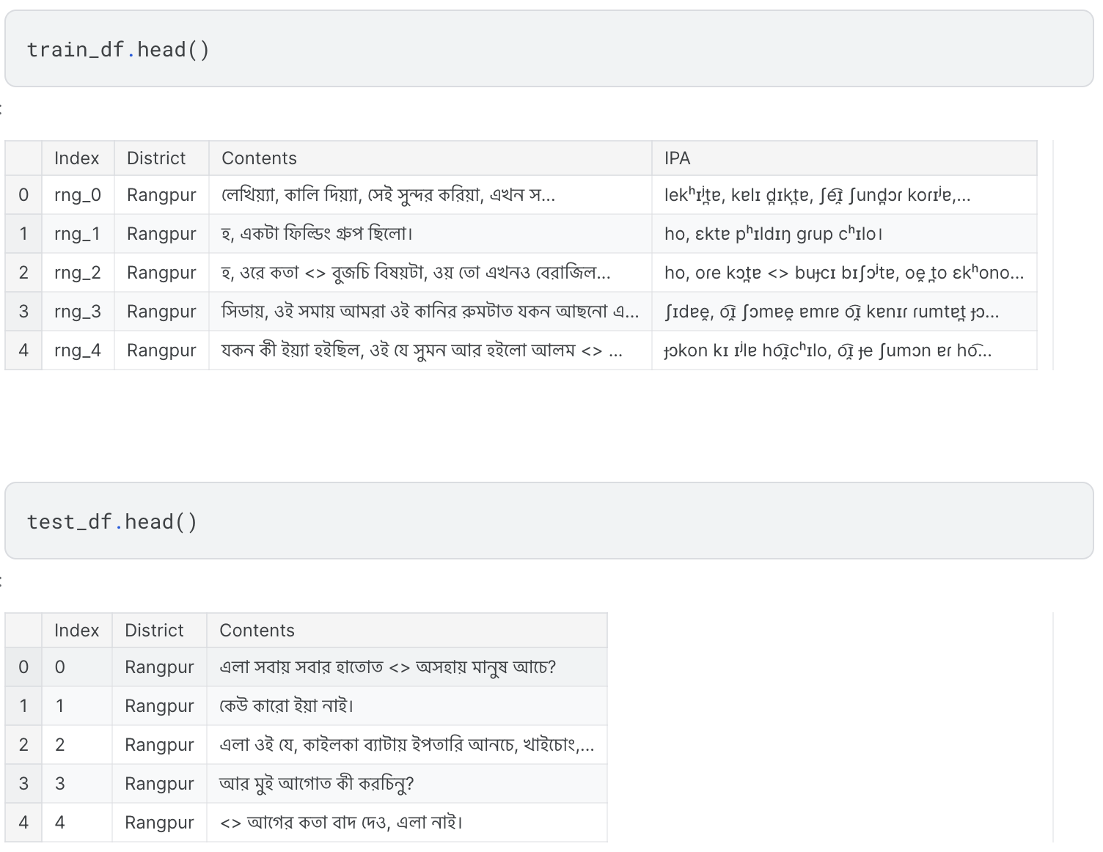
Observations About Data
Number of Training samples: 30311
Number of Testing samples: 8941

Slide 11
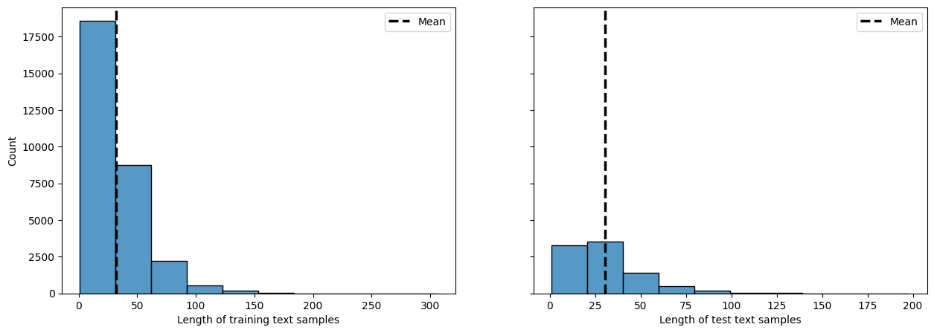
Training Texts Are More Lengthy (Character Count)

Slide 12
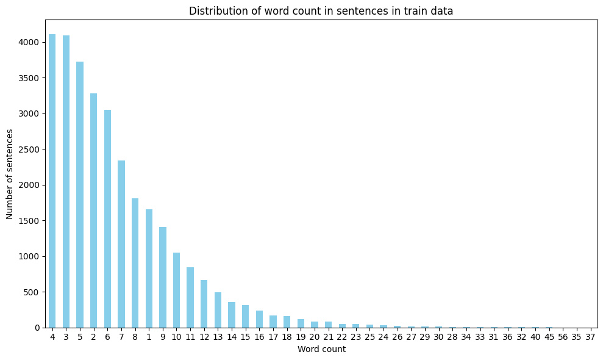
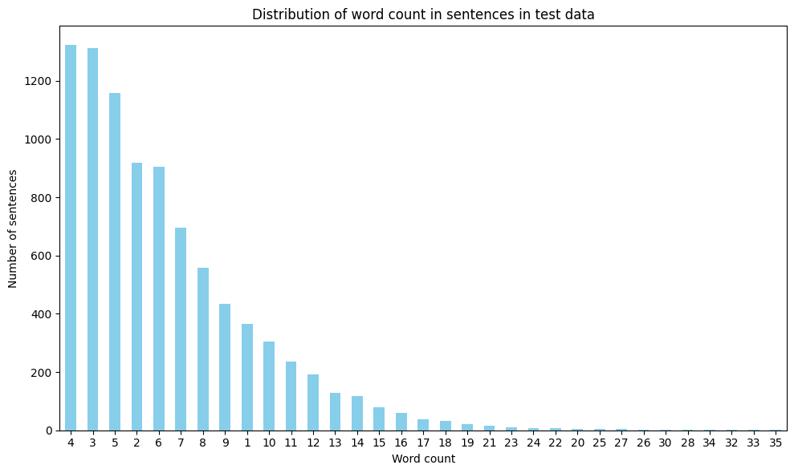
Training Texts Are More Lengthy (Word Count)

Slide 13
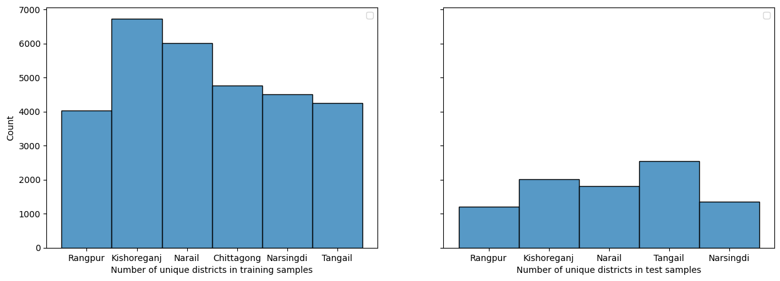
District Wise Distribution (Train-Test)

Slide 14
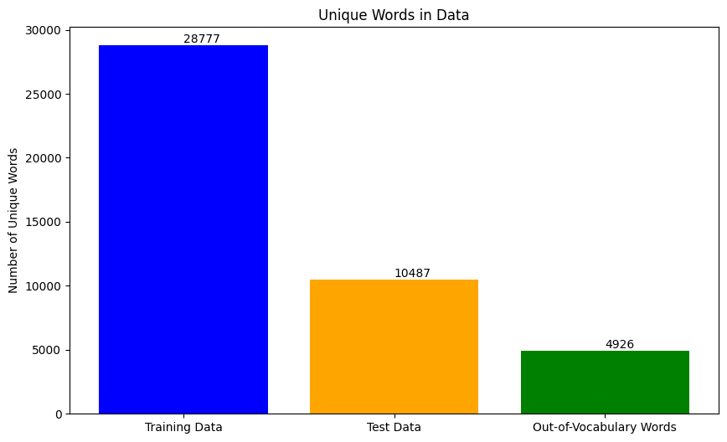
Out Of Vocabulary Words

Slide 15
Special Train Validation Split

Slide 16
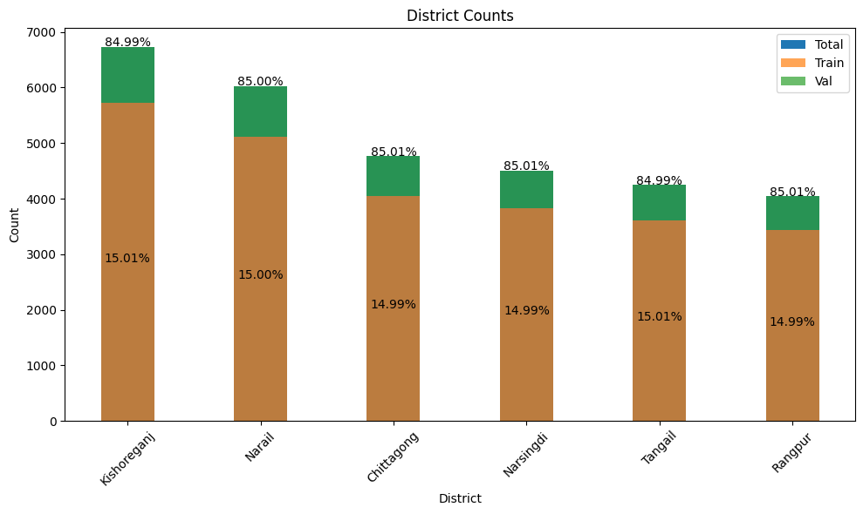
Train-Validation Split (85%-15%)
District Wise

Slide 17
Post Processing & Preprocessing Techniques

Slide 18
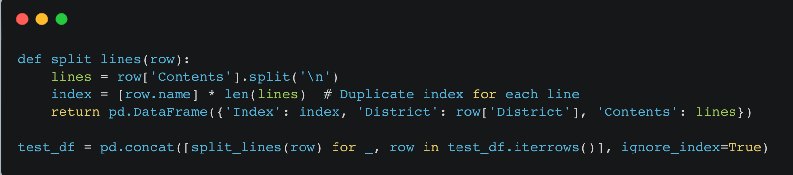
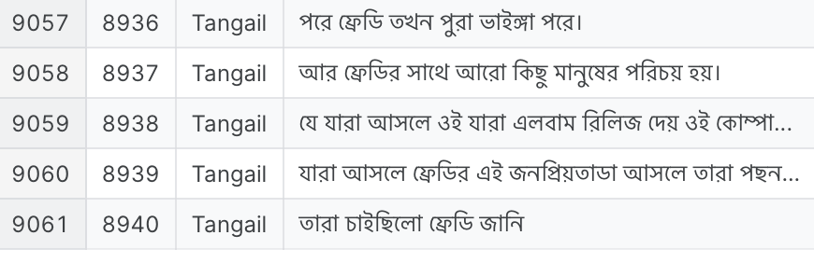
Preprocessing 1 : Splitting Multi Line Row Into Single Line

Slide 19
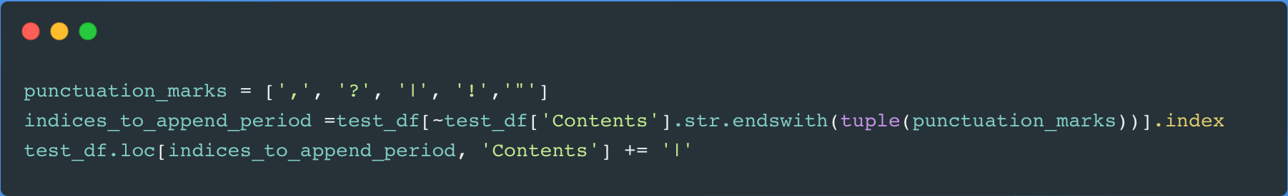
Preprocessing 2 : Adding Stop Words (‘|’)

Slide 20
Postprocessing 1 : Word Count Difference Mitigation With Punctuation & Space Placing
string | string_PP1 | Contents
elɐ ʃɔbɐe̯ ʃɔbɐɾ hɐt̪ot̪ <> ɔʃɔhɐe̯ mɐnuʃ ɐce? | elɐ ʃɔbɐe̯ ʃɔbɐɾ hɐt̪ot̪ <> ɔʃɔhɐe̯ mɐnuʃ ɐce? | এলা সবায় সবার হাতোত <> অসহায় মানুষ আচে?
ke͡u̯ kɐɾo ɪʲɐ nɐ͡ɪ̯। | ke͡u̯ kɐɾo ɪʲɐ nɐ͡ɪ̯। | কেউ কারো ইয়া নাই।
ɐɾ mu͡ɪ̯ ɐgot̪ kɪ koɾcɪnu? | ɐɾ mu͡ɪ̯ ɐgot̪ kɪ koɾcɪnu? | আর মুই আগোত কী করচিনু?
<> ɐgeɾ kɔt̪ɐ bɐd̪ d̪e͡o̯ , elɐ nɐ͡ɪ̯। | <> ɐgeɾ kɔt̪ɐ bɐd̪ d̪e͡o̯, elɐ nɐ͡ɪ̯। | <> আগের কতা বাদ দেও, এলা নাই।
ɐgeɾ d̪ɪn bʱulɪ ɟɐ͡o̯ । | ɐgeɾ d̪ɪn bʱulɪ ɟɐ͡o̯। | আগের দিন ভুলি যাও।
ɐɾ ɐge tekɐ ɐlɐ ɐʃɪl kʰɐlo , kɐe̯? | ɐɾ ɐge tekɐ ɐlɐ ɐʃɪl kʰɐlo, kɐe̯? | আর আগে টেকা আলা আসিল খাল, কায়?
ɟɐe̯ bɐɟɐɾ nɪʲɐ hɐtt̪o gesɪlo ɐɾ ɐccʰɪlo । | ɟɐe̯ bɐɟɐɾ nɪʲɐ hɐtt̪o gesɪlo ɐɾ ɐccʰɪlo। | যায় বাজার নিয়া হাটত গেসিল আর আচ্ছিল।
d̪u͡ɪ̯tɐ tekɐ t̪ɐɾɪ ɐʃɪl । | d̪u͡ɪ̯tɐ tekɐ t̪ɐɾɪ ɐʃɪl। | দুইটা টেকা তারই আসিল।

Slide 21
Post Processing 2 : Word Count Difference Mitigation With Word By Word Inference
string | string_pp2 | Contents
<> tʰɪkbʱɐbe ɟɐe̯,nɐ? | <> tʰɪkbʱɐbe ɟɐe̯ nɐ,nɐ? | <> ঠিকভাবে যায় না,না?
ʃɪhɐd̪ hum? | ʃɪhɐd̪ t̪o hum? | শিহাদ তো হুম?
eɾ ɐgeɾ t̪upʰɐne͡ɪ̯cʰe। | eɾ ɐgeɾ d̪ɪno t̪upʰɐn e͡ɪ̯cʰe। | এর আগের দিনও তুফান অইছে।
plɛnɐcʰe? | plɛn ɐcʰe? | প্ল্যান আছে?
ɾɪd̪eɾt̪ɐpmɐt̪ɾɐbɐlɪ। | ɾo͡ɪ̯d̪eɾ t̪ɐpmɐt̪ɾɐ bɐlo͡ɪ̯। | রইদের তাপমাত্রা বালই।
ʃɔkkɐle ɐcʰolɐ͡ɪ̯n? | ʃɔkkɐle ko͡ɪ̯ ɐcʰolɐ͡ɪ̯n? | সক্কালে কই আছলাইন?
ho, pʰɔd̪d̪ɐ ɟomunɐʃet̪u। | ho, pʰɔd̪d̪ɐ ʃet̪u, ɟomunɐ ʃet̪u। | হ, ফদ্দা সেতু, যমুনা সেতু।

Slide 22
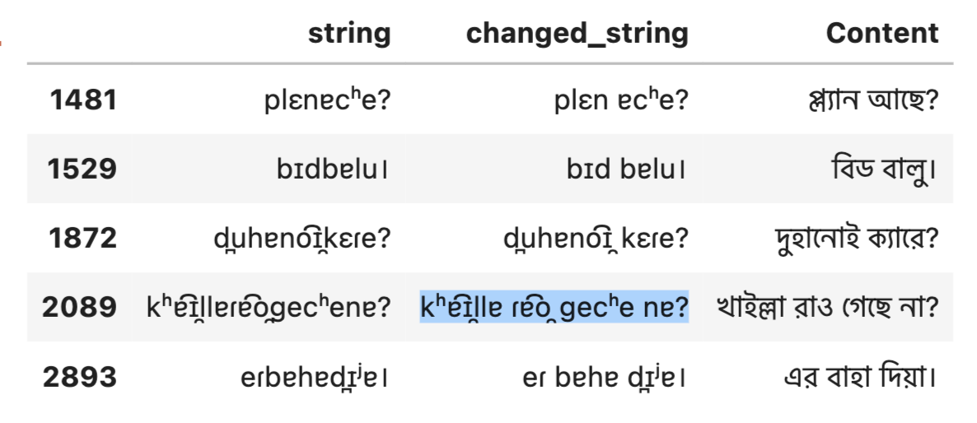
Post Processing 3 : Word Count Difference Mitigation With Word By Word Inference But Changing Rows Having Same Symbols

Slide 23
Area Wise Ensembling Technique

Slide 24
Two Step Training
15 Epoch
Trained Model For Kishoreganj
15 Epoch
Trained Model For Rangpur
15 Epoch
Trained Model For Narail
40 Epoch
Trained Model
Ensembled Trained Model
15 Epoch
Trained Model For Narsingdi
15 Epoch
Trained Model For Chittagong
15 Epoch
Trained Model For Tangail

Slide 25
Training Parameters & Model Selection
Model Name | Epoch | Learning Rate | Train-Validation | Batch Size | Public Score | Private Score
UMT5-base | 25 | 3.00E-04 | Scikit Learn Split Train Validation (90%-10%) | 3 | 0.03364 | 0.03443
MT5-base | 10 | 3.00E-04 | Scikit Learn Split Train Validation (90%-10%) | 3 | 0.35384 | 0.36131
UMT5-base | 25 | 2.00E-05 | Scikit Learn Split Train Validation (90%-10%) | 8 | 0.19924 | 0.20688
ByT5-Small | 14 | 3.00E-04 | Scikit Learn Split Train Validation (90%-10%) | 3 | 0.02495 | 0.02562
ByT5-Small | 25 | 3.00E-04 | Area-Wise Same Proportion Train Validation (85%-15%) | 4 | 0.02349 | 0.02440

Slide 26
Training Parameters & Model Selection
Model Name | Epoch | Special Technique | Train-Validation | Pre Processing | Post Processing | Public Score | Private Score
ByT5-Small | 25 | Area-Wise Separate Model Train | Area-Wise Same Proportion Train Validation (85%-15%) | None | Post Processing 1+Post Processing 2 | 0.02257 | 0.02315
ByT5-Small | 25 | Area-Wise Separate Model Train Ensemble | Area-Wise Same Proportion Train Validation (85%-15%) | None | Post Processing 1+Post Processing 3 | 0.02253 | 0.02308
ByT5-Small | 40 | None | Area-Wise Same Proportion Train Validation (85%-15%) | None | Post Processing 1 | 0.02213 | 0.02107
ByT5-Small | 40 | No Validation Set | 100% Train | Preprocessing 1 & Preprocessing 2 | Post Processing 1 | 0.01961 | 0.02019
ByT5-Small | 40 | No Validation Set & Area-Wise Separate Model Train Ensemble | 100% Train | Preprocessing 1 & Preprocessing 2 | Post Processing 1 | 0.01995 | 0.02004
ByT5-Small | 40 | No Validation Set | 100% Train | Preprocessing 1 & Preprocessing 2 | Post Processing 1 | 0.01945 | 0.02046

Slide 27
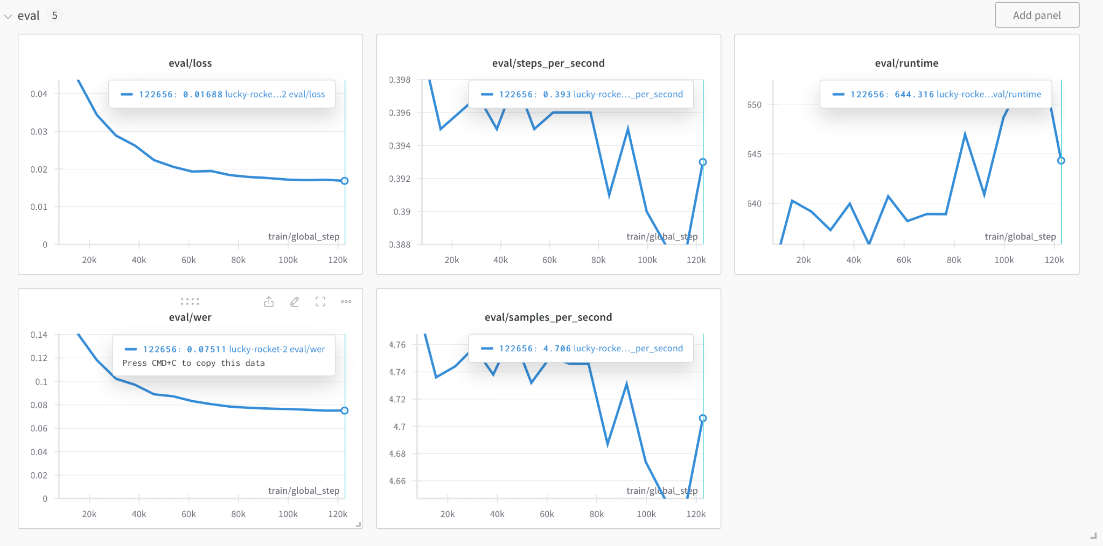
Training & Validation Curve Analysis

Slide 28
03
Future Work

Slide 29
Still Need Improvements!
string | Contents
o͡ɪ̯pɐʃe ɾɔd poɽɪ poɽɪ poɽɪ poɽɪ poɽɪ poɽɪ poɽɪ bʱɐlo nɐge nɐ? | ওইপাশে রড পড়ি পড়ি পড়ি পড়ি পড়ি পড়ি ভালো নাগে না?
kʰepʰɐɾ t̪o <> e͡ɪ̯dɐ kɪ t̪ulu͡ɪ̯n mɛmɐn eɾlɐ͡ɪ̯gkɐkɪcʰe? | খেফার তো <> এইডা কি তুলুইন ম্যামান দেইক্কা এরলাইগ্যা কিছে?
kʰoɾcʰɔlo͡ɪ̯nɐ। | খরছ লওইনা।
ɐɾot̪ɪɾɪʃɔttɐhɐ? | আর তিরিশ ট্যাহা?
bɪʲɐ hoccʰe nɐ kɛmone ɟɐnun bɔ͡u̯ɾtɐd̪ɪʲe ɐɾeho nɐ । | বিয়া হচ্ছে না কেমনে জানুন আফনে বউরটা দিয়ে আরেহ না ।
kono?nɐ, he͡ɪ̯d̪ɪke gecʰe d̪ekcʰɪ। | কোনো এইদিকে?না, হেইদিকে গেছে দেকছি।
bɪd̪eʃ ɟɐbe,unɪ? | বিদেশ যাবে কিডা,উনি?

Slide 30
Incorporating District Names
<token>Rangpur<token> হ, একটা ফিল্ডিং গ্রুপ ছিলো।
<token>Narail<token>পরে আসলানা, এজন্যি।
<token>Chittagong<token> খয়দে সিআরের এইল্লা কি অবস্থা!

Slide 31
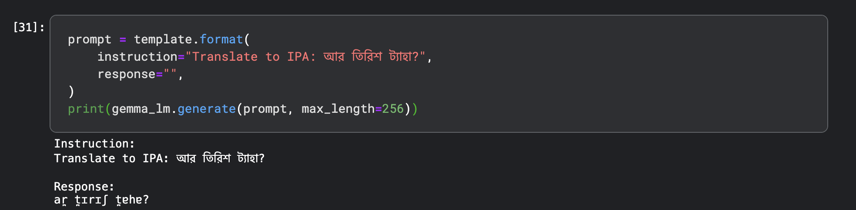
Utilizing LLMs
We have used Gemma 2b and trained it for 1 epochs! The results are very interesting

Slide 32
04
Conclusion

Slide 33
Concluding Thoughts
Comprehensive Coverage of Models
Enhanced IPA Generation
Significant Contribution in Bangla
Pre and Post Processing Bangla
Future Directions

Slide 34
Any Query?!
Mail: abdullaharean2613@gmail.com
bsse1108@iit.du.ac.bd
bsse1124@iit.du.ac.bd

