Slide 1
DL Enigma 1.0 - SUST CSE Carnival 2024 Bangladesh Road Object Detection for Autonomous Vehicles Challenge
Team Name: SUST_Nameless
Member 1: Nasiat Hasan Fahim
Member 2: Niloy Sarker
Member 3: Iqbal Mahmood Sajid
Member 4: Siam Arefin

Slide 2
WorkFlow : Model -> Dataset -> Model
As a beginner in computer visions we first started exploring different model by implementing them using raw dataset.
Then we started understand and explore dataset.
With the key findings from dataset we tried to improve the models which we already explored beforehand.

Slide 3
Single Models:
Model | Score
Yolov8-n | 0.27827
Yolov8-l | 0.35353
Yolov8-x | 0.37001
Yolov5-x | 0.38968
RTDETR-x | 0.41352

Slide 4
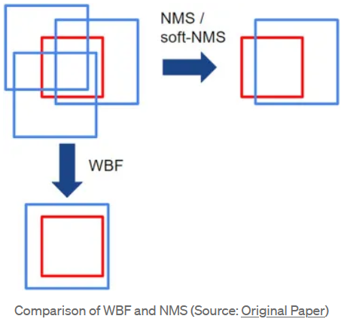
Ensemble Models:
Weighted boxes fusion is used for merging all the predictions from multiple models. Unlike NMS or Soft-NMS methods that simply remove part of the predictions, WBF method uses confidence scores of all proposed bounding boxes to construct the average boxes. This method won’t discard any bounding box, instead, it combines them. This leads to an improvement in the quality of the combined predictions.

Slide 5
We also tried some other models like: Yolo-Nas, Grounding DINO, ResNet-50, EfficientDet
Then we started to read some paper related to computer vision. There we found out about model ensembling.
Model | Score
Yolov5-x + Yolov8-x | 0.40253
Yolov8-x + RTDETR-x | 0.41352
Yolov5-x + RTDETR-x | 0.41141

Slide 6
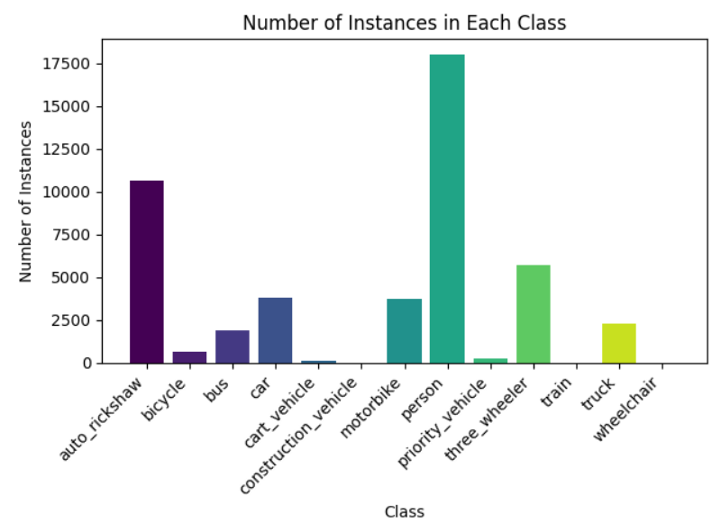
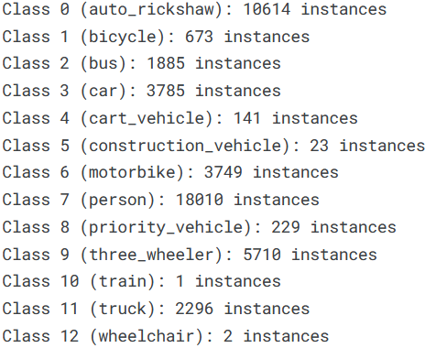
Dataset:
The dataset covers the following 9 districts in Bangladesh: Sylhet, Dhaka, Rajshahi, Mymensingh, Maowa, Chittagong, Sirajganj, Sherpur, and Khulna.
This dataset contains 9825 images with 78,943 Objects with 13 different classes.

Slide 7
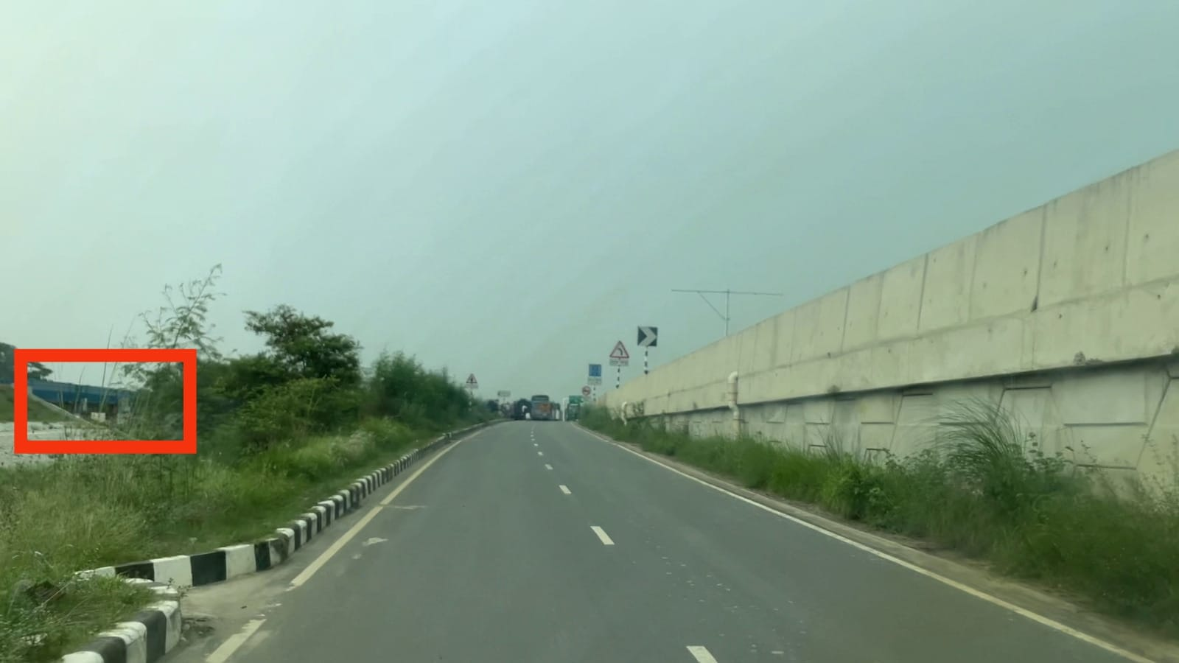
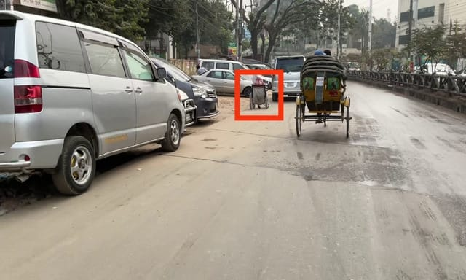
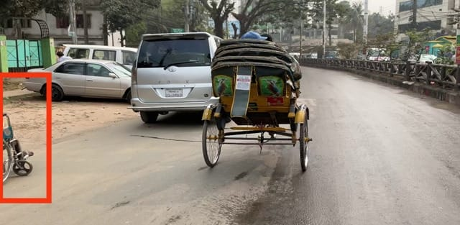

Slide 8
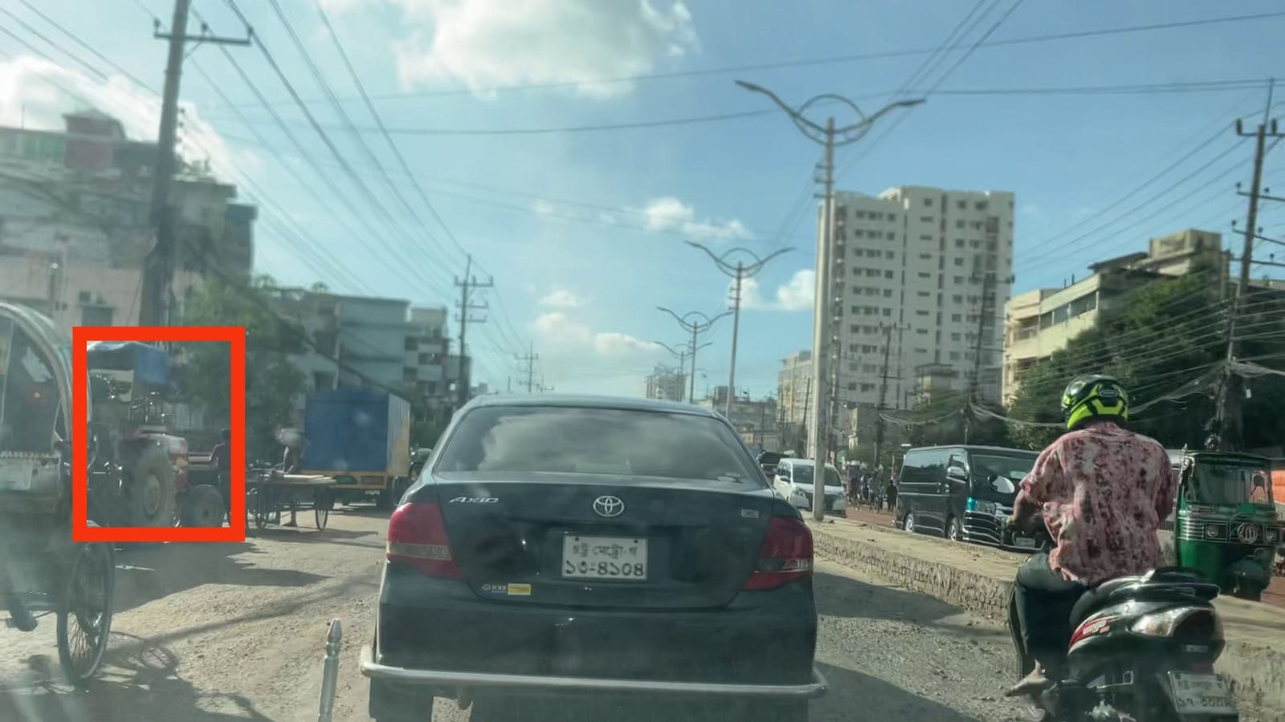
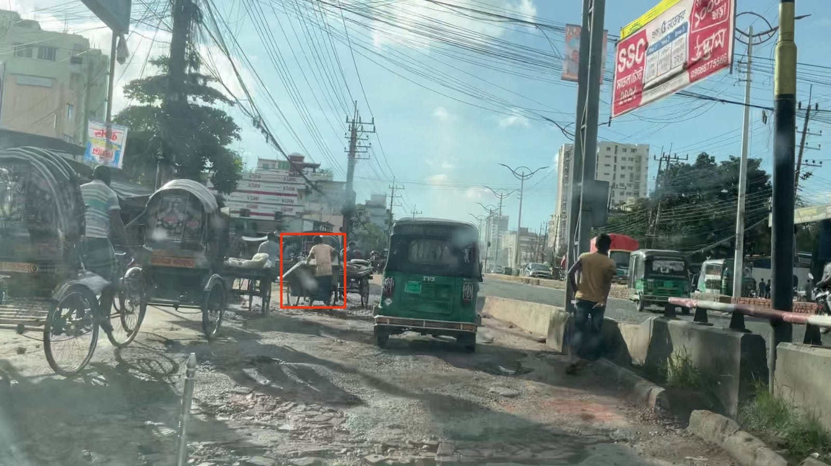
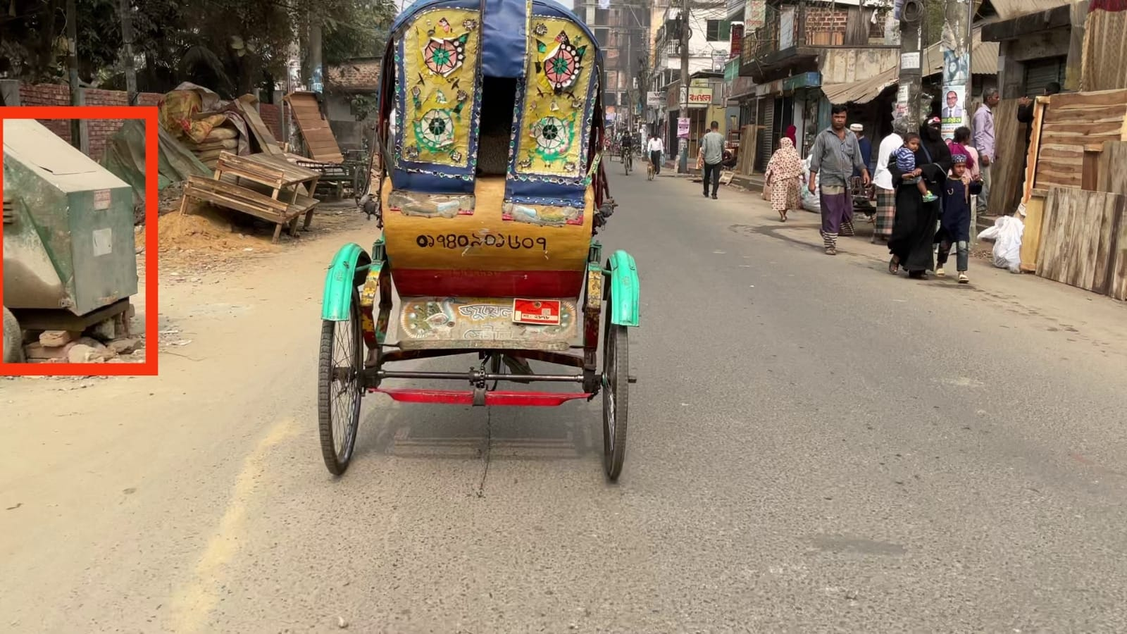
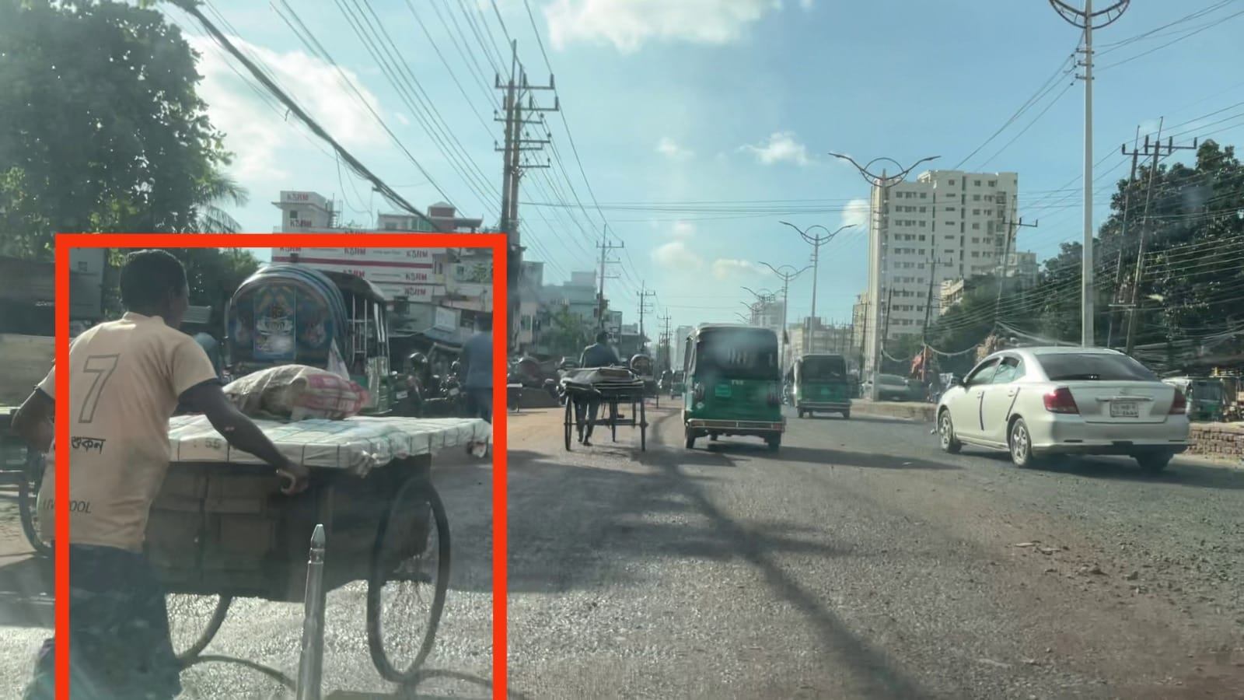
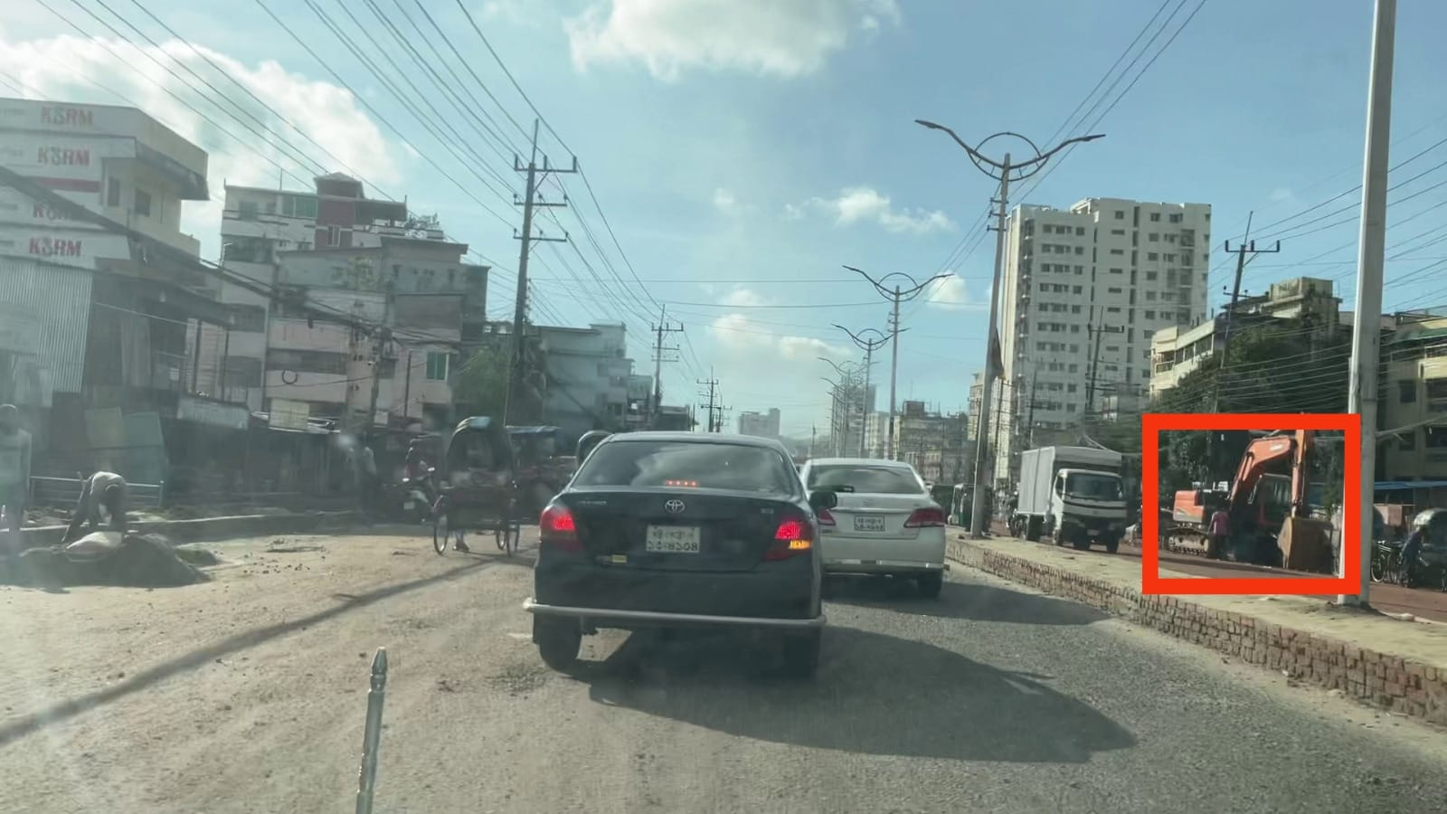
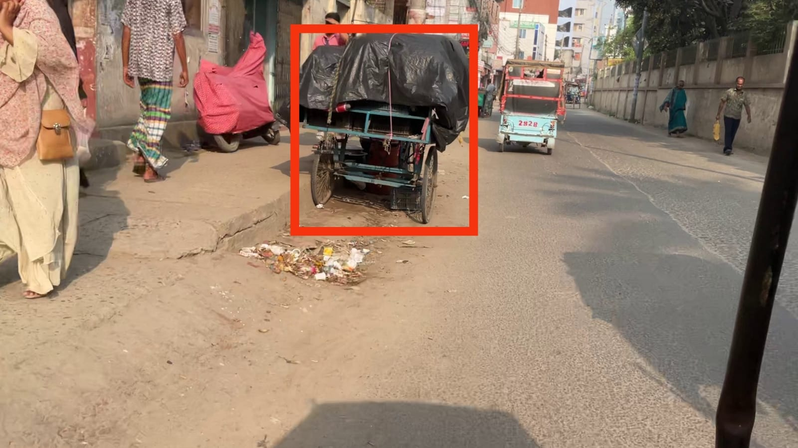

Slide 9
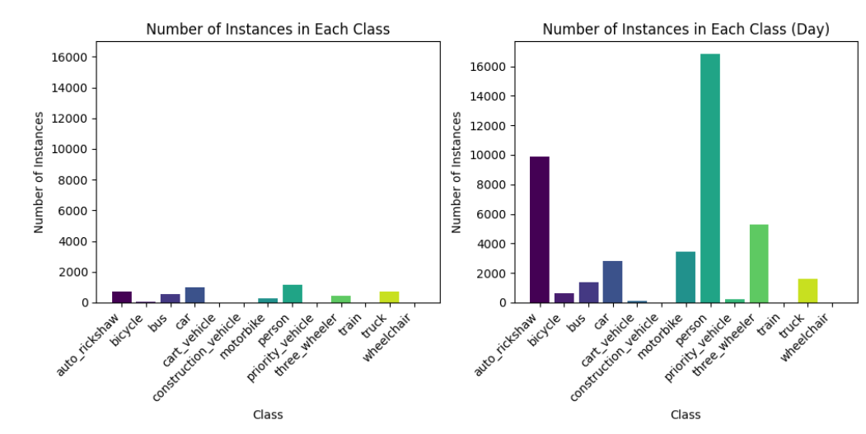
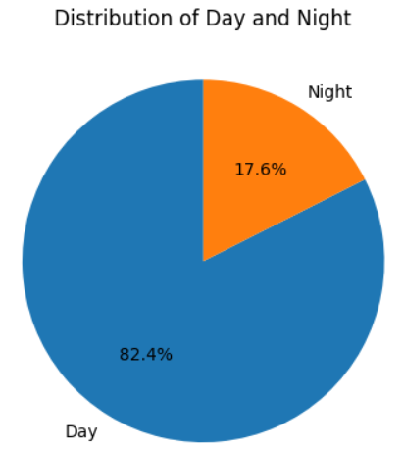
The dataset exhibits additional imbalances beyond the expected variations in content. These include instances of poor image quality. Moreover, disparities in image size are apparent, with some images significantly larger or smaller than the average.

Slide 10
Augmentations:
Random Augmentations
Targeted Augmentations : Min Class
Default Augmentations
Using Models without Training:
Our models couldn’t distinguish between cart vehicles, bicycle, wheelchair and rickshaw.
As some of the categories doesn’t have enough instances in dataset and out pretrained Coco dataset has some common classes like train, person, truck etc. So we decided to use this pretrained models without training in the given dataset.
This may improve our result for those categories which are rare in the dataset.
This approach didn’t meet our expectations as the inference time became much higher and the score wasn’t an upgrade to previous scores.

Slide 11
Using distinct model for rare classes:
This approach also didn’t meet our expectations as the inference time became much higher and the score wasn’t an upgrade to previous scores.
Reverting to the starting point (Here we go again…...)
As of now the key findings we got:
We got the best result from the default augmentations and using ensembling models.
Augmentations didn’t improve our result
Using pretrained models for rare classes didn’t work also.

Slide 12
Final Approach:
We use RTDETR for this competition.
Train model1 for 100 epochs and model2 for 60 epochs.
Then we combine this two models with WBF
Using GPU T4x2 as Accelerator given by Kaggle for faster training
Parameters | Value
Epochs | 100 for model 1 60 for model2
Image size | 640
Batch size | 16
Pretrained | True
Cache | True
Augmentations | Default

Slide 13
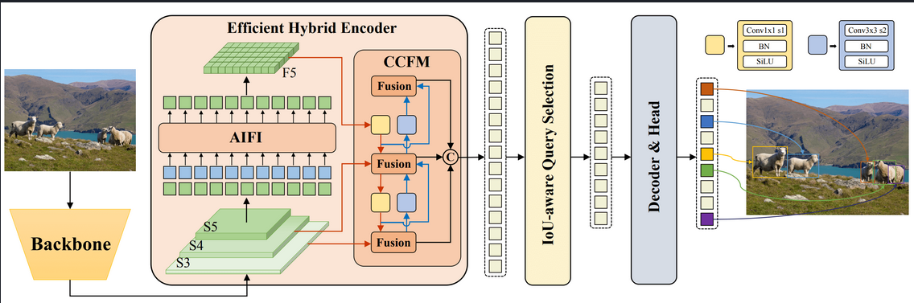
Overview of Baidu's RT-DETR:
Parameter for WBF | Values
Weight | [1,1]
IOU threshold | 0.4
Skip box threshold | 0.001

Slide 14

References:
https://docs.ultralytics.com/models/rtdetr
https://github.com/ZFTurbo/Weighted-Boxes-Fusion

