Slide 1
TPS control method only with Keyboard
2013011082 Lee, Sang-ok

Slide 2
How Tested
Subject Classification
20s + male + HYU CS majored students only.
-> experienced WASD + mouse control?
Group Noob : No Experience in whole life
Group Skilled : 100hour/1year or 300h/3year (recent)
Group Experienced : etc
Experiment method
2 Type of control method (For Measuring the difference)
Auto/ WASD
2 Stage of different level

Slide 3
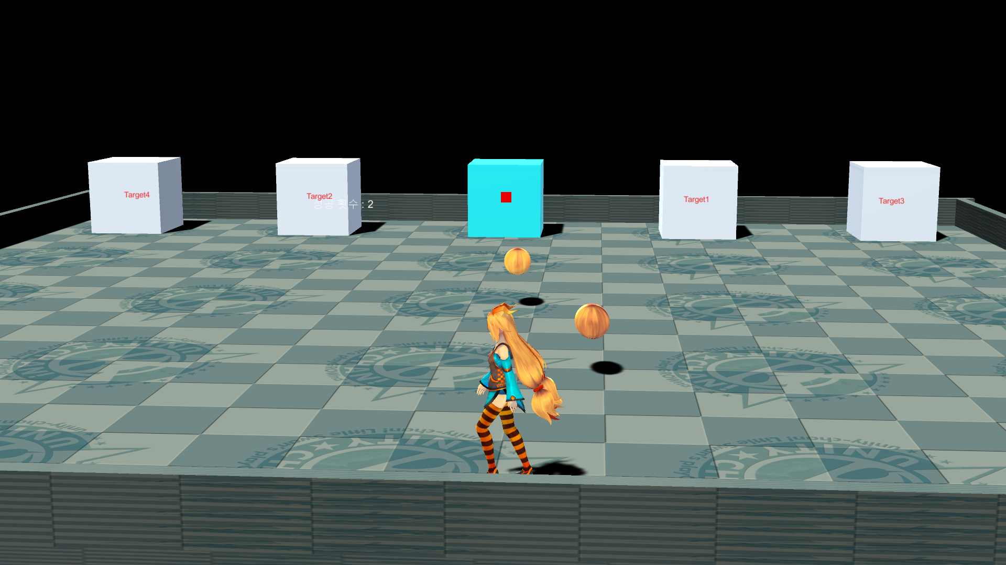
How Tested
Target Changed
when hit (blue == target)
Experiment method
2 Type of control method (For Measuring the difference) Auto/ WASD
2 Stage of different level
Subject Classification
20s + male + HYU CS students only.
Group Noob : No Experience in whole life
Group Skilled : 100hour/1year or 300h/3year (recent)
Group Expeirienced: Expeirienced but not 2nd group
Target attacks player
(not in lv1)
Attack target
Avoid Attack
(not in lv1)

Slide 4
How Tested
Measure what?
In 30 Sec time limit
hit / be hit / miss / wrong target
Score = 2 x (hit – be hit) – (miss + wrong target)
Experiment Sequence
50% of Tester : Auto mode lv1 -> lv2 -> WASD mode lv1 -> lv2
50% of Tester : WASD mode lv1 -> lv2 -> Auto mode lv1 -> lv2
Each level repeated 5 times. 2nd ~ 5th used as data

Slide 5
Test Result
Experienced Group(6 person)
 | Score add | minus | total | growth
WASD1 | 54.67 | 1.83 | 52.83 | 4%
WASD2 | 46.00 | 9.67 | 36.33 | 5%
Auto1 | 53.67 | 0.17 | 53.50 | 2%
Auto2 | 36.33 | 8.17 | 28.17 | 19%
Score = +2 x (hit – be hit) – (miss + wrong target hit)
Growth = (2nd + 3rd) / (4th + 5th) – 100%
Experienced Group & Skilled Group show small difference.
Growth == need more time to used to it.
Auto mode need little bit more time to used to it. (except 1 noob)
Skilled Group(5 person)
 | Score add | minus | total | growth
WASD1 | 52.80 | - | 52.80 | 5%
WASD2 | 45.20 | 8.60 | 36.60 | 13%
Auto1 | 50.40 | 0.40 | 50.00 | 4%
Auto2 | 33.20 | 9.20 | 24.00 | 8%
Noob (1 person) | Score add | minus | total | growth
WASD1 | 50 | 4 | 46 | 23%
WASD2 | 26 | 20 | 6 | 64%
Auto1 | 50 | - | 50 | 4%
Auto2 | 38 | - | 38 | 79%

Slide 6
Test Result Compairing 2 modes
Compare score of 5th trial.
Data : Average gap of 2 mode per each person
Level gap : Lv1->Lv2 Score decreased
Lv1 Lv2 [Lv gap WASD] [Lv gap Auto]
Group Experienced(6 person) -8% -16% -31% < -47%
Group Skilled (5 person) -5% -33% -31% < -52%
Group Noob (1 person) 0% +533% -87% > -24%
Result1 : New [Auto mode] was not good as current [WASD + mouse mode]
Result2 : Auto mode wasn’t good for complex task(level 2)

Slide 7
I thought I can test (test plan slide)
Good
Bad
No ‘Aiming’ make game control easy
Fast Input, Multiple choice
-> speedy PvP
No aim + fast = something new?
Not popular Style
Due to the Lock on, Only few enemy at once
Keypad needed (Some keyboard may not have it)

Slide 8
Actually, it wasn’t what I wanted
Good
Bad
No ‘Aiming’ make game control easy
How hard to fight against multiple targets
in new mode?

Slide 9
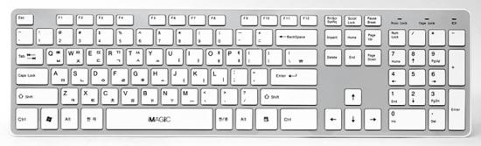
Actually, it wasn’t what I wanted, Because…
Time Limit.
1.Fail to make [Auto-Aiming Mode] against moving target (homing or position prediction needed)
2. So only use not-moving targets
3. To increase difficulty, use multiple targets
4. [Auto Aiming mode] is not suitable against multiple targets
Right hand overloaded to move and change target
Attack Keys (also used for command)
Move Camera
Change Target(R/L)
Change
Target
(distance)
Move
Lock on

Slide 10
Project2 is completing in-perfect test
My plan was testing [Auto-Aim-mode] compare to current [WASD+mouse mode]
Test1 was testing worst case of new mode (Actually, I said new control style must not have more than 3 enemy at once)
Test2 will test best case of new mode and mixed case
Best case : 1 enemy moving and attacking
Mixed case : 2 enemy moving and attacking
Player can not kill enemy, but deal damage and stun them by attacking
For 2 enemy, Un-attacked enemy becomes faster -> need to switch target
Hit as much as Possible, not be hit as less as possible

Slide 11
Problems in test1
30sec test was enough with 4 trial, 5 wasn’t need
No Fixed Tutorial (just 1st trial with explain)
Mouse sensitivity setting not supported, Y-axis limit was not set.
Shot destination was shown only for WASD mode (in Auto, destination marker was burried inside enemy rendering)
Auto mode Lock on key was not automatically set.(0.5~1sec more needed)

