Slide 1
TPS control method only with Keyboard
2013011082 Lee, Sang-ok

Slide 2
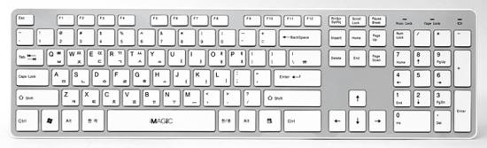
Big Purpose
[WASD + mouse] vs [Keyboard only]
1st one is traditional control style, 2nd one is my suggestion.
Attack Keys (sequence combination of [attack+move] keys makes new skill key)
Move Camera
Change Target(R/L)
Change
Target
(distance)
Move
Lock on

Slide 3
Mission for each style
Project1 : select 1 among not moving, nearby 5 targets -> attack
Advantageous for [WASD + mouse] style
Project2 : chase single moving target correctly -> attack
Problem : [Keyboard only] style supported by auto-aim system.
Meaningless to compare ‘correctness’ (auto vs manual)
So change project 2 plan
Project2 : Chasing single target and multiple targets 360’ around

Slide 4
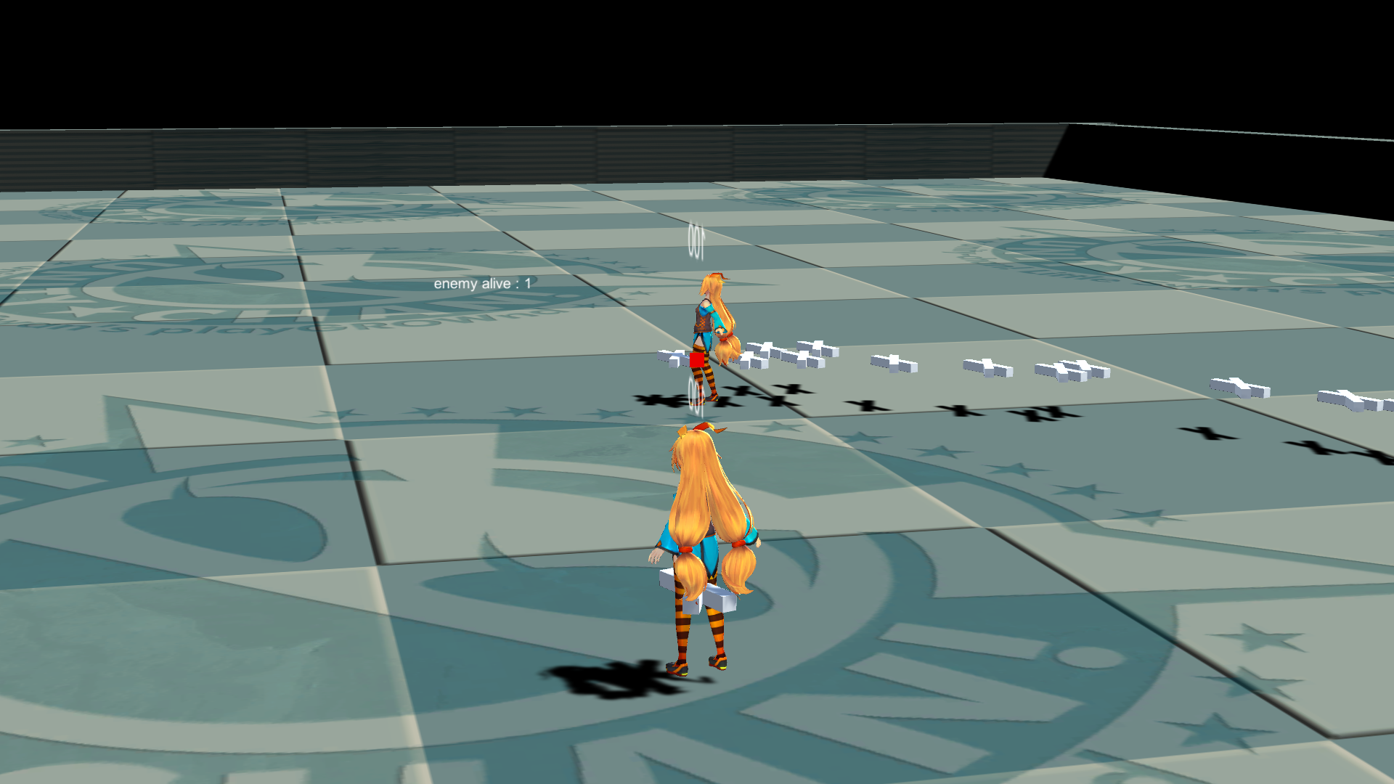
This Project
(single target)
Target Moves around
Attack target
Predict shot supported for Auto Aim
Target attacks player
Avoid Attack
(Need to change direction randomly to avoid prediction)

Slide 5
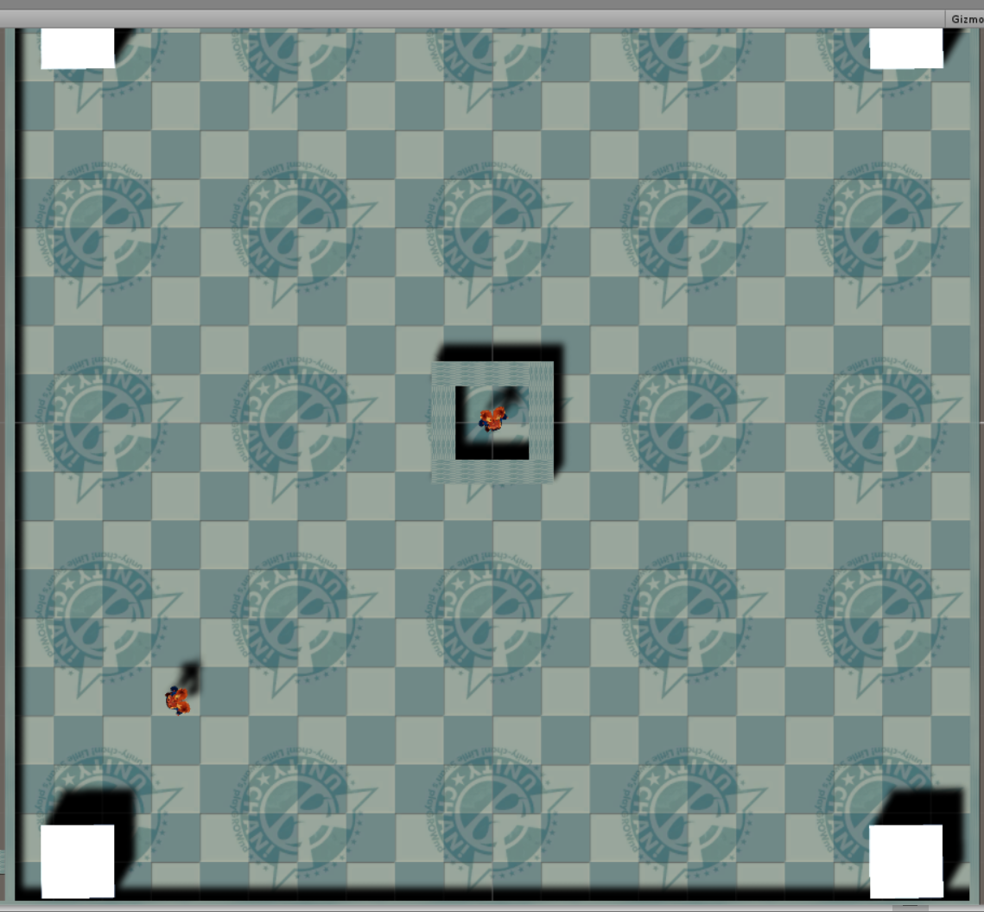
Only measuring
accuracy is meaningless
So, measure time to
end barrier-pattern
Enemy hide in barrier
for every 10 sec
Player should Attack 4 minions to turn off barrier
Move to attack position
Many times, must move to avoid barrier

Slide 6
How to get testers?
Recruit in IT/BT 3rd Floor, 06/08~12
CS majored 20~29 year old male only (can be biased)
reward : 1 menu from cafe at 3rd floor
15 minute test (1 minute test x 10 times + etc)
13 Testers participated.

Slide 7
Tester Classification
Group
Skilled : FPS game experienced, (100h/1year) or (300h/3year) recently
Experienced : others.
Noob : experienced less than 100 hours in hole life
8/4/1 people per group.
Unexpected answers (this is why I don’t believe what they said)
In project 1, testers are classified as 5/6/1, but 8/4/1 in project 2
Same user group, same criteria, different introduction.
“FPS or TPS game” -> “games like Overwatch, BattleGround” (friendly examples)

Slide 8
How Test (similar to last project)
Measure what?
In 1 minute time limit
hit / be hit / miss / average time to end barrier-pattern
5 times for each control system.
Experiment Sequence
50% of Tester : Auto mode -> WASD mode
50% of Tester : WASD mode -> Auto mode
Each level repeated 5 times at once.
1st data not recorded (tutorial)
2nd ~ 5th used as data

Slide 9
Test Result
Attack Success Count | Group | WASD | Auto | Compare | WASD Growth | Auto Growth
 | Skilled | 11.4 | 23.0 | +109% | 17% | 3%
 | Experienced | 10.5 | 20.7 | +107% | -5% | 9%
 | Noob | 4.3 | 21.0 | +394% | 43% | 5%
Average = (2nd + 3rd + 4th + 5th) / 4
Growth = (2nd + 3rd) / (4th + 5th) – 100%
Compare : (wasd + compare%) = auto
Auto mode is better in attack. (expected)
Auto mode make user avoid easier as practice continue.
(not big difference in total average but big gap in last)
19% slower in 360 degree rotation
Auto mode is little bit good for skilled,
Not big difference for experienced group
Attacked by Enemy Count | Group | WASD | Auto | Compare | WASD Growth | Auto Growth
 | Skilled | 7.2 | 6.3 | -9% | 8% | -12%
 | Experienced | 8.7 | 8.6 | -1% | 38% | -45%
 | Noob | 12.3 | 7.3 | -41% | -37% | 23%
Pattern Clear Time | Group | WASD | Auto | Compare | WASD Growth | Auto Growth
 | Skilled | 6.2 | 7.6 | +23% | -7% | -7%
 | Experienced | 6.5 | 7.2 | +11% | -3% | -1%
 | Noob | 10.1 | 8.6 | -15% | 17% | -9%

Slide 10
So, keyboard only system is
novel, not bad, but WASD system is already in position.
Last benefit [able to use many shortcut command keys] can not be easily tested in short time(more than 20 skills required, time to used to it required)
Show high accuracy (supported by auto aiming) but not sure it’s ‘good’ feature
My suggestion is not good as expected.

Slide 11
Serious Dilema There is no “neutral” condition for experiment
How to set these variables to make fair(?) comparison?
Fire rate -> hard to WASD control if too fast (need more concentration)
Enemy hitbox size -> WASD is mattered by it, while Auto mode isn’t
Bullet Speed -> WASD is mattered by it more
I Can Release only one Version for test.
If I have infinite resource (time, testers, money) I can make multiple versions to analyze all factors but resource is tightly limited. 15minuite test is hard use many testers.

