Slide 1
Acoustic Dreams
By
IT & Dreams

Slide 2
Members
Nigar Sultana – 13132528 (Ideas and Developing)
Mahmudul Hasan Navil – (Designing)
Md. Shiam Hossain – 13132693 (Developing)
Md. Saifur Rahman – 13132715 (Software Testing & Debugging)

Slide 3
About Our Company
IT & Dreams
Est . 2010
Experts on Idea Developing, Designing, Testing
Projects – Electric parts managements system, Car managements Systems etc.

Slide 4
Client
Care International
Founded in 1945
Non-profit global venture
Works with Children & improvement of society

Slide 5
Digital Instruments
Digital Musical instrument produces sound digitally
Outputs an electrical audio signal with loudspeaker
Includes a user interface for controlling sound, pitch etc.

Slide 6
Why Digital Instruments
Best option for practicing
cheaper than traditional instruments
no need for any kind of maintenance
No need of physical room space
No need of tuning
Bad weather can cause no damages

Slide 7
Our Goals
Building a portable device
Making it easy to learn for beginners
Helping music lovers to take their first step into musical instruments
Smart UI
Simple and Easy to use
Free Stuffs

Slide 8
Things we Have done
Worked on 3 items
Piano, Drums & Funny Sound
Bringing the items into a smart platform
Click Counter

Slide 9
Targeted Customers
Children and Beginners
People with low budget
Mentally unstable person

Slide 10
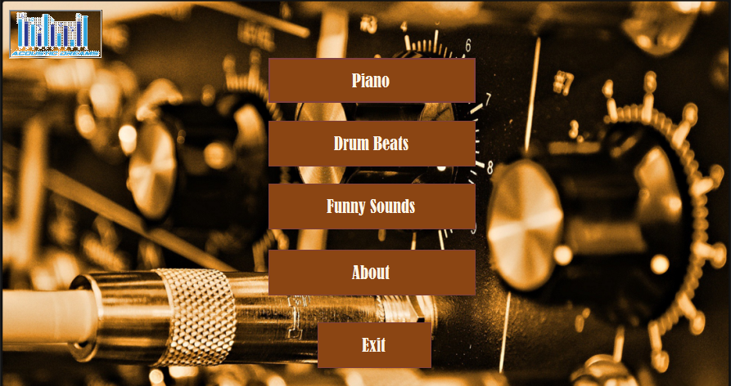
Main Menu

Slide 11
Piano
a musical instrument played using a keyboard
Used in classical, jazz, traditional and popular music
Can be played solo, ensemble performances, for composing or rehearsal.

Slide 12
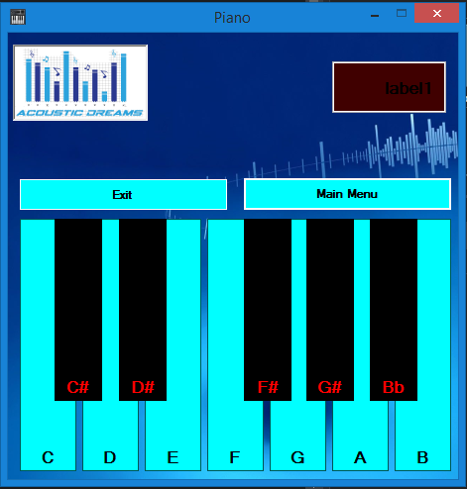
Piano

Slide 13
Drums
Prototype of a rock genre based drums
Used highly synthesized and professionally tuned drum sounds
Two types of drums - bass and snare
Three types of toms - floor, middle and high
Three types of cymbals, crush, ride and hi hat.

Slide 14
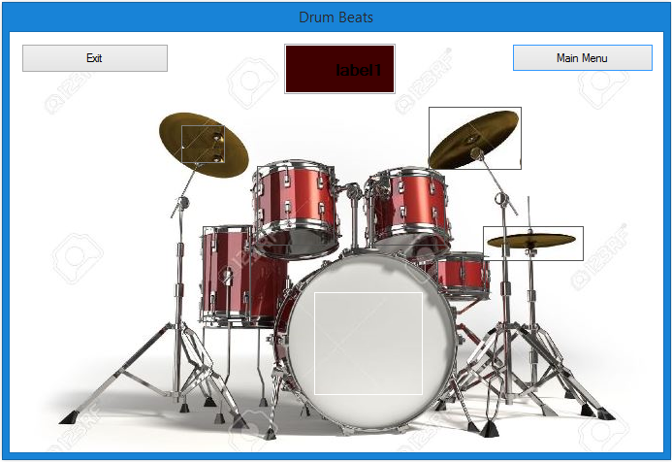
Drums

Slide 15
Funny Noise

Slide 16
That’s all Everybody ☺

