Slide 1
PCS
People Counting System

Slide 2
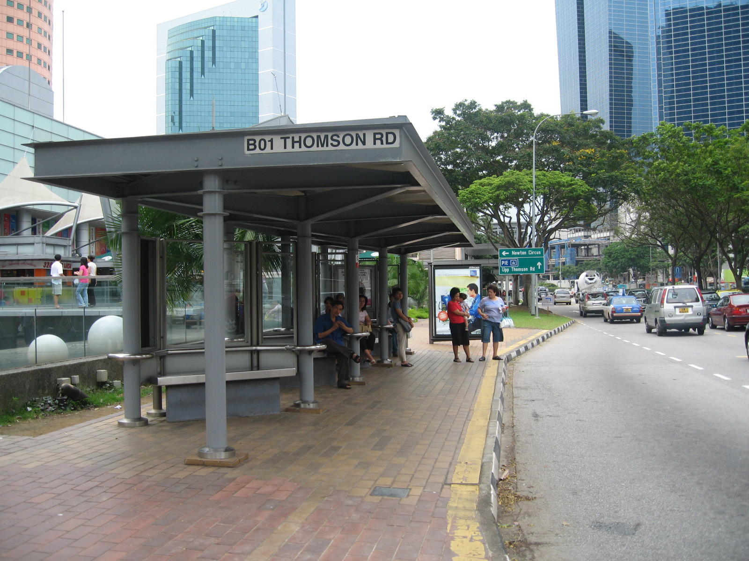
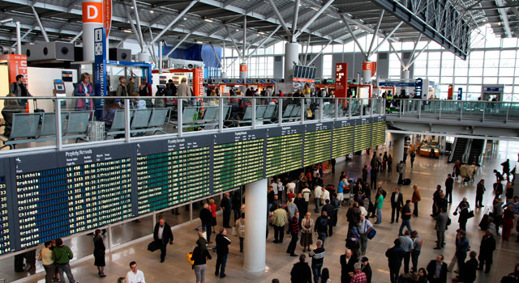

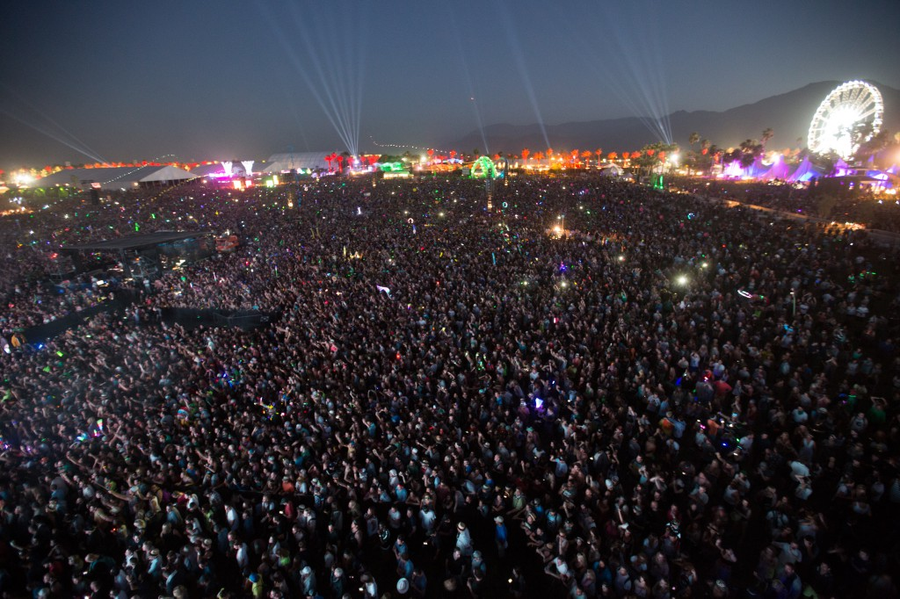
Problems
Smart Mobility
Bus stop
Underground stations
Railway stations
Airport
Others
Concerts
Squares
Public places
Security

Slide 3
Features
Scalability
Modularity
Adaptivity
Generalizability

Slide 4
KETs Key Enabling Technologies
Computer Vision
Neural Networks
REST
Iaas
Node.js
Cloud GPU computing

Slide 5
Global Architecture
Frontend
Web-application (html, css, javascript)
Data take-over (beagleboard xm rev c + webcam)
Python + OpenCV
Middleware
Client node.js
Backend
REST API (Python flesk)
Neural Networks
Hybrid CNN (Caffe)
Standard CNN (Tensorflow)

Slide 6
Frontend - device
BeagleBoard-xM rev. C
Open hardware design brings the previous generations' laptop-like performance and expandability to the next level, while adhering to hand-held power levels. Direct connectivity is supported by the on-board four-port hub with 10/100 Ethernet, while maintaining a tiny credit-card-sized footprint.
Custom OS (Debian) with DSP enabled
Python 2.7
USB Webcam mounted
Ethernet connection

Slide 7
Frontend - software
OpenCV
Designed for computational efficiency and with a strong focus on real-time applications. The library can take advantage of multi-core processing. Enabled with OpenCL, it can take advantage of the hardware acceleration of the underlying heterogeneous compute platform.
Cascade Classifiers:
Haarcascade_eye
Haarcascade_frontalface
Haarcascade_fullbody
Haarcascade_uppedbody
Haarcascade_lowerbody
Haarcascade_profileface
Hybrid approach LPM

Slide 8
Frontend - approaches
Local valuation with opencv algorithms
Remote valuation with deep learning algorithms
Narrow-scale - tensorbox
Large-scale - crowdnet

Slide 9
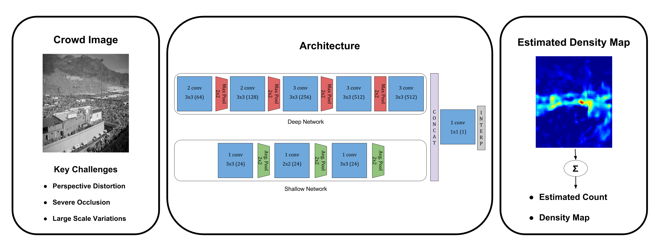
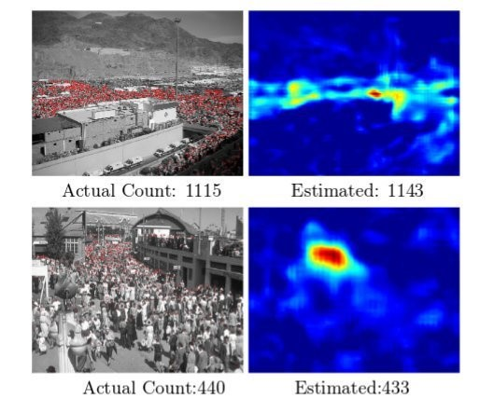
Backend CrowdNet – deep crowd counting

Slide 10
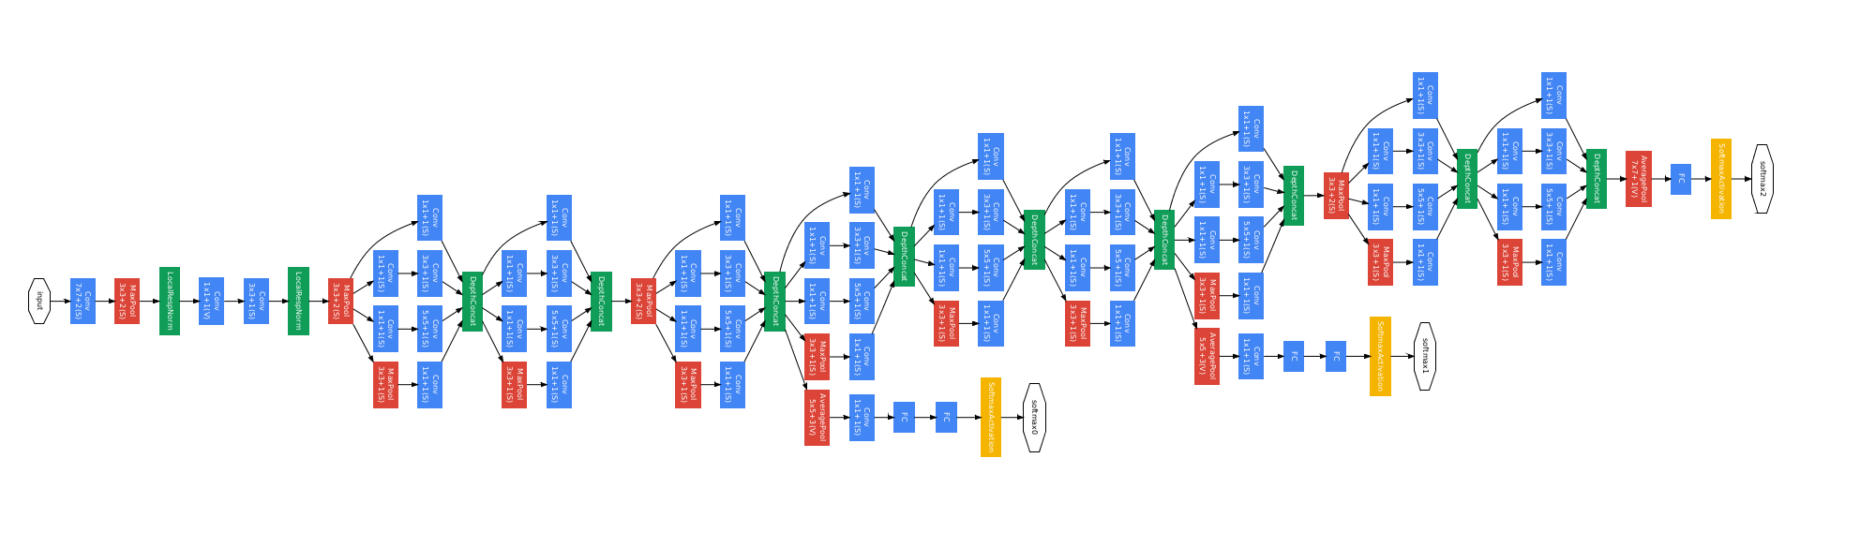
Tensorbox
Simple framework for training neural networks to detect and count objects in images. The basic model implements the simple and robust GoogLeNet-OverFeat algorithm with attention.

Slide 11
Iaas on Amazon Web Service EC2
GPU computing
G2 instances are optimized for graphics-intensive applications.
High-performance NVIDIA GPUs, each with 1,536 CUDA cores and 4GB of video memory
Public deep learning oriented AMI 64 bit
Ubuntu with MXNet, Tensorflow, Caffe, Theano, Torch and CNTK
Model | GPUs | vCPU | Mem (GiB) | SSD (GB)
g2.2xlarge | 1 | 8 | 15 | 1x60

Slide 12
Iaas – IoT Platform on Amazon Web Service EC2
REST server & Computing
High Frequency Intel Xeon Processors.
Lowest-cost general purpose instance type.
Custom AMI 64 bit
Ubuntu-16.04, OpenCV, Caffe, Tensorflow, Flask, Python 2.7
Model | vCPUs | Mem (GiB) | EBS (GB)
t2.small | 1 | 2 | 20 (8 + 12)

Slide 13
REST API Interface
https://github.com/sianniello/Rest_API#rest_api
Features:
Data from all cameras
Data from single cameras
Time-interval average data
GET & POST methods

Slide 14
Data format
XML
<cams>
<cam id=‘id:cam_id’ name=‘string:cam_name’>
<value timestamp=‘float:timestamp’>’int:value’</value>
</cam>
</cams>

