Slide 1

Patient Tracker System
Siara Saylor
INFO-C451

Slide 2
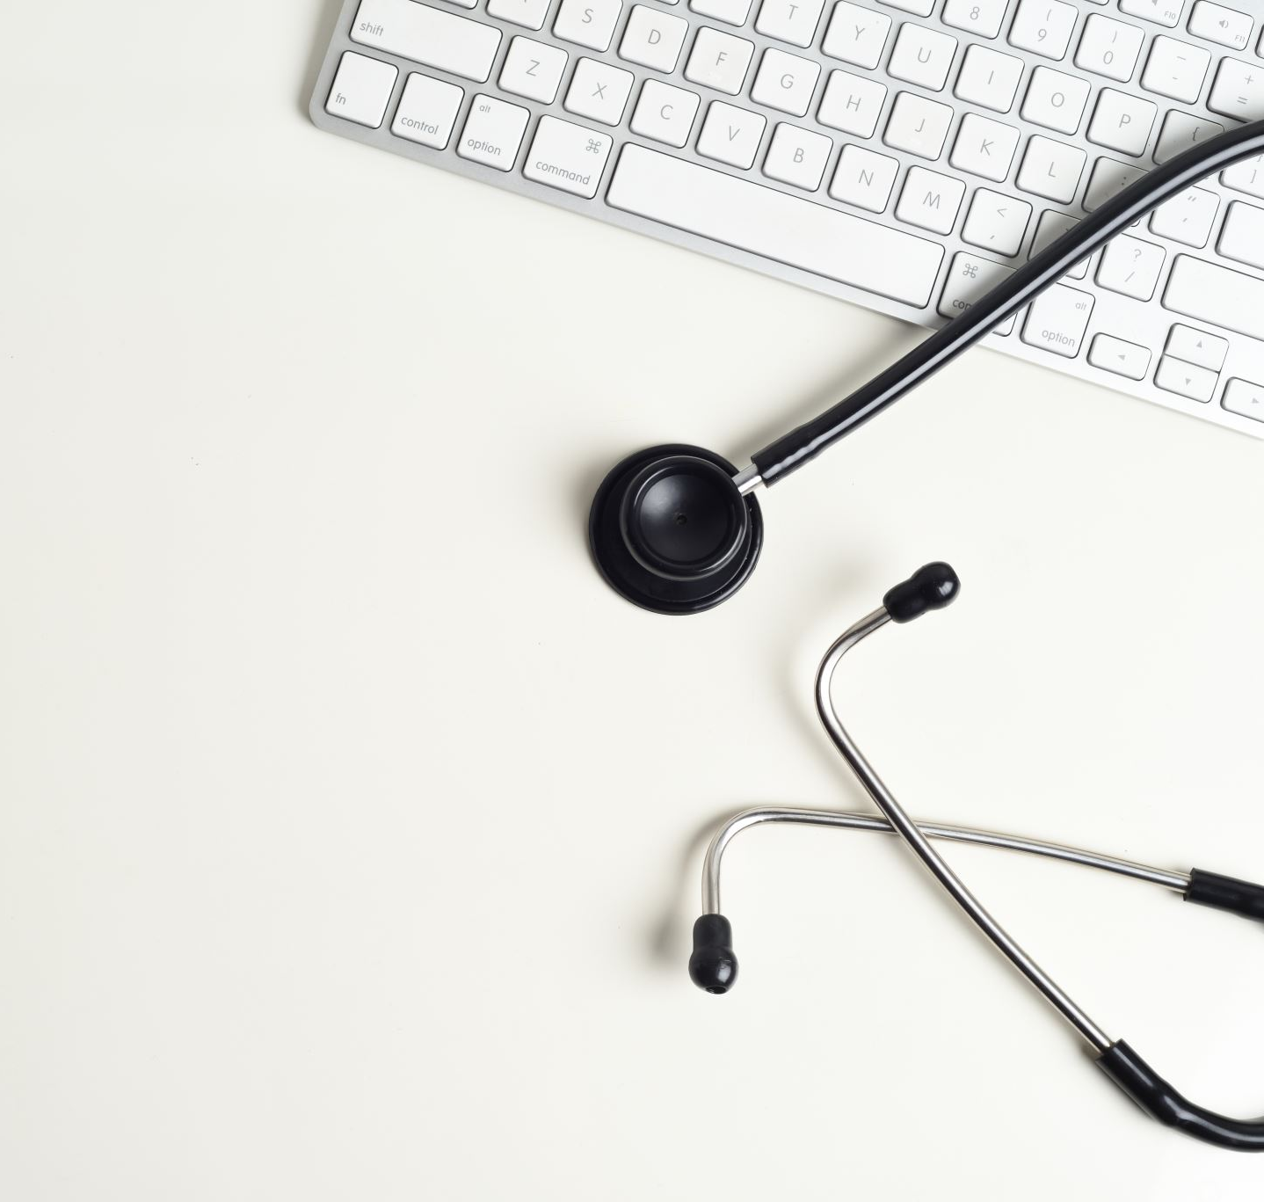
What is the Patient Tracker System?
A system that allows patients and doctor’s office staff track patient information and appointments.

Slide 3
Who will use this application?
Patients
Front Desk Staff
Nurses
Doctors

Slide 4
Demo 2 – Part 1
Log in as patient.
Pre-Appointment Information
Prior Appointments
Cancel/Reschedule Appointments

Slide 5
Demo 2 – Part 2
Log into program as Doctor.
View Patient’s information
Search for patient.
View Patient’s pre-appointment info.
View Patient's prior Appointments
Cancel/Reschedule appointments

