Slide 1
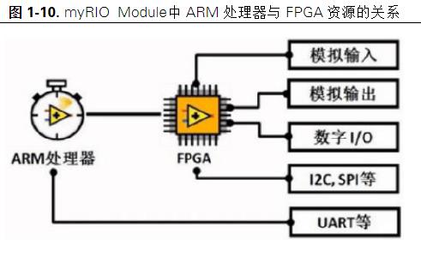
myRIO-1900

Slide 2
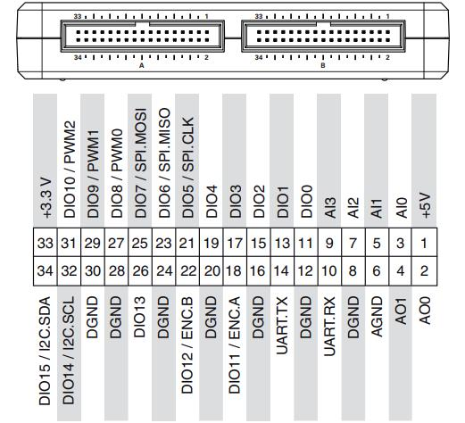
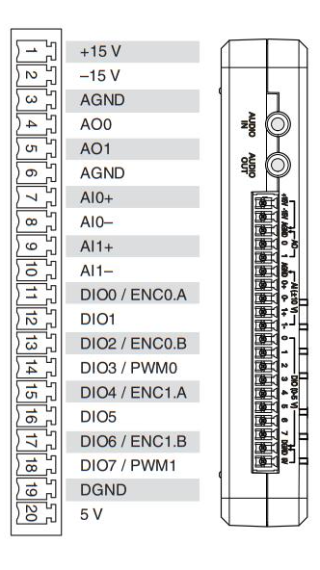
myRIO-1900
AI: 10
AO: 6
DIO: 40
LEDS: 4
UART.TX and UART.RX
RESET BUTTON
BUTTON0
Accelerometer
Wireless Indicator light
Power Requirement: 6 V to 16 V, 14 W
Analog Input and Output Also Available Through 3.5 mm Audio Jacks

Slide 3
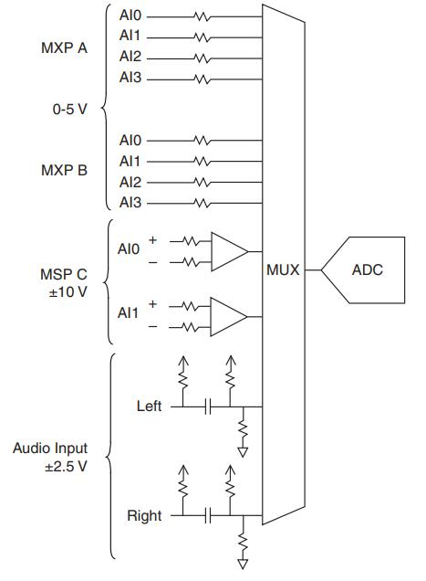
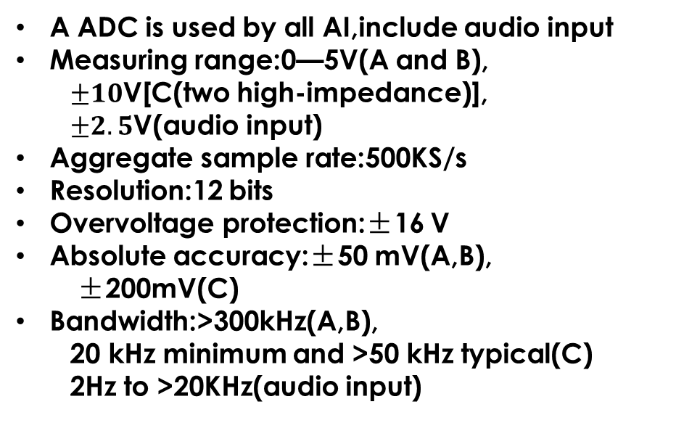
AI OVERVIEW
A ADC is used by all AI,include audio input
Measuring range:0—5V(A and B),
$±10$V[C(two high-impedance)],
$±2.5$V(audio input)
Aggregate sample rate:500KS/s
Resolution:12 bits
Overvoltage protection:±16 V
Absolute accuracy:±50 mV(A,B),
±200mV(C)
Bandwidth:>300kHz(A,B),
20 kHz minimum and >50 kHz typical(C)
2Hz to >20KHz(audio input)

Slide 4
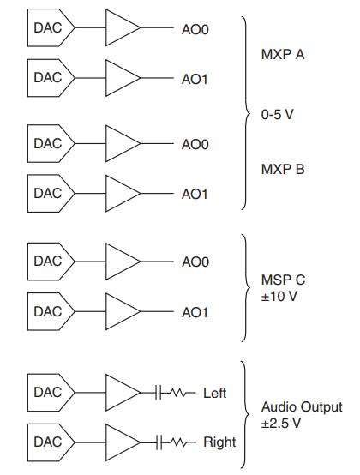
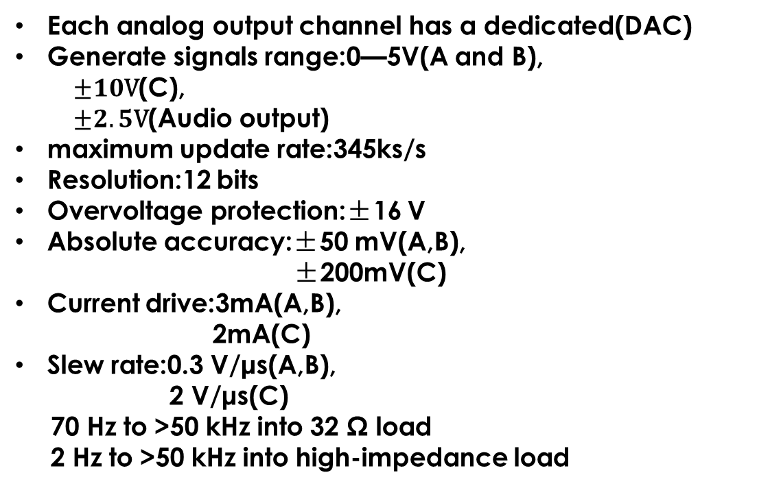
AO OVERVIEW
Each analog output channel has a dedicated(DAC)
Generate signals range:0—5V(A and B),
$±10\text{V}$(C),
$±2.5\text{V}$(Audio output)
maximum update rate:345ks/s
Resolution:12 bits
Overvoltage protection:±16 V
Absolute accuracy:±50 mV(A,B),
±200mV(C)
Current drive:3mA(A,B),
2mA(C)
Slew rate:0.3 V/μs(A,B),
2 V/μs(C)
70 Hz to >50 kHz into 32 Ω load
2 Hz to >50 kHz into high-impedance load
A BUS
FPGA
A BUS
Audio output
Bandwidth

Slide 5
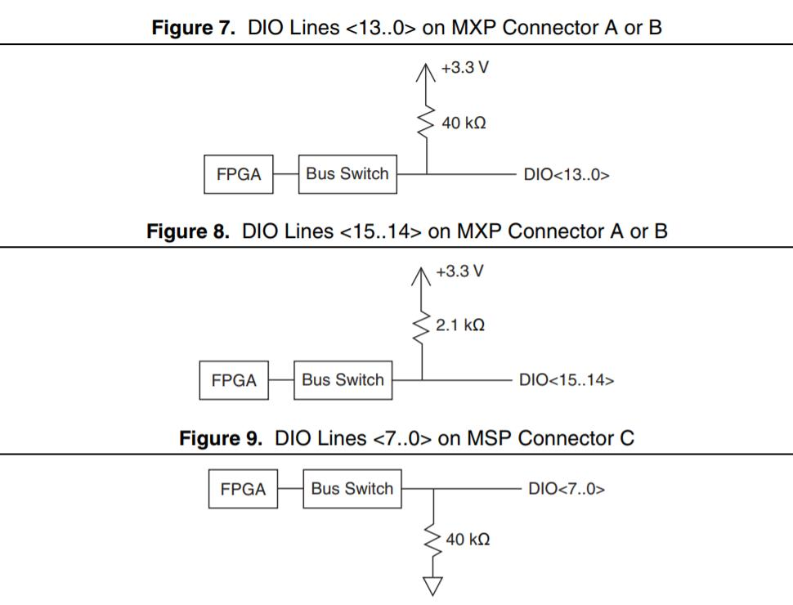
Digital I/O OVERVIEW
• when the myRIO device is starting up
• when the line is configured as an input
• when the myRIO device is powering down
You can add a stronger resistor to a DIO line to cause it to float in the opposite direction
SPI ：4 MHz
PWM：100 kHz
Quadrature encoder input： 100 kHz
I2C： 400 kHz
Direction control:individually programmable as in or out
Input logic levels:low 0V—0.8V
high 2V—5.25V
Output logic levels:low 0V—0.4V
high 2.4V—3.465V
Min pulse width：20ns
+3.3V

Slide 6
Other functions
Reset Button
Pressing and holding the reset button for 5s, restarts the device and into safe mode
Communicate with it by using the UART lines on MXP connector A
Serial-port terminal program configured:
– 115,200 bits per second
– Eight data bits
– No parity
– One stop bit
– No flow control
UART Lines
10 and 14 lines are RX and TX
Max baud rate:230400bps
Flow control:XON/XOFF
Button0
Logic true(depress)
Logic false(not depress)
Memory
Nonvolatile memory:512MB
DDR3:memory256MB/clock frequency533MHz/data bus width16bits
Processor
XilinxZ-7010(FPGA)/667MHz
Connect to a host computer over USB and wireless 802.11b,g,n

Slide 7
LEDS
Number of Flashes Every Few Seconds | Indication
off | normal
Turn on | Runs a power-on self test
2 | The device has detected an error in its software. This usually occurs when an attempt to upgrade the software is interrupted. Reinstall software on the device.
3 | The device is in safe mode
4 | The software has crashed twice without rebooting or cycling power between crashes. This usually occurs when the device runs out of memory. Review your RT VI and check the memory usage. Modify the VI as necessary to solve the memory usage issue.
Continuously flashing or solid | The device has detected an unrecoverable error. Contact National Instruments.
Status led instructions

Slide 8
camera
Use VAS and ImageView for control
NI-IMAQ,NI-IMAQdx和NI-IMAQ I/O的区别：
NI-IMAQ
NI Camera Link 帧接收器
NI 并行数字帧接收器
NI 模拟帧接收器
NI 17xx 智能相机
NI-IMAQ I/O 驱动程序是一种较小的驱动程序API，专门用于NI Vision RIO 图像采集卡编程，包括以下板卡：
NI PCIe-8255R
NI PCI-8254R
NI PCIe-8237R
NI PCIe-1473R
NI PCIe-1473R-LX110
NI 1483 FlexRIO 适配器模块
NI-IMAQdx：
支持GigE Vision的千兆以太网摄像头
FireWire IEEE 1394 相机
支持Microsoft DirectShow的USB 2.0 相机
支持USB3 Vision的USB 3.0 相机
支持多种API，包括：Native C/C++，.NET/C#/VB.NET, Python, Java, android, DirectShow, Twain, LabView, MatLab等等

Slide 9
Camera parameter
parameter | scope | default
AutoExpoTarget | 16-235 | 120
LevelRange | 0-255 | Low = 0 High = 255
Contrast | -100-100 | 0
Hue | -180-180 | 0
Saturation | 0-255 | 128
Brightness | -64-64 | 0
Gamma | 20-180 | 100
parameter |  |  | scope | default
white balance | Temp/tint | Temp | 2000-15000 | 6503
 |  | Tint | 200-2500 | 1000
 | Rgb gain | Read gain | -127-127 | 0
 |  | Green gain
 |  | Blue gain
Auto Exposure | MAX | Exposure time |  | 350ms
 |  | Analog gain |  | 500
 | MIN | Exposure time |  | 0
 |  | Analog gain |  | 100

Slide 10
USB-6356
Signal Name | Description
P0
P1/PFI P2/PFI | As an input, each PFI terminal can be used to supply an external source for AI, AO, DI, and DO timing signals or counter/timer inputs. As a PFI output, you can route many different internal AI, AO, DI, or DO timing signals to each PFI terminal. You can also route the counter/timer outputs to each PFI terminal. As a Port 1 or Port 2 digital I/O signal, you can individually configure each signal as an input or output.
USER<1-2> | the USER BNC connectors allow you to use a BNC connector for a digital or timing I/O signal of your choice. The USER BNC connectors are internally routed to the USER screw terminals
APFI0 | AO external reference inputs for AO and analog trigger input

Slide 11
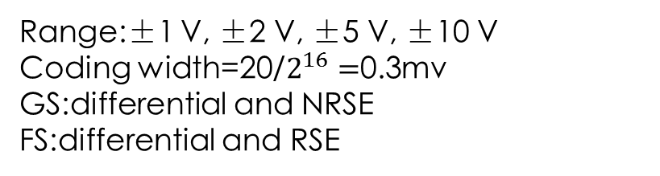
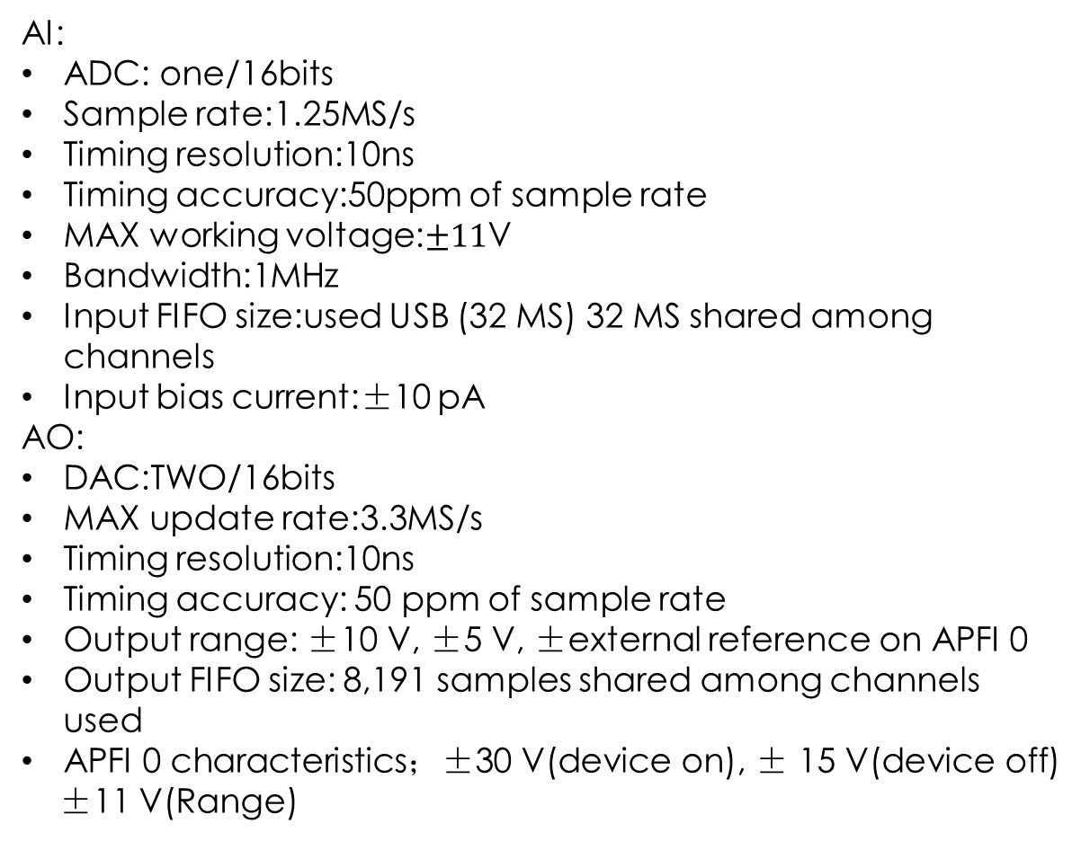
Waveform Characteristics (Port 0 Only)
AI:
ADC: one/16bits
Sample rate:1.25MS/s
Timing resolution:10ns
Timing accuracy:50ppm of sample rate
MAX working voltage:$±11$V
Bandwidth:1MHz
Input FIFO size:used USB (32 MS) 32 MS shared among channels
Input bias current:±10 pA
AO:
DAC:TWO/16bits
MAX update rate:3.3MS/s
Timing resolution:10ns
Timing accuracy: 50 ppm of sample rate
Output range: ±10 V, ±5 V, ±external reference on APFI 0
Output FIFO size: 8,191 samples shared among channels used
APFI 0 characteristics；±30 V(device on), ± 15 V(device off)
±11 V(Range)
Port/sample size：8bits
FIFO of DO:2047samples
FIFO of DI:255samples
DI sample clock frequency:0 to 1MHz
DO Sample Clock frequency:
Regenerate from FIFO 0 to 10 MHz
Streaming from memory 0 to 1 MHz
Analog Triggers
Source: AI0-7 , APFI 0
Resolution 16 bits
Bandwidth: AI 3.4 MHz
APFI 0 3.9 MHz
Accuracy: ±1% of range
Range:±1 V, ±2 V, ±5 V, ±10 V
Coding width=20/$2^{16}=$0.3mv
GS:differential and NRSE
FS:differential and RSE

Slide 12
PFI/P1/P2:
Functionality: Static digital input, static digital output, timing input, timing output
Timing output sources:Many AI, AO, counter, DI, DO timing signals
Debounce filter settings:90 ns, 5.12 µs, 2.56 ms, custom interval, disable; programmable high and low transitions; selectable per input
Positive-going threshold (VT+) 2.2 V maximum
Negative-going threshold (VT-) 0.8 V minimum
IIL input low current (VIN = 0 V) -10 μA maximum
IIH input high current (VIN = 5 V) 250 μA maximum
Data transfers | instructions
DMA | Direct memory access. Data transfer is application-independent
IRQ | Data transfer is application-independent, increases CPU utilization.
Programmed I/O | Data transfer occurs only when "DAQmx read" or "DAQmx write" is invoked.
USB Bulk | Using the USB Bulk
USB-6356 supportUSB Signal Stream and programmed I/O

Slide 13
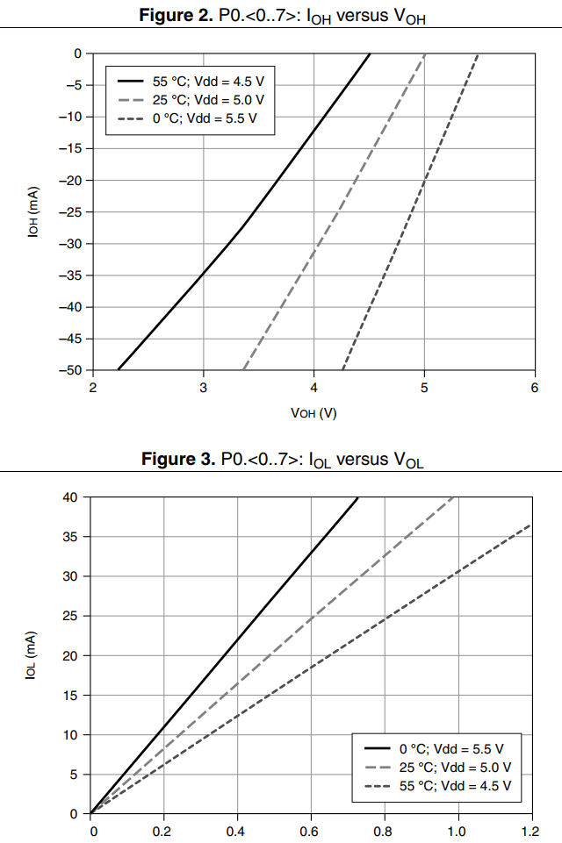
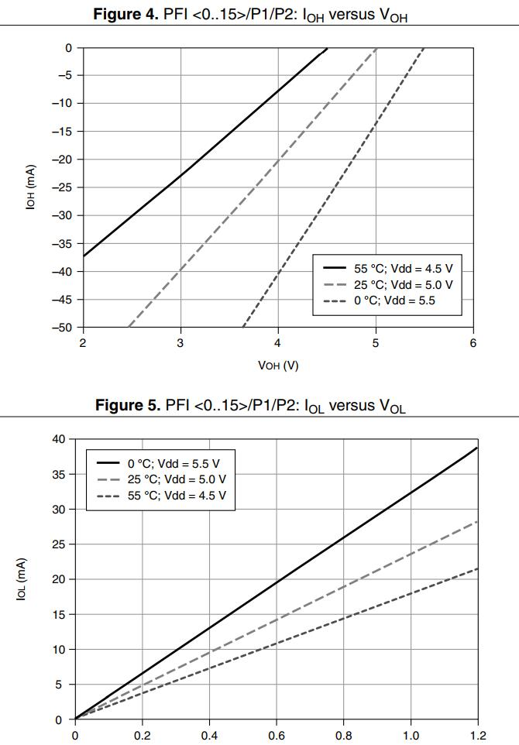
VIH:2.2V-5.25V
VIL :0V-0.8V
IOL: P0— -24mA
P1/2— -16mA
IOH: P0— 24mA
P1/2— 16mA

Slide 14
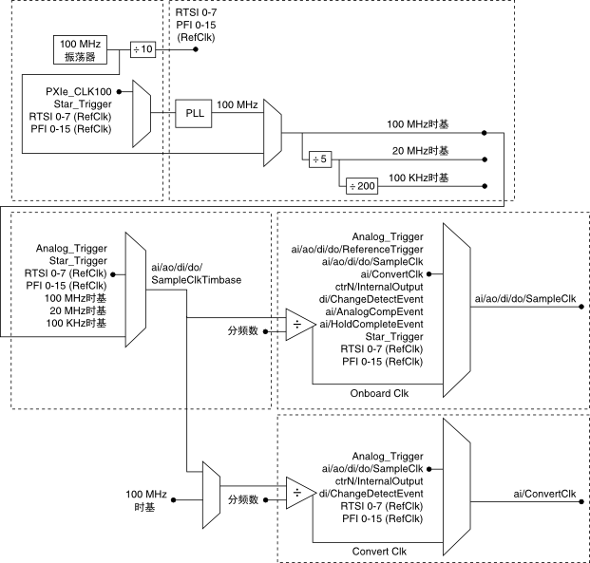
X series clock
Base clocks 20 MHz, 10 MHz, 100 kHz
Divisors 1 to 16
Base clock accuracy：50 ppm
The source of routes timing and control signals：
X Series device
Other devices in your system through RTSI
User input through the PFI terminals
User input through the PXI_STAR terminal

Slide 15
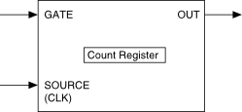
Counter
GATE
SOURCE
OUT
Application | Purpose of Gate Terminal
Pulse Generation | Pause or Start Trigger
One Counter Time Measurements | Input Signal
Two Counter Time Measurements | Unused
Nonbuffered Edge Counting | Pause Trigger
Buffered Edge Counting | Sample Clock
Two-Edge Separation | Second Input Terminal
Position | Z Input Terminal
Application | Purpose of Source Terminal
Pulse Generation | Counter Timebase
One Counter Time Measurements | Counter Timebase
Two Counter Time Measurements | Input Terminal
Nonbuffered Edge Counting | Input Terminal
Buffered Edge Counting | Input Terminal
Two-Edge Separation | Counter Timebase
Position | A Input Terminal
Application | Purpose of Source Terminal
Pulse Generation | Counter Timebase
One Counter Time Measurements | Counter Timebase
Two Counter Time Measurements | Input Terminal
Nonbuffered Edge Counting | Input Terminal
Buffered Edge Counting | Input Terminal
Two-Edge Separation | Counter Timebase
Position | A Input Terminal

Slide 16
测量 | Ctr0 | Ctr1 | Ctr2 | Ctr3
边沿计数
脉冲宽度测量 | PFI 9 | PFI 4 | PFI 1 | PFI 6
周期/频率测量（单个计数器的低频） | PFI 9 | PFI 4 | PFI 1 | PFI 6
周期/频率测量（两个计数器的高频） | PFI 8 | PFI 3 | PFI 0 | PFI 5
周期/频率测量（两个计数器的大范围） | PFI 8 | PFI 3 | PFI 0 | PFI 5
脉冲测量 | PFI 9 | PFI 4 | PFI 1 | PFI 6
半周期测量 | PFI 9 | PFI 4 | PFI 1 | PFI 6
两边沿间隔测量 | 开始：PFI 10 停止：PFI 9 | 开始：PFI 11 停止：PFI 4 | 开始：PFI 2 停止：PFI 1 | 开始：PFI 7 停止：PFI 6
位置测量 | A:PFI 8 B:PFI 10 Z:PFI 9 | A:PFI 3 B:PFI 11 Z:PFI 4 | A:PFI 0 B:PFI 2 Z:PFI 1 | A:PFI 5 B:PFI 7 Z:PFI 6
边沿：PFI8
计数方向：PFI10
边沿：PFI3
计数方向：PFI11
边沿：PFI0
计数方向：PFI2
边沿：PFI5
计数方向：PFI7
Resolution：32bits
Internal base clocks:100/20MHz,100KHz
External base clocks:0-25MHz
Base clock accuracy:50ppm
FIFO:127samples per counter
Ctr0 | Ctr1 | Ctr2 | Ctr3
PFI 12 | PFI 13 | PFI 14 | PFI 15

