Slide 1
NVIDIA Jetson Nano: Specs & Model deployment
ZHI Xiaoying & WANG Xuan

Slide 2
Why we dropped Google Coral
Success: Train ResNet with Quantization-aware training
Failure: Continue to train DeepLabCut with Quantization-aware training
Failure from: datatype mismatch in TensorFlow library
Mismatch waiting to be fixed
Still another approach: rewrite the DLC model, so that it does not load ResNet and continue training, but train from the very start as a whole

Slide 3
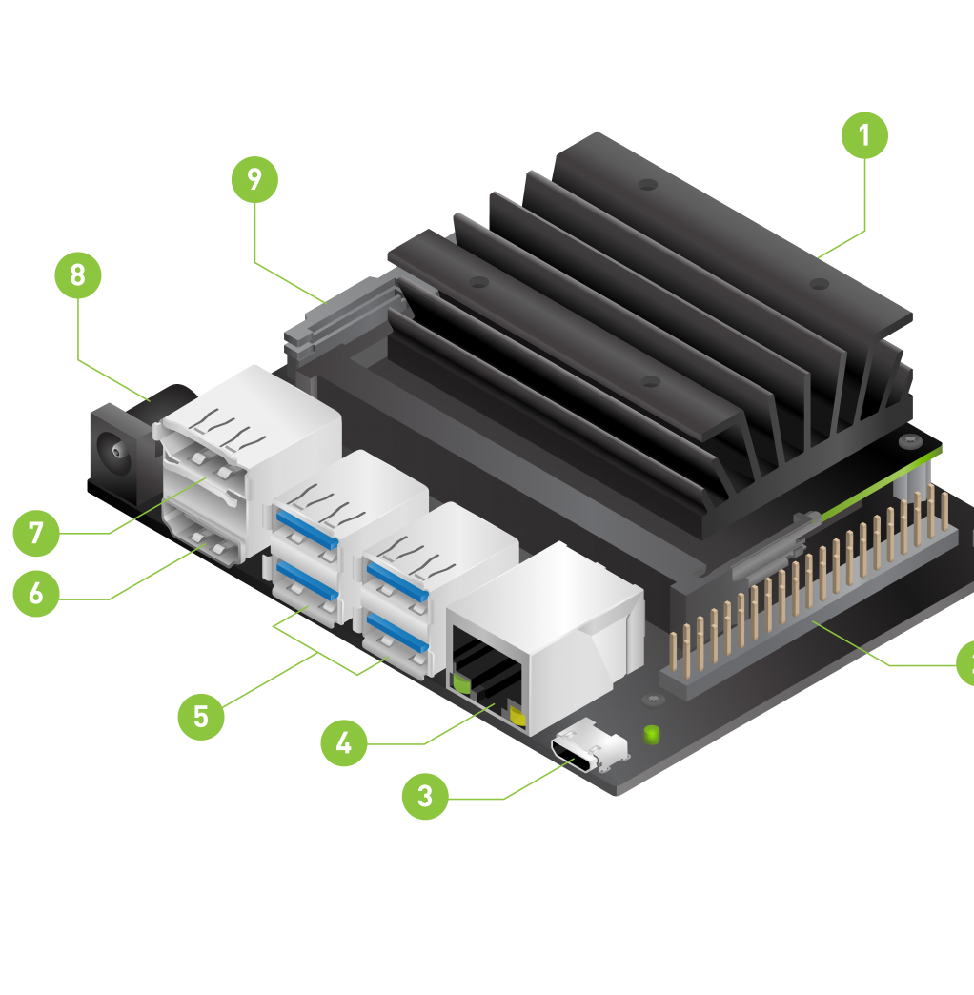
Hardware Components
Storage: micro-SD card
Power: micro-USB / power jack
Ethernet port
HDMI / DisplayPort
MIPI CSI camera
E.g. Raspberry Pi camera module V2

Slide 4
SDK: NVIDIA JetPack
OS: Full desktop Linux with NVIDIA driver
AI & CV libraries and APIs
TensorRT, cuDNN, CUDA
VisionWorks & CV
Camera application API
Sensor driver API
Developer tools
Nsight Systems
Nsight Graphics
New version features:
Docker enabled
TensorRT support for INT-8 DLA operations
Notes:
Nsight Systems is a system-wide performance analysis tool for visualization of application’s algorithms.
Nsight Graphics is a developer tool for debugging, profiling and exporting frames.
DLA: deep learning accelerator

Slide 5
Jetson Nano vs. Google Coral
Jetson Nano
Price: $99
Size: 69.6mm x 45mm
Linux distri: Ubuntu 18.04
AI Accelerator: 128 CUDA cores
RAM: 4GB
Flash: 16GB
Performance: faster in some cases, slower in others
Google Coral
Price: $149
Size: 88mm x 22mm
Linux distri: Mendel (32-bit)
AI Accelerator: Edge TPU
RAM: 1GB LPDDR4
Flash: 8GB
https://towardsdatascience.com/google-coral-edge-tpu-board-vs-nvidia-jetson-nano-dev-board-hardware-comparison-31660a8bda88
Notes:
BLE: bluetooth low energy

Slide 6
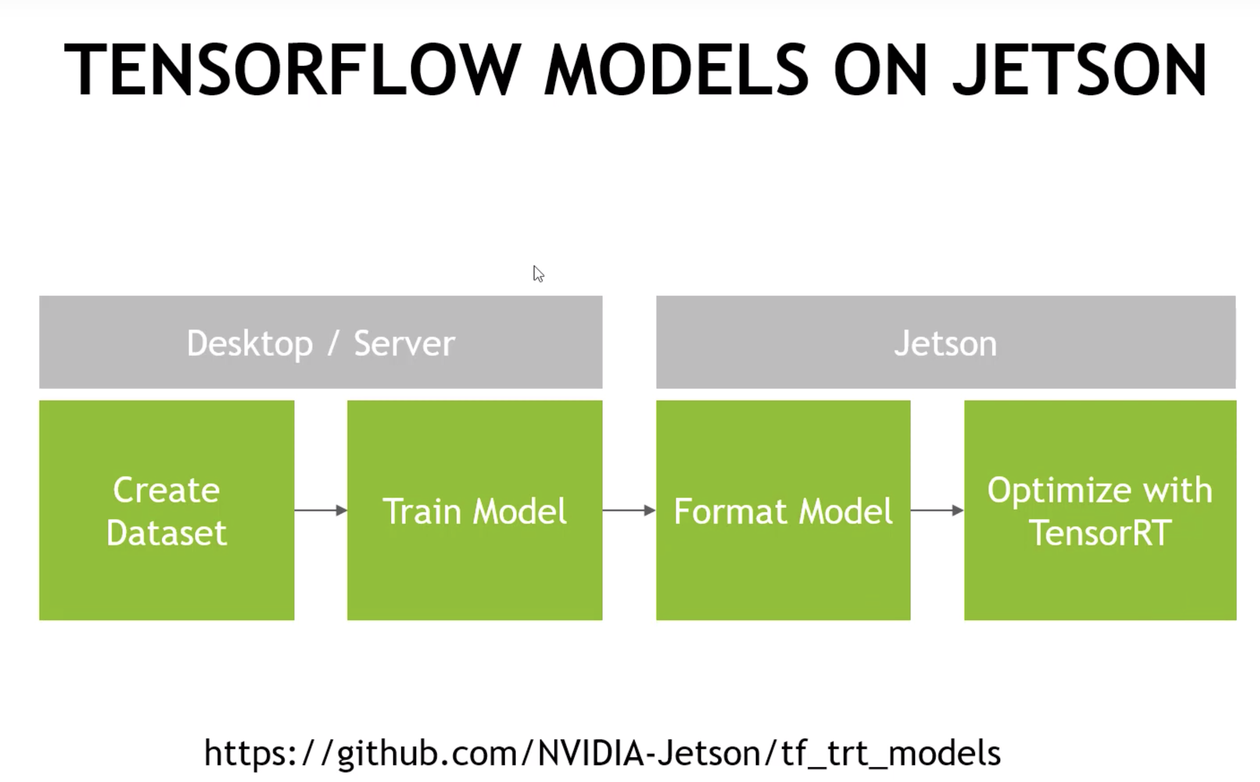

Slide 7
Install Corresponding TF API;
Configure as required
Download and build from checkpoint
Create TensorRT inference graph;
Save in required format
Run and make a prediction
Load the TensorRT graph
https://www.jianshu.com/p/dd2cfc33b437

